Slide 1
Coming up this week…
This assembly will cover:
Thought of the Week: What could you do to help the environment?
Be informed: What are the 3 R’s?
Be curious: What can be recycled?
Be heard: Becoming a zero-waste champion!
Making your voice heard!
Please Note:
This assembly is a modified version of our original assembly from September 2019, in case it looks familiar!
Videos:
Sea Bins (slide 10)
Eco-bricks (slide 10)
Notes:
Safeshare Video Links:
Sea bins: https://safeshare.tv/x/SQl0xyKfm6I
Eco-bricks: https://safeshare.tv/x/mQU9ZKlV5CI
Alternative Video Links:
Sea bins: https://www.youtube.com/watch?v=SQl0xyKfm6I (0:00-0:36)
Eco-bricks: https://youtu.be/mQU9ZKlV5CI
Images
iStock

Slide 3
Thought of the Week…
What could you do to help the environment?
Notes:
Images
iStock

Slide 4
Be informed: What are the 3 R’s?
Have a guess!
Today, we will be looking at the environment. So, what do you think the “3 R’s” are?
The best thing you can to is reduce. If you don’t buy it at all then it doesn’t need to be reused or recycled.
REDUCE
Tip: Buy one big pot instead of lots of little ones!
If you need to buy it, think about how you can reuse it for something else – this can be practical or decorative.
Tip: Food containers like jars make great storage!
REUSE
If you can’t use it again, do your best to recycle it. There are lots of guides online about what the different symbols mean.
RECYCLE
Tip: Give it to someone else (e.g. clothes), or put it in a recycling bin!
Notes:
Images
Icons8

Slide 5
Be curious: What can be recycled?
For every 100 pieces of plastic thrown away, only 9 pieces will be recycled.
What are the chances?
On this slide are100 plastic bottles. How many of these do you think will be recycled? Click to find out…
But why is this the case? Head to the next slide to find out.
Notes:
Images
iStock

Slide 6
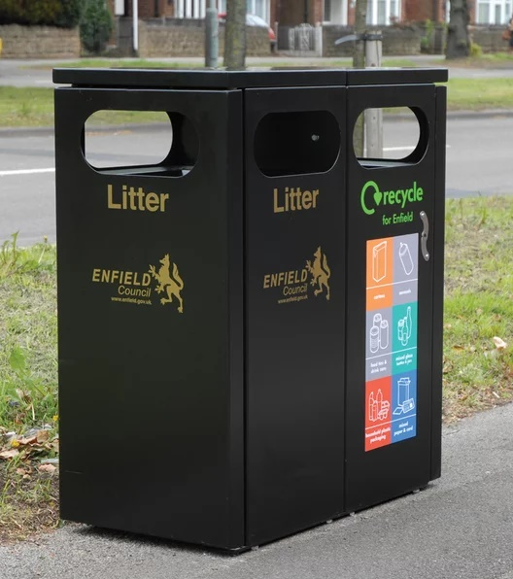
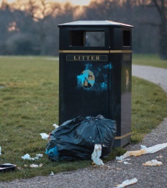
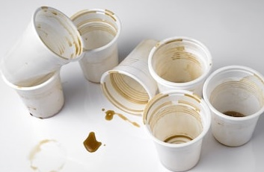
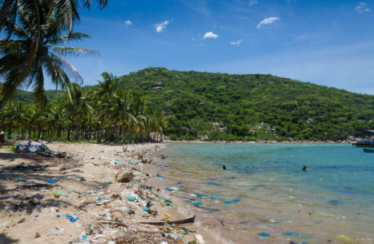
Be curious: What can be recycled?
Not all bins outside are recycling bins. If you throw your rubbish in these bins, it will not be recycled.
Look out for these recycling bins when you are outside!
Did you know: one dirty piece of rubbish can make everything else dirty, and it could all end up not being recycled? This is why we have to be thoughtful when we recycle!
There are still some places in the world that do not have many recycling facilities – some have none at all. So wherever you go, it’s important to do what you can.
Notes:
Images
iStock
References
https://www.nationalgeographic.com/new
https://www.change.org/p/government-build-a-recycling-facility-on-phu-quoc-island-vietnams/2017/07/plastic-produced-recycling-waste-ocean-trash-debris-environment/

Slide 7
Be curious: What can be recycled?
Hands up…
Knowing what can and can’t be recycled is no easy task, which means lots of people feel a bit lost when it comes to disposing of their rubbish. As you look at each item on the next slide, put your hand up if you think it can be recycled!
Challenge:
Choose one item and decide how you could reuse it!
Notes:
Images
iStock

Slide 8
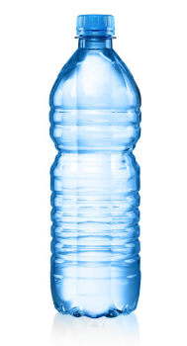
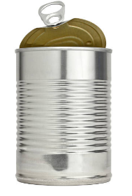
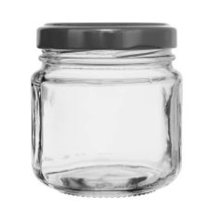
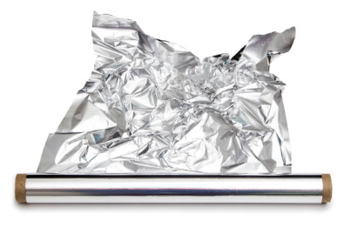
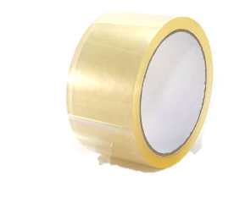
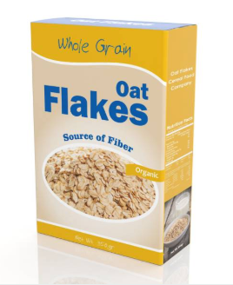
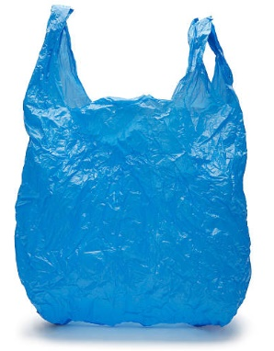
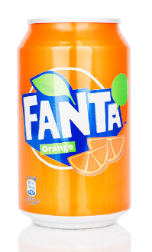
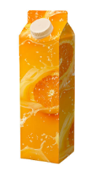
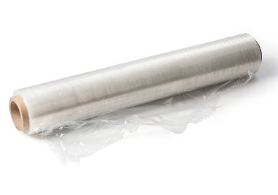
Be curious: What can be recycled?
Plastic bottles
Food tins
Jam jars
Newspaper
Tin foil
Magazines
Sellotape
Cereal boxes
Carrier bags
Cling film
Cans
Juice cartons
All of these can be recycled in most places! For some things, like carrier bags, you might have to take them to your local supermarket where they have special recycling points. Keep a lookout for these next time you go shopping!
Notes:
Images
iStock

Slide 9
Be heard: Becoming a zero-waste champion!
What would work in my community?
On the next two slides are some of the amazing ways people around the world are helping to reduce, reuse and recycle. Have a look at each one and decide: which would work well in your community (either at your school or where you live)?
Challenge:
Find out what is already happening in your area! How could this be improved? Share your ideas with decision-makers!
Notes:
Images
Icons8

Slide 10
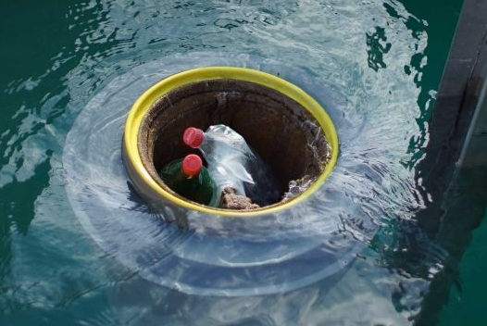
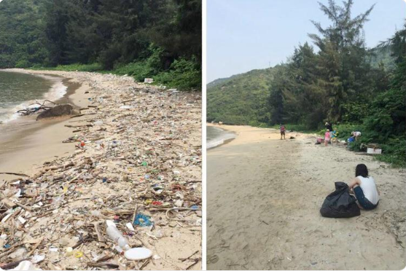
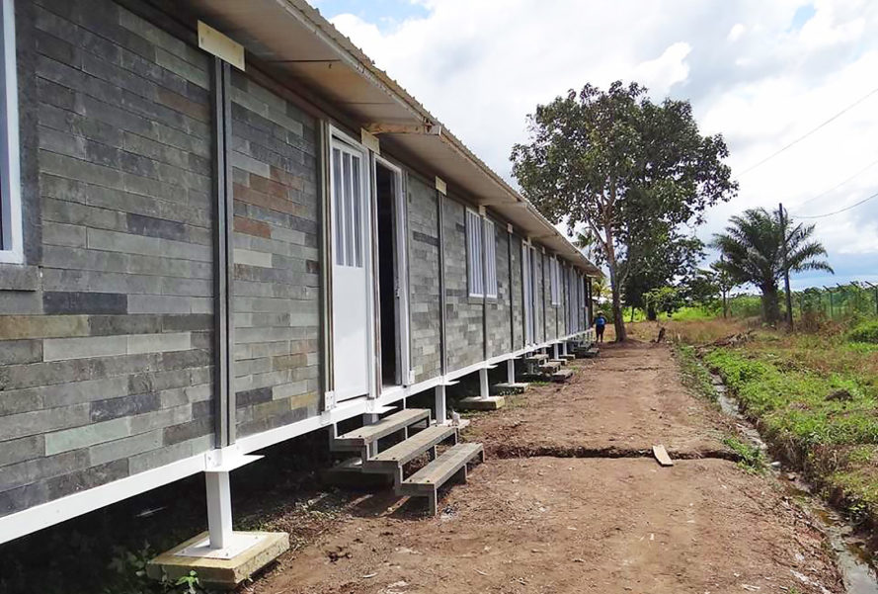
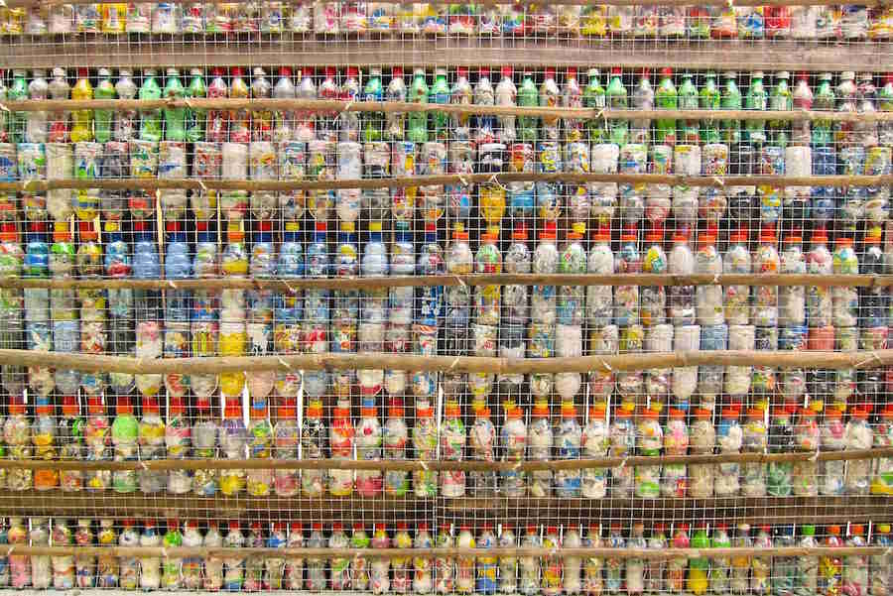
Be heard: Becoming a zero-waste champion!
0:00-0:36
Sea bins are being used to take rubbish out of the ocean, and people are posting photos of themselves picking up rubbish with the hashtag #TrashTag!
Click the image to see sea bins in action!
Can you spot the difference?
Which would work well in your community (either at your school or where you live)?
0:00-1:07
Meanwhile, in Colombia, a company is building houses using bricks made from recycled plastic. The bricks can also be used for furniture and even playgrounds!
How similar do they look to “regular” bricks?
Click the image to see how to make your own!
https://safeshare.tv/x/SQl0xyKfm6I
https://safeshare.tv/x/mQU9ZKlV5CI
Notes:
Alternative Video Links:
Sea bins: https://www.youtube.com/watch?v=SQl0xyKfm6I (0:00-0:36)
Eco-bricks: https://youtu.be/mQU9ZKlV5CI
Images
https://twitter.com/Reddit_Pics_Bot/status/1173437706308935680
https://www.abc.net.au/news/2019-02-17/perth-seabin-invention-sucking-cigarettes-and-plastic-from-ocean/10800792
https://inhabitat.com/lego-like-building-blocks-of-recycled-plastic-allow-colombians-to-build-their-own-homes/
References
https://observers.france24.com/en/20160815-colombia-building-homes-recycled-plastic-displaced
https://www.ecotricity.co.uk/news/news-archive/2019/what-is-an-ecobrick
http://katewashere.com/2017/07/12/what-i-do-with-all-the-plastic-in-my-life/

Slide 11
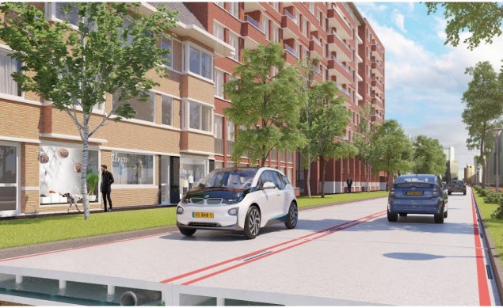
Be heard: Becoming a zero-waste champion!
In the city of Amsterdam in The Netherlands, the first ever plastic road was built. It is made from recycled plastic and other materials.
In Wales, scientists have been testing putting plastic in our roads.
Which would work well in your community (either at your school or where you live)?
Here in the UK, the Government are planning to bring in these plastic bottle machines by 2023 in England & Wales, where you can recycle your bottles and get money off your shopping bill.
1 million plastic bottles are made around the world every minute!
Notes:
Images
https://interestingengineering.com/smart-cities-from-plastic-pollution-to-plastic-roads
https://www.theguardian.com/environment/2018/mar/27/bottle-and-can-deposit-return-scheme-gets-green-light-in-England
References
https://interestingengineering.com/smart-cities-from-plastic-pollution-to-plastic-roads
http://www.deeside.com/recycled-plastic-could-be-used-to-surface-flintshires-roads-if-new-trial-proves-successful/
https://www.vice.com/en/article/9kem9e/plastic-bottle-reverse-vending-machines-recycling

Slide 12
How do I make sure my voice is heard?
Cast your vote at the end of each lesson!
Voice your opinions during your VotesforSchools lessons!
Let us know any future VoteTopics you would like to see!
Send your thoughts and comments on the VoteTopic to us.
Even though you might be at home at the moment, you can still vote using our special SurveyMonkey link or email us!
Notes:
Images:
iStock
Icons8

