Slide 1
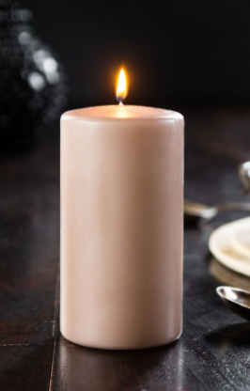
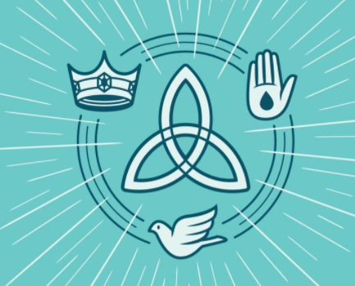

Slide 3
Why it is important to treat everyone as an equal?

Slide 4
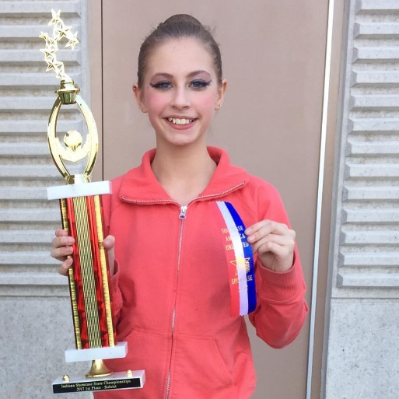
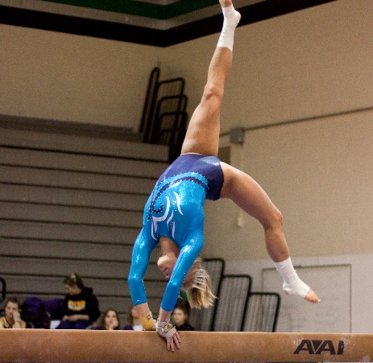
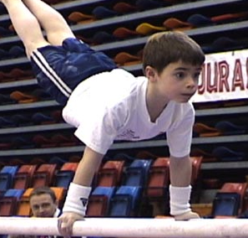
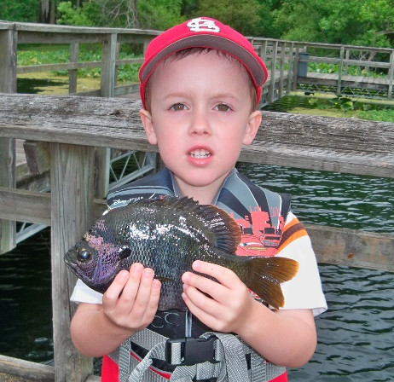
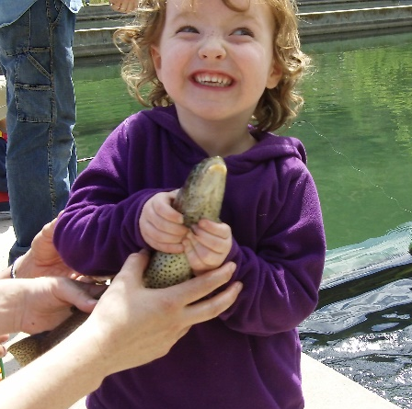
Achievement
What are you good at?
Think about It …
Do you have to be a boy to be good at some things and a girl to be good at others?

Slide 5
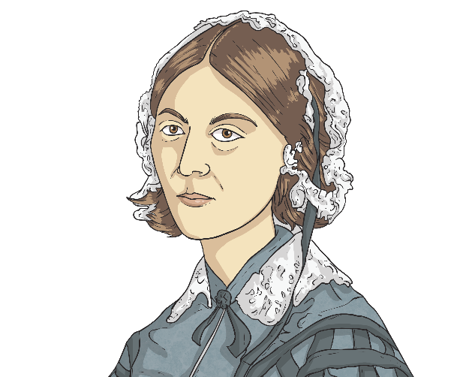
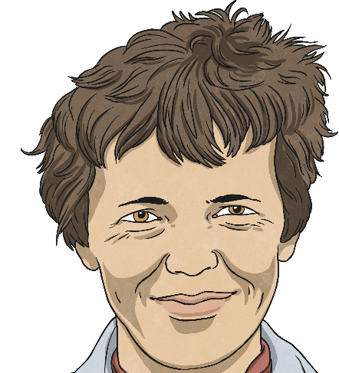
Achievement
What do you know about these famous women?
Queen Elizabeth I
Florence Nightingale
Amelia Earhart
Did You Know…?
All these women had to fight against injustice and work hard because they had ambitions to take up roles that were uncommon for women in the societies in which they lived. We remember such women and their achievements on International Women’s Day.

Slide 6
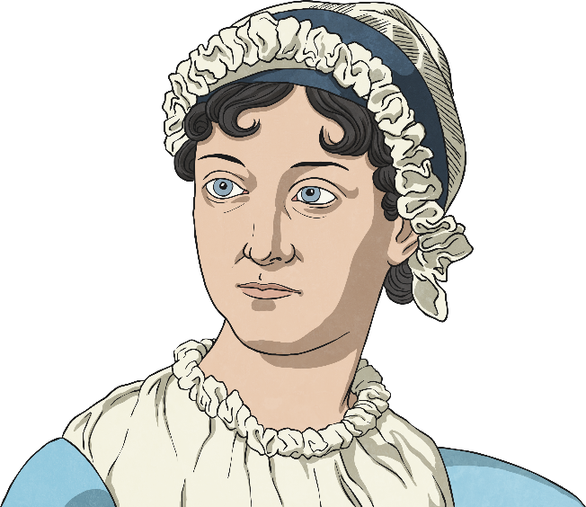
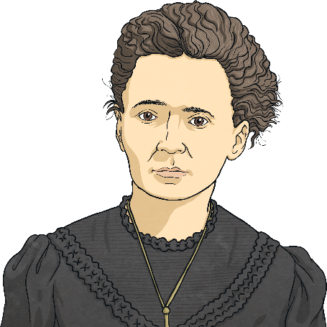
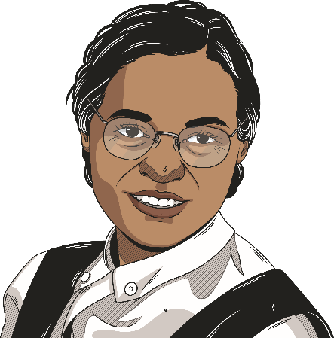
International Women’s Day
When is International Women’s Day? 8th March
What is International Women’s Day? International Women’s Day is an event that celebrates amazing things done by women. It is a way to show how women have, and continue to, influence the world because they are outstanding at what they do.
I did groundbreaking research on radioactivity that led to the treatment of many illnesses.
'I campaigned against segregation and for equal rights for Black people in America.
I wrote books in a time when people thought it wasn’t right for women to work.
Jane Austen
Marie Curie
Rosa Parks

Slide 7
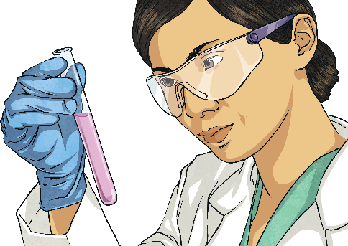
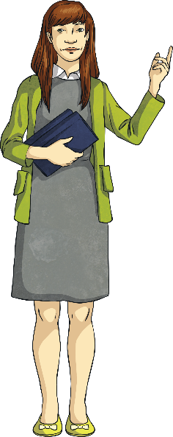
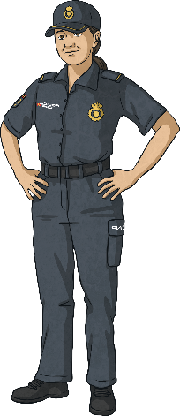
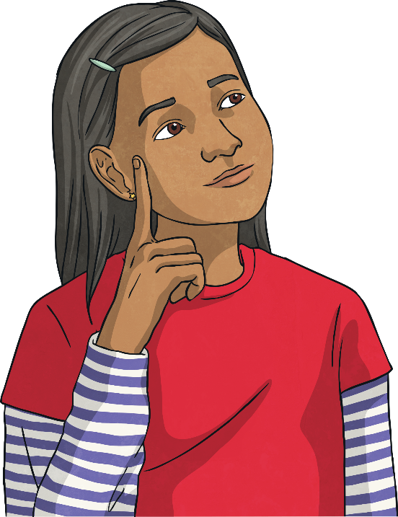
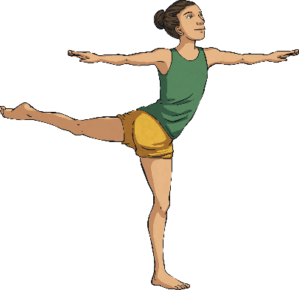
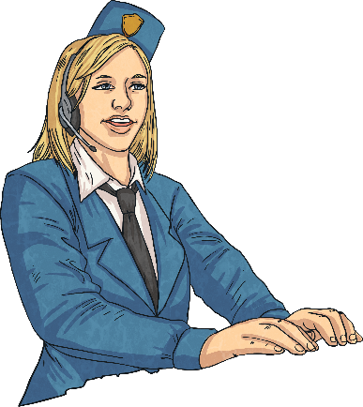
Roles
The aim of International Women’s Day is for everyone, especially girls, to be encouraged to pursue their dreams and ambitions.
What do you want to be when you’re older?
Remember, it’s just as important for boys to be the best they can be too!

Slide 8
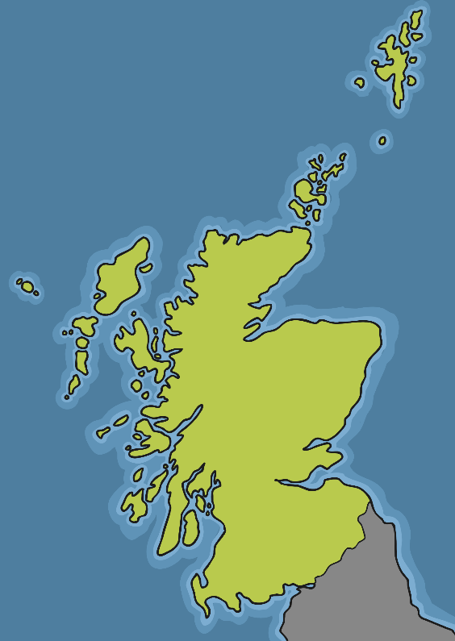
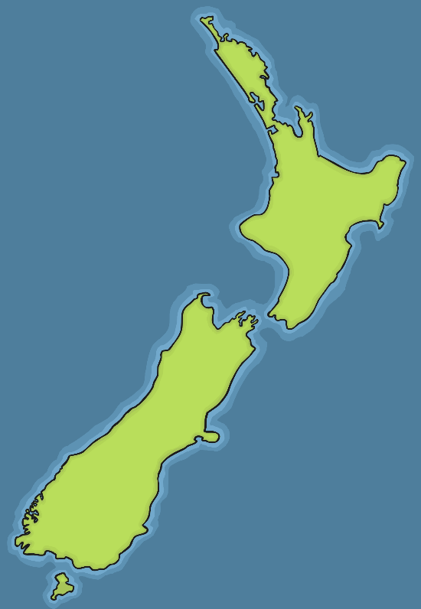
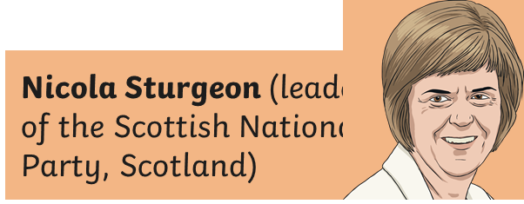
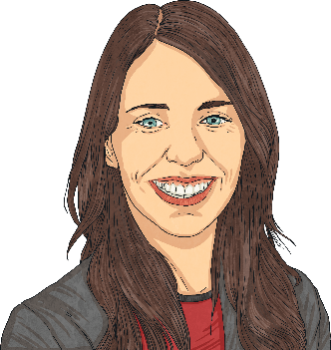
Ladies Who Lead
Think about It …
What makes a good leader? Does it matter if they are
a man or a woman?
New Zealand
Scotland
Jacinda Ardern (New Zealand’s Prime Minister)

Slide 9
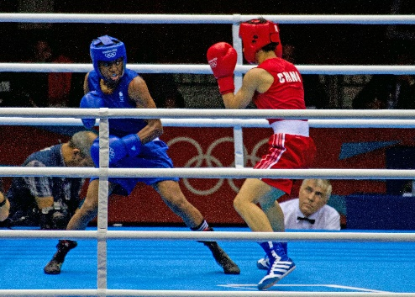
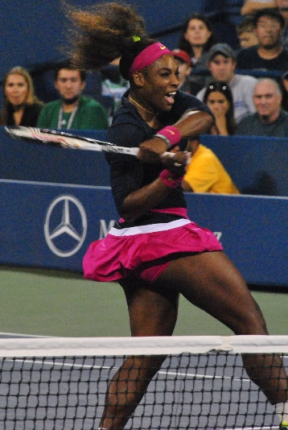
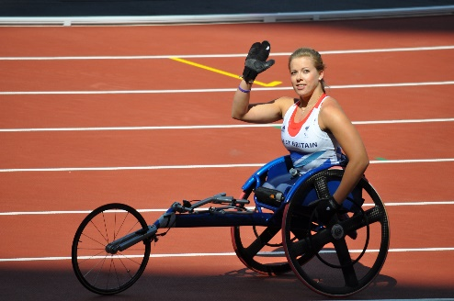
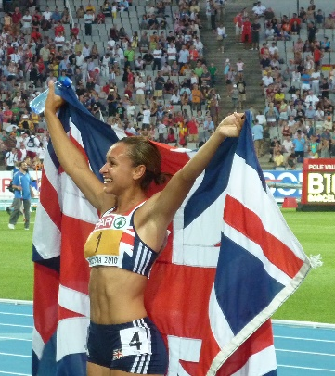
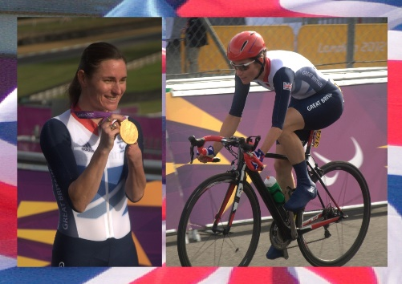
Famous Sports Stars
What do you know about these famous women?
Nicola Adams – boxer
Jessica Ennis-Hill – heptathlete
Serena Williams – tennis player
Hannah Cockroft – wheelchair racer
Sarah Storey – Paralympic cyclist
https://www.bbc.co.uk/sport/56258817

Slide 10
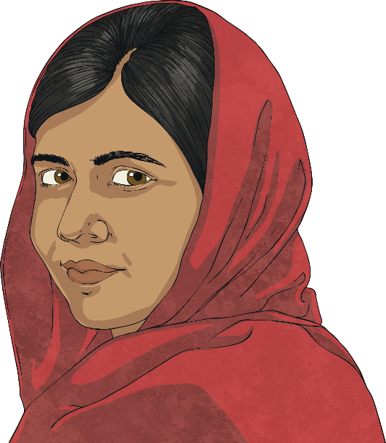
Why Celebrate International Women’s Day?
International Women’s Day was first celebrated over 100 years ago in 1910. The aim was to have equality for men and women across the world.
However, important rights, such as health and education, are still not realised for some women.
Meet Malala Yousafzai Malala was only a little girl when she was hurt very badly because some people thought that girls should not go to school. Malala disagreed and spoke out for the right of girls to be educated. Now she helps girls all over the world to go to school.
What Would You Speak out For?
Helping your friends?
Protecting wildlife?
Recycling?
Being kind?

Slide 11
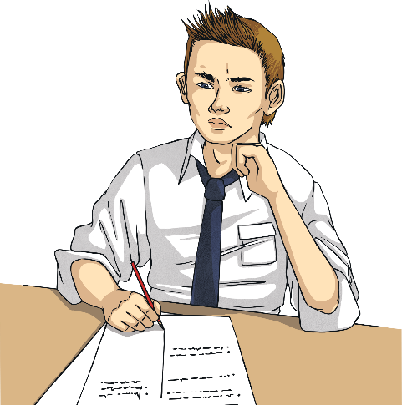
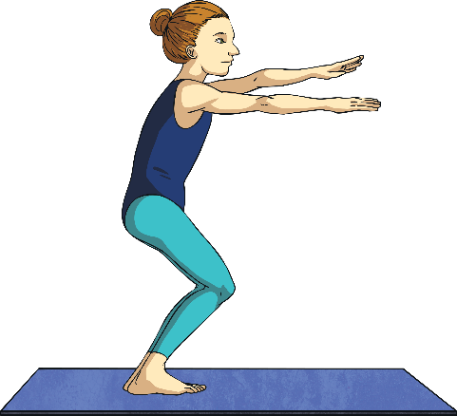
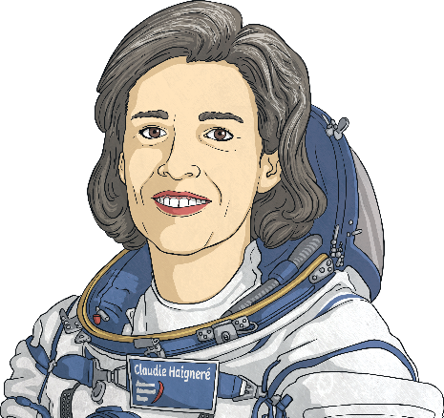
What Can You Do?
Challenge yourself to try something new. Whether you’re a boy or a girl, have a go at something you’ve never done before.
Think about a job you would like when you’re older. How can you get to achieve your dreams?
Research some more famous figures who have done extraordinary or pioneering things. How have they used our toolkit?

Slide 12
Perseverance
Resilience
Optimism
Team Work
Leadership
Problem solving

Slide 13
https://www.youtube.com/watch?v=5Mc06cIrvXE
But those that wait upon the Lord
Will renew their strength
They will mount up with wings like Eagles
(Isaiah 40 v 31)

