Slide 1


Welcome to Year 5
Curriculum Evening
Miss Jackson

Slide 2
The Daily Routine
9.00am | Registration
9.00am – 9.30am | Daily Task/ Whole school collective worship/ Hymn Practice
9.30am - 10.30am | 1st session English
10.30am – 10.45am | Playtime
10.45am - 12pm | 2nd session Maths
12pm – 1pm | Lunch
1-2.05pm | 3rd session Foundation Subjects/RE
2.05-2.15pm | Daily Mile
2.15pm - 3.15pm | 4th session Foundation Subjects/RE
3.20 - 3.30pm | Whole Class Reading
3.30 pm | Hometime

Slide 3
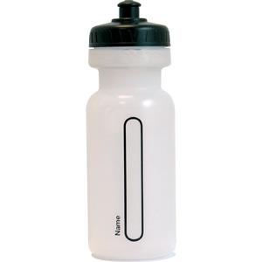
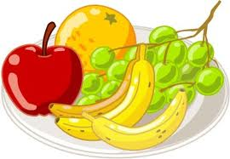
Water Bottles / Milk
Please ensure your child has a water bottle in school. They can get a drink at playtime and when they come in from playtime. Children can also access their bottles for a drink during lessons.
They are encouraged to take them home every night.
If children receive milk at school they have this after morning break.

Slide 4
Changes in Y5
Independence, Independence, Independence!!!!
Increased responsibility for themselves and their belongings.
Increased responsibility for their own learning and homework.
First residential trip away from home with the school at Hawkhirst Adventure Scout Camp in Kielder (30th April - 2nd May)

Slide 5
Hawkhirst
First residential trip away from home with the school at Hawkhirst Adventure Scout Camp in Kielder.
2 nights away from home – girls and boys dormitories .
This will be from the 30th April to the 2nd May 2025.
Outward bound activities including: abseiling, bell boats, zip wire, orienteering, archery.
Meeting will be held in Spring Term with further details.
Approx. cost last year = All inclusive £254 (broken down into 4 payments of £63.50)
- These will be paid in four instalments, you will receive a letter and there will be a meeting closer to the time.

Slide 6
Homework in Year 5
Homework is generally linked to the activities your child has been working on in class, for consolidation of their skills.
There will be one project per ½ term sent out as homework.
Day given | Subject | To be handed in
Thursday | Maths and English written homework | Tuesday
Thursday | Spelling - sentences | Tuesday - weekly tests

Slide 7
Homework in Year 5
Homework provides the opportunity for children to develop as independent learners and to extend and reflect upon their ‘in school’ experiences.
We are aware that many outside activities which take up much of the children’s time e.g., dancing, swimming etc. It is therefore our philosophy not to give out a lot of homework unnecessarily. Homework compliments and reinforces what is taught in school.
Homework will not usually be given when a pupil is absent through illness or holiday.

Slide 8
Parents evenings
Autumn Term
Spring Term
Appointment slips will be sent out and appointments will be allocated to accommodate requests and siblings in the school.
If for any reason you are unable to make dates – please contact me at school and I am happy to arrange another time.

Slide 9

Year 5 Rewards
House points
Stickers
Star Assembly
Year 5 Weekly Rewards (e.g., games time)
Privilege Cards

Slide 10

Behaviour Policy
At St Matthew’s, we have the ‘Good to be Green’ behaviour policy.
Children are given warnings and on their third warning they receive a ‘Stop and Think’ card to give them the opportunity to change their behaviour.
If their behaviour persists, or if they are rude to a member of staff or a peer then they will receive an amber card.
Children will receive a red card if either they do not change their behaviour after warnings or they will receive an instant red card for reasons such as abuse (whether that is verbal or physical).

Slide 11


Year 5 Curriculum
Subjects
English
- Maths
- Science
- Computing
- Religion
- RSE
- PSHCE
- History
- Geography
- Art
- Design & Technology
- Music
- French
- PE

Slide 12
Lessons in Year 5
Children are taught in structured lessons, which consists of 5 main parts:
- Retrieval (assess prior knowledge)
- Aim/Learning Objective (we are learning to…)
- Whole class teaching (smartboards / powerpoints / practical and interactive)
- Independent work (individual / paired / small group)
- Plenary (summary of lesson)
Assessment is continuous and tracked to ensure that each child’s unique needs are catered for.
There will also be an assessment week in the Autumn, Spring and Summer term.

Slide 13

English – Talk for Writing
Across the whole school we have a scheme called Talk for Writing.
Talk for writing enables children to imitate the language they need for a particular topic orally, before reading and analysing it, and then writing their own version.
It ensures that pieces of text are gone through in fine detail to emphasise understanding by the reader. It also allows children to achieve their full creative potential.

Slide 14
English
Autumn Term:
Myths and Legends
Instructions
Tales from other cultures
Non-Chronological Report
Spring Term:
English Classic
Discussion Writing
Flashback
Journalistic Writing
Summer Term:
Journey Tale
Diaries
Warning Tale
Text Explanation

Slide 15
English - Book choices
How to Train Your Dragon (Myths and Legends)
The Butterfly Lion (Tales from other Cultures)
The Wind in the Willows (English Classic)
The Sleeping Sword (Flashback)
The Midnight Fox (Journey Tale)
The Wolves of Willoughby Chase (Warning Tale)

Slide 16
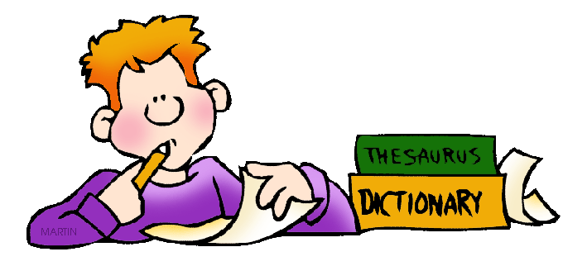
Writing Focus
Vocabulary – adjectives, similes, descriptive phrases, interesting and ambitious words, verbs and adverbs
Connectives – and, but, so, then, because, if when, although, however, as well as,
Openings – First, Just then, Next, Finally, After a while, Also, Immediately,
Varying sentence openings – start with an adverb-ly or -ing word, a questions, in the middle of action
Punctuation - . , !, ? “ ”… ( ) : ;
Spelling (See separate sheet – reading record)
Grammar (Terminology – reading record)

Slide 17
Writing Focus / SPAG
(spelling, punctuation and grammar)
The man walked down the lane.
The old man shuffled slowly down the cobbled lane.
Slowly, the elderly man shuffled down the cobbled lane, with a wooden walking stick in his hand, even though he was in pain.

Slide 18

Guided Reading
Vocabulary - find and explain the meaning of words in context.
Infer - make and justify inferences using evidence from the text.
Predict - what might happen from the details given and implied.
Explain - how content is related and contributes to the meaning as a whole.
Retrieve - retrieve and record information and identify key details from fiction and non-fiction.
Summarise - the main ideas from more than one paragraph.

Slide 19

Spelling
There will be a new spelling focus each week.
Children will complete activities linked to focus in class.
At home, they will be asked to write sentences for each word.
The test words will be taken from the list of words the children have and they will also get two bonus words.
Therefore, the children need to ensure they know the rule not rope learn a set of words.
Children need to practise the rule every night.

Slide 20

Independent Reading
Children choose a home reader each week, and are encouraged to pick a range of fiction and non-fiction texts.
They should be aiming to be able to read this fluently but with some challenging words. (check meanings of unfamiliar words)
EVERY CHILD – EVERY NIGHT (at least 10 minutes!!)
Not necessary to hear every word but please encourage children to talk about what they have read.
Comment in reading record is their responsibility and they need to write the date and what page they’re up to.
Please ensure your child’s book is in school everyday.
Thank you.

Slide 21
Reading Diaries
Reading books need to be in school every day. You need to write a comment about your book each week telling me what has happened so far in your stories or some of the facts you have learned. Also include your favourite part/fact and why.
In Year 5 our books are sometimes very long and can’t be read in a week, therefore your comment will be about the part you have read that week (also include how much you read – p56-123).
This note is in every child’s reading diary along with the Reading Reward Square
Your job as a parent - you need to put your initials in the box each time you have listened to your child read for 10 minutes.

Slide 22

Handwriting – Letter-join
We have a scheme for handwriting called Letter-join. Children get the chance to log into this in school to practice their handwriting on the iPad and computers. You have received an email about logging into this on Tuesday.
Our aim is for a neat, joined, consistent style of handwriting.
Pride in their presentation.
Please encourage your child to use the school handwriting style in all their homework.

Slide 23

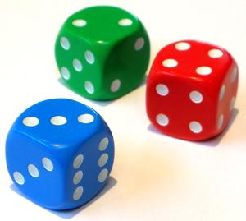

Maths
Throughout the year the children will cover these topics:
Place Value
Addition and Subtraction
Multiplication and Division
Fractions
Decimals and Percentages
Perimeter and Area
Statistics
Shape
Position and Direction
Negative Numbers
Converting Units
Volume

Slide 24
Maths Curriculum
There will be a greater emphasis on arithmetic/mental skills
The promotion of efficient written methods of long multiplication and division.
More demanding content in fractions, decimals and percentages.

Slide 25
Key Maths Skills for Year 5
Tables facts and division facts to 12 x 12
Knowledge of place value (numbers to 1,000,000)
Multiply and divide by 10, 100, 1000
Written methods of calculation for all four operations
Problem solving and application of skills

Slide 26
Key Maths Skills for Year 5
Our Maths lessons focus on MATHS MASTERY.
The lesson are split into small steps where I teach then the child practice, then I teach and they do more practice throughout the lesson.
This encourages the children to think for themselves and apply their knowledge to different contexts.

Slide 27
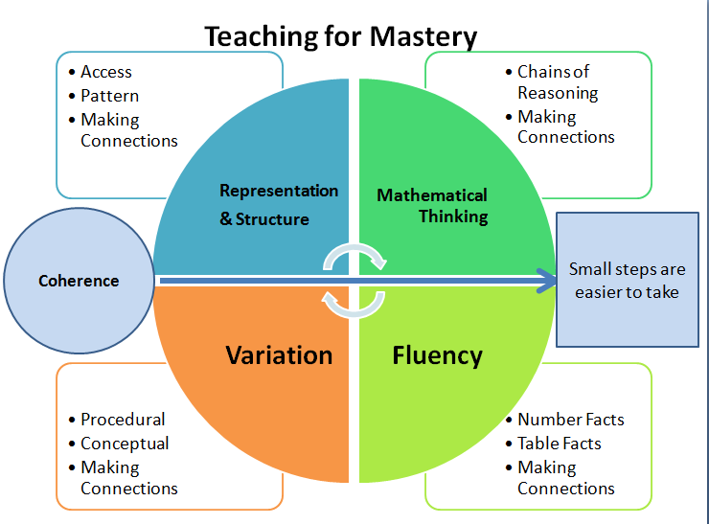

Slide 28
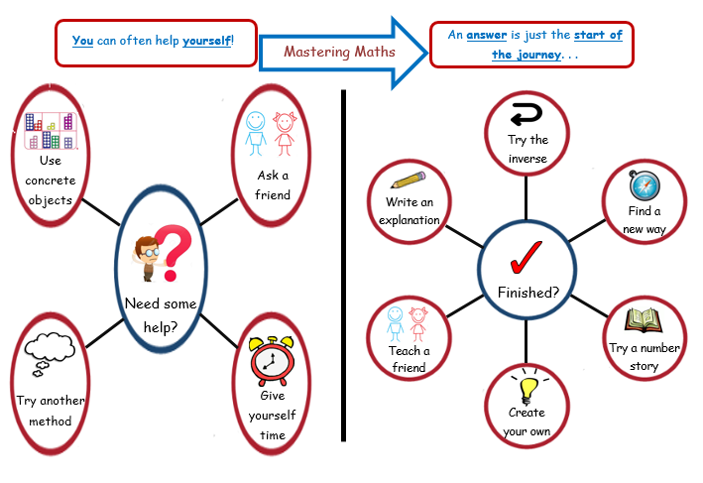

Slide 29
Addition
164
+125
289
5486
+1225
6711
1
1

Slide 30

Subtraction
165 – 34 =
174 – 46 =
1 7 4
4 6
1 2 8
165
34
131
6
1
_
Check with inverse – 128 +
46
174
1

Slide 31
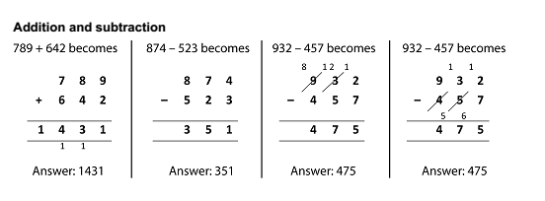
Calculation Strategies

Slide 32
Multiplication
3 4
x 6
204
2

Slide 33
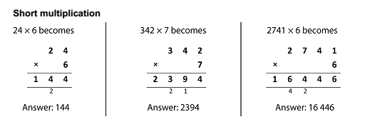
Multiplication – Using larger numbers

Slide 34
Division – Using multiplication facts
3 x 4 = 12
So
30 x 4 = 120
3 x 40 = 120
300 x 4 = 1200
12 ÷ 4 = 3
So
120 ÷ 4 = 3
120 ÷ 40 = 3
1200 ÷ 400 = 3

Slide 35

Division
68 ÷ 4 =
17
4
68
2

Slide 36
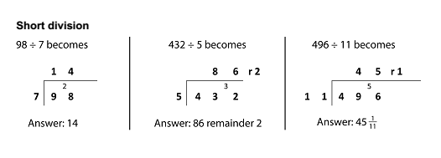
Division

Slide 37
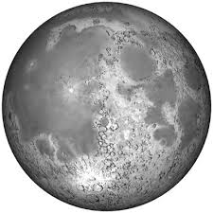
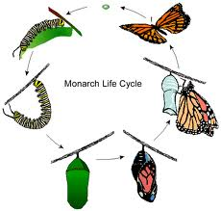
Science
Sound and hearing
Animals including humans
Movement, forces and magnets
Materials
Earth and space
Living things

Slide 38

Art and DT
Autumn first half term:
Art - Drawing Pop Portraits
Autumn second half term:
DT - Textiles Paste Relief - Coat of Arms
Spring first half term:
Art - Painting movement lines
Spring second half term:
DT - Fairground Transition Project - Secondary linked
Summer first half term:
Stretch art and DT skills
Summer second half term:
DT - Cooking Pretzels

Slide 39

Computing
The children have one computing lesson a week in the computing room.
Data and Information
Media Creation
Computer Networks
Information Technology
Computer Science

Slide 40
Religious Education
Autumn Term
Ourselves / Passover / Life Choices / Hope
Spring Term
Mission / Memorial Sacrifice / Sacrifice
Summer Term
Transformation / Freedom and Responsibility / Ramadan and Pilgrimage/ Stewardship

Slide 41
RSE – Relationships and Sex Education
As a school to teach RSE we use TenTen.
The 3 main topics that they will be getting taught in Years 5 and 6 are:
Created and loved by God
Created to love others
Created to live in community
We will also be covering topics on significant days such as internet safety, bullying and mental health awareness.

Slide 42
History/ Geography
TERM | TITLE
AUTUMN 1 | Anglo Saxons and Vikings / Settle Down
AUTUMN 2 | Anglo Saxons and Vikings / Settle Down
SPRING 1 | Anglo Saxons and Vikings / Settle Down
SPRING 2 | Early Islamic Civilisation / Natural resources
SUMMER 1 | Early Islamic Civilisation / Natural resources
SUMMER 2 | Early Islamic Civilisation / Natural resources
Notes:
- Transition project

Slide 43
French
The children have an hour of French every other week.
The children are taught oral and written skills in French on a range of subjects.
Grammar: Adverbs, Connectives, ‘er’ verbs and reflexive verbs. The topics they will be covering this year are:
Retrieval of - greetings, family members and physical and character descriptions.
Weather
Health - Healthy and unhealthy food and drink
Free time e.g., sports

Slide 44
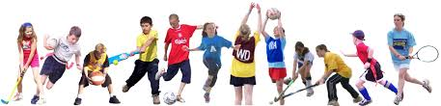
PE
Lessons take place on a Monday and Thursday on the first half term
Correct P.E kit is needed for all PE lessons.
Y5 children also get the opportunity throughout the year for some additional coaching and events – Tag Rugby, Athletics etc.

Slide 45



PE
In this element of the curriculum, the children in Year 5 will take part in the following;
Autumn Term:
Indoor Athletics
Rugby
Netball
Football
Spring Term:
Gymnastics
Hockey
Tennis
OAA
Summer Term:
Cricket
Health Related Fitness
Outdoor Athletics
Dance

Slide 46

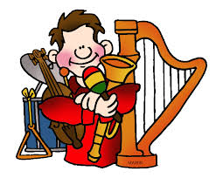
Music
The children have a bi-weekly music lesson with Mr McNally for one hour
Lessons include:- elements of music, Keyboard skills, Pulse and Rhythm, Class Orchestra,

Slide 47



Marking
All children’s work is marked with positive comments.
A challenge / next step / improvement is also identified.
In Year 5, children get the opportunity every lesson to go through the previous days work and make corrections using their red pen/pencil.

Slide 48

Year 5 – “An open door”
I am in school most mornings by 7.30am and usually leave around 5pm
Please come and see me about anything that is concerning or worrying you.
Contact the office to make an appointment.

Slide 49
Thank you for listening.
Any further questions?

