Slide 1
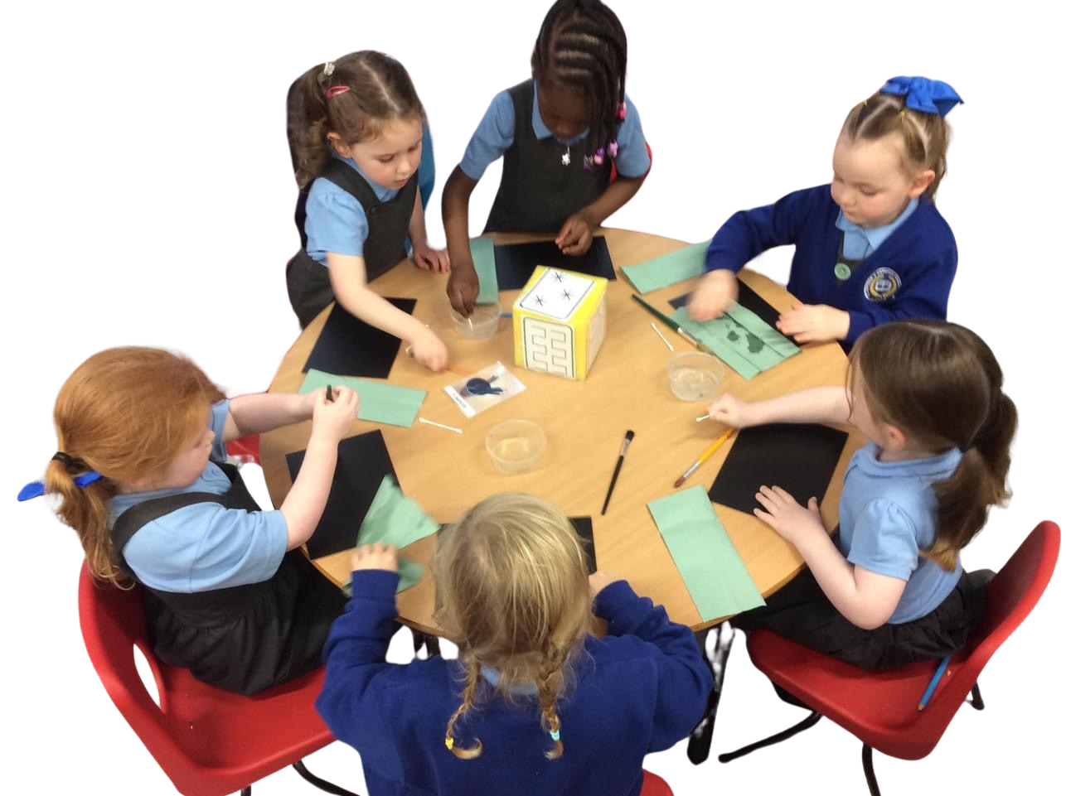


A STRONG START

Slide 2

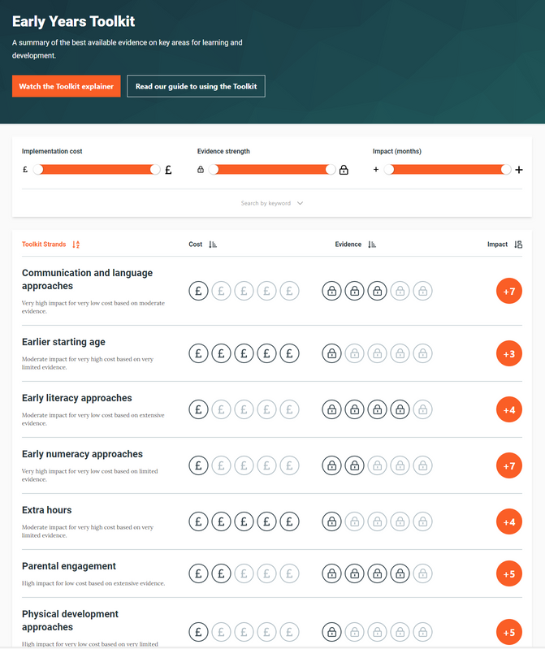
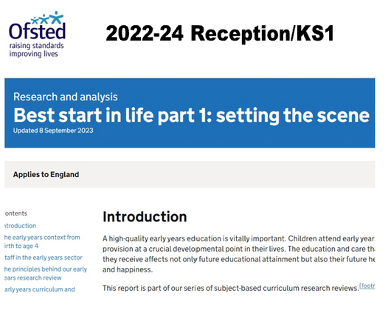

Based on research evidence.
Early education should be ambitious for all, especially those who are disadvantaged.
Communication and language skills, educational attainment and health and wellbeing are all built on strong foundations. If these gaps are not closed in the early years, the gap only widens.
If we get it right for the most vulnerable, we get it right for all.

Slide 3






Foundational Knowledge
We aim to equip all children, without fail, with the knowledge and skills they need to make progress in Reception, through key stage one and beyond. Our early years education provides children with strong foundations so that they can successfully learn how to:
communicate
read
write
calculate
Secure foundational knowledge relies on the development of:
Executive function for learning and well-being
Physical, social and emotional readiness for learning

Slide 4
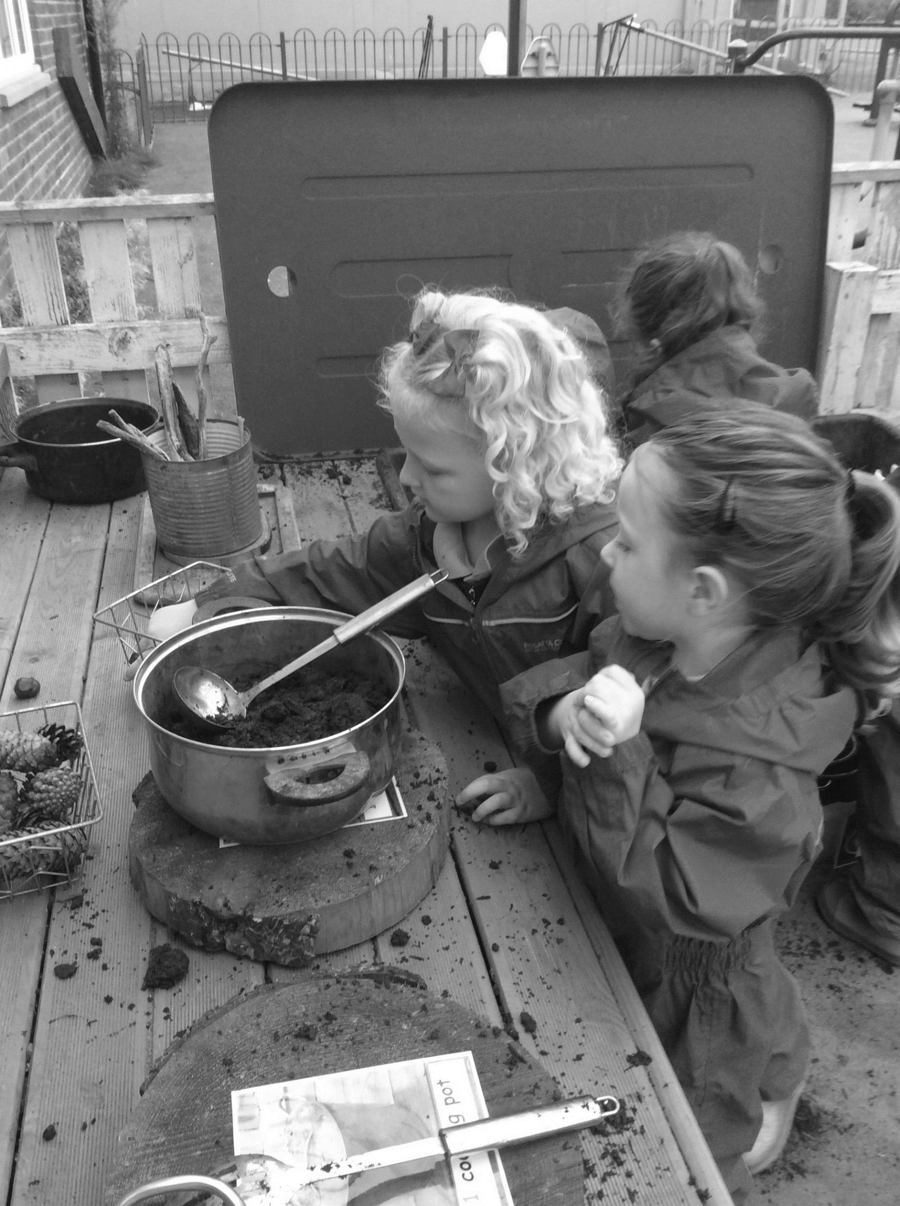

Planning for learning through ensuring clarity in the curriculum
What do we want children to learn?

Slide 5

Birth to seven years old is a specific and unique neurological and developmental phase.
This requires careful consideration of the importance of:
    Concrete experiences that enable later abstraction.
    revisiting ideas and experiencing them in different contexts.
    embedding learning ‘behaviours’ - not just talking about ‘what’ children learn but also, ‘how’ they are going about their learn.
    teaching that utilises intrinsic motivation. if we build upon what fundamentally interests the children, then they will be more motivated to learn.
Planning for learning through ensuring clarity in the curriculum
What is the
uniqueness of early years?
Directed activities
Curriculum through focused discussion
and group activities
Enhanced provision
Curriculum through resources stimulus, interactive display, visits and visitors.
Continuous provision
Curriculum through high quality indoor and outdoor learning environment

Slide 6
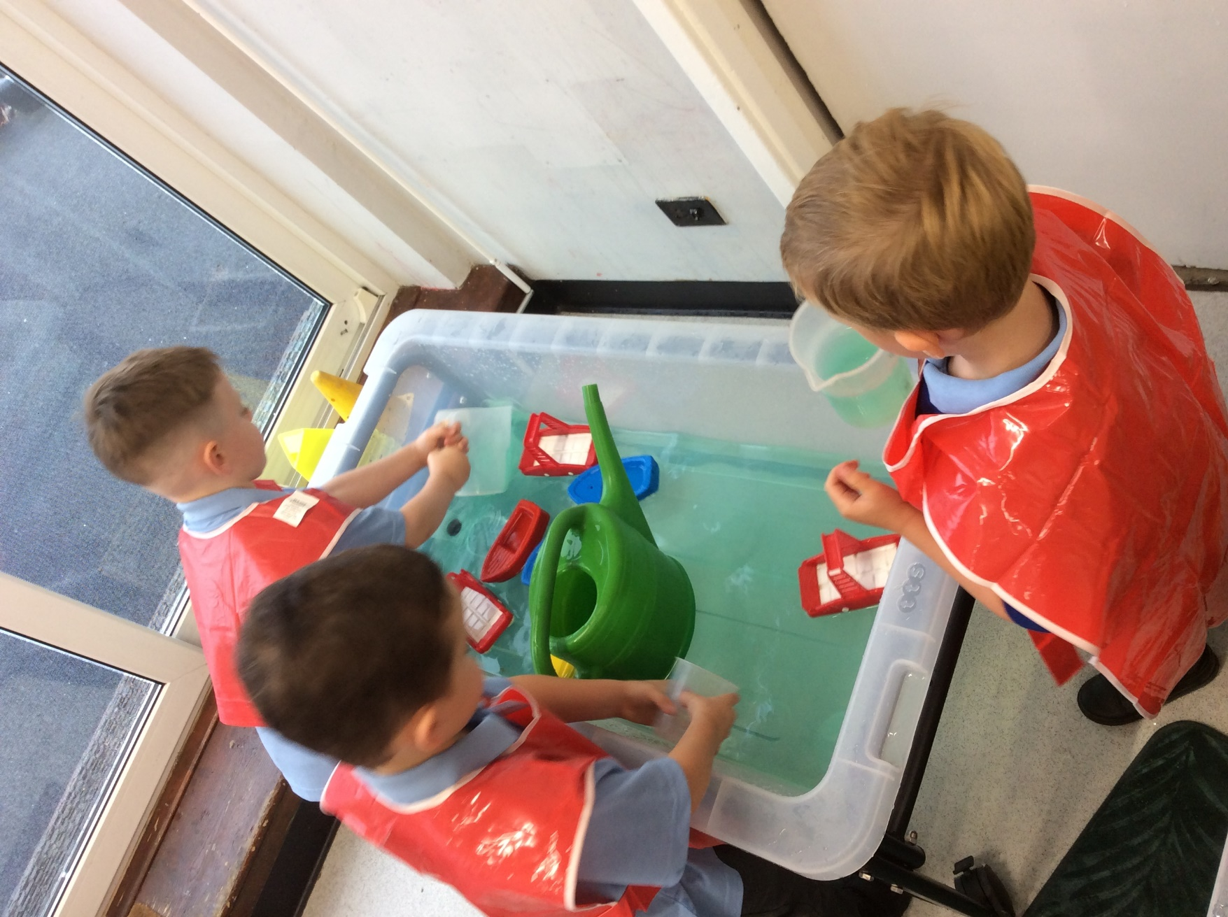
Continuous
Provision
This includes:
  Everything that is there, all of the time.
  All of those places in the Early Years setting that have earned their place and are going to be there right the way through the year.

Slide 7

Continuous provision in the learning environment
Prioritising possibilities of the resources over the amount of resources.
1 | The layout of our Early Years space is clearly defined. | The layout of our Early Years space is clearly defined.
2 | Resources and materials are consistently available in the area everyday. | Resources and materials are consistently available in the area everyday.
3 | Resources are accessible and presented in the same way every day. | Resources are accessible and presented in the same way every day.
4 | Children can use the resources independently. | Children can use the resources independently.
Children know what to expect. They can arrive at school having already made plans and thought about what they might do that day because they are able to picture the learning space set out for them and knows what happens where? | Children know what to expect. They can arrive at school having already made plans and thought about what they might do that day because they are able to picture the learning space set out for them and knows what happens where?
Children know how to engage in different learning spaces. Resources provided are considered to ensure a pathway to progress. | Children know how to engage in different learning spaces. Resources provided are considered to ensure a pathway to progress.
Children know what to expect and know what they can do. They do not have to relearn how to use the area every day. | Children know what to expect and know what they can do. They do not have to relearn how to use the area every day.
Independence leads to intrinsic motivation and success. If children cannot access the space independently adults have considered how to model this for them. | Independence leads to intrinsic motivation and success. If children cannot access the space independently adults have considered how to model this for them.
WHY?
WHY?
WHY?
WHY?

Slide 8
Layout of the learning space
Plan for beginnings, plan for progression, plan to reflect interests and needs, evolve and enrich (as necessary)

Slide 9
Why do we use continuous provision?
Continuous provision provides a learning environment where children are able to learn and develop a range of concepts in a rich way. The environment supports an active approach to learning, helping children to experience many things for the first time, as well as repeat, practice and refine what they already know and can do. Children are not just developing in terms of learning new ideas and concepts but are developing as learners.
Our Early Years environment supports children as learners and so it must also support their wellbeing, by establishing:
Benefits for children: | Benefits for children:
Continuity, security, well-being, independence. | Consistency and continuity will lead to and nurture confidence in a way that an area that is always changing may not. Offering continuity is really important for developing the wellbeing, independence and security of our children
Engagement, curiosity | How we organise our learning spaces and with the resources we offer, we aim for our children to return and go back to something. They will repeat ideas and form relationships in the learning spaces with other children of similar interests. The spaces provides opportunities to self regulate and carry new ideas out
Benefits for staff: | Benefits for staff:
Reduce workload, improve well-being | The planning of continuous provision is done early in the year which takes pressure of short term workload. Effective continuous provision is essential so that staff do not over compensated with frequent changes in the short term. When this happens, the learning spaces in the classroom need constant introduction to the children, telling them what they need to do to access an space every few days or each new week.

Slide 10
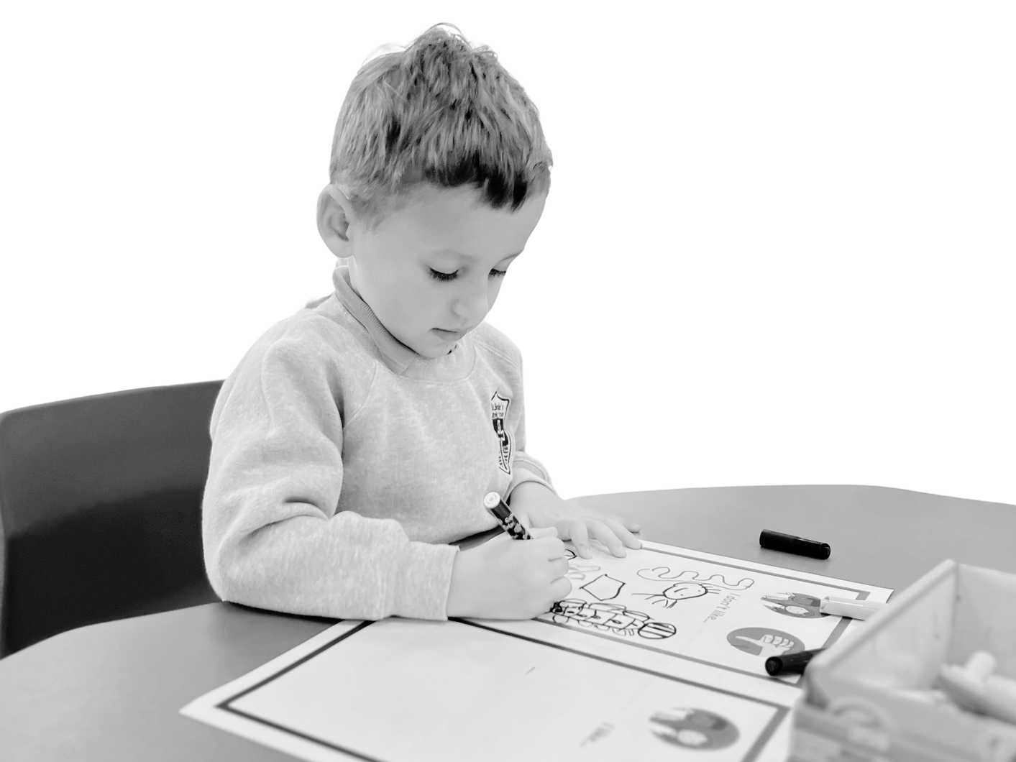
Planning for learning through ensuring clarity in the curriculum
Continuous provision is not a replacement for direct instruction. It should serve a purpose to provide the context in which children will embed concepts that have been introduced through direct instruction.

Slide 11
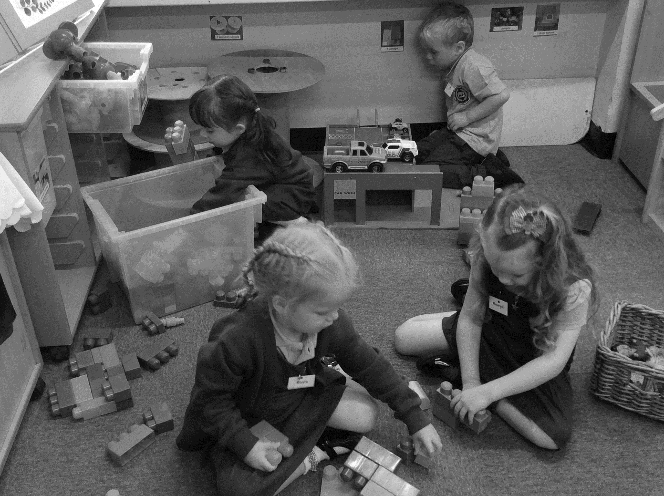




Evaluating continuous provision?
Playing and exploring - Engagement
Finding out and exploring
Playing with what they know
Being willing to have a go
Active Learning - Motivation
Being involved and concentrating
Keeping trying
Enjoying achieving what they set out to do
The Characteristics of Effective Learning provide a reflection tool and a lens through which to look at the how children are engaging with the learning environment planned for them.
    Can we see the Characteristics of Effective Learning happening?
    Are there some spaces where learning and the engagement of pupils is visible to see and some where it is less so?
    Does anything need to change as a result?
Creating and Thinking Critically - Thinking
Having their own ideas
Making links
Choosing ways to do things

Slide 12
Look for the learning
THINK, PLAN, DO, REVIEW
Date/Time | Learning space observed (max 10 mins) | What is working well? | Is there anything we need to evolve or enrich?

Slide 13
Learning spaces are not created and then left. The adult has a crucial role in the learning and developing the teaching in the Early Years environment. They must devote time to support the learning taking place.
Teaching happens whenever we are interacting with our children within the classroom setting and beyond. All interactions, in all spaces in the classroom are teaching moments. These moments provide rich opportunities for effective assessment and getting to know our children.
Teaching within the Early Years occurs in every interaction that adults can have with children, within all the different contexts that we are providing. Carefully planning what is in the space also requires careful planning of what interactions may happen - we plan for what the adults can do in the space alongside the children.
Through the learning environment we: nurture independence, promote learning behaviours, build confidence and self esteem, develop knowledge and skills side by side, encourage collaboration, meet children’s individual needs (supporting, enriching, extending).
Planning for learning through ensuring clarity in the curriculum
What is the
role of the adult?

Slide 14

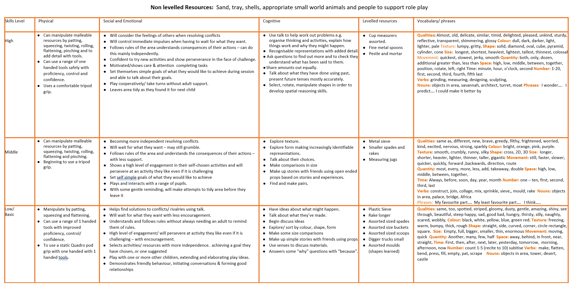
Learning Space: Wet Sand

Slide 15
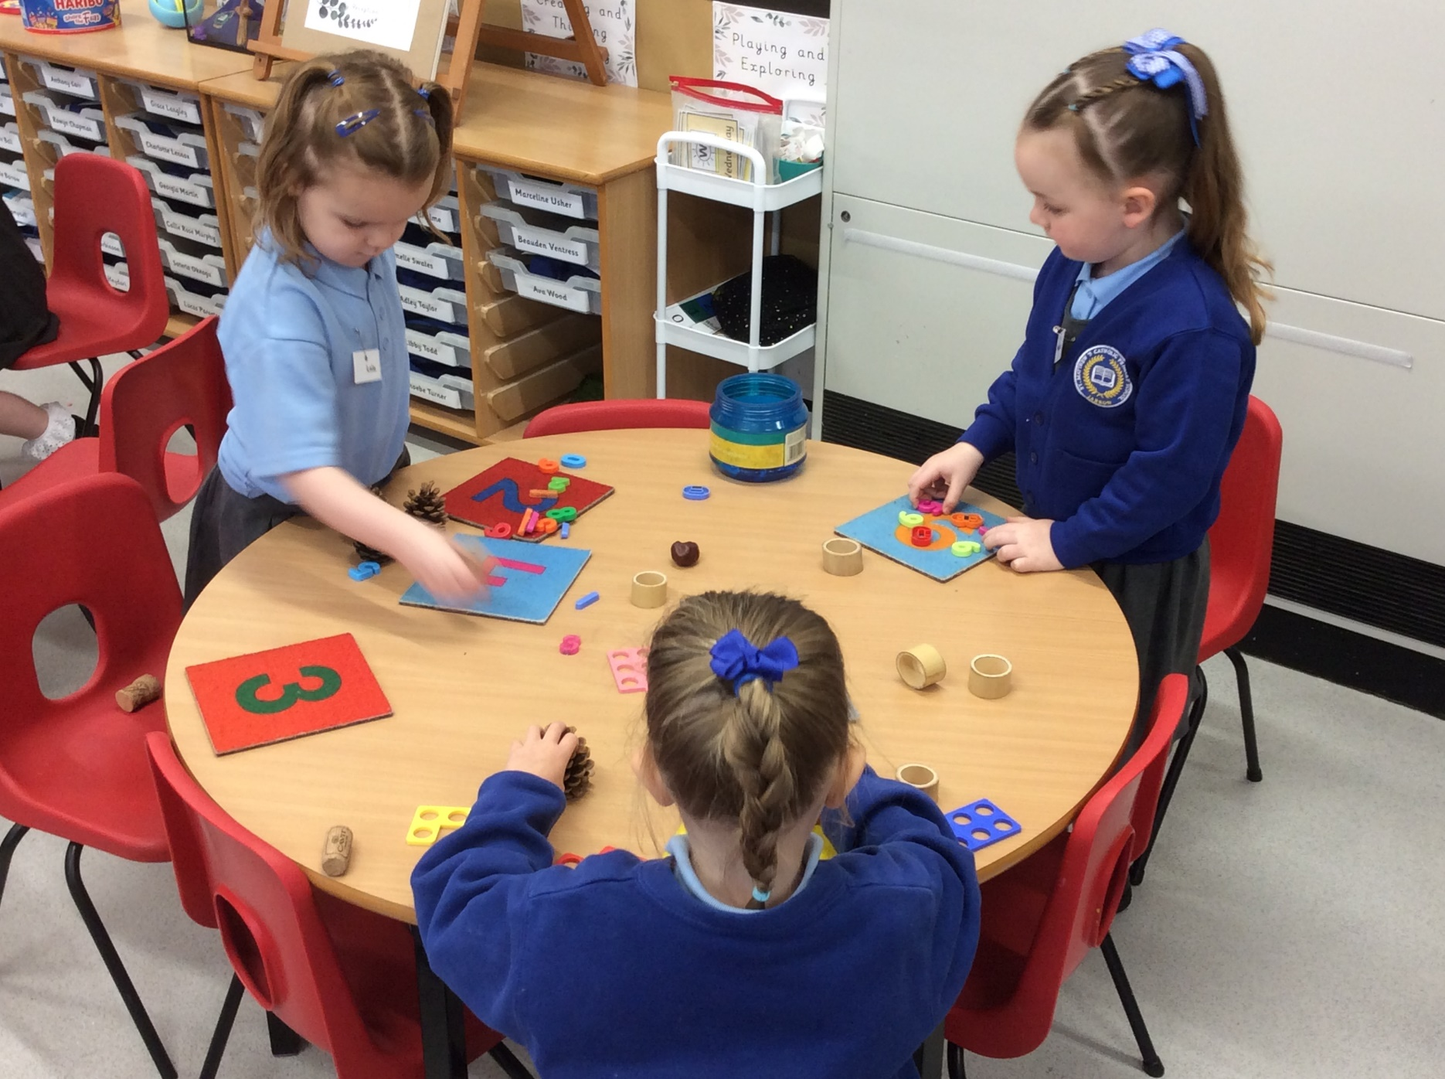
Enhanced
Provision

Slide 16
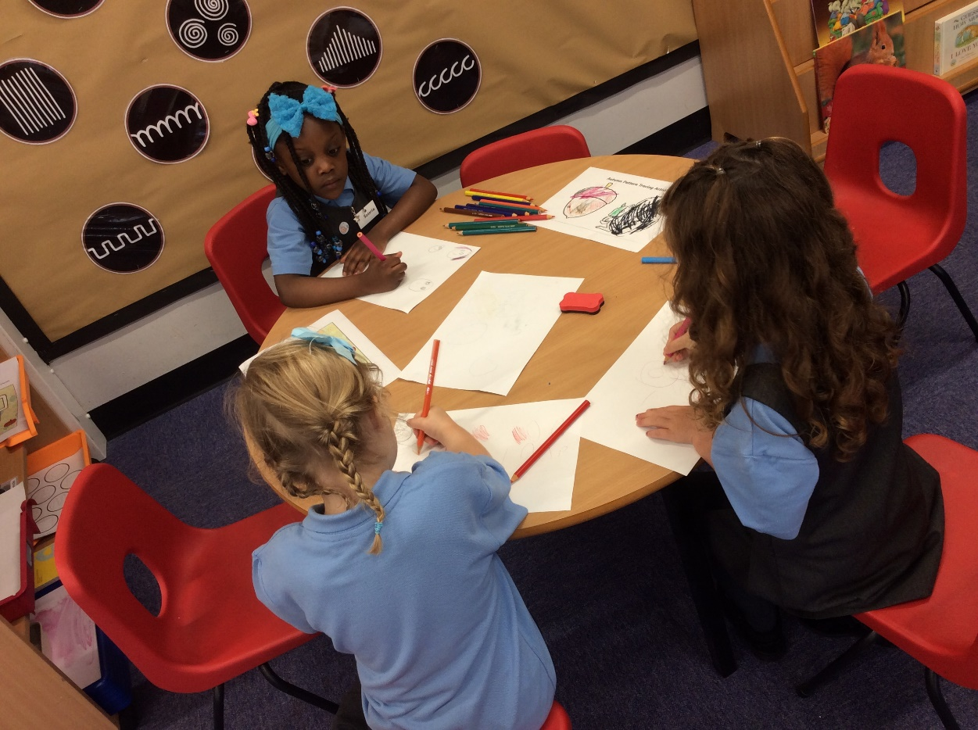
Areas Rich in Early Literacy, Speech and Language and Reading Opportunities
Small World
Development of vocabulary, meaning and describing objects.
Understanding and use of narrative structure and story telling conversations.
Development of speech in sentences in relevant contexts.
Extending complexities of speech and language
Using speech and language for a range of purposes and in a range of contexts.
Investigation
Development of investigative and scientific language.
Development of extraordinary vocabulary name and describing objects and actions.
Use of tenses – forward planning and reflecting on what has passed.
Role Play
Rehearsing and consolidating everyday speech and language.
Use speech and language for a range of purposes in specific contexts.
Development in different ‘voices’, styles and perspectives.
Development of conversation ‘serve and return’ interactions.
Music and Song
Development of vocabulary, naming and describing objects and actions.
Understanding the use of narrative structure and story telling conventions.
Development in speech in sentences and relevant contexts.
Extending complexity of speech and language.
Using speech and language for a range of purposes and in a range of contexts.
Story and Puppets
Understanding the use of narrative structure and storytelling conversations
Development speech in extended sentences using story telling conventions
Extending complexity of speech and language
Using speech and language for a range of purposes and in a range of contexts
Telling stories from a range of perspectives and using a range of stimuli.

Slide 17
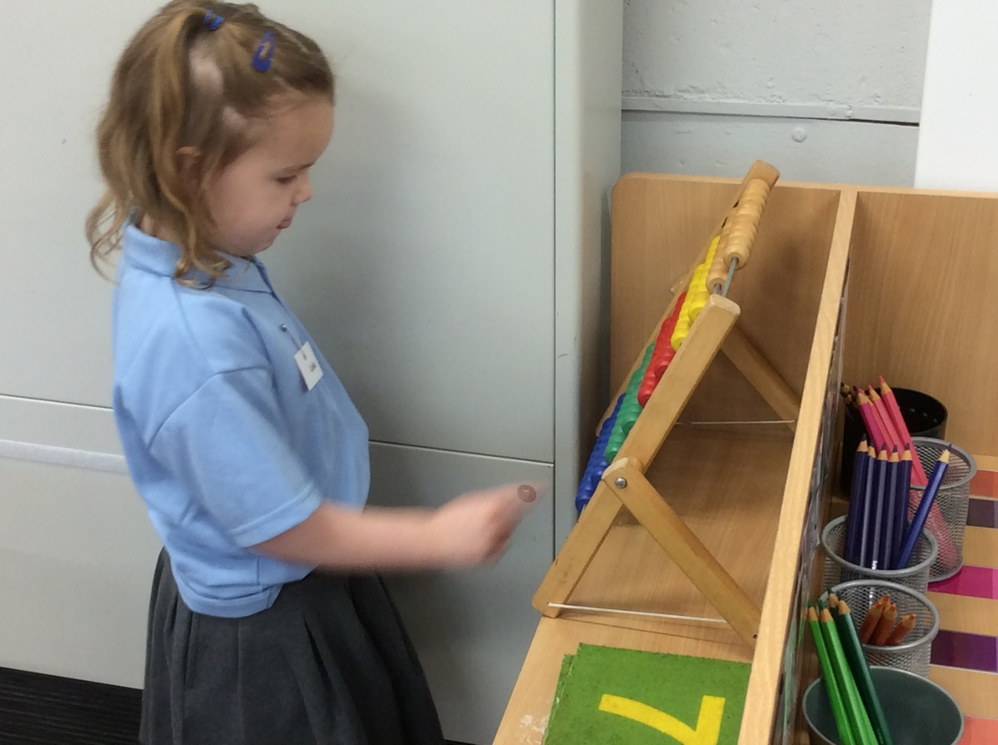
Areas Rich in Early Maths, Number, Shape Space and Measure Opportunities
Maths
Number recognition, subitising, counting and calculating whilst playing board games.
Applying knowledge of number, more than, less than whilst inventing own games.
Sorting grouping, matching and counting with objects and trays.
Making patterns with 2d shapes, understanding properties, tessellation, reflection and rotation.
Tidy Up Time
Sorting, grouping and counting to tidy resources away
Matching similarities using shape and size.
Noting sameness and difference to organise and arrange.
Applying concepts of more and fewer.
Block Play
Counting out pieces to design and build ideas.
Selecting shapes and size of blocks to meet a design need.
Experiencing the properties of shape and how certain shapes can be used.
Positioning and sequencing blocks including tessellation, reflection and rotation.
Recognising, creating and understanding patterns as part of play
Dough
Exploring shape and size through use if graduated shape cutters.
Developing number sense, counting, matching one to one and making pairs as part of baking with bun cases and tins.
Using measure and number recognition as part of pretend baking.
Small Construction
Regognising, understanding and naming shape, size and colour whilst selecting and tidying away
Recognising, creating and understanding patterns as part of model making.
Counting and cardinality as part of organising pieces and sets whilst building.
Subsitising and partitioning as part of building.
Using positional language to talk about ideas and models.
Transient Art
Using regular and irregular shapes to represent ideas and make patterns.
Exploring shapes, lines and grids whilst using natural materials.
Recognising, creating and understanding patterns.
Sorting, grouping and matching whilst selecting resources and being creative.

Slide 18
Directed
Activities

