Slide 1
EAL Coffee Morning

Slide 2
Agenda
-Meet the EAL team
-Find out about interventions
-In class support
-Maths
-What you the parents can do!

Slide 3
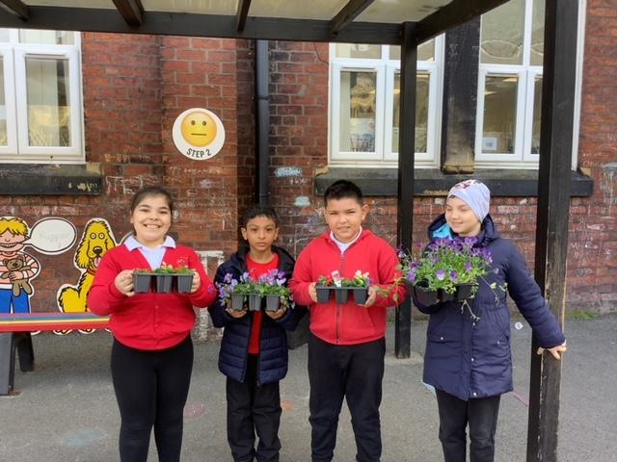
Who we are
As a school family we speak over 26 different languages such as Urdu, Romanian, Ukrainian, Spanish, Hungarian, Lithuanian, Punjabi and many more.
Our aim is to improve the education of our pupils who use English as an additional language (EAL) through academic support.

Slide 4
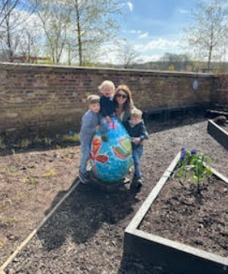
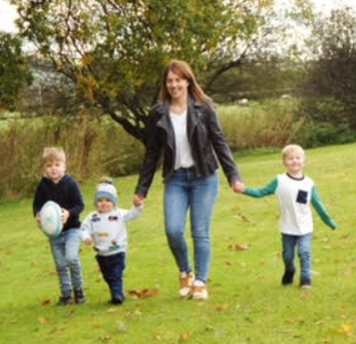
Miss Brennand
EAL Subject Lead
Currently overseeing data
Liasing with staff to ensure correct interventions are in place
Currently undertaking the EAL accreditation

Slide 5
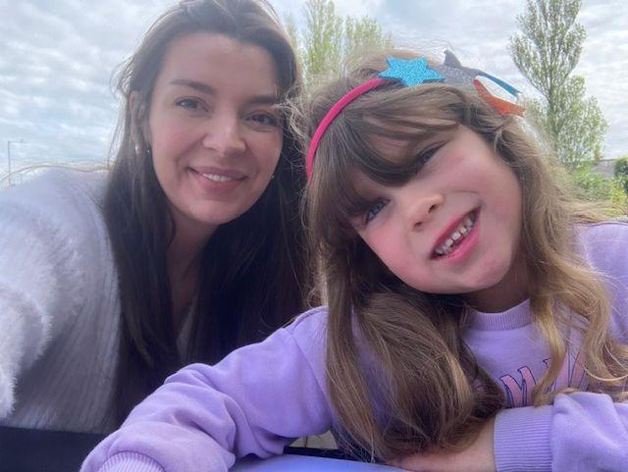
Mrs Farnworth
EAL Learning Mentor
I complete initial inductions and set pupils up with a buddy.
I run weekly interventions and provided pupils with extra support in class.
Well being checks

Slide 6
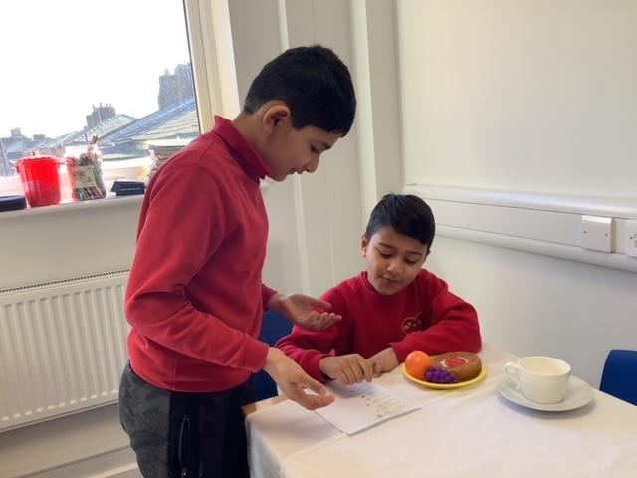
Inductions and Buddy System
-When a new pupil arrives who is classed as EAL they will complete the necessary paperwork with Mrs. Farnworth with their parents and be taken on a tour of the school.
They will also be assigned a buddy who (if possible) speaks their language and is in their key stage. This buddy will help will translations in home language but will also play with them at break times and speak with them in english.

Slide 7
Language Ambassadors
We have language ambassadors for almost all of the languages represented at our school.
These are pupils who have a moderate proficient level of english but who also speak an additional language.
They act as buddies for new arrivals and help assist with translation such as at parent/teacher meetings.

Slide 8
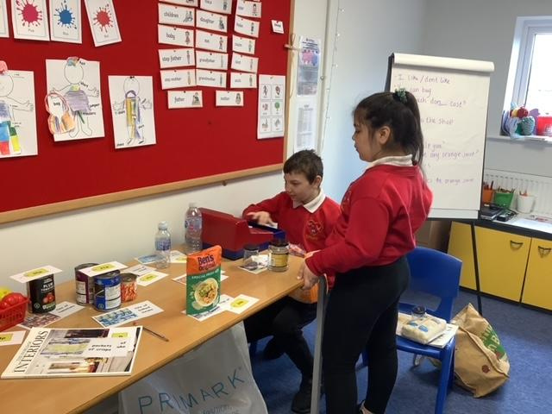
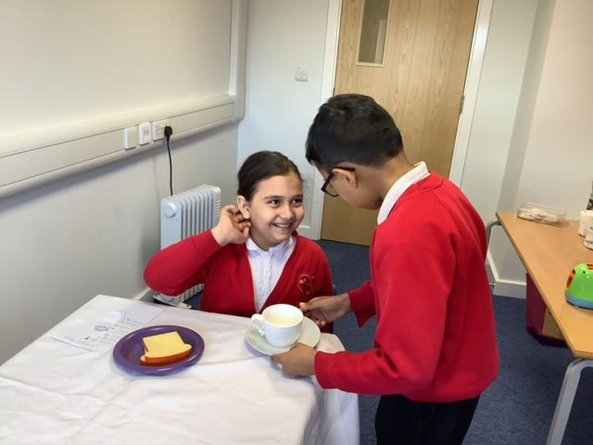
Interventions
We run weekly interventions:
-Speaking and Listening. For pupils with very limited english. We look at vocabulary together, discuss meanings and practice speaking words and phrases through games and activities.
-Grammar Intervention. For pupils with a higher level of english. We cover grammar topics related to learning in class such as correct punctuation and tenses.

Slide 9
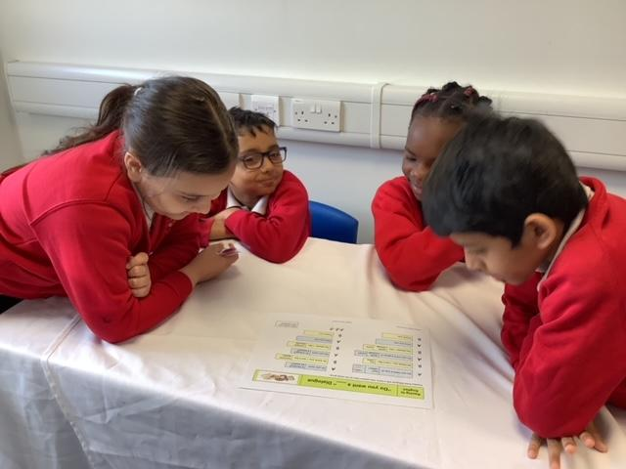
In class support
-Pupils at tier 2 level receive 1-2 hours of extra support in class.
-Pre teaching of science and history vocabulary at the start of the term.
-Pre reading stories/ key vocabulary prior to it being covered in lessons.
-Added visual aids through widget
-Colourful semantics

Slide 10
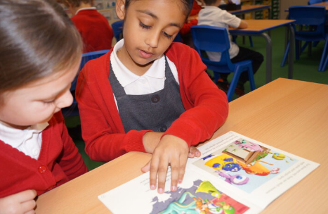
Reading
Children be should reading every day with an adult at all ages.
Any genre is acceptable alongside the school reading scheme.
Written in diaries
Use the AF questions

Slide 11
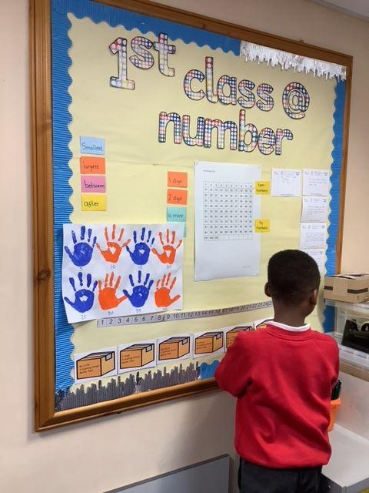
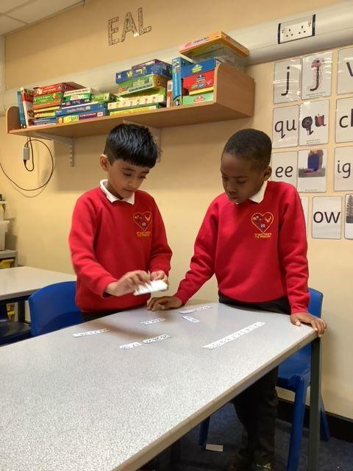
Maths
1st Class Numbers- A maths intervention for year 2 children. Focusing on number recognition and calculation as well as communication skills.
TTRS
Hit the button
Sally to add

Slide 12
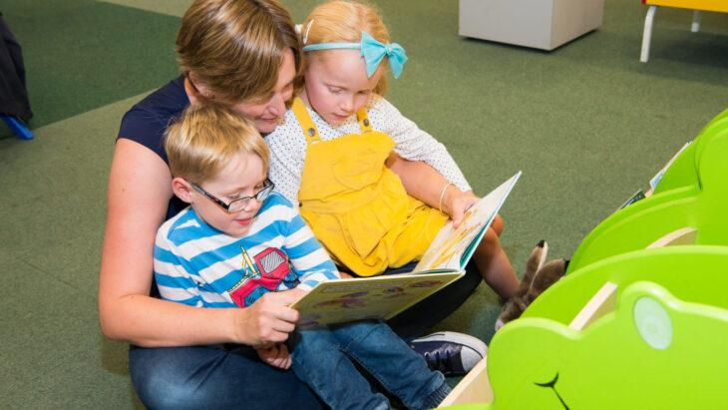
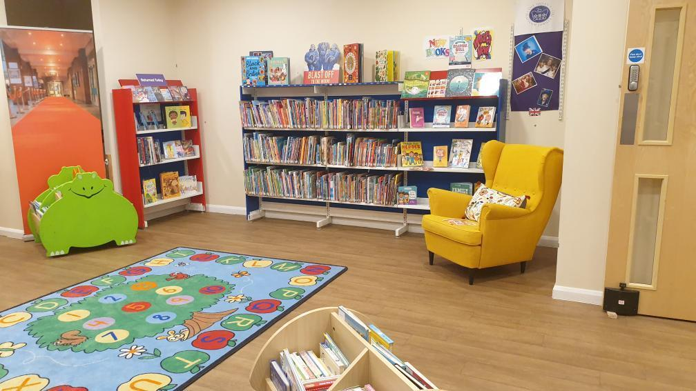
What you the parents can do!
-Reading- KS2 15 minutes each night. KS1 10 minutes.
-School Library. Children and can select a book each term to take home and read.
Public Library- Preston Harris Library in the Guild Hall/ Ribbleton Library
https://www.lancashire.gov.uk/libraries-and-archives/libraries/library-services/young-readers/

