Slide 1
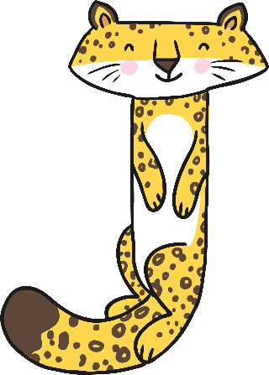
J

Slide 2
The letter j looks like this…
j
J
Can you draw it with your finger?

Slide 3
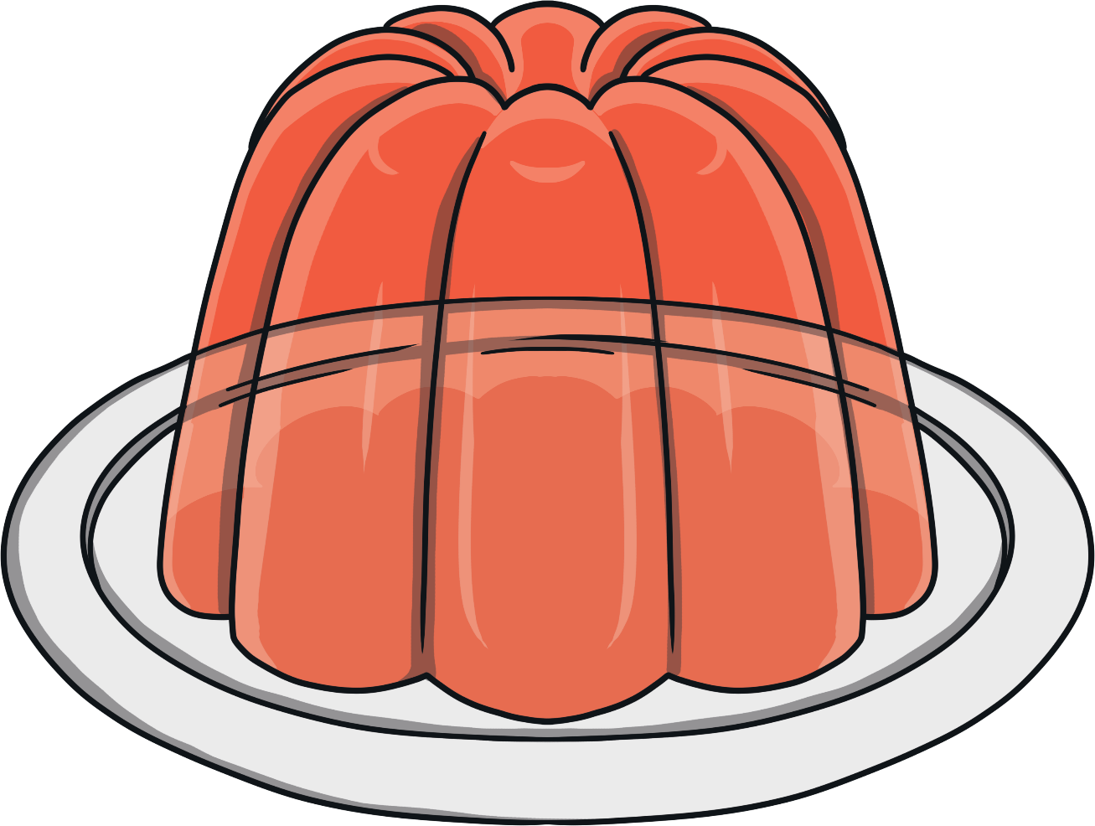
The letter j sounds like this…
j, j, j
Notes:
Say the sound /j/ and have children repeat it back multiple times.

Slide 4
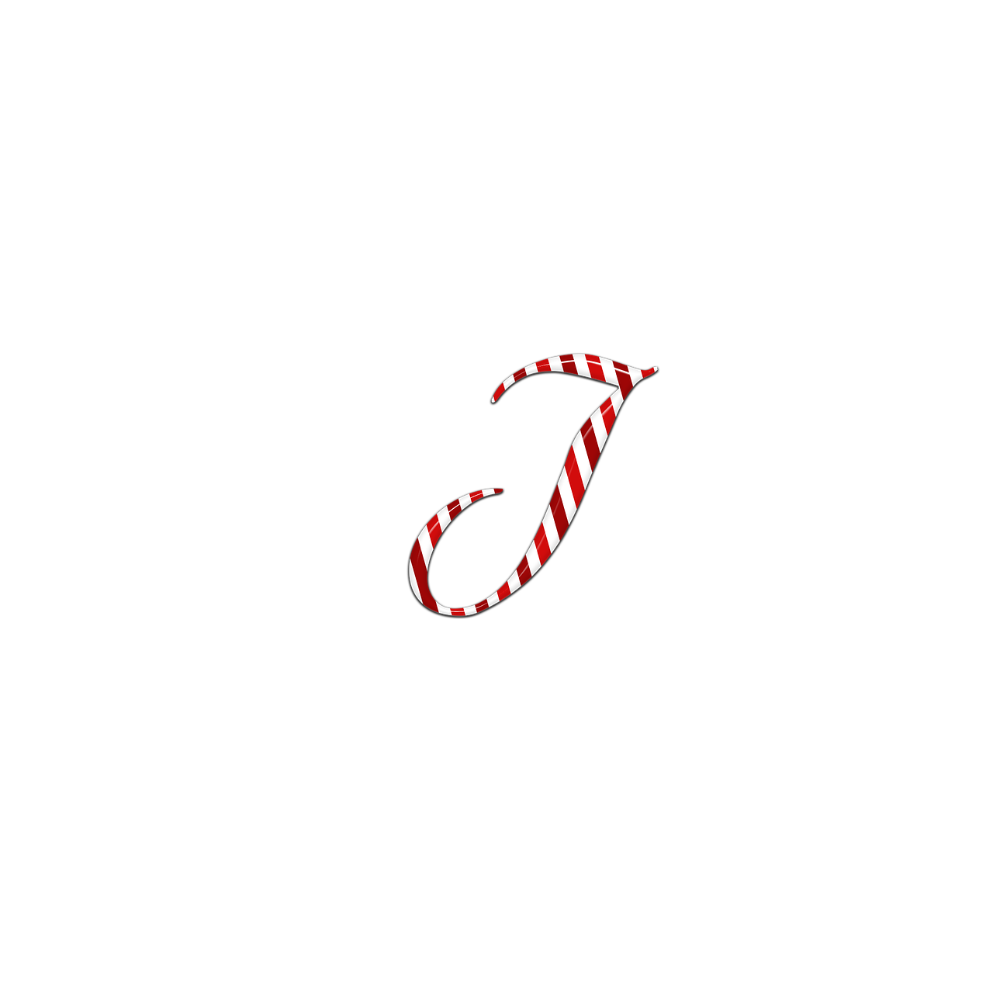
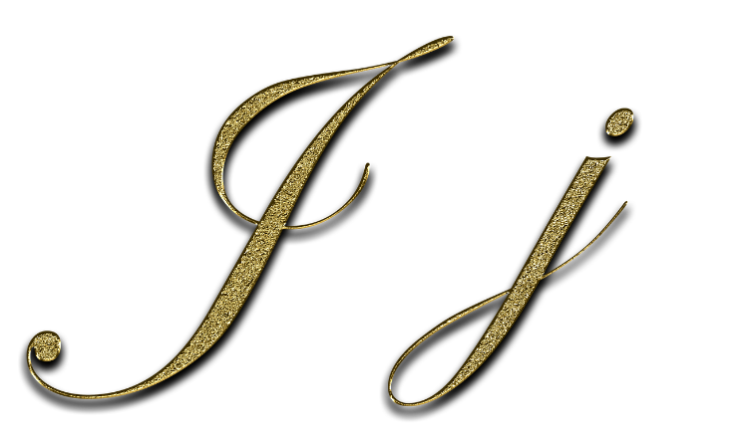
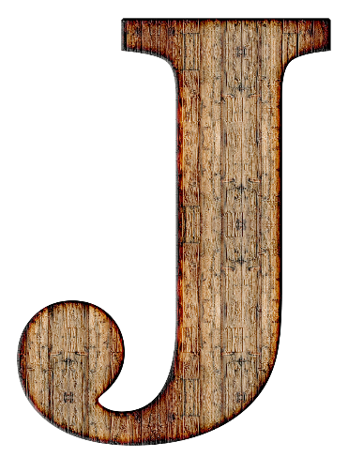
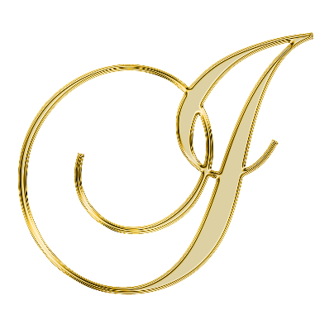
It can also look like this…

Slide 5
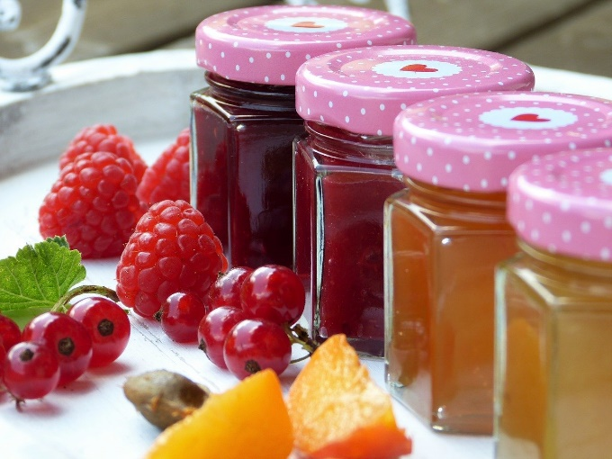
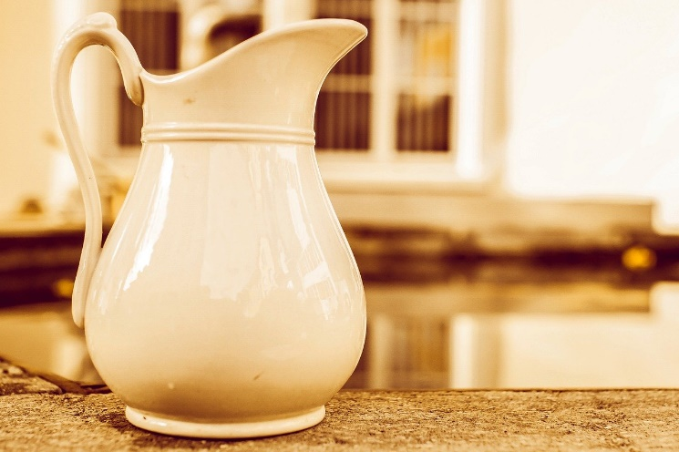
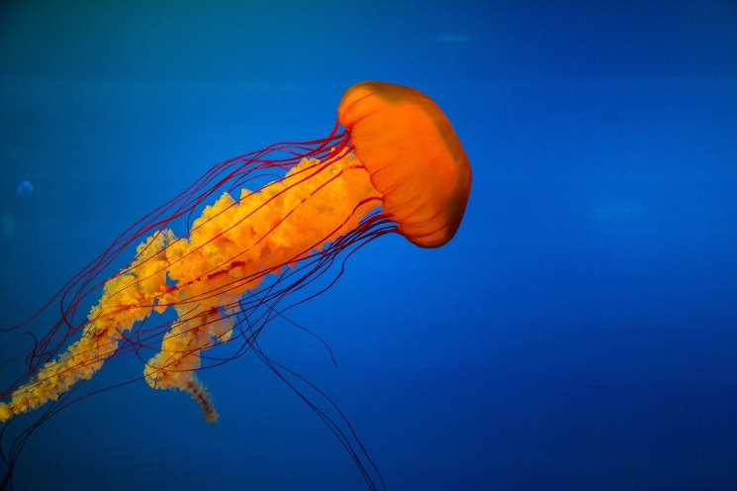
Some things that start with j are…
Notes:
Jam, jellyfish, jug

Slide 6
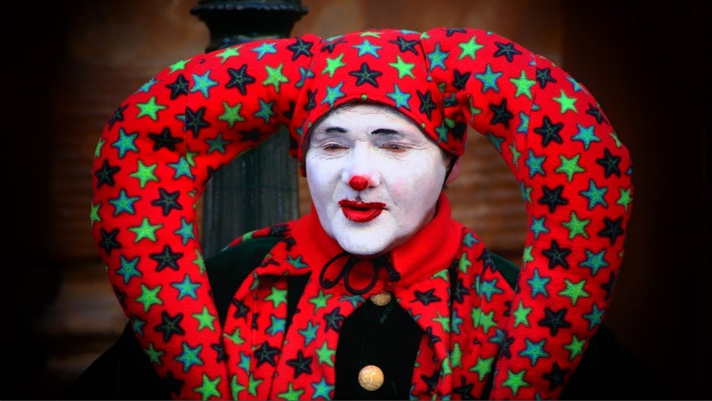
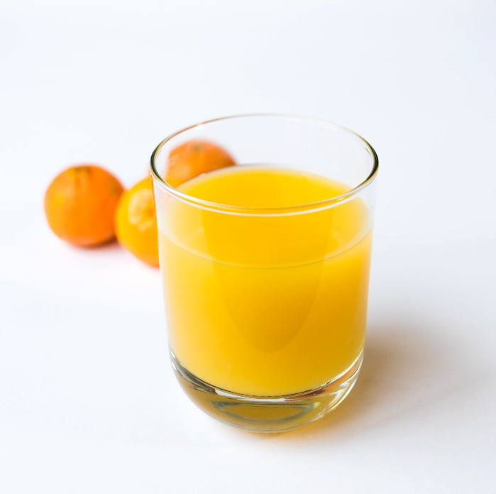
Some things that start with j are…
Notes:
Juice, jacket, joker

Slide 7
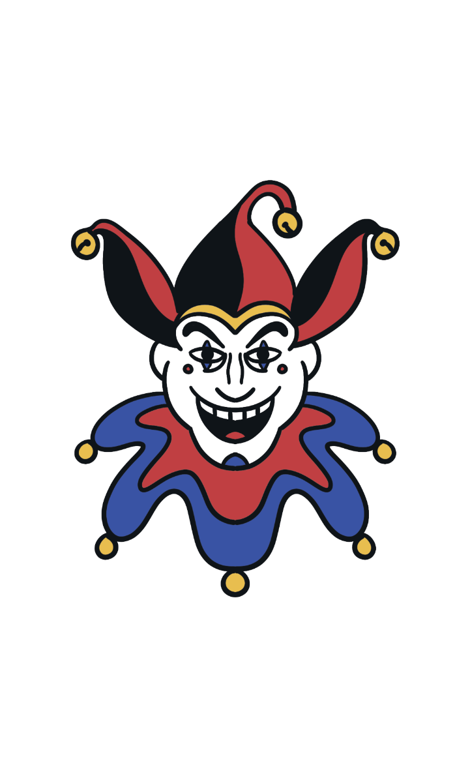
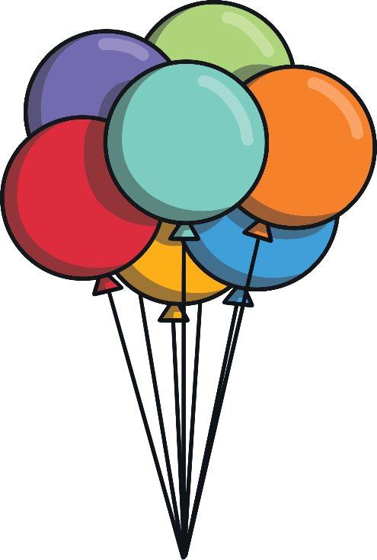
Which of these start with j?
Try Again!
Yes!
Notes:
Pause briefly after the initial sound of each word to assist students to identify the sounds.

Slide 8
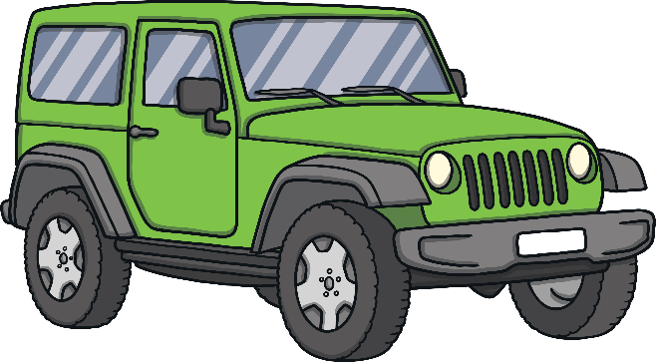
Which of these start with j?
Try Again!
Yes!

Slide 9
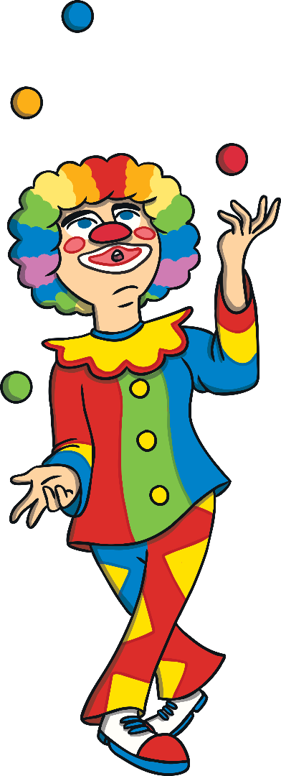
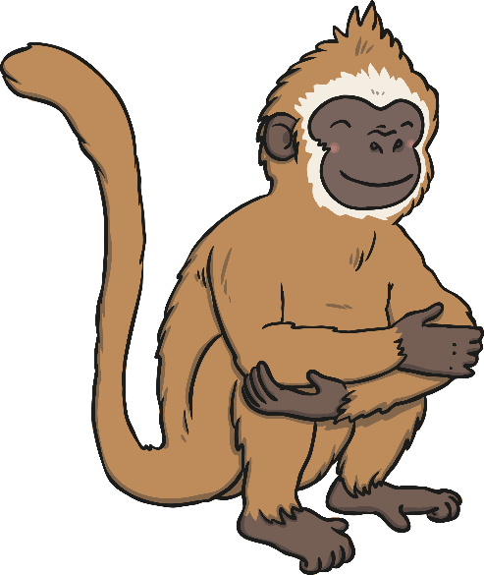
Which of these start with j?
Try Again!
Yes!

Slide 10
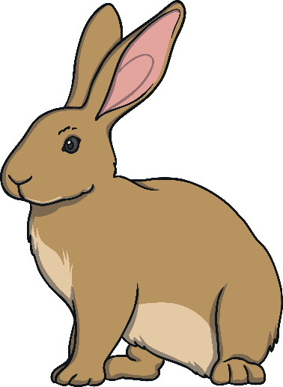
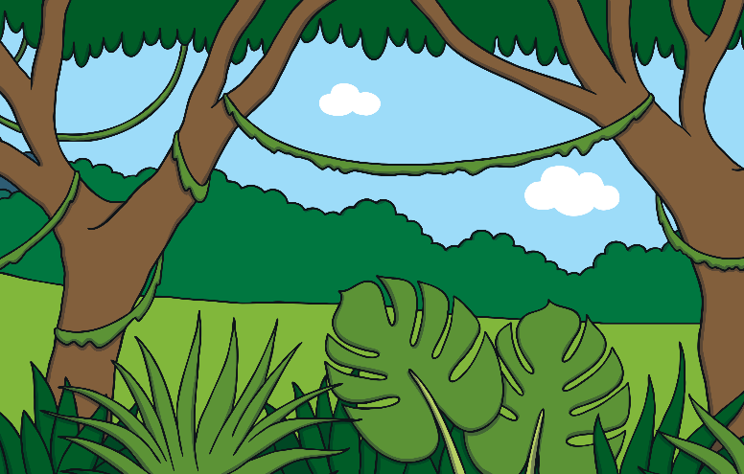
Which of these start with j?
Try Again!
Yes!

