Slide 1
PSHE & RSE
Be blessed by God, be happy and aspire to be…

Slide 2
PSHE at St Matthew’s
As a school, we decided together that PSHE would be at the heart of our whole school curriculum at St Matthew’s. PSHE itself, builds upon many skills, attributes, and values that a child will need throughout their lives to develop into young citizens of today’s on-going changing society.
Our mission statement links very closely to the PSHE education that we dedicate to provide for the children of our school.
St Matthew’s Mission Statement
“St. Matthew’s C.E. primary school is dedicated to providing an education which enables every child to fulfil his/her best potential. It seeks to promote spiritual, academic and emotional growth in a Christian environment welcoming children drawn from diverse cultures.”
As part of our PSHE whole school curriculum, we have looked at how values such as, Spiritual, Moral, Social and Cultural values (SMSC), British Values as well as our Christian Values also immerse into this whole school approach. Our school vision itself supports what we aspire and strive to promote for our children during their journey with us at St Matthew’s and beyond.

Slide 3
Back in 2021, parts of PSHE Education became statutory (just like English, Maths, etc there is a requirement for us to provide this education for children.
We must provide the following to all pupils. The Health Education and Relationships Education aspects of PSHE (personal, social, health and economic) education will be compulsory in all primary schools.
The DfE made it clear that schools should not just ‘teach to the guidance’, but see it as the basic requirement which forms part of broader PSHE education.
What did this mean? What does the statutory guidance cover?
This covers broad areas of particular relevance and concern to children and young people today. It should ensure that every child is guaranteed a PSHE education that covers mental health and wellbeing, physical health (including healthy lifestyles and first aid) and learning about safe, healthy relationships, including understanding consent and negotiating life online.
Although the old curriculum already covered work on health and relationships, the new requirements were about raising and ‘levelling up’ of PSHE standards across all schools.

Slide 4
Definitions
Relationships Education is the programme of work that forms part of the basic curriculum. It covers all types of relationships including online, peer to peer, family and carer relationships. It also covers respect for others and staying safe.
Health Education is a programme of teaching about puberty, physical health and fitness, healthy eating, mental wellbeing, drugs, alcohol and tobacco. Please see the PSHE policy for more information.
Sex Education is a programme of work that covers the biological process of sexual reproduction including human reproduction linked closely to the objectives in the science curriculum (This is the optional part in PSHE that parents have the choice to withdraw)

Slide 5
RSE (Relationships and Sex Education)
The new statutory requirements do not extend to sex education at KS1 and 2 (beyond the biological/reproductive aspects which schools are already required to cover in science)
However, the Department for Education ‘continues to recommend that all primary schools should have a sex education programme tailored to the age and the physical and emotional maturity of the pupils’
Where schools provide sex education at key stages 1 and 2, parents will have the right to withdraw their child from sex education but not from statutory Relationships Education or Health Education
Withdrawals- Parents have the right to withdraw their children from sex education but not health and relationships.
In 2021, we created out RSE policy. This is now currently being reviewed.
Please see our RSE policy on our school website for more information.

Slide 6
In 2020/21, we had a working group that discussed the new statutory requirements. We took information from local
data, pupil voice, staff and governors as well as parents.
Pupil Voice
Parent Voice
Staff and Governor Voice
During the academic year 2023/24, we are going through the process of reviewing our curriculum and policies,
considering views of the above again.

Slide 7
On our PSHE website page, you can find out about what we are learning and when in each year group on our curriculum overview.
As a reminder, we will always add on to our year group curriculum letters what we are doing in each class. This may also tell you when we may be covering certain sensitive topics, which you may wish to speak to your child about prior to this.
All guidance for our PSHE and RSE curriculum has been developed from the Blackburn Diocesan board along with the PSHE association and Lancashire County Council advisors. All resources are quality assured by the PSHE Association.
The guidance categorically states that the religious background of pupils must be taken into account when planning the teaching programme so that topics are appropriately handled. It also states that schools must ensure that they comply with the Equality Act 2010 in which religion and belief are amongst the protected characteristics. Therefore, for church schools there are some clear additional requirements which can be summarised as follows. Schools, at an appropriate time in the curriculum, should:
Schools, at an appropriate time in the curriculum, should:
• Teach what the Church of England teaches on marriage.
Teach that the legal view of marriage is that it represents a formal and legally recognised commitment of two people to each other which is intended to be lifelong.
Teach that there are different views within the Christian church and the Church of England on same sex and heterosexual relationships.
• Allow balanced debate on issues seen as contentious whilst ensuring that all views are respected and that all individuals are valued for who they are.
• Always be in line with the law.

Slide 8
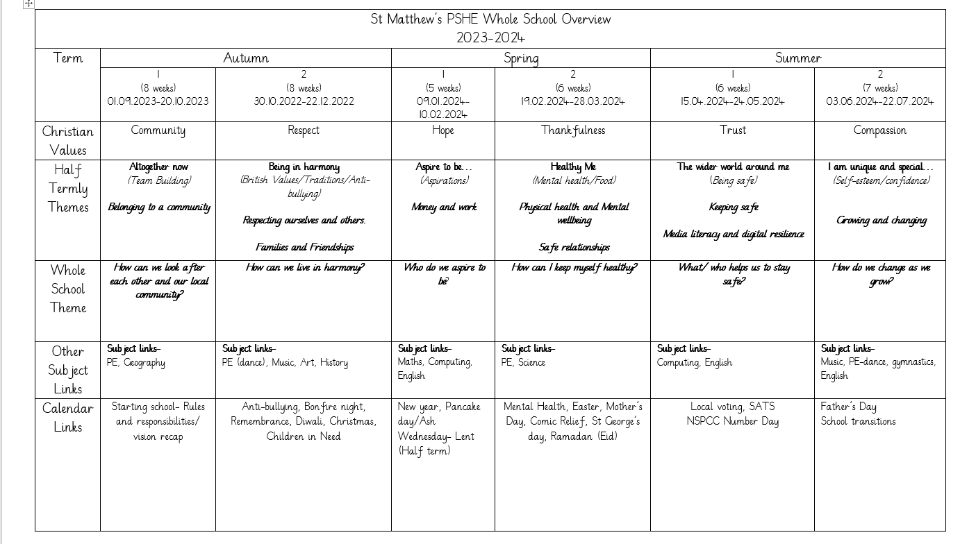
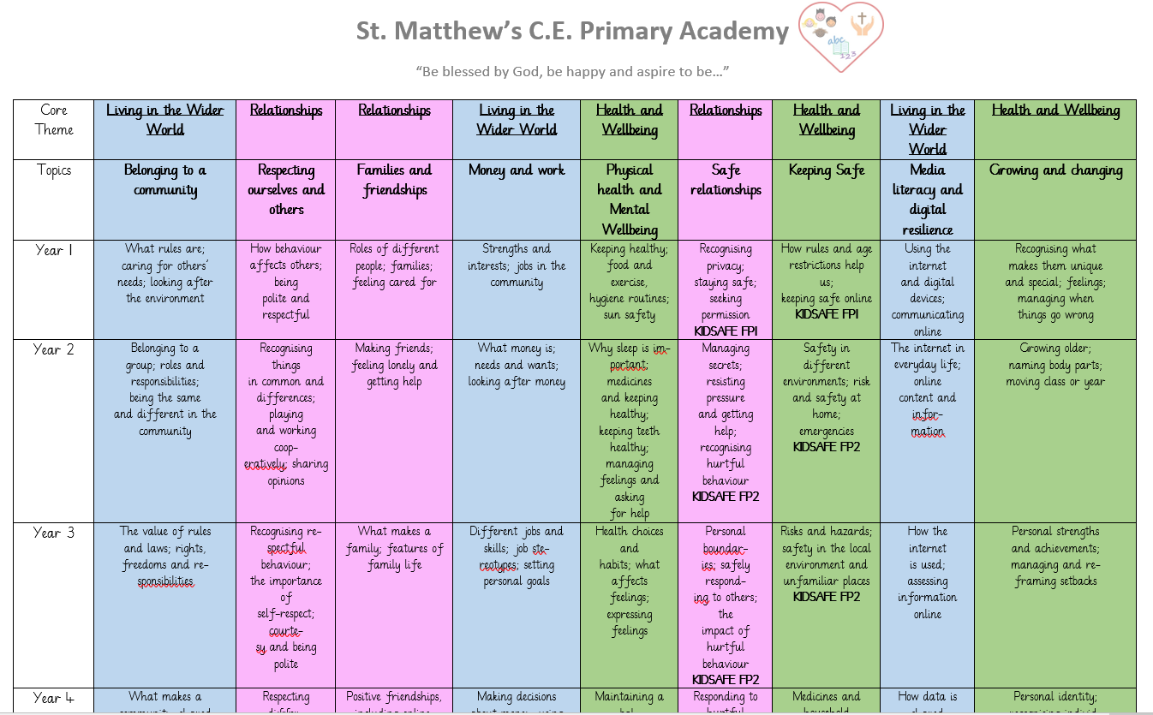
Whole School Overview

Slide 9
Yellow highlighted are
Health Statutory requirements.
Purple highlighted are
Relationships Statutory requirements.
Health Education
The parts highlighted, mean that they are statutory requirements. This means that you
cannot withdraw your child from this learning.
Any Sex Education links have been written in red with explanations of how it will be taught at St Matthew’s.

Slide 10
Yellow highlighted are
Health Statutory requirements.
Purple highlighted are
Relationships Statutory requirements.
Relationships Education
The parts highlighted, again mean that they are statutory requirements. This means that you cannot withdraw your child from this learning.
We always deal with PSHE learning in a safe, sensitive manner protecting all of the protected characteristics.

Slide 11
Yellow highlighted are
Health Statutory requirements.
Purple highlighted are
Relationships Statutory requirements.
Living in the Wider World
Some parts in Living in the Wider World are highlighted. We have chosen most of the objectives in here as we feel that they are what we would
like to ensure that We aspire for all pupils to leave St. Matthew’s as happy, respectful citizens, who are prepared to make a positive
contribution to society.

Slide 12
For more information you can find this in our PSHE and RSE policies on the schools policy page.
Review

