Slide 1
Today’s learning objectives:
To learn about physical and emotional changes during puberty.

Slide 2

Changes Lesson 1

Slide 3
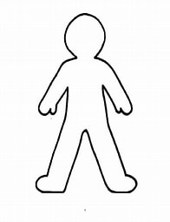
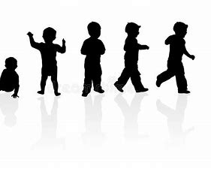
Annotate the body with changes you cannot control and changes you can control….
What changes will happen as you turn into a teenager?

Slide 4
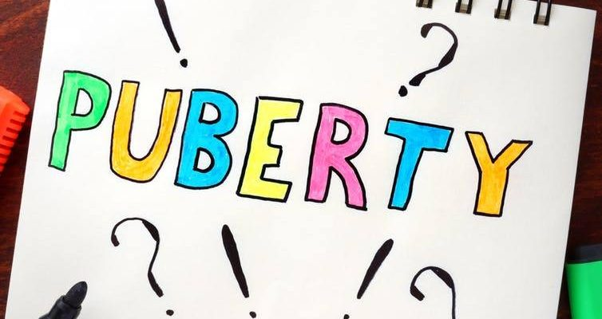
Guess the word: _ _ _ _ _ _ _

Slide 5
What does the word mean?

Slide 6

Group work…
In groups, discuss:
Does everyone start puberty at the same time? Will these changes happen to everyone at the same time? Why are these changes happening?

Slide 7


Slide 8
Puberty
Usually, puberty starts between ages 8 and 13 in girls and ages 9 and 15 in boys. This wide range in ages may help to explain why some young people in the same age group are at different physical stages in their development.

Slide 9
Puberty starts when your body is ready. It’s a bit like when you start to lose your milk teeth—it happens to everyone at different times.

Slide 10
Puberty is a time when someone’s body begins to develop and change as they mature from being a child to an adult. During puberty, your body will grow faster than at any other time in your life—except for when you were a baby. Puberty is caused by sex hormones: chemicals which are released into the bloodstream to send messages to different parts of the body.

Slide 11
Children and adults use lots of different words for parts of the body—some pupils may have special words which they use with their families. Some words are scientifically correct and some are the common, everyday (slang) words.
Some slang words can be confusing, and learning the anatomical words will make sure we all understand each other in these lessons.

Slide 12
Write the correct names on the body parts

Slide 13
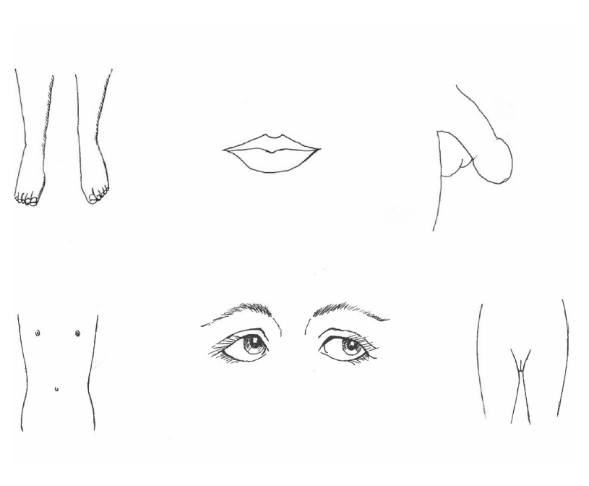

Slide 14
Recap - Penis, testicles, vagina, and vulva, along with the other body parts: mouth, eyes, nipples, feet/legs

Slide 15
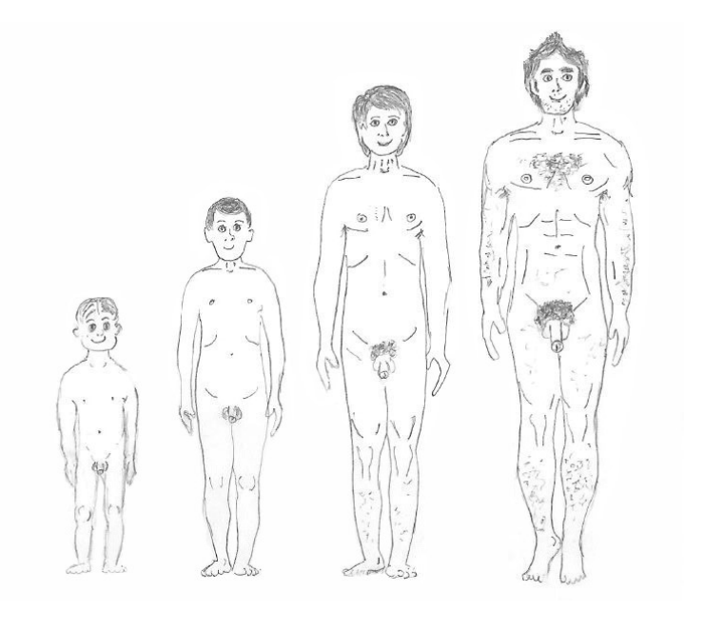
What changes can you see?

Slide 16
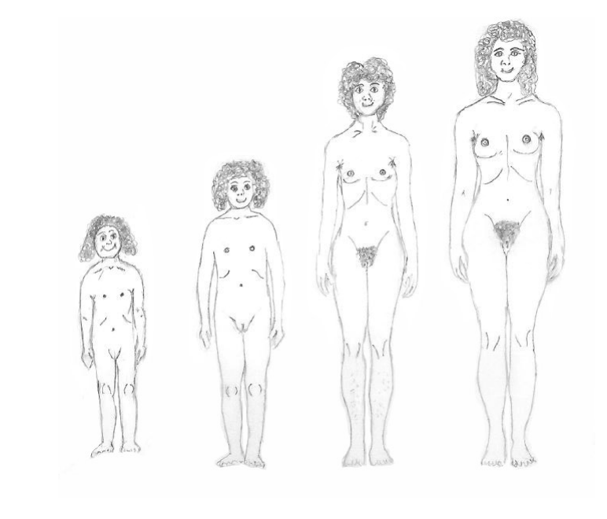
What changes can you see?

Slide 17
What changes can you see?
Males | Females

Slide 18
Summary of changes.
• Females and Males: hair – pubic and body; body producing more oil, leading to greasy hair, spots and sweat; grow taller; larynx (voice box) grows and voice gets deeper.
• Females: breasts – growth and nipples darken; waist and hips change shape
• Males: muscles increase; penis and testicles grow; changes to the larynx or ‘voice box’ leads to the voice ‘breaking’ (going deeper) — as the larynx grows it tends to protrude from the front of the neck — known as the Adam’s Apple.

Slide 19
Any Questions?
Put them in the ask it basket!

Slide 20
Reflection
• I’ve just turned 11 but nothing is happening yet. When will I start puberty? • Why are these changes happening to me? • I feel a bit scared about puberty, is this normal?

