Slide 1
Puberty Session 2
In this session, we are splitting up into girls and boys.
LO: -Key facts about the menstrual cycle and menstrual well being, erections and wet dreams

Slide 2
Kelly’s diary… Last night I was getting ready for bed when I realised I had started my period… What has happened to Kelly? How do they think she is feeling? What do you think Kelly should do now?

Slide 3
Explain that ‘starting periods’ is another change that happens at puberty. This is when females pass blood from the vagina for a few days each month. Explain that the scientific name for periods is menstruation and ask if they know any other names for this, and what they already know or have heard about periods.

Slide 4
You might discuss that people sometimes say that starting periods is when the female body becomes able to have children. (Although it is possible to become pregnant if sex happens in the month before someone’s first period starts). Although starting periods is a sign that the body is preparing for adulthood, there are other aspects of growing up that means their body is not ready yet to have a baby. Now may be a good time to show examples of pads, tampons and reusable period products.

Slide 5
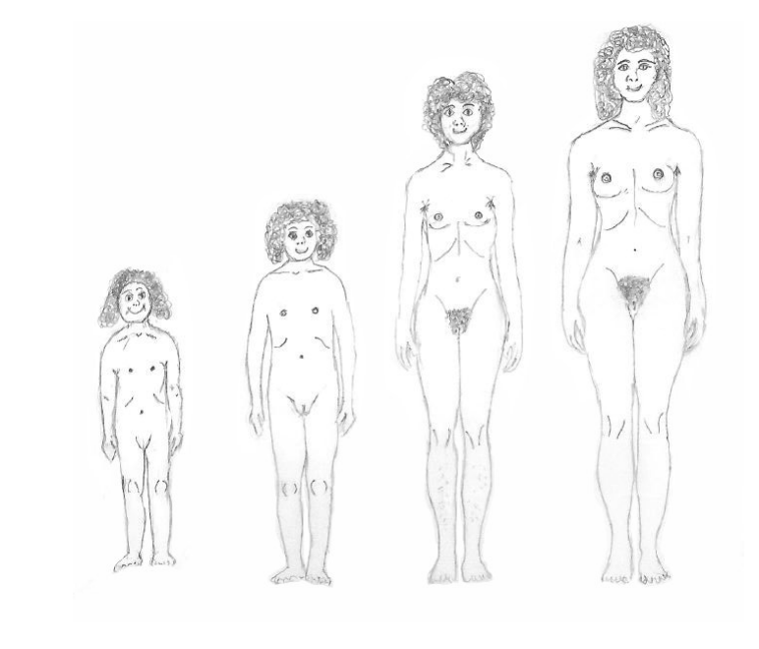
In the previous lesson, pupils labelled a simple image of the front view of the vulva. However, to fully understand female genitalia, the internal reproductive organs and menstruation, it is important that pupils are aware of the external appearance of the female body. Talk about how not all body parts look the same. For example, the vagina can be different sizes or shapes.
It’s easy to see the male sex parts/genitalia but that in females it’s harder as the vulva is between the legs.

Slide 6
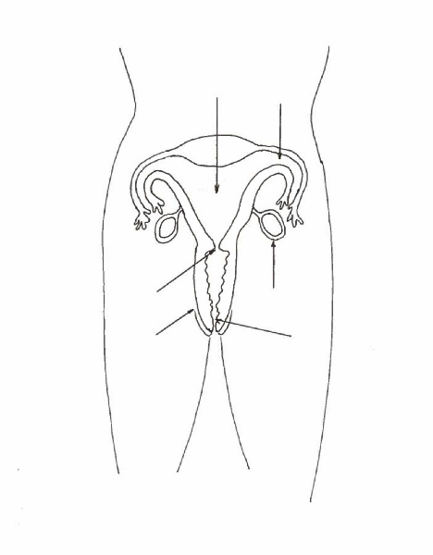
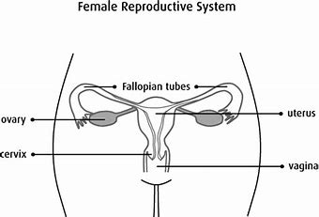
External female genitalia.
Name and label the different parts.

Slide 7
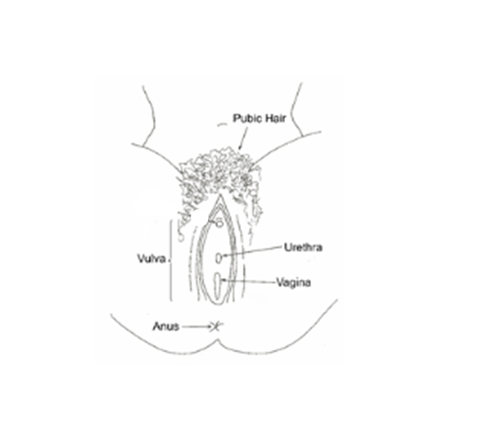

Slide 8
Watch this video:
The Menstrual Cycle - YouTube

Slide 9
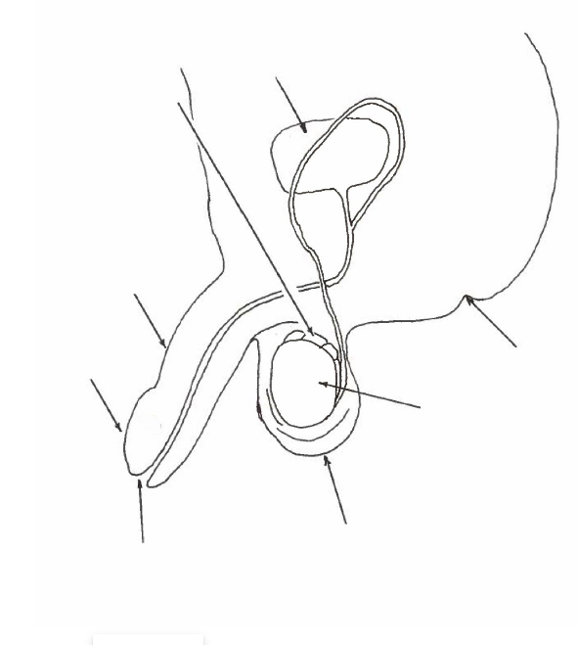
The male reproductive organs.
Label the parts.

Slide 10
You may want to demonstrate the size of the testicles by showing the marbles and the plums, explaining that before puberty, each testicle is about the size of a marble and during puberty it will grow to the size of a plum. Show the following video section from 02.39 ‘What’s up down there?’ to 03.21, that explains about erections and wet dreams. Then play this video from 0.30 to pause point 0.44. Pause the video and ask pupils: Why is Ali trying to hide the semen? What could/should he do? Continue the video and pause at point 1.52. Ask pupils to suggest what Ali’s father could explain to him. How is Ali feeling now? What would they advise someone in the same situation to do?

Slide 11
Show the following video section from 02.39 ‘What’s up down there?’ to 03.21, that explains about erections and wet dreams. Boys and Puberty (for Kids) - Nemours KidsHealth

Slide 12
Watch PSHE for SEN - Wet dreams - KS3 PSHE and Citizenship - BBC Bitesizefrom the beginning to pause point 0.30.
Ask the pupils to explain 1) What has happened to Ali? 2) How is he feeling? 3)What should he do?

Slide 13
Then play this video from 0.30 to pause point 0.44. Pause the video and ask pupils: Why is Ali trying to hide the semen? What could/should he do?
Continue the video and pause at point 1.52. Ask pupils to suggest what Ali’s father could explain to him. How is Ali feeling now? What would they advise someone in the same situation to do?

Slide 14
Give pupils a few minutes to write any questions they have about the previous activities. These should be anonymous and put into the ‘ask-it-basket’. Explain that their questions will be responded to as soon as possible (you will need time to read the questions and consider how best to respond—some will be addressed through a quiz activity in a later lesson.

Slide 15
Any Questions?
Put them in the ask it basket!

