Slide 1
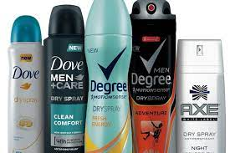
Puberty Lesson 3
The importance of personal hygiene routines during puberty including washing regularly and using deodorant.

Slide 2
Bailey’s mum and dad are explaining to Bailey that it is important to keep the body extra clean when growing up.
“Now that you are getting older Bailey, there are some things you must do to make sure you look after your body well. It is really important, especially when you start puberty.” “Why?” says Bailey
Imagine you are in-role as Bailey’s mum or dad. Write a sentence to explain why this is important and what Bailey should do.

Slide 3
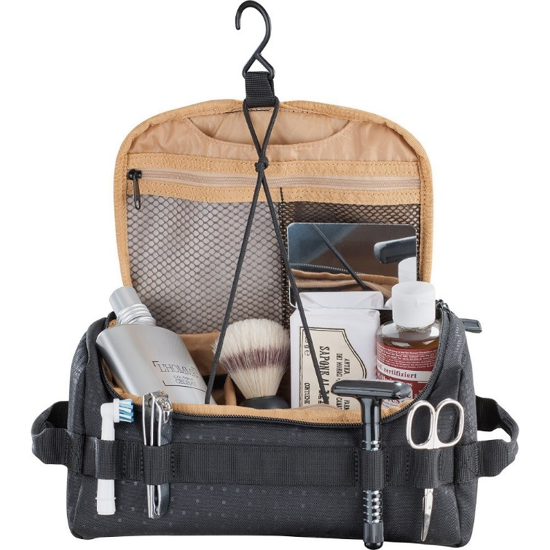
Think back to Bailey’s discussion with his parents and about the kinds of products Bailey might want to buy to prepare for puberty. If you were to make Bailey a wash-bag, what would you choose to include? Work in pairs to write/draw the items for Bailey.

Slide 4

Why is keeping clean especially important for young people who are going through puberty?
Draw a stick person with a face. Label all the different parts of the body that the young person will need to pay special attention to now in terms of their personal hygiene. Write next to each label why they need to pay particular attention to this part, how they should do this and how often.

Slide 5

Discussions…
• Can someone go swimming when they have their period?
• Are periods dirty?
• Are periods painful?
• Do all boys have wet dreams?
• Are erections embarrassing?
Each pair to choose a question and write a response on the paper underneath the question.
Write in full sentences to explain their answers. Then swap questions with another pair who will add an additional response (they may agree or disagree with the original response).

