Slide 1
Year 6 – Lesson 5
Relationships and Sex Education

Slide 2
Discuss
How might a loving adult couple show commitment, care and love for each other?

Slide 3
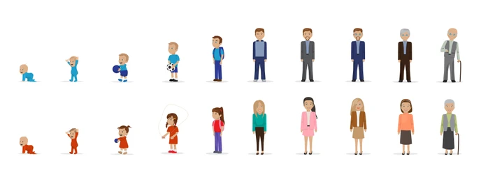
The human life cycle!

Slide 4
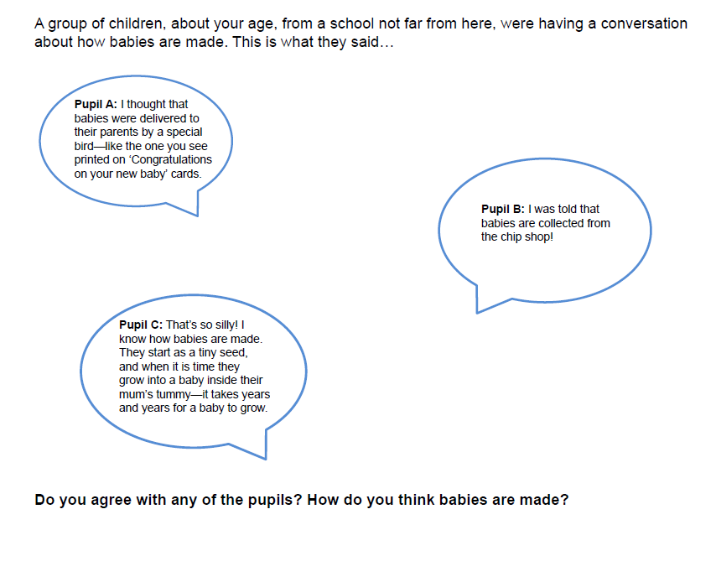
Discussion

Slide 5
What is Sexual Intercourse (Sex)?

Slide 6
What is consent?

Slide 7
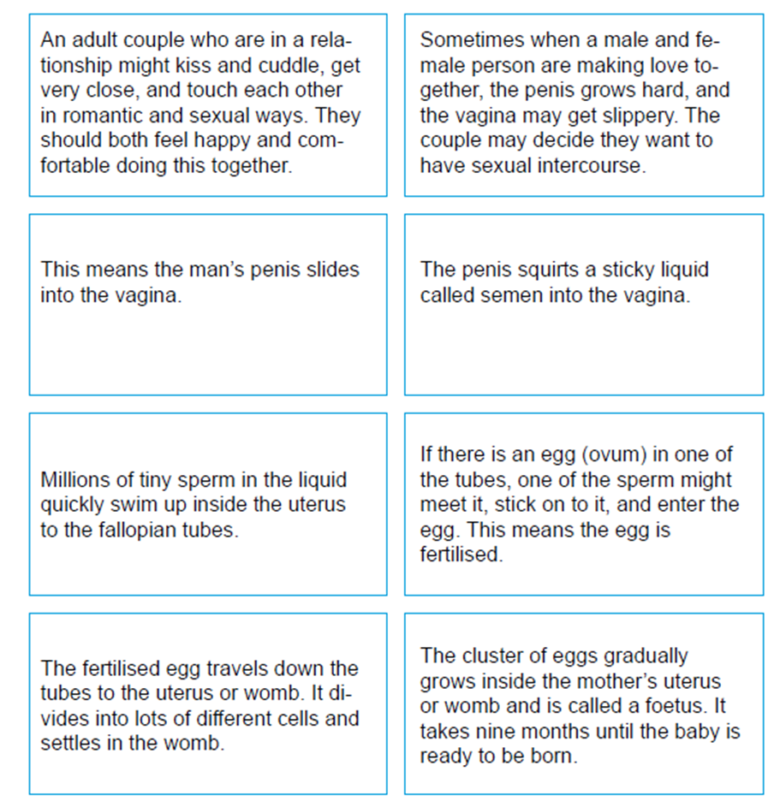
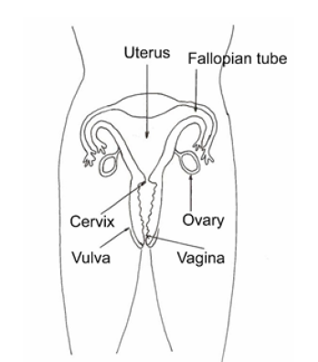
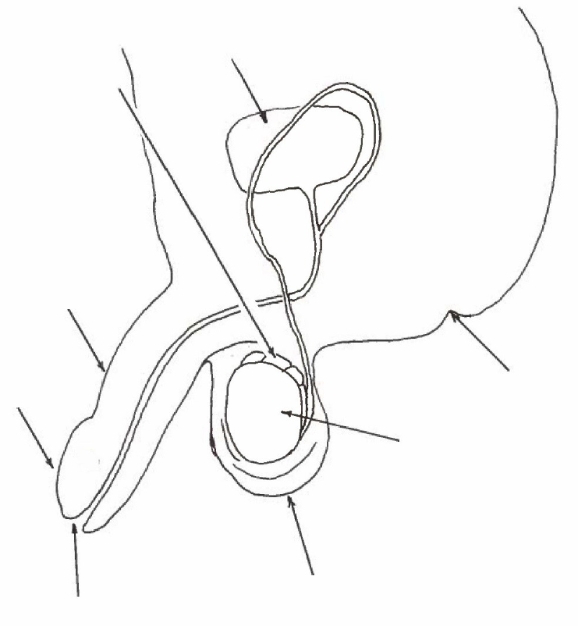
How a baby is made

Slide 14
cells

Slide 15
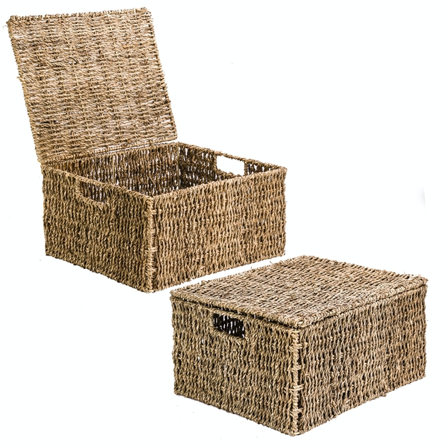
Ask it basket!

