Slide 1
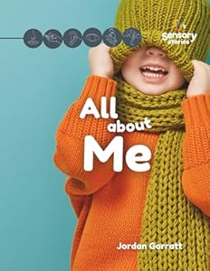
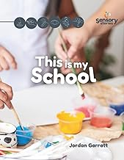

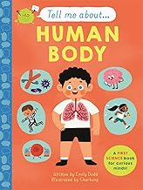

Communication and Language
This term we are spending lots of time getting to know the children, their likes and interests and how they like to communicate. We will spend time improving the children’s ability to listen by using lots of intensive interaction.
Children in Treetops have their own Speech and Language programmes which will be followed.
Treetops uses a total communication approach, including spoken word, signs and visuals.
These are the books we will be reading as part of our Sensory Stories …
MATHS
As part of our maths we use lots of nursery rhymes to engage children and to make them sensory. Our intent is to engage children in a learning time and begin to recognise rhyme, and numbers 1-5.
We also build mathematically language in to interactions and play.
Bucket Therapy
Bucket therapy is an attention-building activity within the Attention Autism framework and is , designed to develop a child's focus and engagement with an adult-led activity.
We have Bucket Therapy daily.
Treetops
Sensory Circuits
We practice Sensory Circuits each day.
A Sensory Circuit is a short, fun, physical routine of 10-15 minutes that uses activities to help a child become alert, organize their senses, and then calm down, preparing them for learning and regulating their attention
Forest School
Children in Treetops have a Forest School Session each week. We follow The Equals Curriculum: My Outdoor School.
Forest School promotes children's holistic development through hands-on, child-led experiences in a natural setting. It builds confidence, self-esteem, social skills, and a connection to nature through regular, learner-inspired activities.
Curriculum Overview Autumn 1 – All About me!
Personal, Social and Emotional Development
In our ‘All about me!’ theme, children are developing their ability to see themselves as special, unique and a valuable member of our community. We teach children how to build constructive and positive relationships with children in class and with adults. We are developing a sense of awareness.
Curriculum Information
In Treetops, the children have a range of different needs and have unique ways of learning. Different learning needs require different teaching approaches, which often change over time.
We adopt a blended approach of an informal, semi-formal and formal curriculum.
Music Therapy
Children in Treetops will have access to our Music Therapy weekly with our external partner Donna Morgan.
Music Therapy is intended to promote relationships, connection and communications. Reports will be sent home for Parents & Carers.

