Slide 1
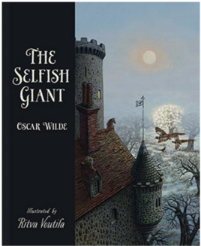

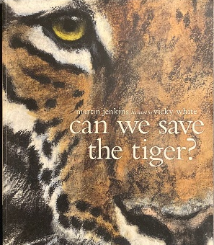

.
Place value and addition, subtraction, multiplication and division.
The children will be exploring numbers up to 1,000,000 and will use the formal column method to add and subtract numbers. They will also practice mental strategies with both large and small numbers, using their understanding of place value.
ENGLISH
Children will continue to learn the features of a non – fiction text through learning about the book ‘How to save a tiger’ and will be creating an information leaflet as their final piece. After this children will be writing a retelling of a narrative of Oscar Wilde’s classic, ‘The Selfish Giant’.
READING
In our Reading lessons we will be reading ‘The Place for Me’ by K. N. Chimbiri, Dame Floella Benjamin et al., the children will be drawing inferences (inferring characters’ feelings, thoughts and motives from their actions) and justifying with evidence the influence of the Windrush generation.
Here are some of the books we will be reading this half-term:
MATHS
SCIENCE
Living things and their habitats
The children will explore the requirements of life and the differences between living and non-living things. They will group animals and plants based on their features, such as vertebrates and non – vertebrates.
Year 6
HISTORY
What was the impact of WW2 on the people of Britain?
The children will learning to identify the causes of World War II and identifying the different phases in the Battle of Britain. They will describe how children may have felt when evacuated and evaluate the accuracy, reliability and usefulness of sources.
ART & DESIGN
Painting and Mixed Media: Artist Study
This unit focuses on understanding narratives and descriptive languages in art, exploring meanings behind paintings, and developing personal interpretations. The artist they will be studying is David Hockney.
Curriculum Overview
Autumn Half Term 2
FRENCH
The children will be learning how to describe people and places, discussing daily routines and shopping, using present and future tenses.
PHYSICAL EDUCATION
ABC
The children will carry out activities focusing on Agility, Balance and Co-ordination. They will undertake activities that require precise movement, like controlling a ball with their feet or hands.
PSHE
Emotions and how to manage them
Children will be learning about prejudice and stereotype and the effects it could have in the wider world. They will be learning about aspirations and how to aspire to be the best they can be. They will also be learning about pride and respect.
COMPUTING
Computer Science
The children will explore how people can use computing and technology to make their surroundings more responsive to the needs of the community. They will begin by exploring computing concepts such as loops, variables, sensing and conditional statements to program simulations of responsive systems,
MUSIC
Songs of World War II
The children will be using musical and comparative language in discussion and follow the scores with a good sense of timing, showing that they understand which section of pitch they are using.
RELIGIOUS EDUCATION
Life as a journey
Children will given the opportunity to think about the idea that life is a journey and what it means to make that journey as a Christian. They will begin to understand the concept of taking a religious pilgrimage.

