Slide 1
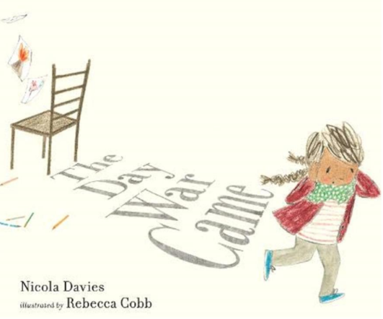
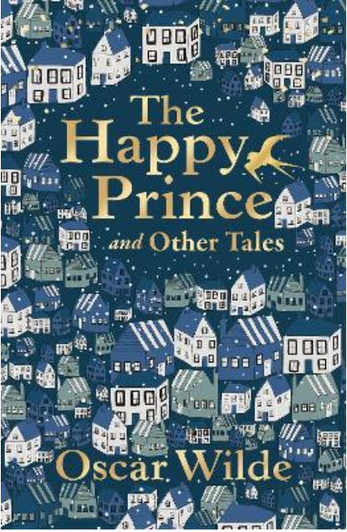

ENGLISH
This half term in English, Year 6 will be reading The Day War Came and exploring its themes. They will use this inspiring story to write a persuasive letter and an emotive diary, whilst, developing their creativity and writing skills along the way.
READING
This half term in Reading, Year 6 will be studying The Happy Prince by Oscar Wilde, with a focus on developing fluency, retrieval, explanation, and summarising skills.
MATHS
Ratio, Algebra and Decimals
This half term in Maths, Year 6 will continue following the White Rose Maths Spring term scheme. They will focus on ratio, algebra and decimals, developing fluency, reasoning, and problem-solving skills throughout.
Here are some of the books we will be reading this half-term:
SCIENCE
Light
This half term in Science, Year 6 will be studying light following the White Rose Maths Year 6 scheme. Through six small steps, pupils will learn about light - how it travels and how it allows us to see.
Year 6
History
What can the census tell us about local areas?
This half term in History, Year 6 will be learning about what a census is and what we can learn from them. Children will focus about census’ from our local area.
Art
Expressing Ideas
This half term in Art, Year 6 will express their feelings about a subject of their choosing. Using street art, children will be learning about one point perspective and enlargement. Children will create a small piece of art before enlarging it.
Curriculum Overview
Spring Half Term 1
FRENCH
The children will …
PHYSICAL EDUCATION
Dance
This half term in PE, Year 6 will be creating a dance to the music of Thriller by Michael Jackson.
PSHE
Safety and the Changing Body
Year 6 will learn about staying safe and healthy, including understanding the risks of alcohol, being responsible online, and managing relationships. They will also study puberty and reproduction and develop essential first aid skills, such as responding to choking and emergencies.
COMPUTING
Smart Communities
This half term in Computing, Year 6 will explore how technology can be used to make their surroundings more responsive to the needs of their community. Pupils will learn about loops, variables, sensors, and conditional statements to program simulations, before using a user-centred design process to plan and prototype improvements for their school
MUSIC
Theme and Variations: Film Music
This half term in Music, Year 6 will explore the concept of film music. Children will work towards composing their own film score.
RELIGIOUS EDUCATION
What difference does the resurrection make to Christians?
This half term in RE, Year 6 will explore the ‘big story’ of the Bible, focusing on the life, death, and resurrection of Jesus Christ. Pupils will study Luke 24 and learn how ideas of sacrifice, forgiveness, and eternal life are reflected in Christian worship and practice.

