Slide 1
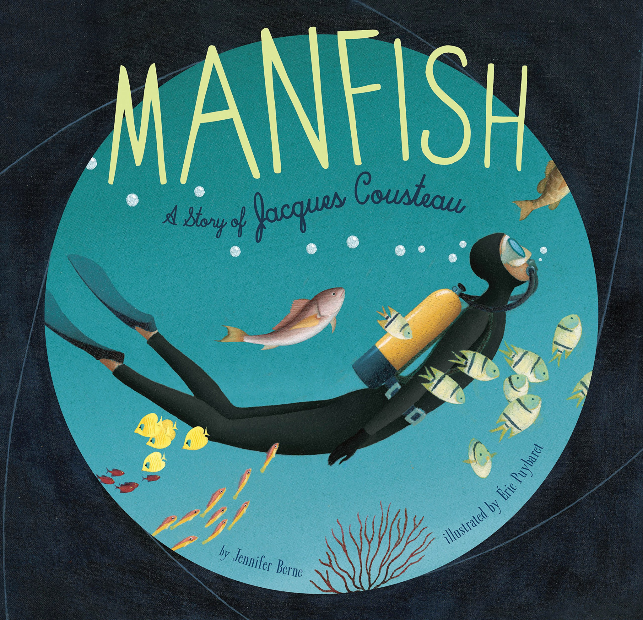


ENGLISH
This half term in English, Year 6 will be reading Manfish: A Story of Jacques Cousteau and exploring its themes and characters. They will use this inspiring story to write a range of texts, including a persuasive letter, a comic strip, a biography, and a narrative, developing their creativity and writing skills along the way.
READING
This half term in Reading, Year 6 will be studying Great Adventurers by Alastair Humphreys, with a focus on developing fluency, retrieval, explanation, and summarising skills. They will also complete standalone reading comprehension activities, with a strong emphasis on SATs-style practice to build confidence and exam readiness.
MATHS
FDP, Perimeter, Area, Volume, Statistics
This half term in Maths, Year 6 will continue following the White Rose Maths Spring term scheme. They will focus on fractions, decimals and percentages, before moving on to perimeter, area and volume, and finishing with statistics, developing fluency, reasoning, and problem-solving skills throughout.
Here are some of the books we will be reading this half-term:
SCIENCE
The CIrculatory System
This half term in Science, Year 6 will be studying the circulatory system following the White Rose Maths Year 6 scheme. Through six small steps, pupils will learn about the heart, blood vessels, and blood, how oxygen and nutrients are transported around the body, the effects of lifestyle choices on health, and will take part in a practical heart dissection to deepen their understanding through hands-on investigation.
Year 6
GEOGRAPHY
Where does our energy come from?
This half term in Geography, Year 6 will be learning about the importance of energy and exploring different renewable and non-renewable sources. They will investigate how energy is generated in the United States and the United Kingdom, evaluate the best ways to produce energy, and apply their knowledge by collecting and presenting data to decide the best place for a solar panel on the school grounds.
DESIGN & TECHNOLOGY
Structures: Playground Pioneers
This half term in DT, Year 6 will take part in a playground design challenge, generating ideas and considering real-life constraints. They will create digital designs using Autodesk Tinkercad, build and finish scale prototypes, and evaluate their structures to improve both function and appearance.
Curriculum Overview
Spring Half Term 2
FRENCH
The children will be learning how to describe animals and habitats, They will also be able to tell the time on the hour and half hour, and will be able to ask and answer simple questions.
PHYSICAL EDUCATION
Netball 6H and Cricket 6E
This half term in PE, 6E will be taking part in cricket lessons delivered by Lancashire Cricket Club. 6H will be developing their skills in netball, focusing on passing, shooting, movement, and teamwork. They will take part in small-sided games and competitive activities to build confidence, improve fitness, and apply tactics in match situations.
PSHE
Safety and the Changing Body
Year 6 will learn about staying safe and healthy, including understanding the risks of alcohol, being responsible online, and managing relationships. They will also study puberty and reproduction and develop essential first aid skills, such as responding to choking and emergencies.
COMPUTING
Smart Communities
This half term in Computing, Year 6 will explore how technology can be used to make their surroundings more responsive to the needs of their community. Pupils will learn about loops, variables, sensors, and conditional statements to program simulations, before using a user-centred design process to plan and prototype improvements for their schooll
MUSIC
Theme and Variations: Pop Art
This half term in Music, Year 6 will explore the concept of theme and variations through Pop Art and classical music, They will learn to perform complex rhythms, practise patterns and use music notation to create visual representations of rhythm,
RELIGIOUS EDUCATION
What difference does the resurrection make to Christians?
This half term in RE, Year 6 will explore the ‘big story’ of the Bible, focusing on the life, death, and resurrection of Jesus Christ. Pupils will study Luke 24 and learn how ideas of sacrifice, forgiveness, and eternal life are reflected in Christian worship and practice.

