Slide 1
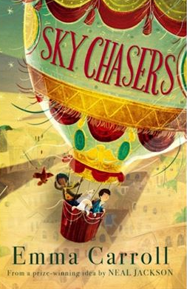

ENGLISH
This half term in English, Year 6 will be reading Skychasers by Emma Carroll. They will use this novel to write a range of texts, including a letter, diary entry and a chapter from different viewpoints.
READING
This half term in Reading, Year 6 will be studying Skychasers but Emma Carroll with a focus on developing fluency, retrieval, explanation, and summarising skills. They will also complete standalone reading comprehension activities, with a strong emphasis on SATs-style practice to build confidence and exam readiness.
MATHS
SATS Revision
Problem Solving: Themed projects
This half term in Maths prior to the SATs taking place, Year 6 will be revisiting the key concepts on the KS2 SATs Mathematics papers. Post SATs, they will be getting secondary ready by taking part in themed projects.
Here are some of the books we will be reading this half-term:
SCIENCE
The CIrculatory System
This half term in Science, we will continue to study the circulatory system.
Diet, drugs and lifestyles
We will explore the impacts of diet, drugs and lifestyle on overall body health and identify how diet can have positive or negative effects on the heart.
Year 6
GEOGRAPHY
Where does our energy come from?
Year 6 will be continuing to learn about the importance of energy. They will investigate how energy is generated in the United States and the United Kingdom, evaluate the best ways to produce energy, and apply their knowledge by collecting and presenting data.
PSHE
Citizenship
Y6 will learn that education is a human right; understand environmental issues relating to food production; understand the importance of caring for others; what prejudice and discrimination are; the value of diversity in society; and the roles and responsibilities of people in government.
Curriculum Overview
Summer Half Term 1
FRENCH
The children will be learning the names of animals, how to pay compliments and agreeable adjectives.
PHYSICAL EDUCATION
Athletics 6H and Netball 6E
This half term in PE, 6H will be developing their skills in athletics. 6E will be developing their skills in netball, focusing on passing, shooting, movement, and teamwork. They will take part in small-sided games and competitive activities to build confidence, improve fitness, and apply tactics in match situations.
RELIGIOUS EDUCATION
For Christians, what kind of king was Jesus?
Year 6 will pupils will find out about parables from the Bible and learn that most Christians believe that Jesus told some parables to share what the Kingdom of God is like and to invite people to join God’s kingdom by letting God rule in their hearts.
COMPUTING
Information Technology
This half term in Computing, Year 6 will learning how the computer networks, such as the internet, work. They will be asked to analyze data and present this data using a range of different programs.
MUSIC
Baroque
This half term in Music, Year 6 will define some key features of Baroque music, including recitative, canon, ground bass and fugue; take part in a vocal improvisation task based on Baroque recitative; and play several parts of a canon using staff notation, with or without letter names.

