Slide 1
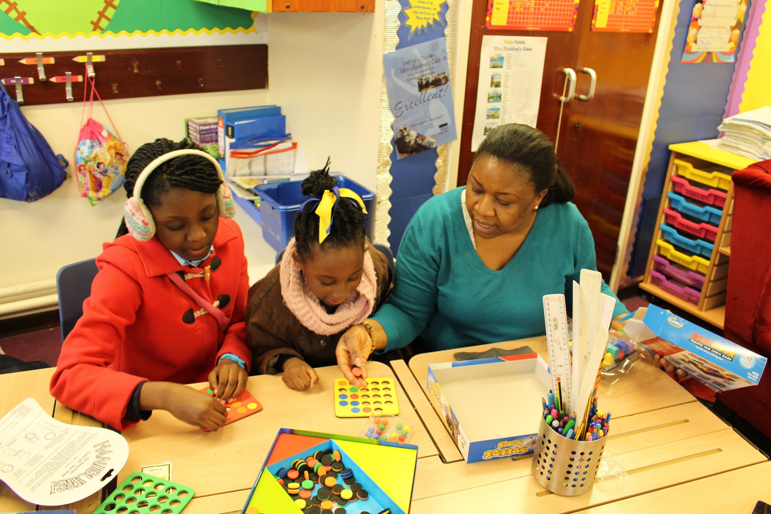
Help your child love maths!
St Matthew’s CE Primary School – Thursday 18th January 2024 - 9-10 am
nationalnumeracy.org.uk

Slide 2
How do you feel about maths?
nationalnumeracy.org.uk
Notes:
www.youtube.com/watch?v=pKdA0LCNg2s

Slide 3
What do other people say?
nationalnumeracy.org.uk

Slide 4
National Numeracy’s top tips for supporting children
Point out maths in the real world
Be positive about
maths
Praise effort rather than talent
Improve
your own confidence
nationalnumeracy.org.uk

Slide 5
Point out maths in the real world
nationalnumeracy.org.uk
nationalnumeracy.org.uk

Slide 6
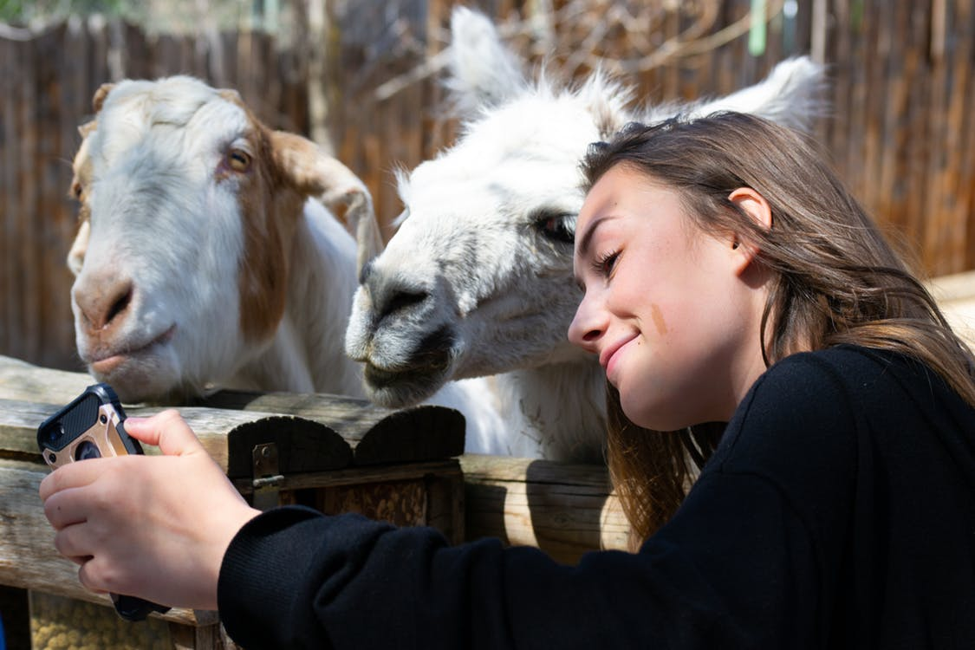
Point out maths in the real world
Consider a scenario from daily life
How are numbers involved?
What opportunities are there to point out numbers to your children?

Slide 7
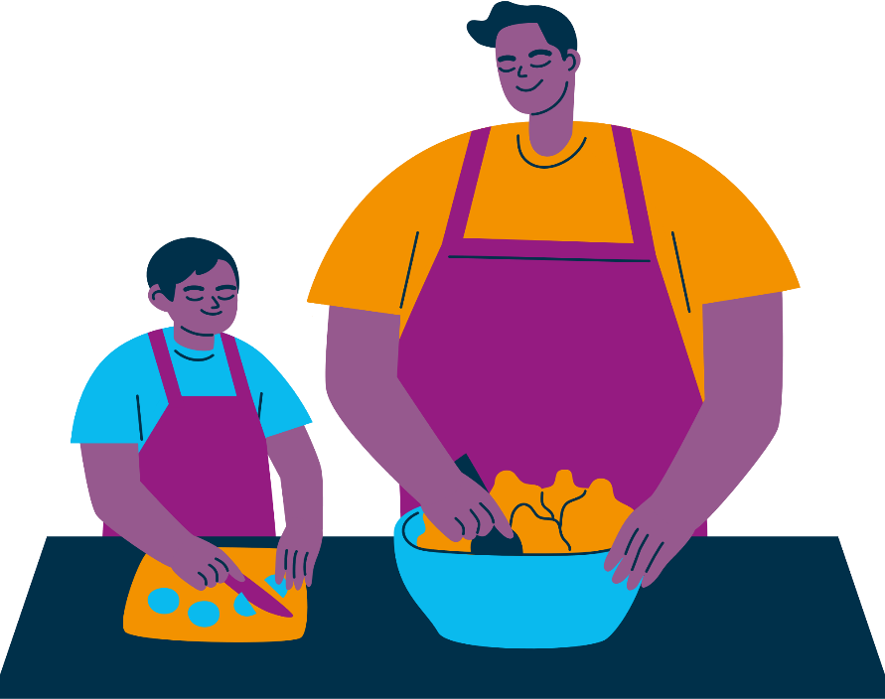
Point out maths in the real world
Planning journeys
Shopping
Cooking
D.I.Y.
Reading the news
Making financial decisions
nationalnumeracy.org.uk

Slide 8
Talking positively about maths
nationalnumeracy.org.uk
nationalnumeracy.org.uk

Slide 9
Here are some things people sometimes say to children about maths.
Have you heard these things being said?
Why might these be unhelpful to say to children?
What could be said instead to encourage positive attitudes in children?
?
?
nationalnumeracy.org.uk

Slide 10
“I was never any good at maths at school and it did me no harm.”

Slide 11
“You won’t need to worry about maths once you’ve finished school.”
nationalnumeracy.org.uk

Slide 12
“It’s ok. You can’t be good at everything. You’re better at literacy. Your brother is more of a maths person.”

Slide 13
“Well done for getting that right. You’re so clever.”
nationalnumeracy.org.uk

Slide 14
Praise effort rather than talent
nationalnumeracy.org.uk

Slide 15
Praise effort rather than talent
Praising Talent
Praising Effort
“Well done for working so hard at that.”
“You’ve learned so much, well done.”
“It’s great that you kept going even when it was tricky.”
“Well done, you’re so clever.”
“You’re naturally really good at this.”
“It’s amazing that maths is so easy for you.”
nationalnumeracy.org.uk

Slide 16
Growth Mindset
Fixed Mindset
Growth Mindset
Talent is something you’re born with
Some people just can’t do certain things
There is no point in trying to improve if you aren’t born with an ability
Ability is not fixed
You can learn and improve at anything if you put enough time and effort into it
If you put your mind to it, you will be able to improve; ability isn’t something you’re born with
nationalnumeracy.org.uk

Slide 17
Improve your own confidence
nationalnumeracy.org.uk

Slide 18
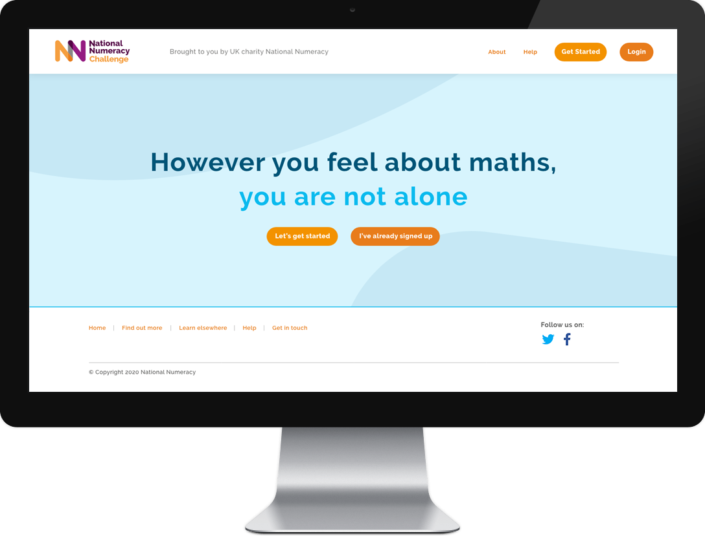
The National Numeracy Challenge
Focuses on everyday maths
Includes multiple choice questions with an option for ‘I don’t know’
Has no time limits
Takes up to an hour to complete
Allows learners to log
in and out at any time and save their progress
Adapts to the learner’s level
Praising Talent
nationalnumeracy.org.uk

Slide 19
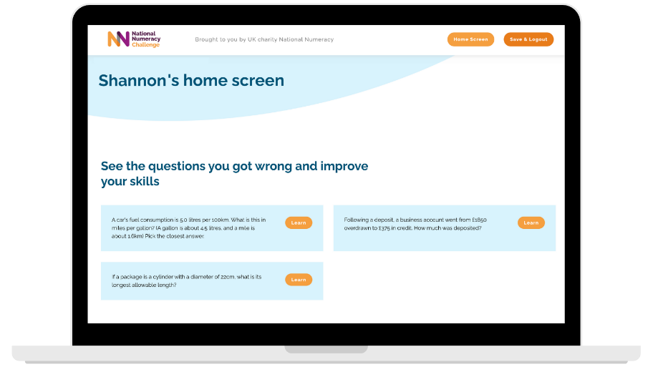
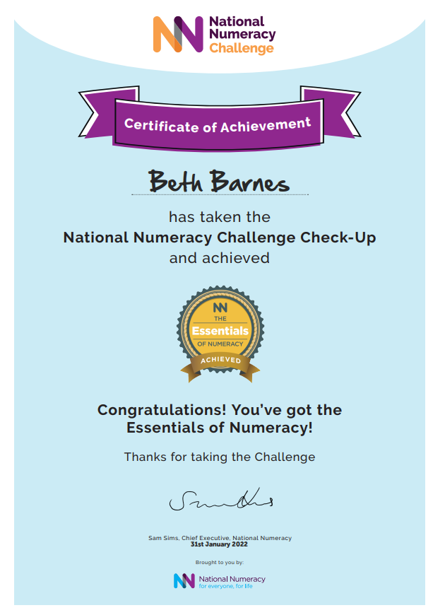
The National Numeracy Challenge
Linked to the questions the learner got wrong
Selected at the right level
Provides choice for learners
Available on mobile
Can be worked through independently
Designed for those with even the lowest confidence
nationalnumeracy.org.uk

Slide 20
The National Numeracy Challenge
Notes:
https://www.youtube.com/watch?v=XZuert73Le0

Slide 21
Family Maths Toolkit
Over 200 ‘everyday maths’ activities for children and their families to do together
Reception and Years 1 – 6
Weekly maths challenge to complete outside of school with the family
Activities are linked to objects around the home, school calendar and cultural events
Aligned to the 2014 National Curriculum

Slide 22
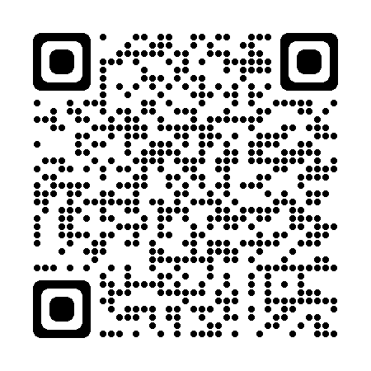
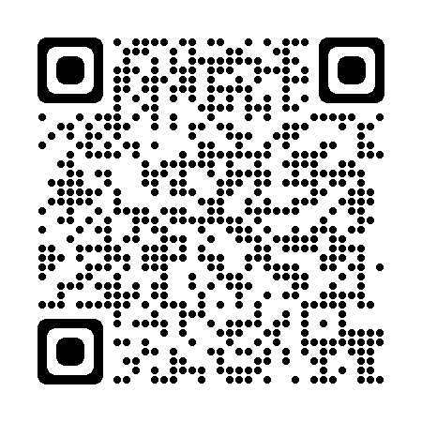
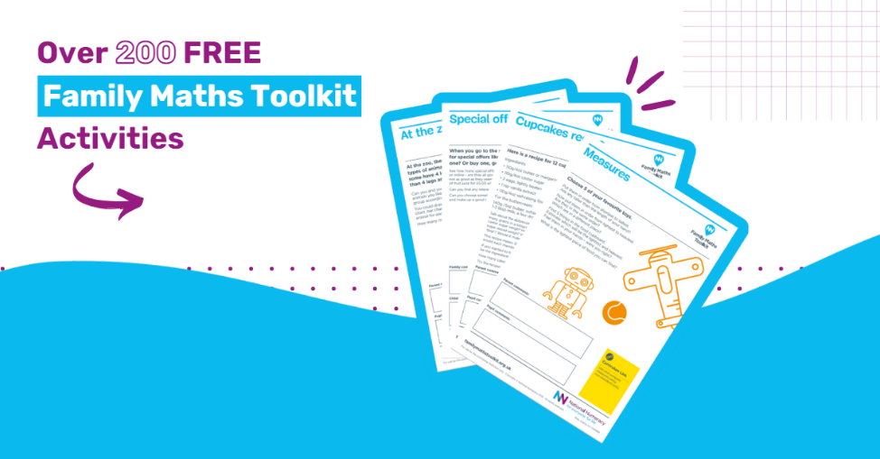
www.nationalnumeracy.org.uk/challenge/smcepsaq
Technical Support: support@nnchallenge.org.uk
https://www.nationalnumeracy.org.uk/free-family-maths-toolkit

Slide 23
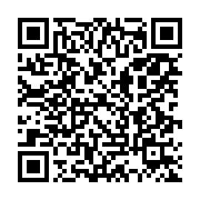
Thank you!
Any questions?
iain@nationalnumeracy.org.uk
Please complete the feedback form
nationalnumeracy.org.uk

