Slide 1

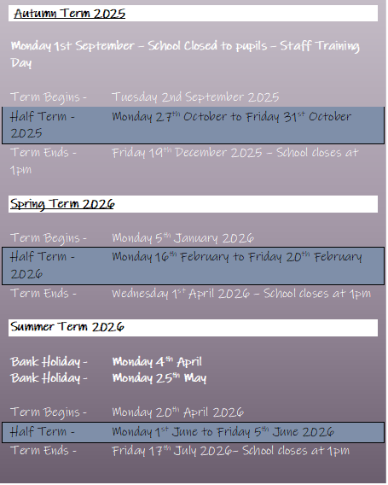

Newsletter
March 2026
www.st-matthews.bolton.sch.uk
We are an Operation Encompass School, which means that we receive reports from the police when there has been an incident in a home where a child lives.
MESSAGE FROM THE
HEADTEACHER
As we come to the end of the Spring term, we have lots to celebrate and share at St. Matthew's. This morning in our worship, we finished with a whole school Easter Egg raffle, which raised lots of money for our school. Thank you to our families for supporting this event and also for your kind donations to the, 'Just one thing' project with Urban Outreach.
Well done to our Dojo winners, who went out on their celebration trip with Miss. Worthington this week -keep up the great work!
Many of our classes have taken part in a wide range of activities this term to support their learning in class. Reception visited The Hive at Moss Bank Park to find out more about mini-beasts and their habitats, Year 5 visited Sharples to find out more about Astronomy, and Year 6 took part in a heart dissection workshop.
Last week, we had a visit from a Paralympic athlete called Michael Churm, who has cerebral palsy. The children had chance to find out more about Michael and how his disability has never held him back - he was very inspirational!
Thank you to our families who have attended events in school this half-term. We have hosted parents' evenings, both Year 3 and Year 4 class assemblies, and seen the launch of the PINS project to support neurodiversity in schools.
Goodbye and good luck to Mrs. Stryker, who starts her new role as a SENDCo in 2 schools after the holidays. Thank you for all your hard work and dedication at St. Matthew's! We welcome Mrs. Aherne to our staff team as our new SENDCo. Mrs. Aherne is an experienced SENDCo, who joins us from a large school in Manchester. She is looking forward to meeting the children and families when we return to school.
We hope our families who celebrated Eid recently enjoyed special time with family and friends, and we wish all our families a happy and peaceful Easter.
Mrs A Lister
School Term Dates
2025-2026
School gates will open on January 5th at 8:35 AM
Gates will close at 8:45 AM
Important Notice
If you're driving your child to school please make sure you park safely, legally and considerately.
Please do not block the school gate as you are preventing staff from getting to school on time and do not use the garages near school to turn your vehicle around or drop off, this is for local residents.
Please don't park across household driveways near schools and always park safely. We don't want to see anyone hurt.

Slide 2

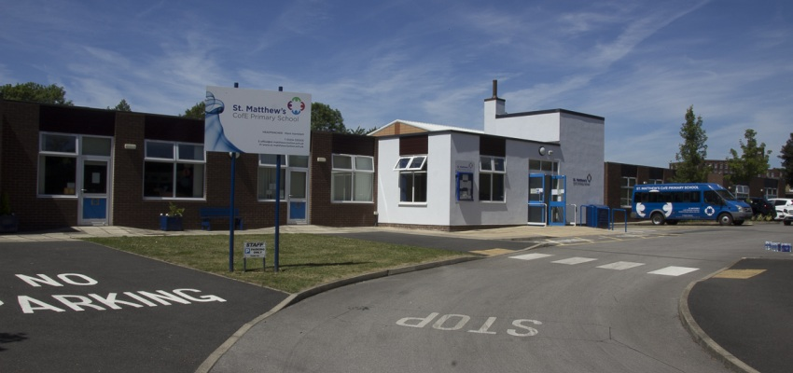

SCHOOL NEWS
Holiday List
2026/2027
DATES ARE INCLUSIVE
AUTUMN TERM – 2026
Tuesday 1st September - School Closed to pupils - Staff Training Day
Term Begins - Wednesday 2nd September 2026
Half Term - Monday 26th October to Friday 30th October 2026
Term Ends - Friday 18th December 2026 – School closes at 1pm
SPRING TERM - 2027
Term Begins - Tuesday 5th January 2027
Half Term - Monday 15th February to Friday 19th February 2027
Term Ends - Thursday 25th March 2027 – School Closes at 1pm
SUMMER TERM – 2027
Term Begins - Monday 12th April 2027
Bank Holiday - Monday 3rd May
Monday 31st May
Half Term - Monday 1st to Friday 11th June 2027
Term Ends - Friday 23rd July 2027 – School closes at 1pm

Slide 3



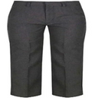
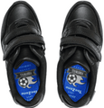


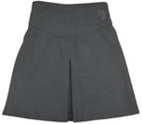
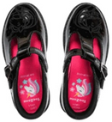

St. Matthew’s School Uniform
Boys
Trousers (grey/black)
Sweaters/sweatshirts/fleece (navy blue)
Shirts/polo-necked shirts (white)
Socks (white/grey/black)
Footwear – black shoes/trainers (all black including laces, no obvious logos)
Girls
Trousers (grey/black)
Skirts/pinafore dresses (grey/black)
Sweaters/sweatshirts/fleece/cardigans (navy blue)
Shirts/polo-necked shirts/ blouses (white)
Socks/tights (white/grey/black)
Footwear – black shoes/trainers (all black including laces, no obvious logos)
Jewellery
No jewellery should be worn at school apart from a pair of small plain studs earrings (large or hoop earrings are not allowed for health and safety reasons) and a simple watch (no smart watches)

Slide 4

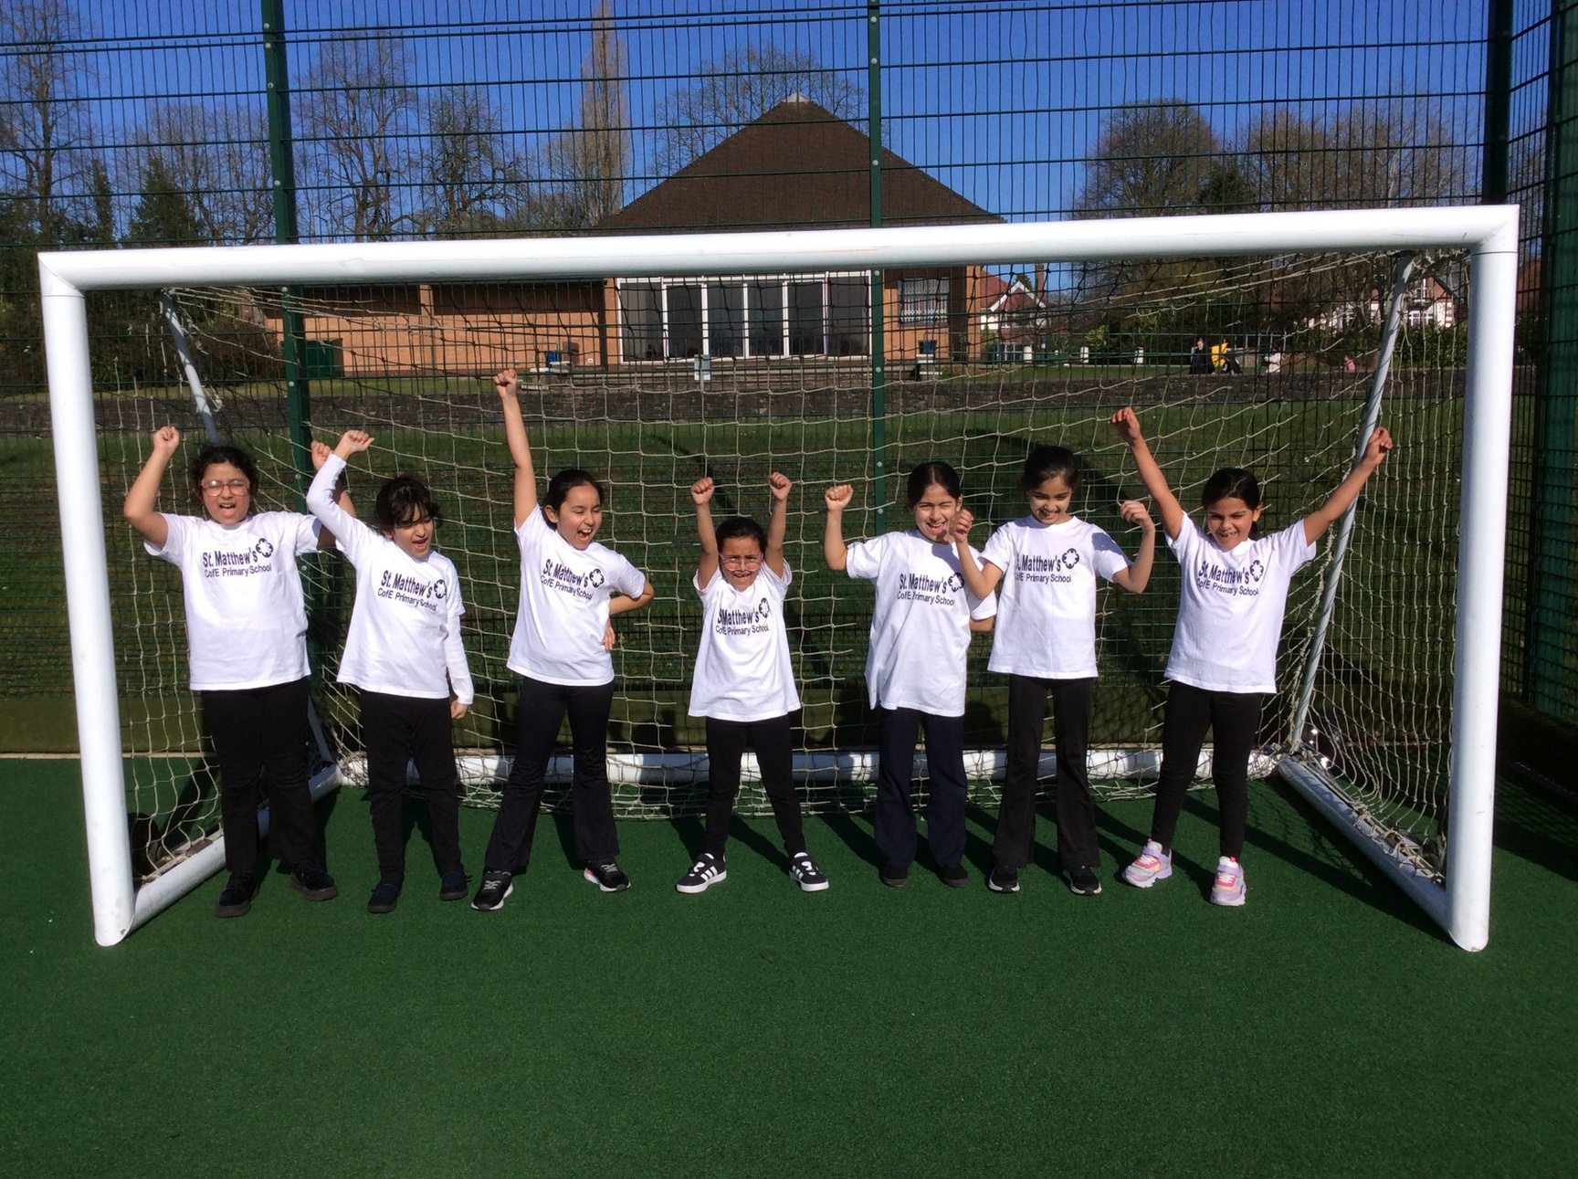

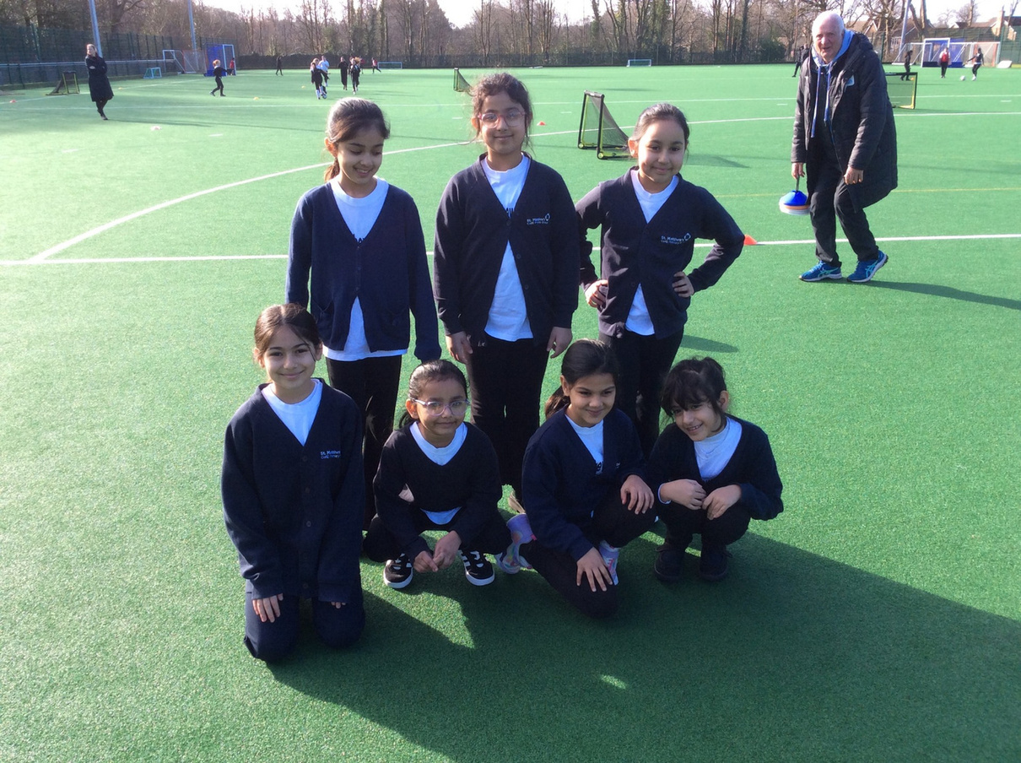
SCHOOL NEWS
Sporting Events
This was a targeted event for South Asian girls in Years 3 and 4. The children took part in a range of skill stations designed to develop and improve their football skills, while building confidence and encouraging participation in sport.

Slide 5

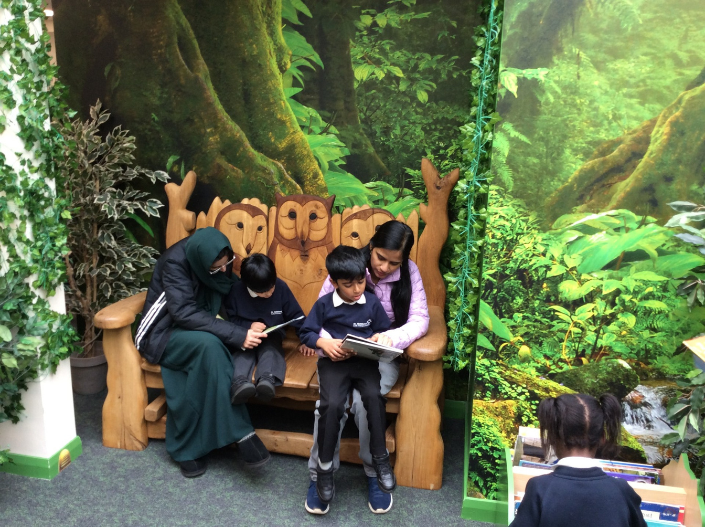
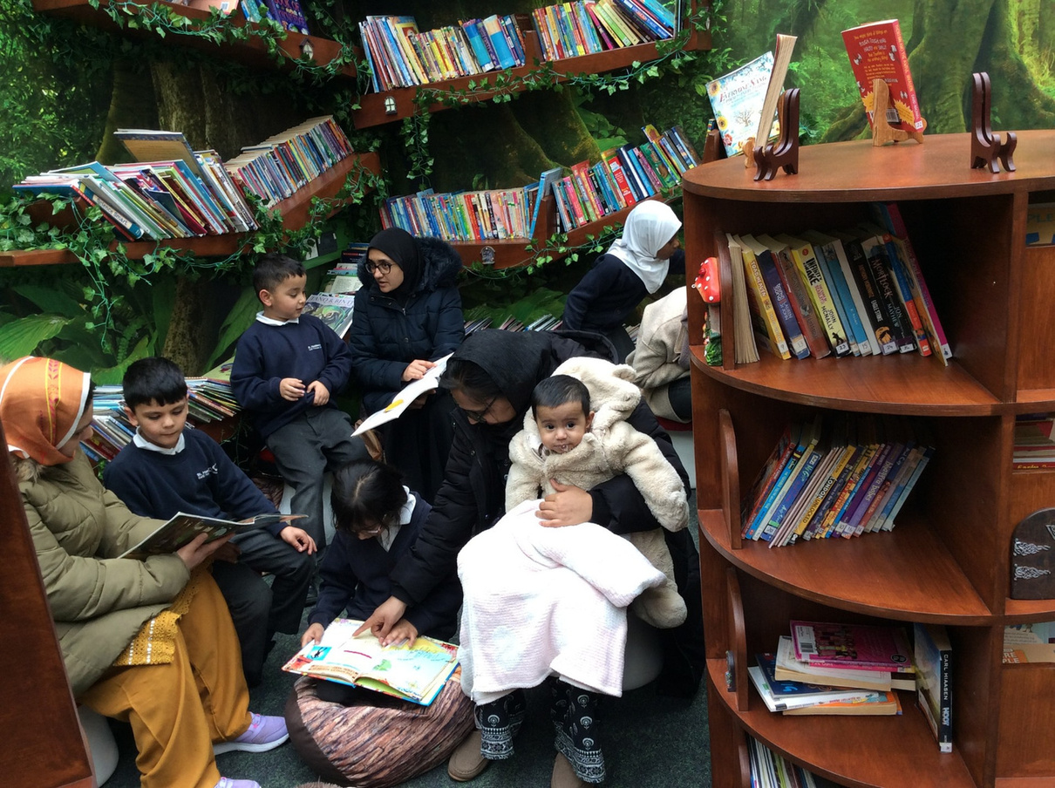
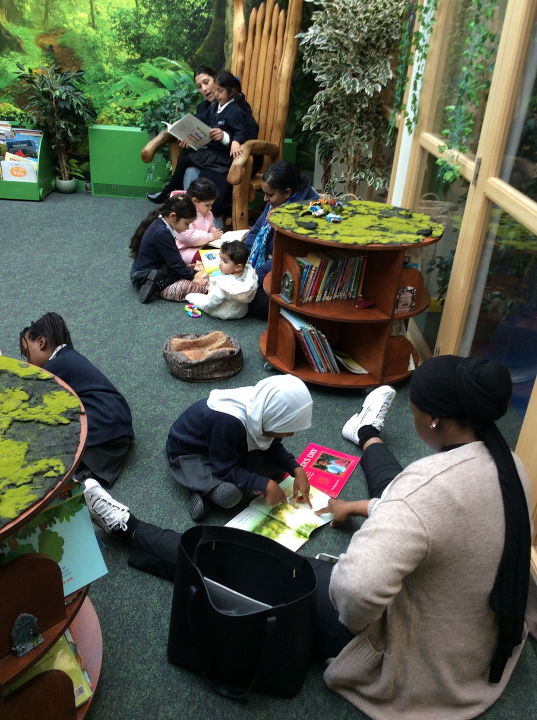
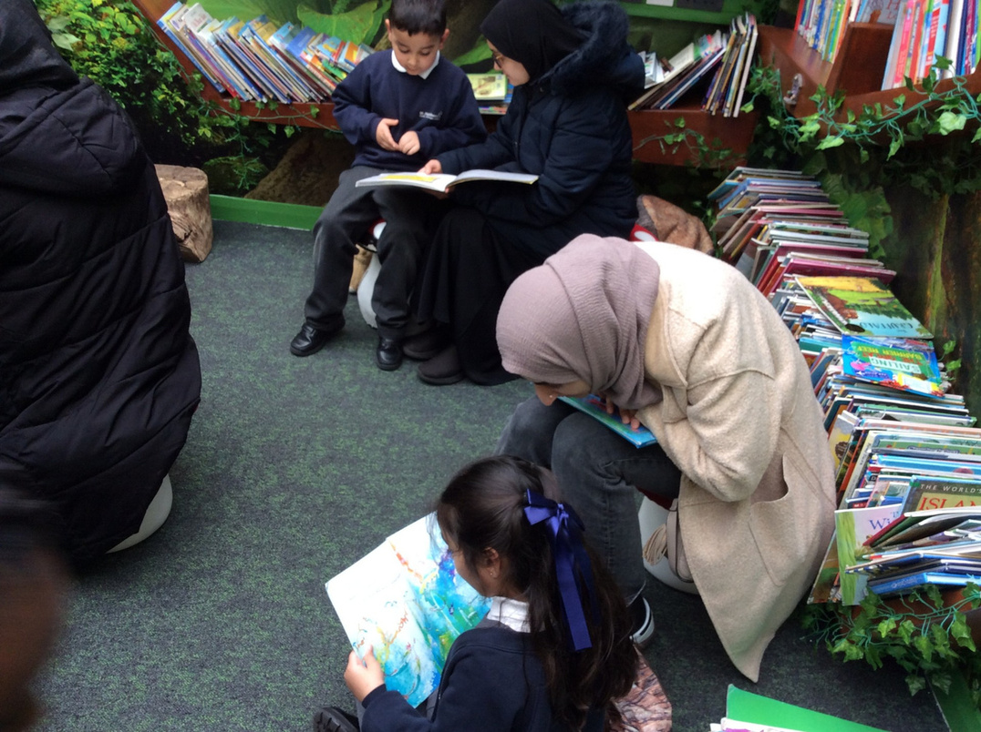
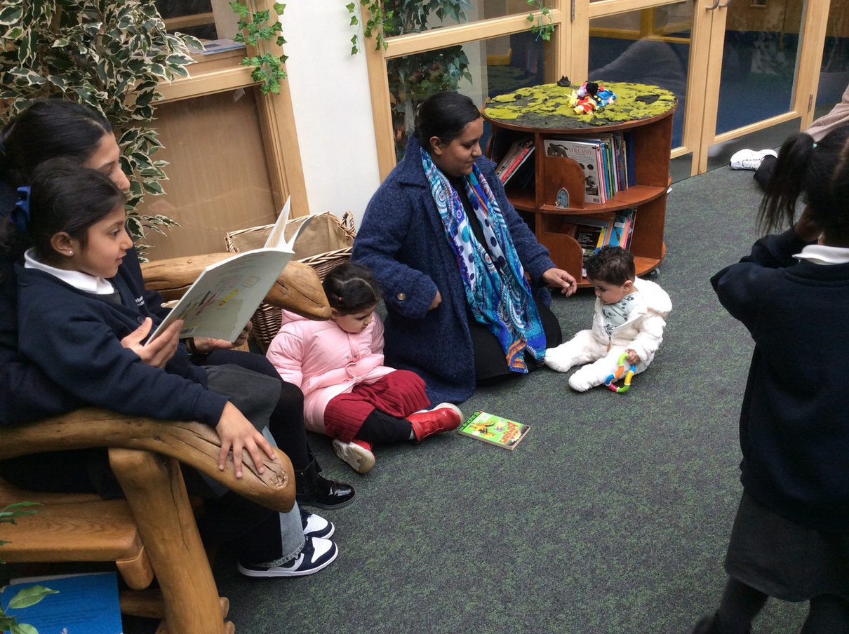
SCHOOL NEWS
Reading Afternoon 1M
Thank you to the parents who joined 1M for their Reading Afternoon – the children loved sharing stories and reading together.

Slide 6
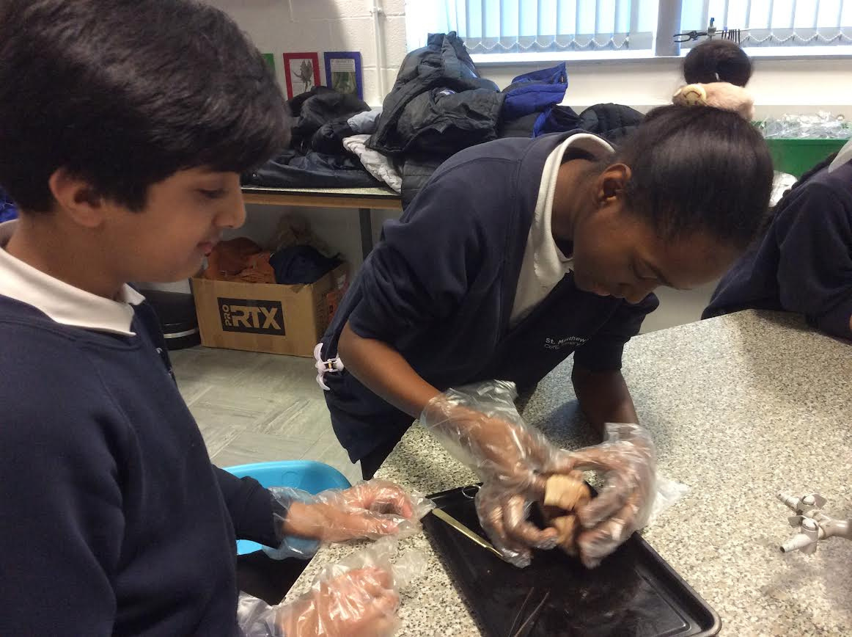
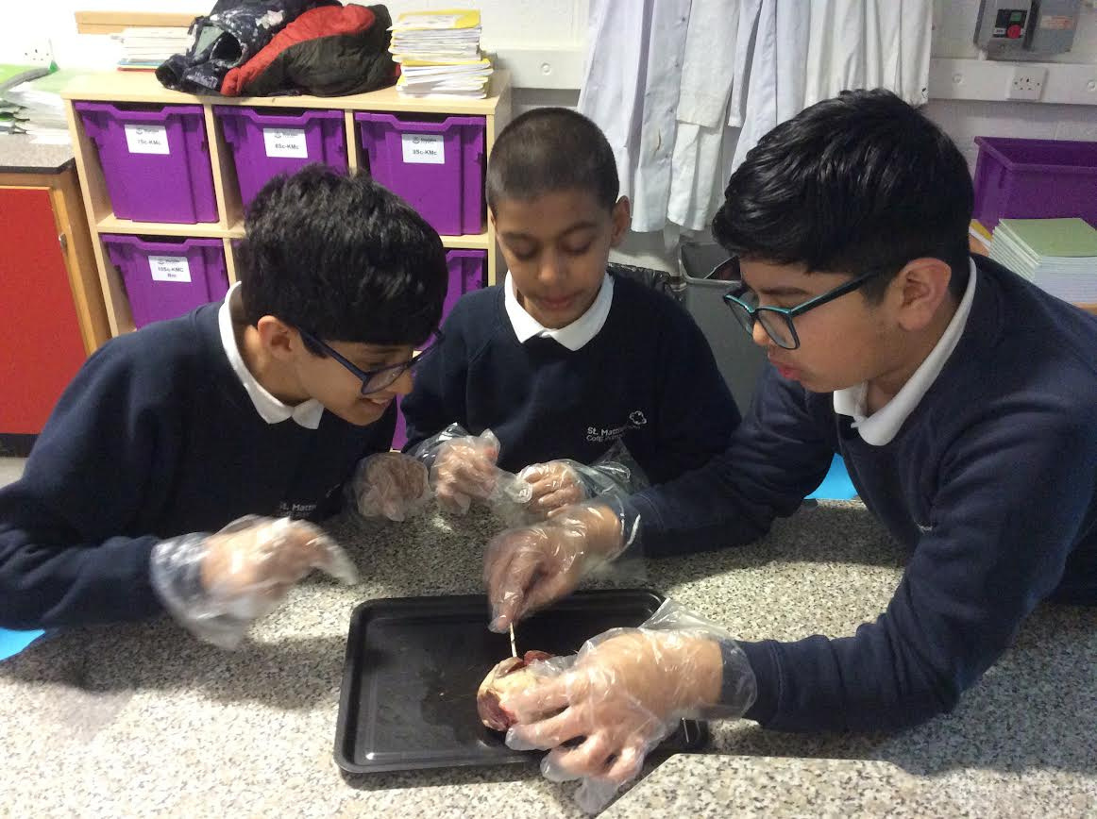
SCHOOL NEWS
6E Sharples High School Visit
6E visited Sharples High School to take part in a science lesson which was to dissect a heart.
It was fascinating and we all got stuck in...... well nearly all of us.

Slide 7
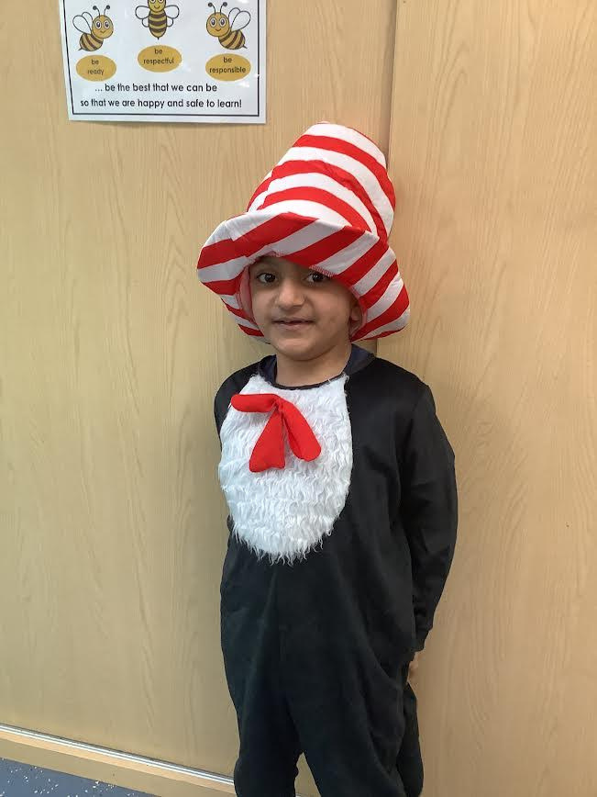
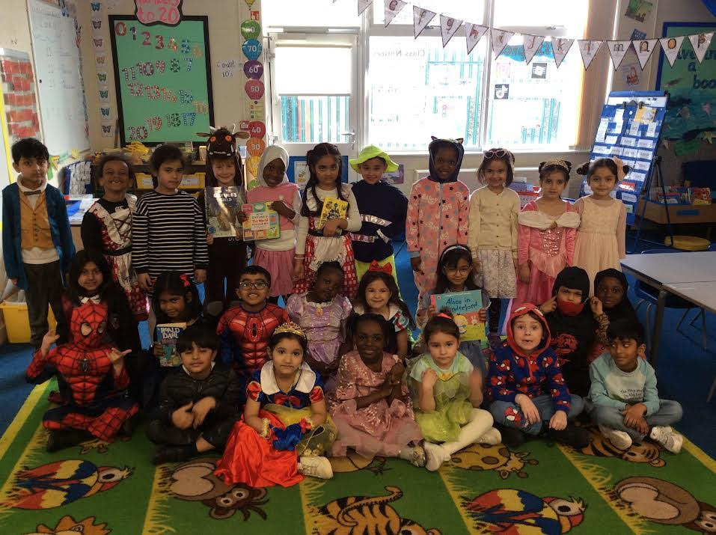
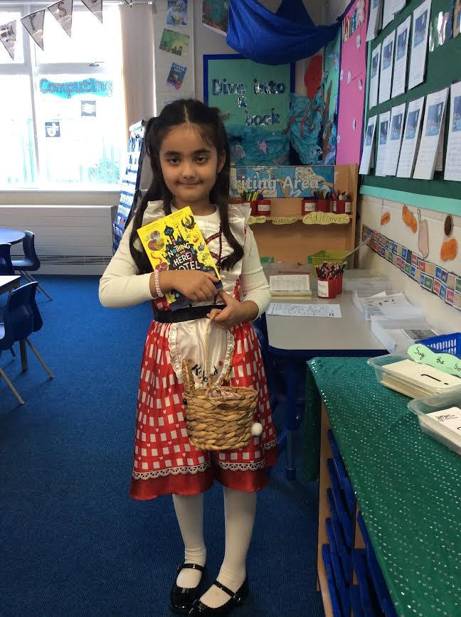
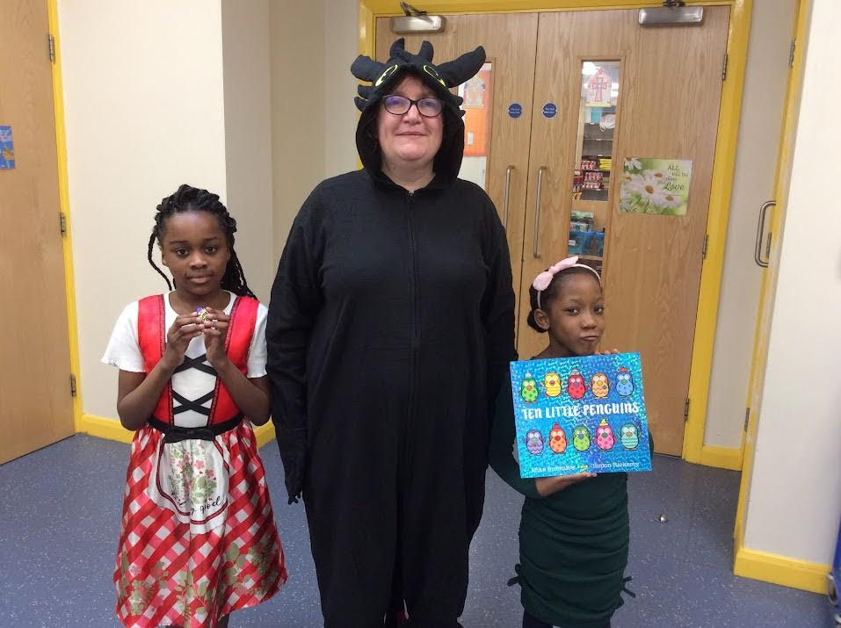
SCHOOL NEWS
World Book Day
The children all had a fantastic day celebrating World Book Day. The whole school looked at the picture book 'A Planet in a Pickle Jar' and completed lots of different activities as well as reading in the library and buddy reading with other year groups across the school. We also had a celebration assembly to share our fantastic costume and extreme reader competition winners.

Slide 8
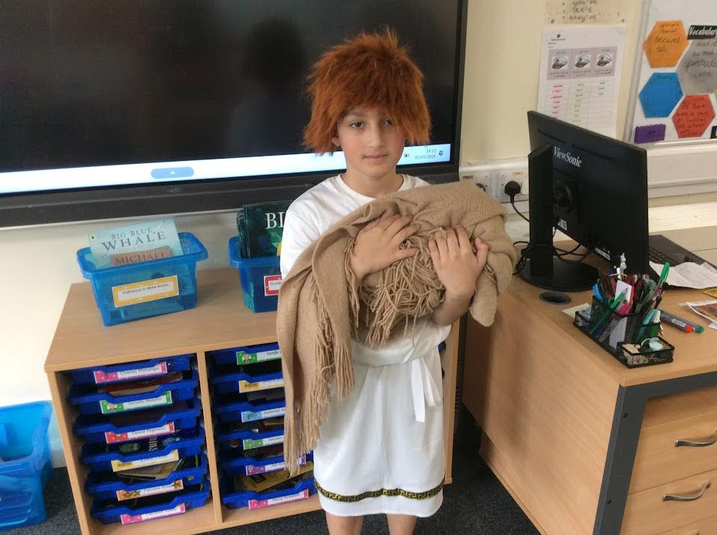
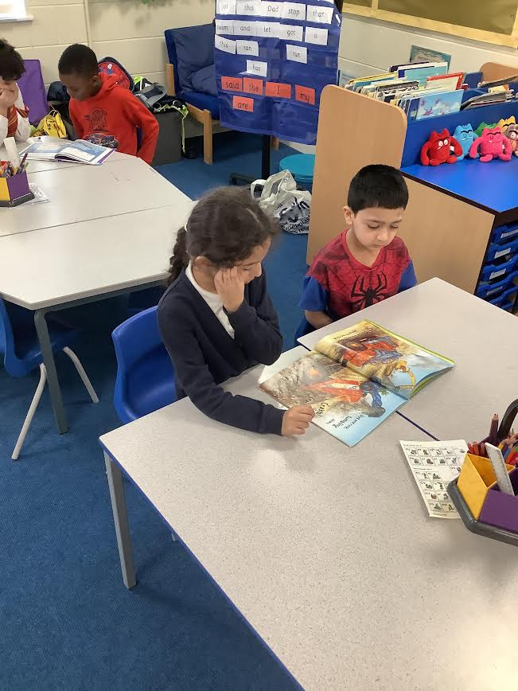
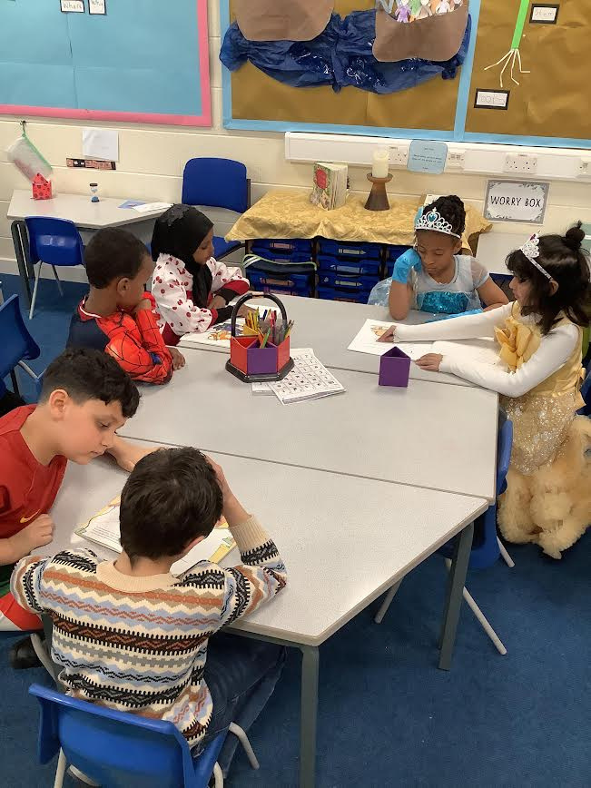
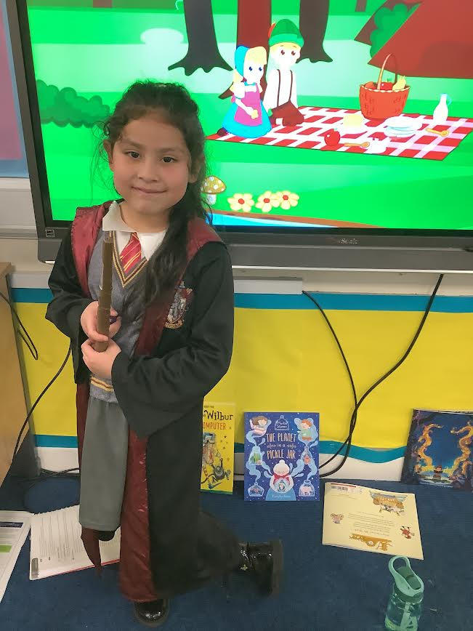
SCHOOL NEWS
World Book Day

Slide 9
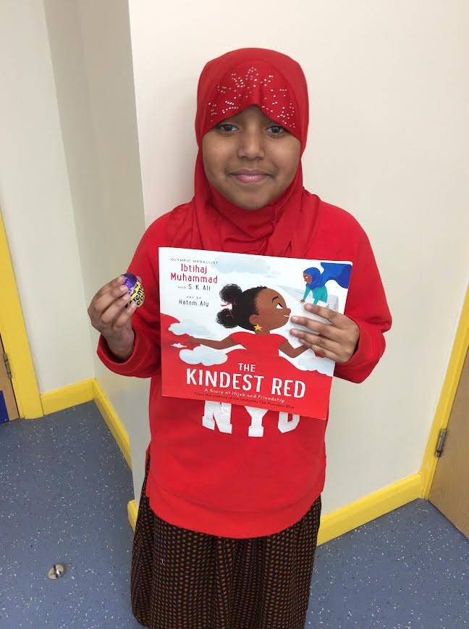
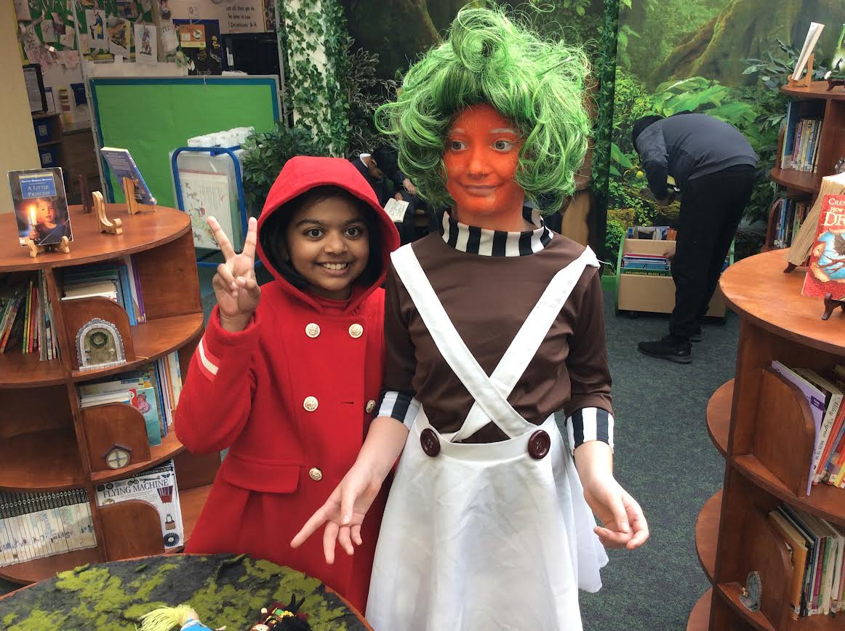
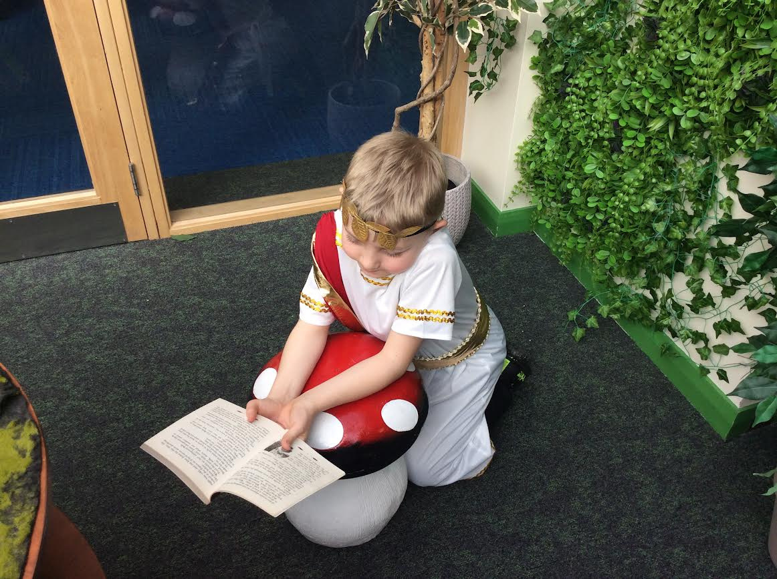
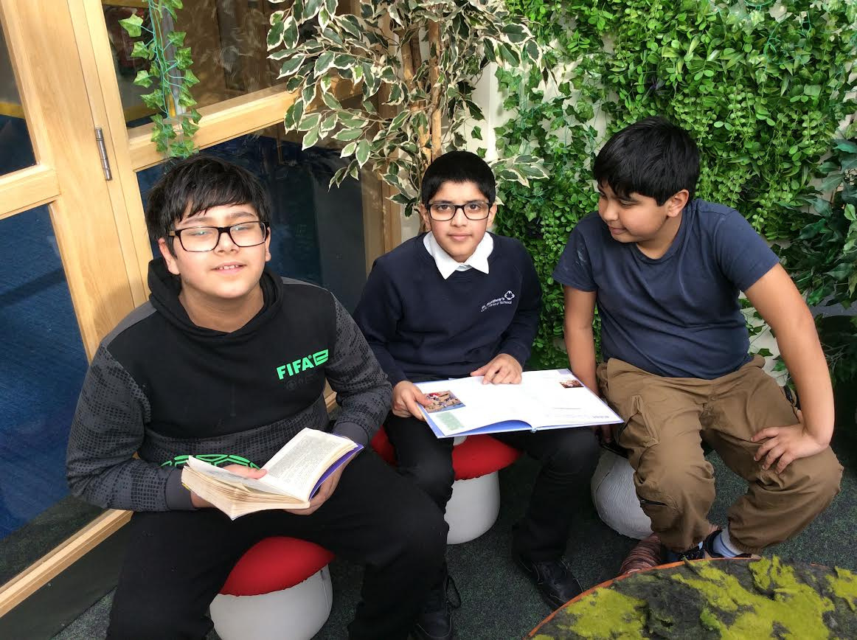
SCHOOL NEWS
World Book Day

Slide 10
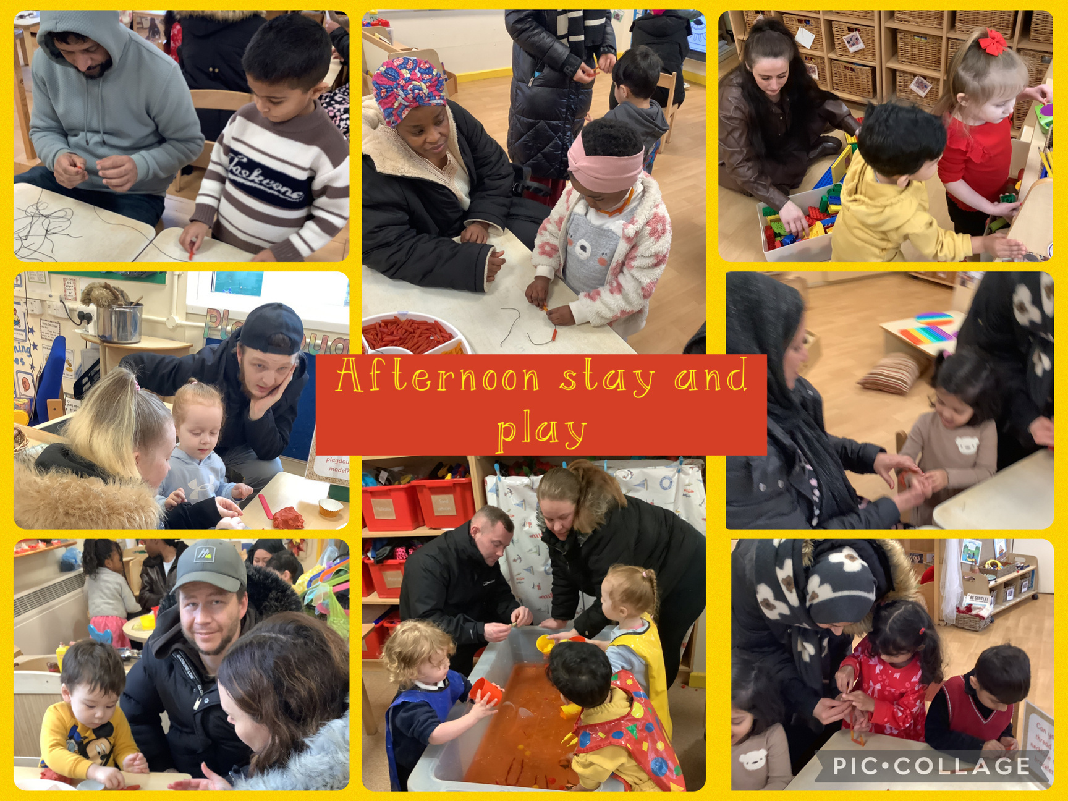
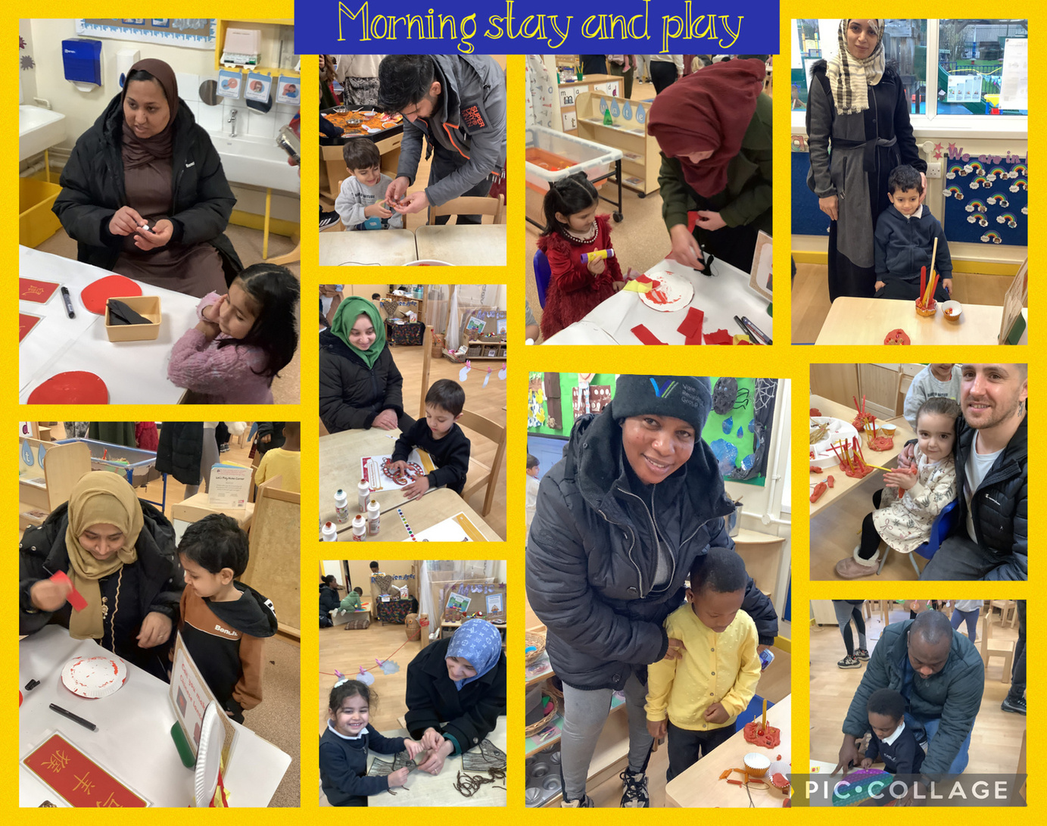
SCHOOL NEWS
Nursery Stay and Play

Slide 11
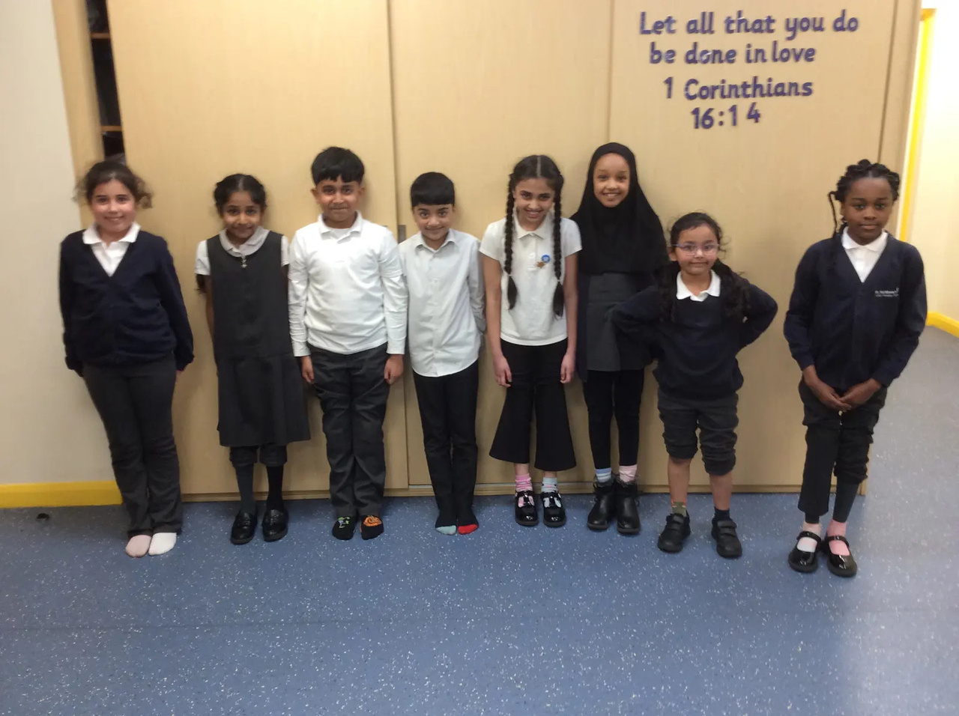
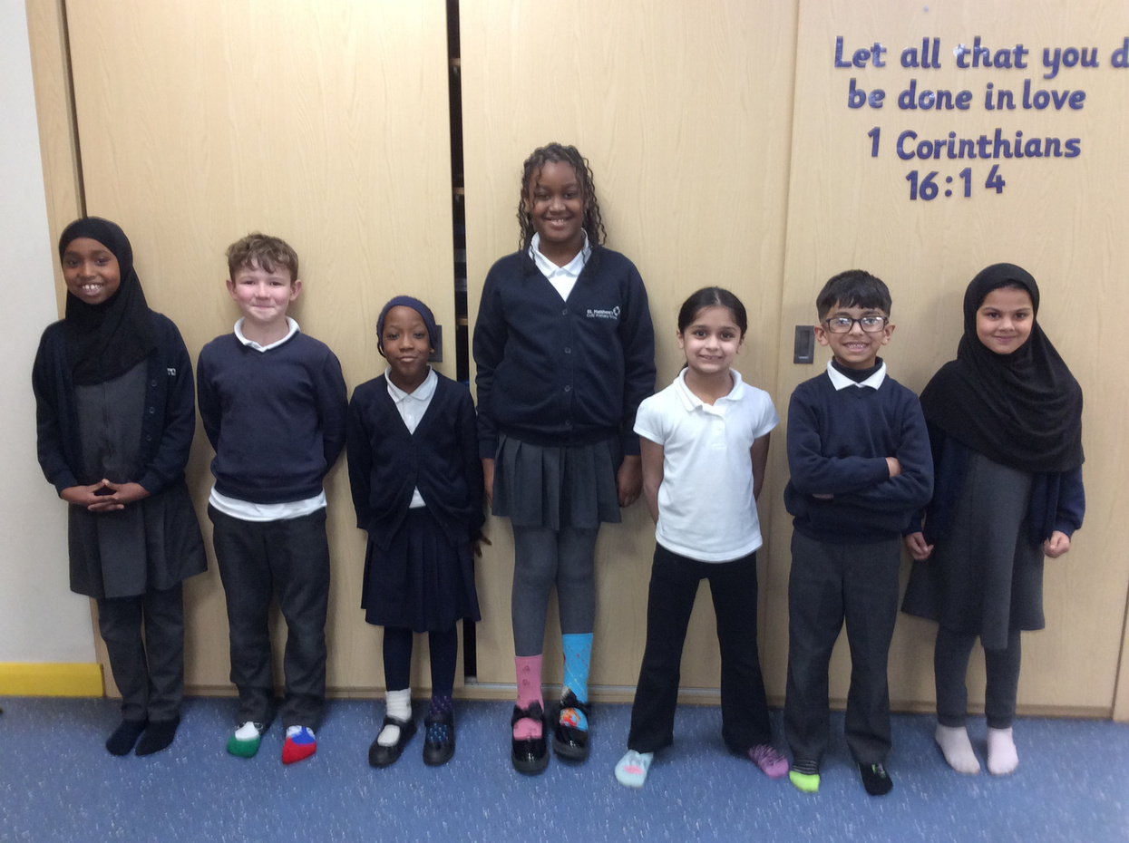
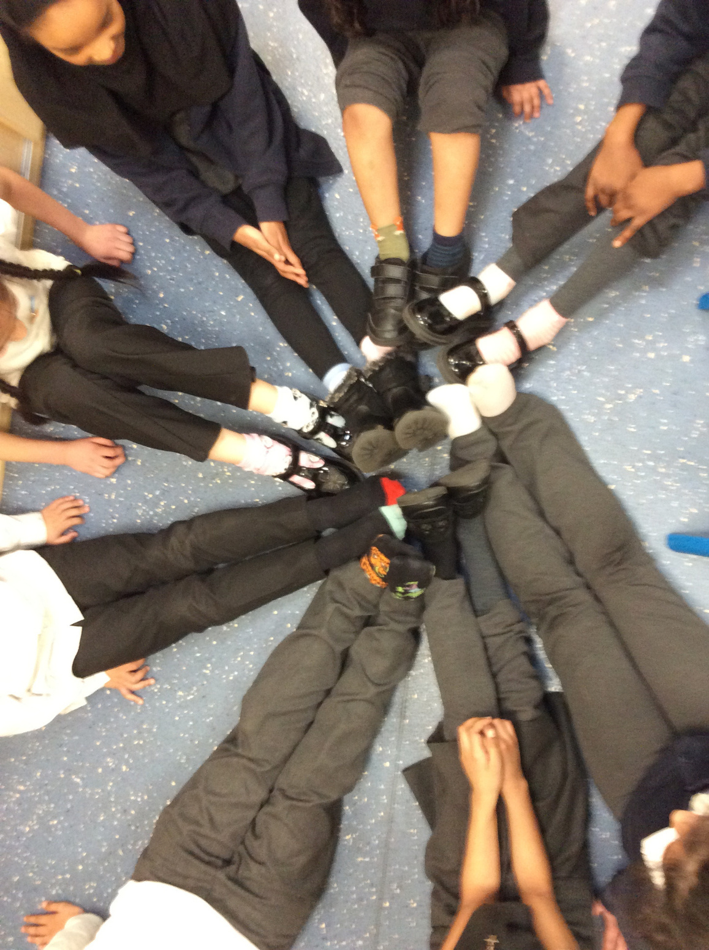
SCHOOL NEWS
Odd Socks Day for World Downs Day

Slide 12
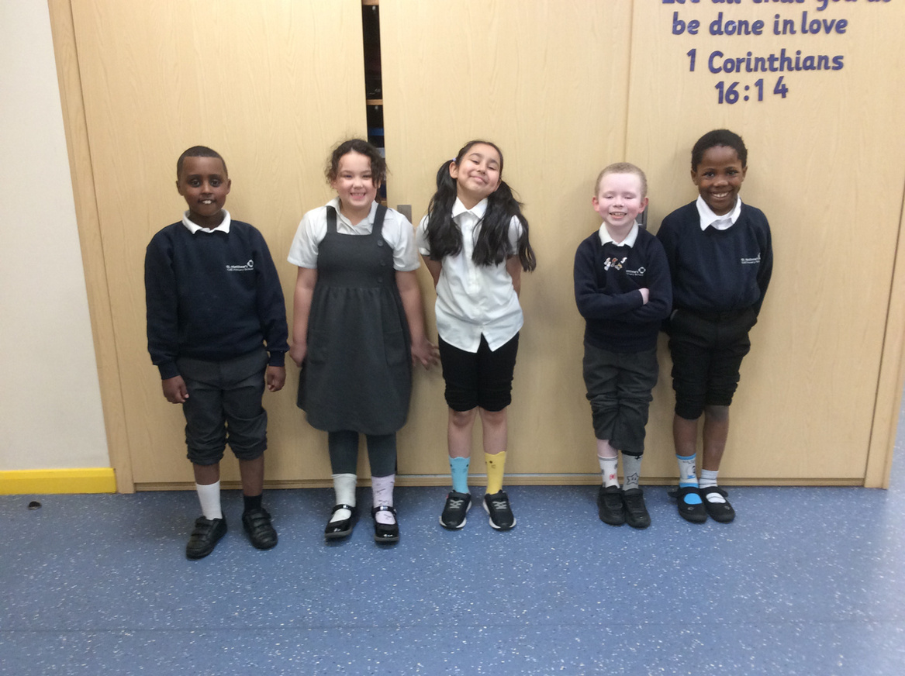
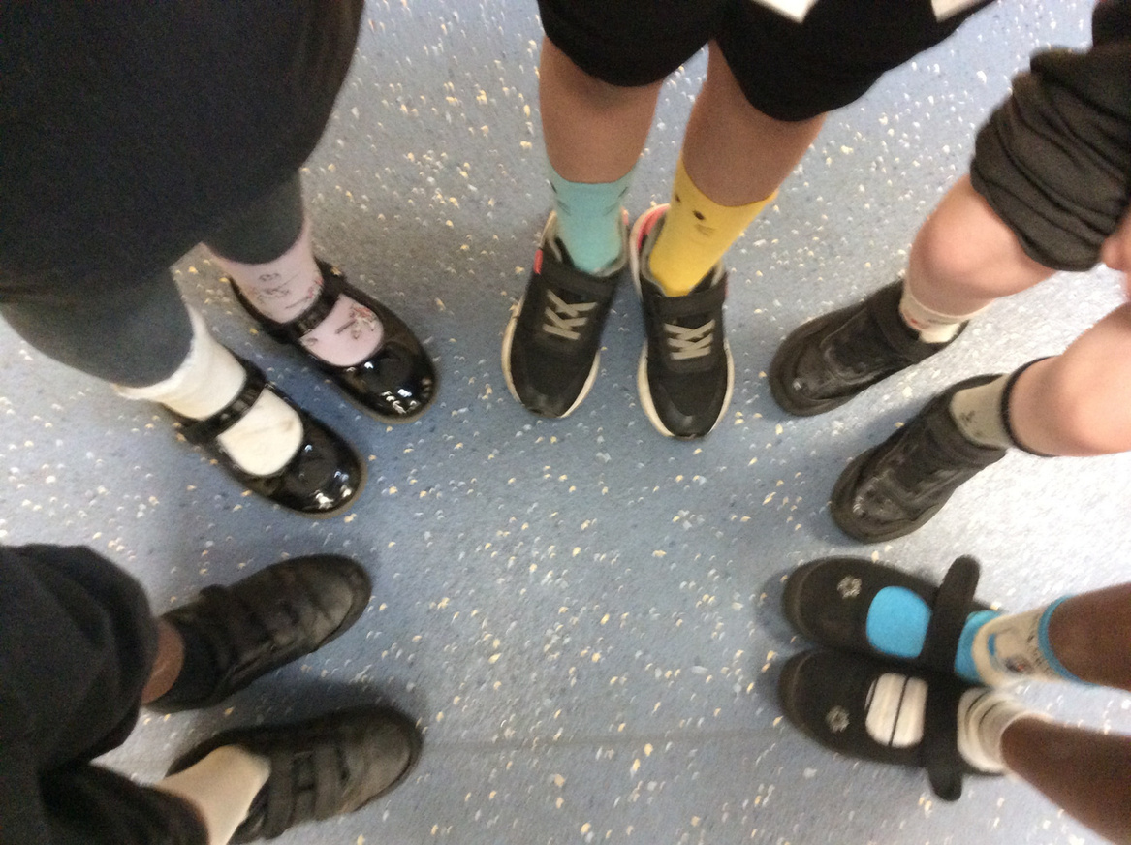
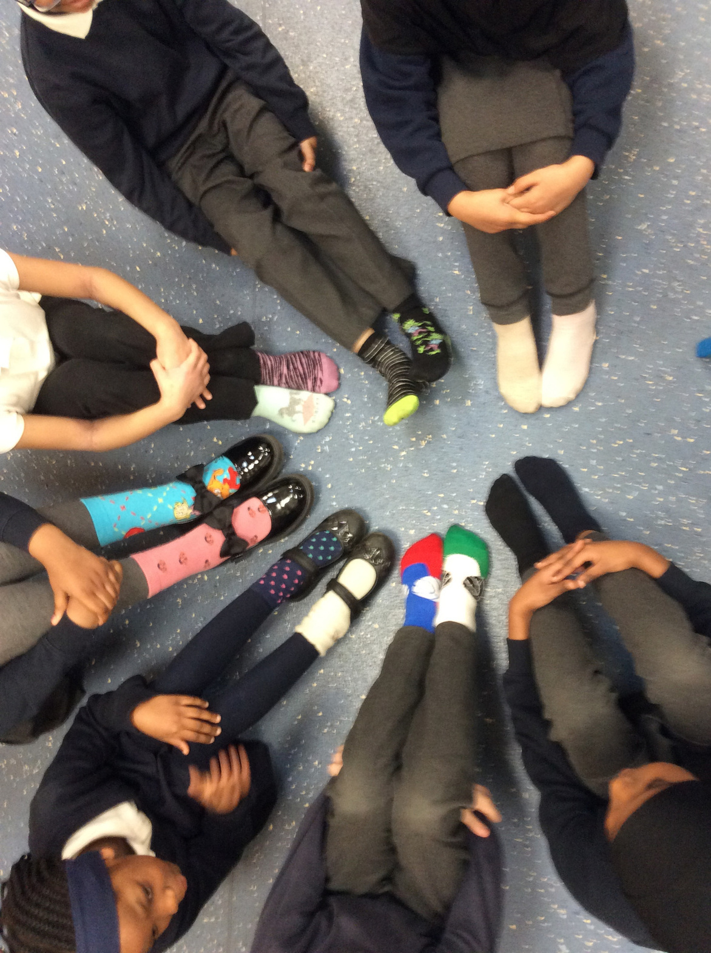
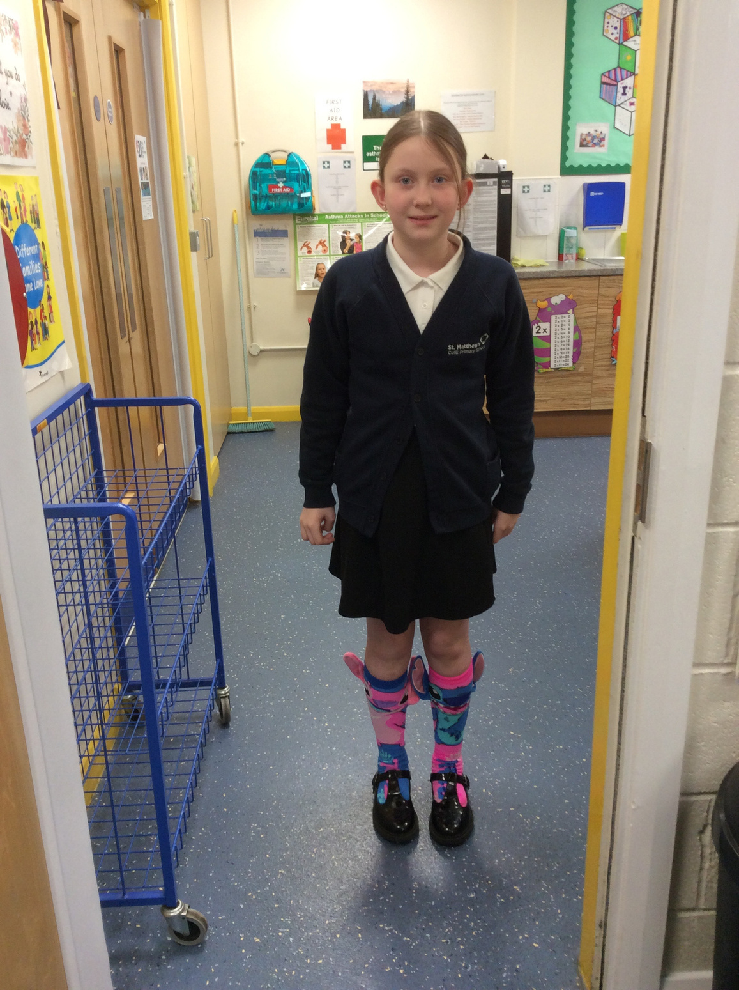
SCHOOL NEWS
Odd Socks Day for World Downs Day

Slide 13
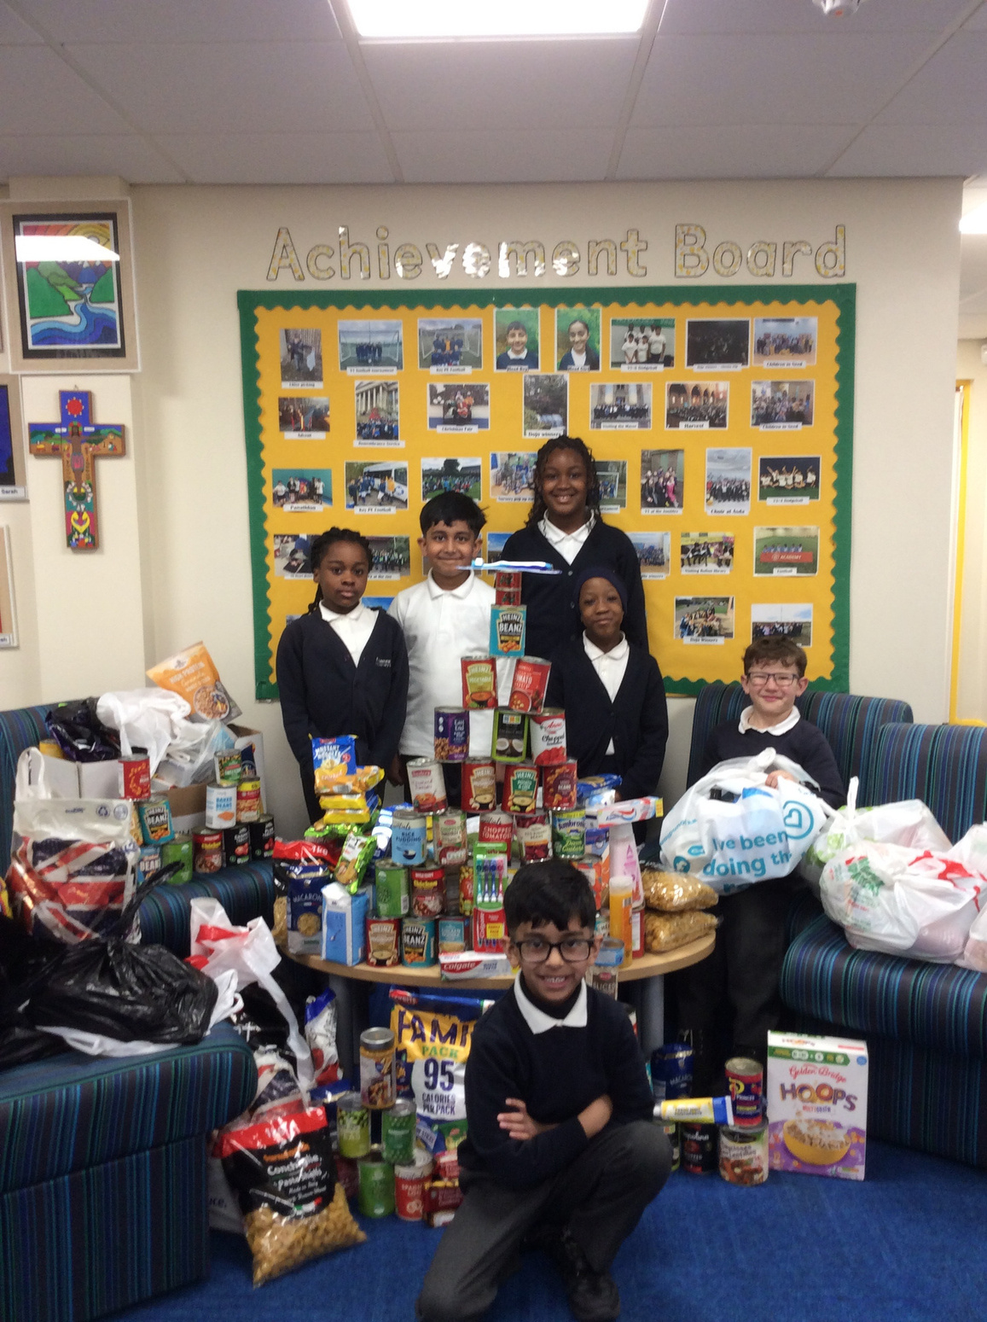
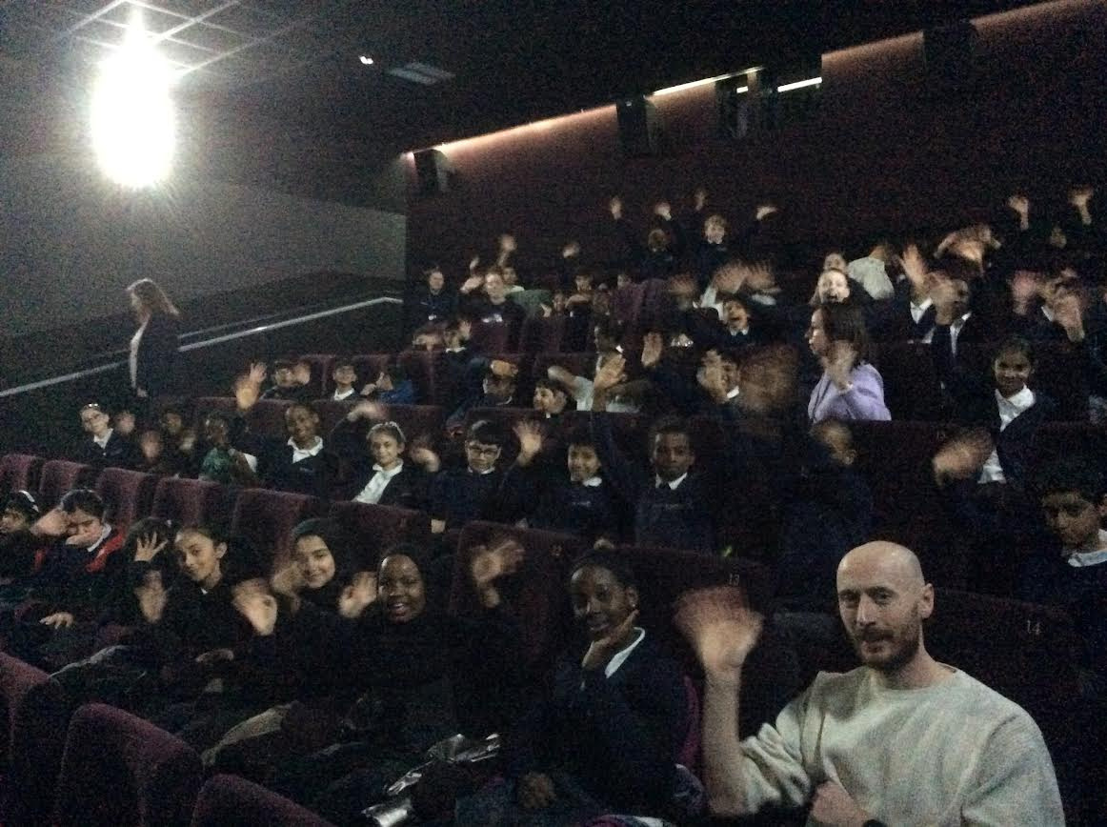
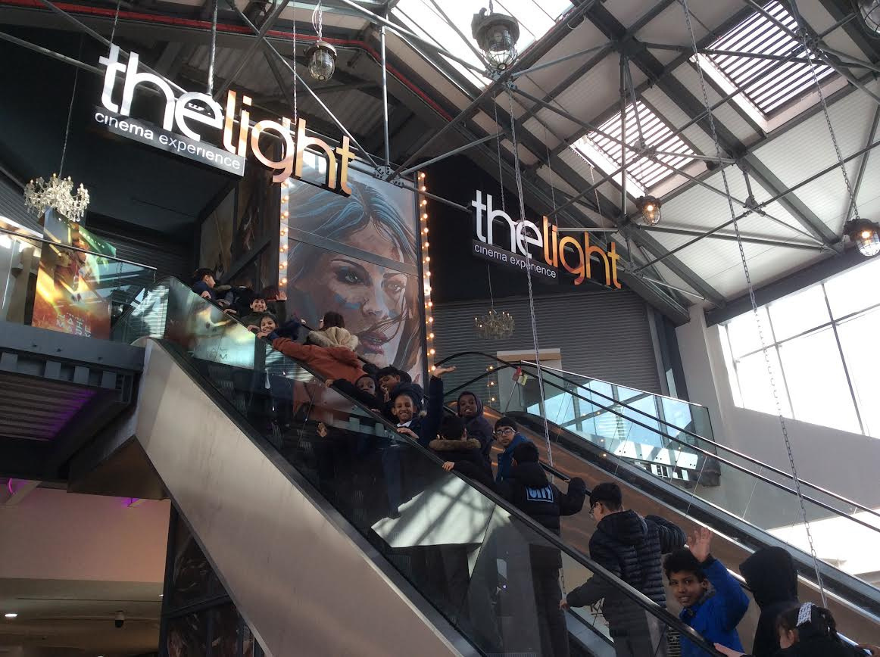
SCHOOL NEWS
Just One Thing & The Cinema Trip

Slide 14


