Slide 1

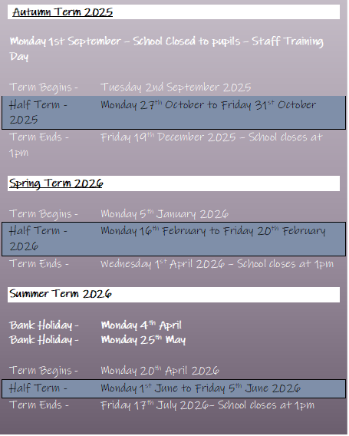

Newsletter
May 2026
www.st-matthews.bolton.sch.uk
We are an Operation Encompass School, which means that we receive reports from the police when there has been an incident in a home where a child lives.
MESSAGE FROM THE
HEADTEACHER
Dear parents/carers,
As we come to the end of the first half of the summer term, we have lots to celebrate across the school. We are very proud of the huge improvements seen in our whole school attendance since September, compared to the same time last year - well done everyone!
This term, we are pleased to announce that St. Matthew's is now a MHST (Mental Health Support Team) school. This means we are working with Bolton Mental Health Support Team to access specialist support for our children and families.
A huge well done to all our Year 4 & Year 5 children who started their swimming lessons this term - we have already seen the children growing in confidence and making great progress in the pool.
At the start of May, Year 5 enjoyed a trip to Smithills Hall to take part in a Tudor workshop linked to their learning in history, and this week, Year 3 visited Chester to find out more about Roman Britain.
Thank you to all our families who have supported the library sessions held this term. It was lovely to see so many children sharing a book with a family member in our school library.
Eid Mubarak to our staff, children and families who celebrated this week. Wishing everyone a safe and relaxing half-term break. A reminder that school reopens on Monday 8th June at 8.35am.
School Term Dates
2025-2026
School gates will open on January 5th at 8:35 AM
Gates will close at 8:45 AM
Important Notice
If you're driving your child to school please make sure you park safely, legally and considerately.
Please do not block the school gate as you are preventing staff from getting to school on time and do not use the garages near school to turn your vehicle around or drop off, this is for local residents.
Please don't park across household driveways near schools and always park safely. We don't want to see anyone hurt.

Slide 2

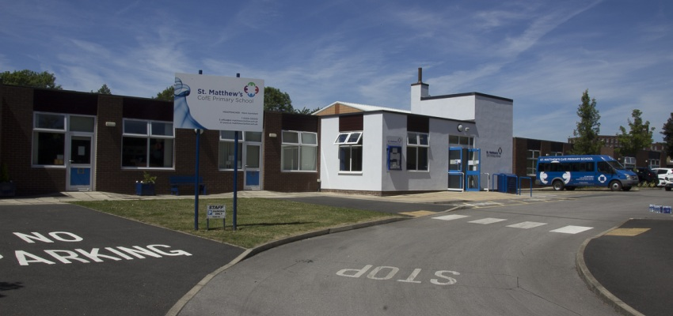

SCHOOL NEWS
Holiday List
2026/2027
DATES ARE INCLUSIVE
AUTUMN TERM – 2026
Tuesday 1st September - School Closed to pupils - Staff Training Day
Term Begins - Wednesday 2nd September 2026
Half Term - Monday 26th October to Friday 30th October 2026
Term Ends - Friday 18th December 2026 – School closes at 1pm
SPRING TERM - 2027
Term Begins - Tuesday 5th January 2027
Half Term - Monday 15th February to Friday 19th February 2027
Term Ends - Thursday 25th March 2027 – School Closes at 1pm
SUMMER TERM – 2027
Term Begins - Monday 12th April 2027
Bank Holiday - Monday 3rd May
Monday 31st May
Half Term - Monday 31st to Friday 11th June 2027
Term Ends - Friday 23rd July 2027 – School closes at 1pm

Slide 3
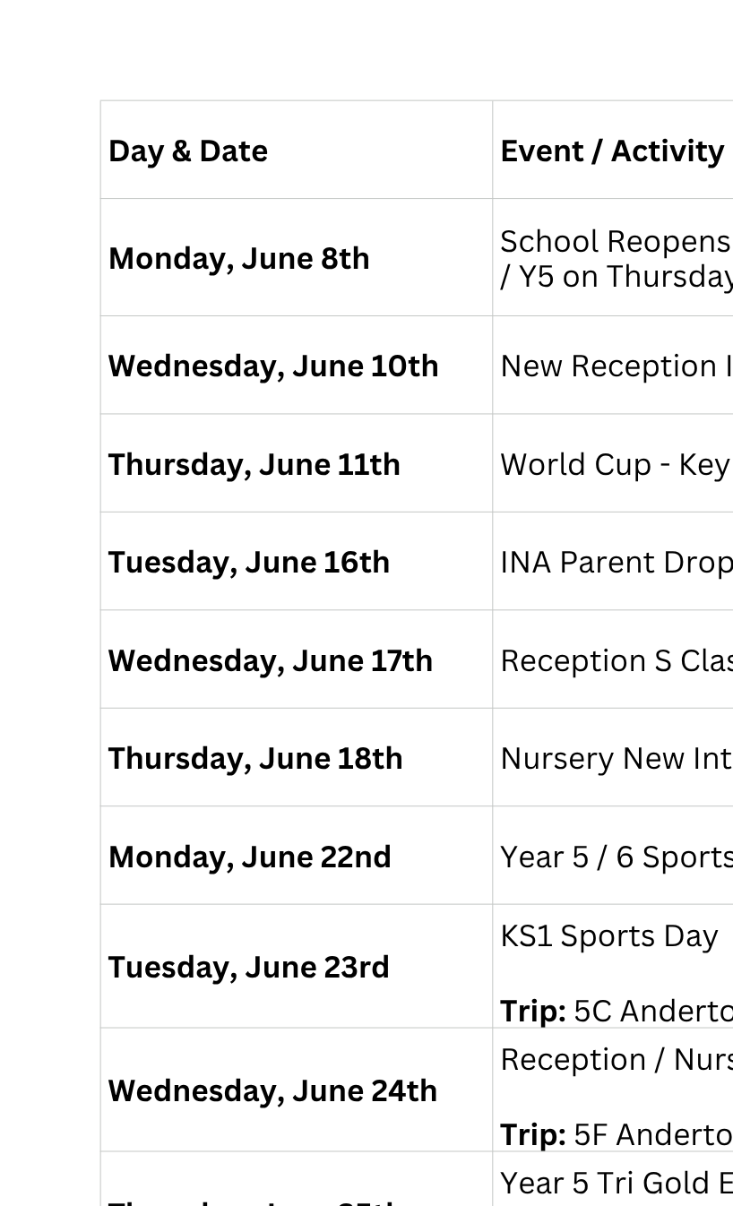
Important Dates

Slide 4

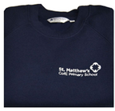

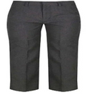
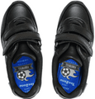
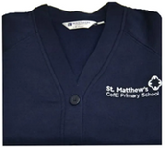
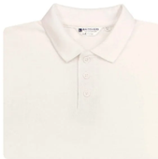
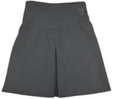
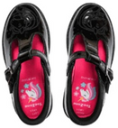
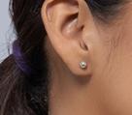
St. Matthew’s School Uniform
Boys
Trousers (grey/black)
Sweaters/sweatshirts/fleece (navy blue)
Shirts/polo-necked shirts (white)
Socks (white/grey/black)
Footwear – black shoes/trainers (all black including laces, no obvious logos)
Girls
Trousers (grey/black)
Skirts/pinafore dresses (grey/black)
Sweaters/sweatshirts/fleece/cardigans (navy blue)
Shirts/polo-necked shirts/ blouses (white)
Socks/tights (white/grey/black)
Footwear – black shoes/trainers (all black including laces, no obvious logos)
Jewellery
No jewellery should be worn at school apart from a pair of small plain studs earrings (large or hoop earrings are not allowed for health and safety reasons) and a simple watch (no smart watches)

Slide 5
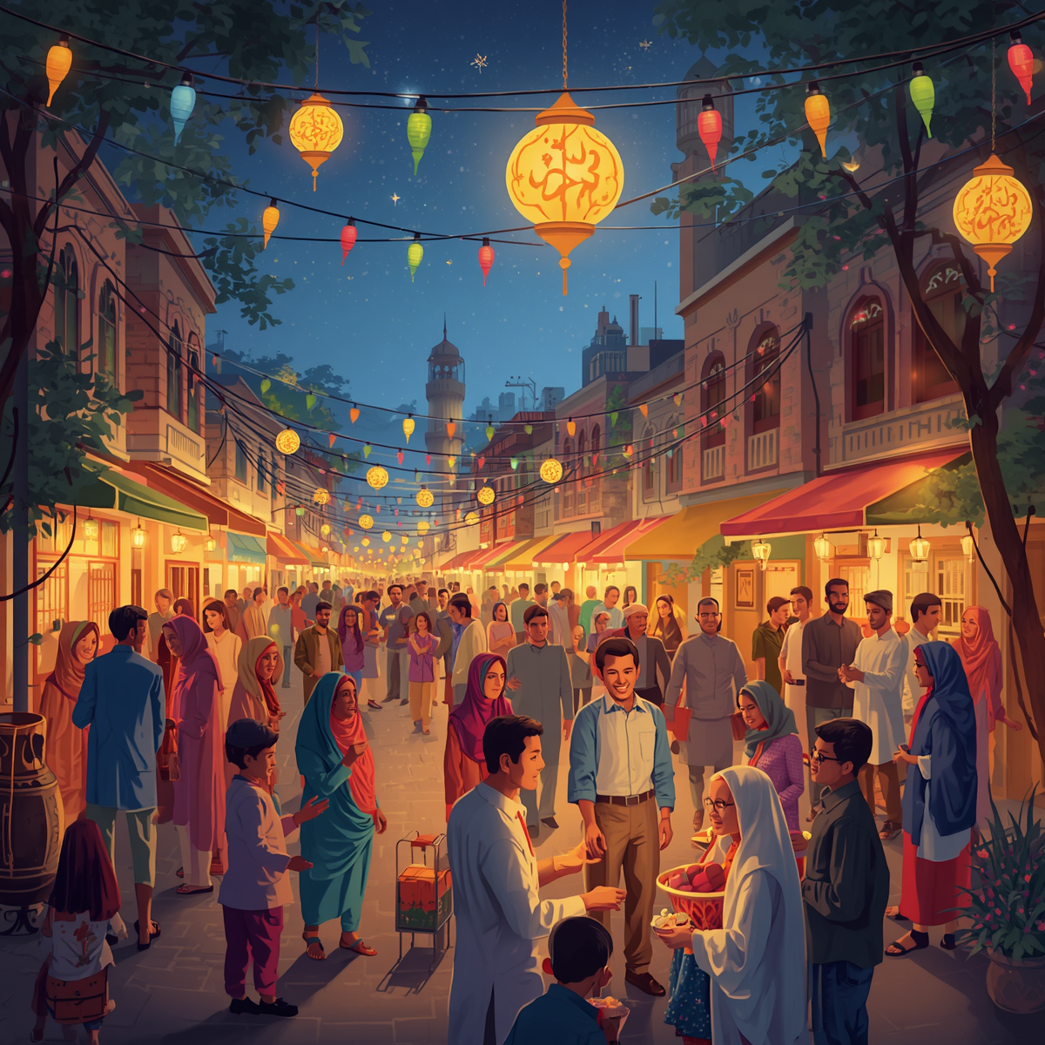

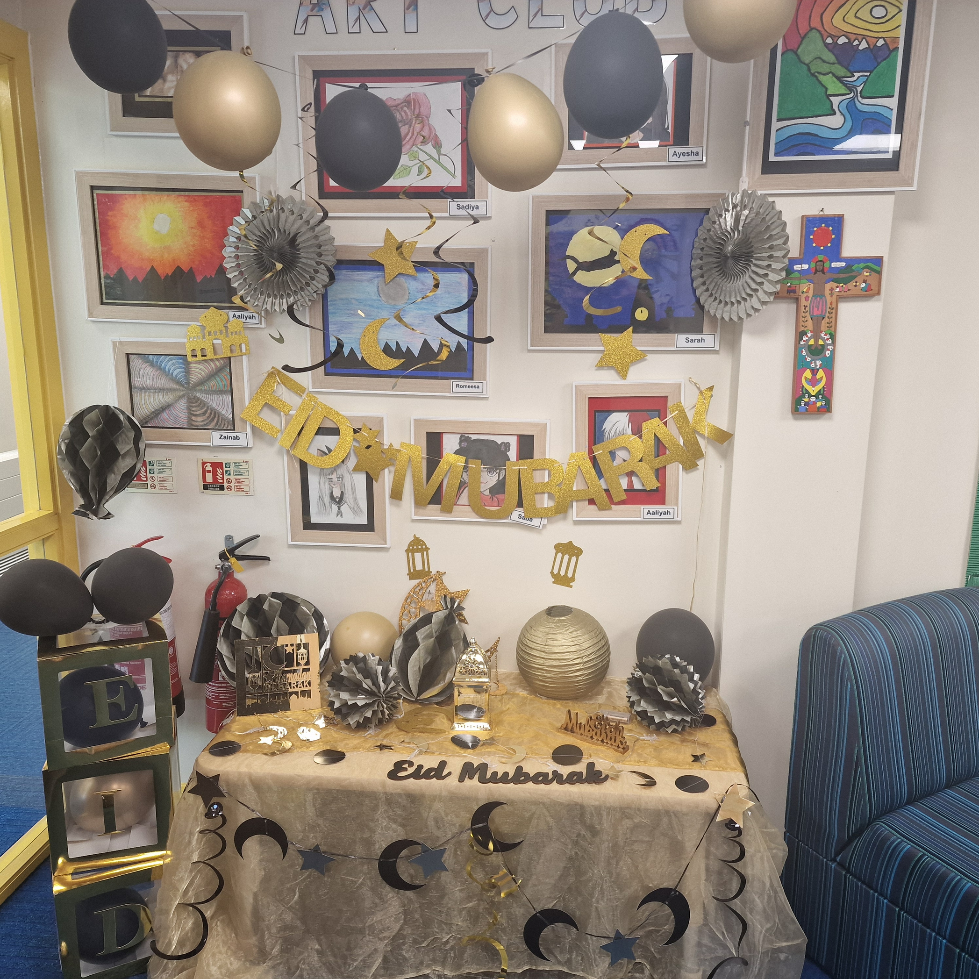
SCHOOL NEWS
Eid al-Adha

Slide 6


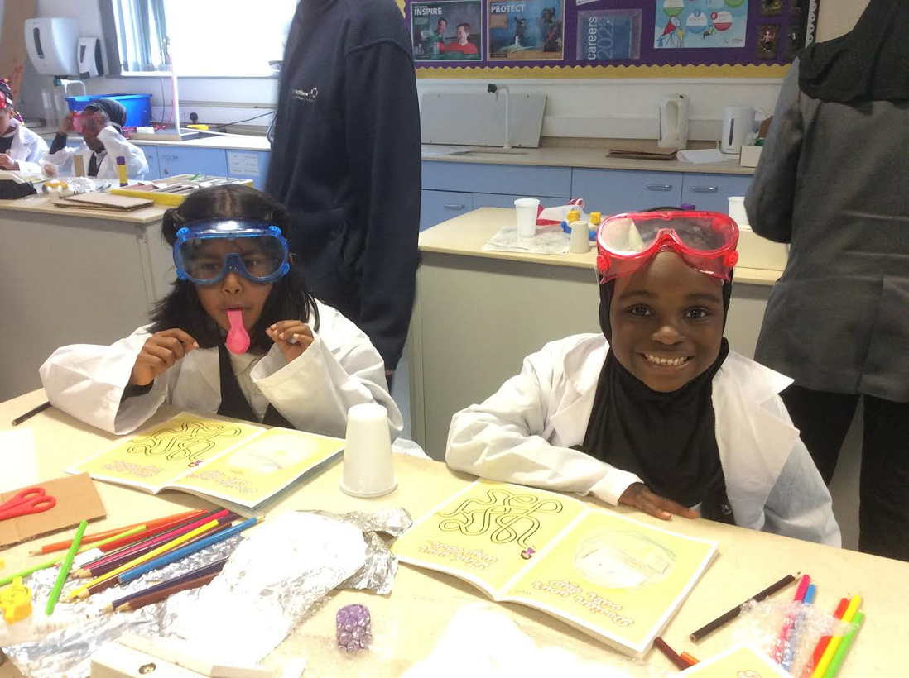
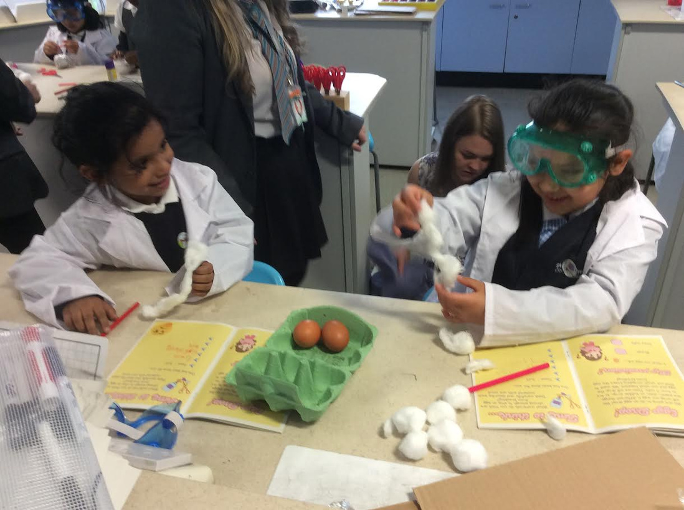
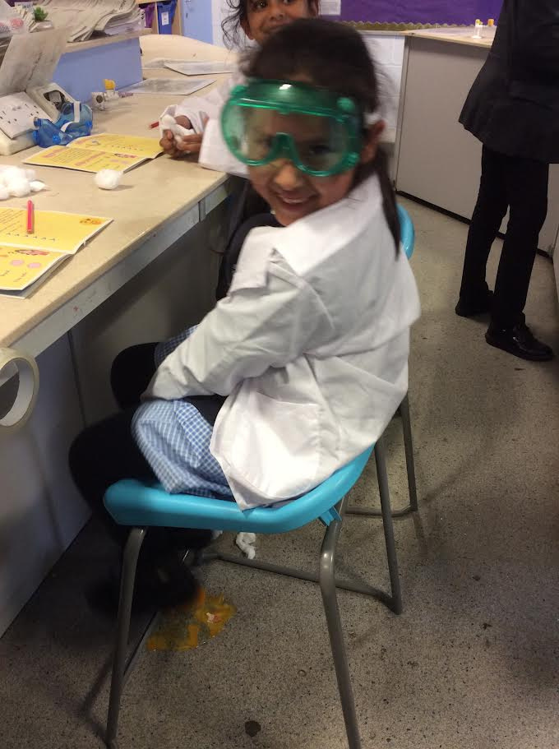
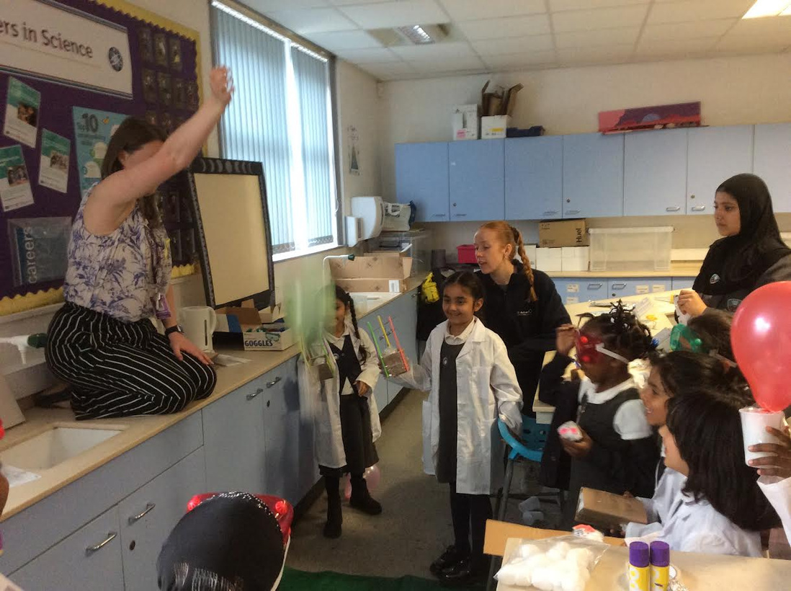
SCHOOL NEWS
Physics Club
This was a targeted event for South Asian girls in Years 3 and 4. The children took part in a range of skill stations designed to develop and improve their football skills, while building confidence and encouraging participation in sport.

Slide 7
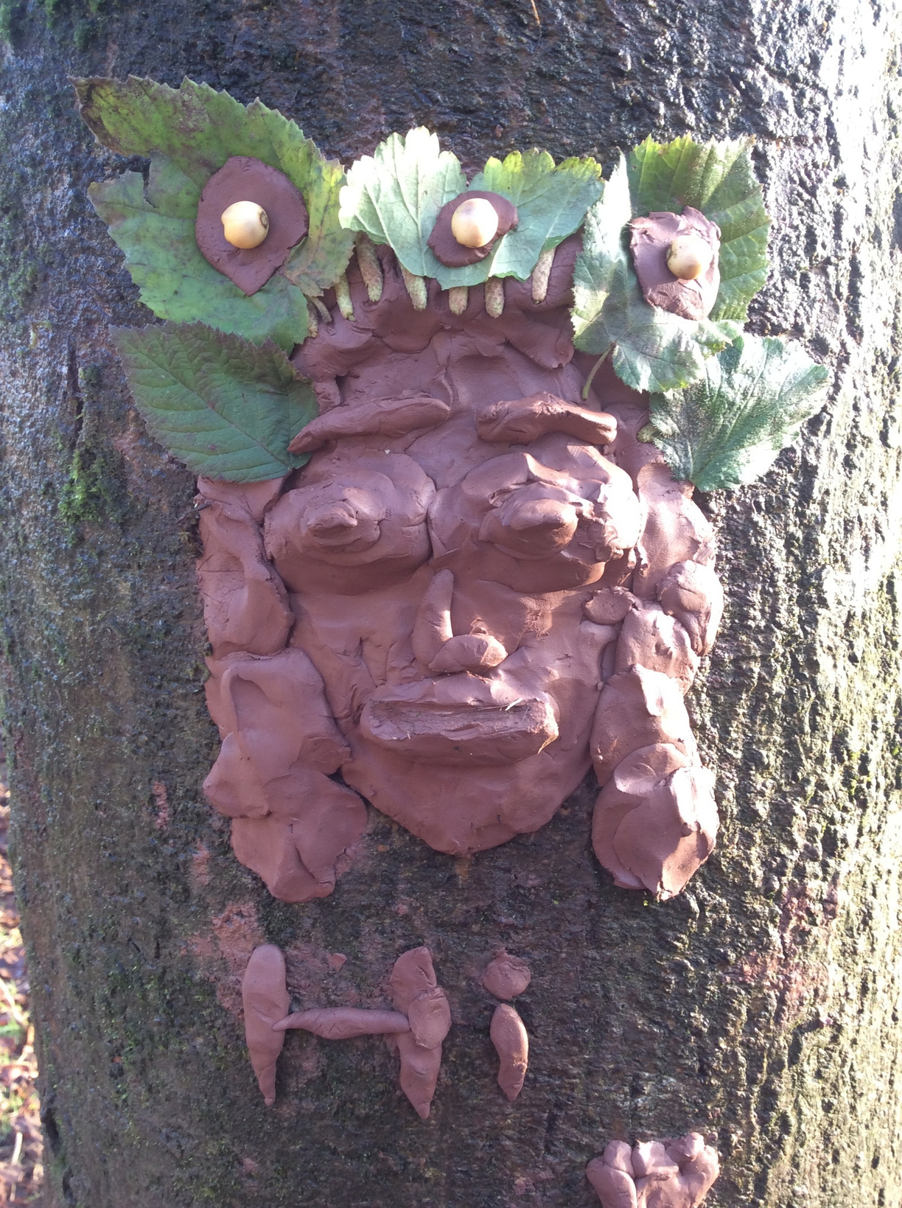

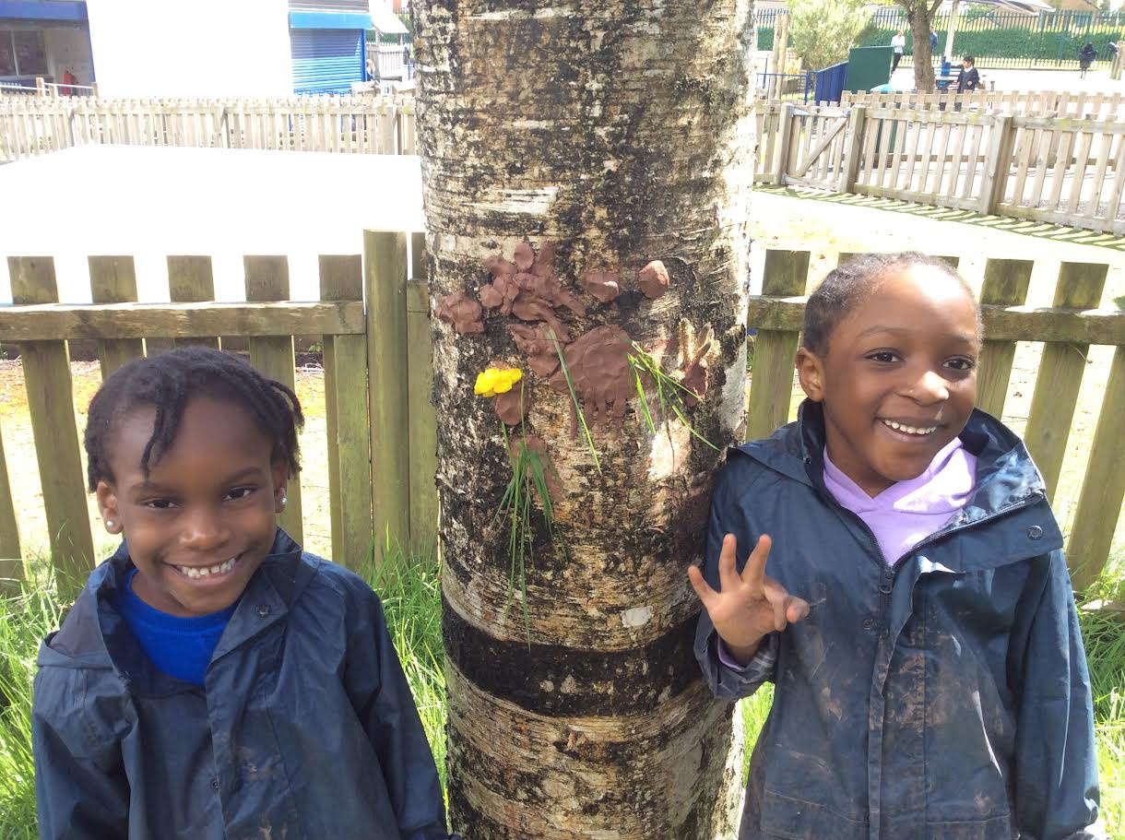
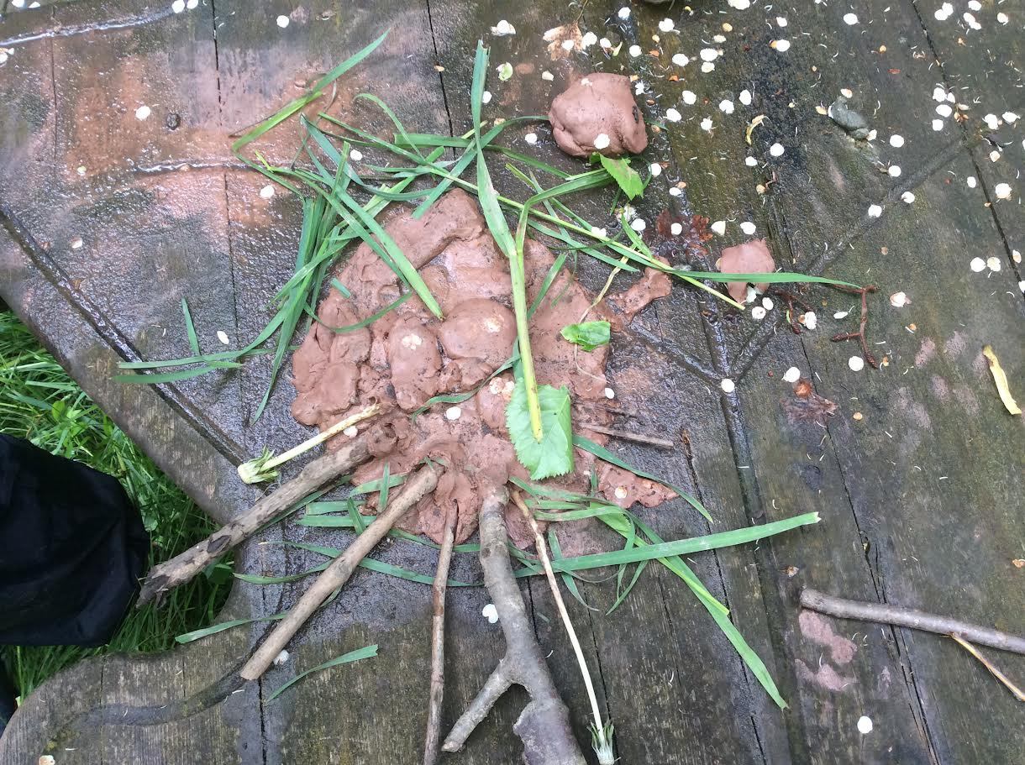
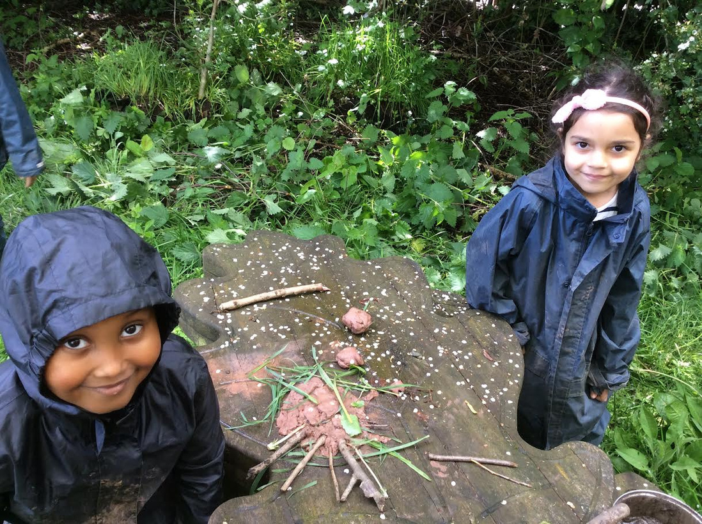
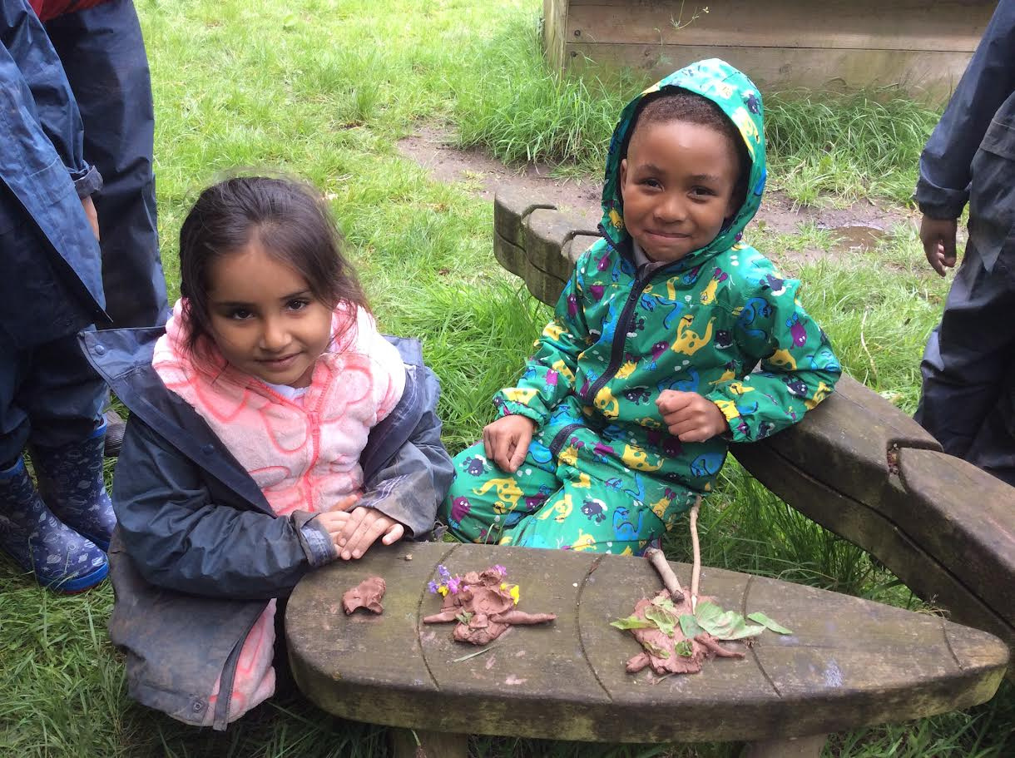
SCHOOL NEWS
Forest School
Year 1D are enjoying being out in Forest School this half term. This week we created tree spirits. Do you like them?

Slide 8
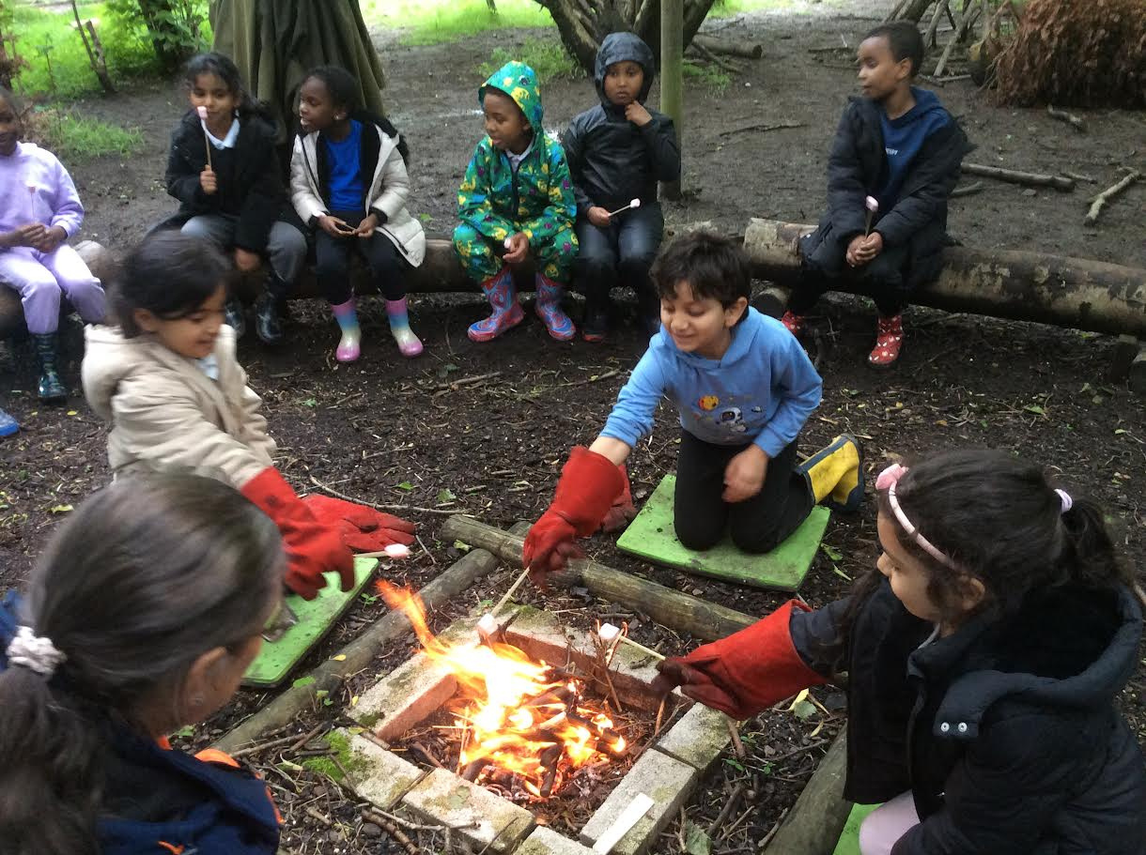
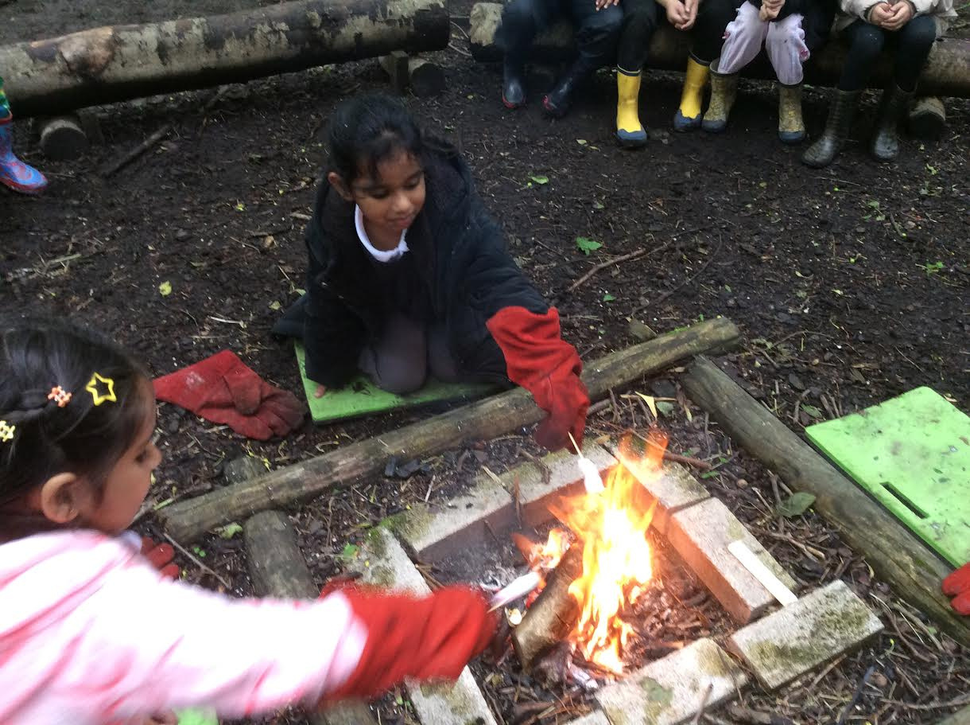
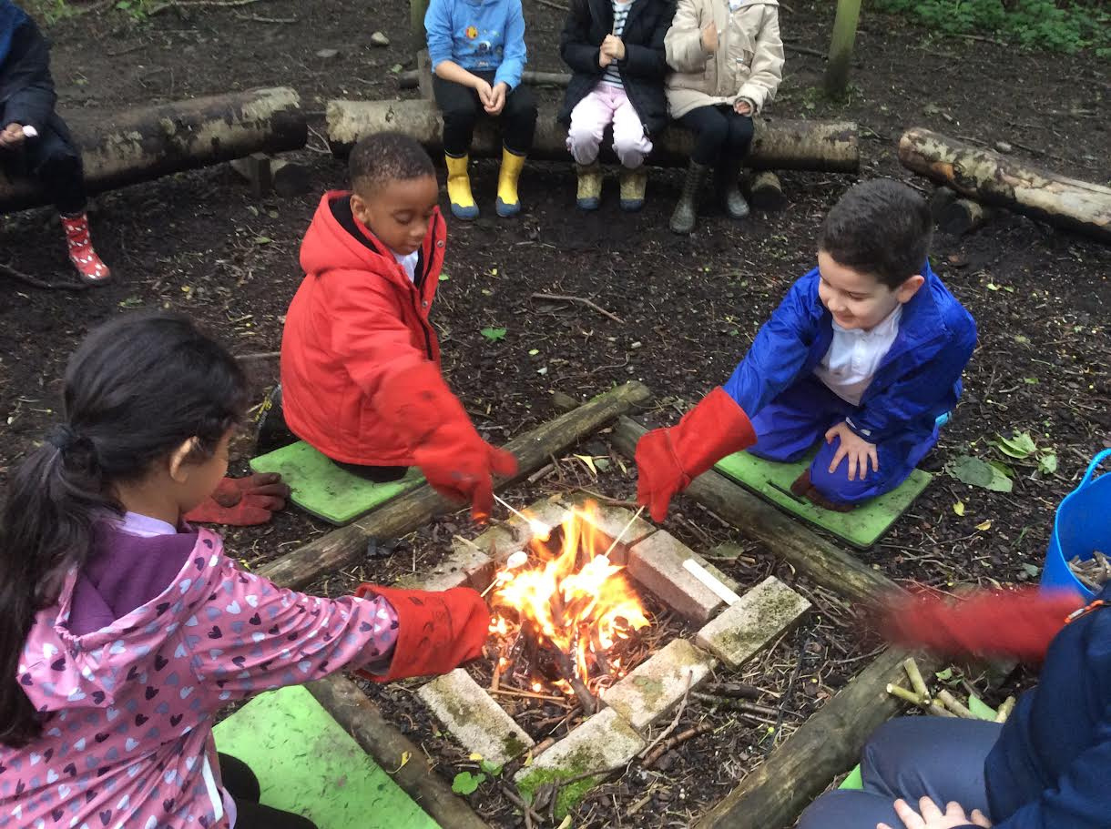
SCHOOL NEWS
Forest School
Y1D had a fire this week in forest school. We toasted marshmallows and made smores. Some of us had eight marshmallows! It was the best day ever.

Slide 9

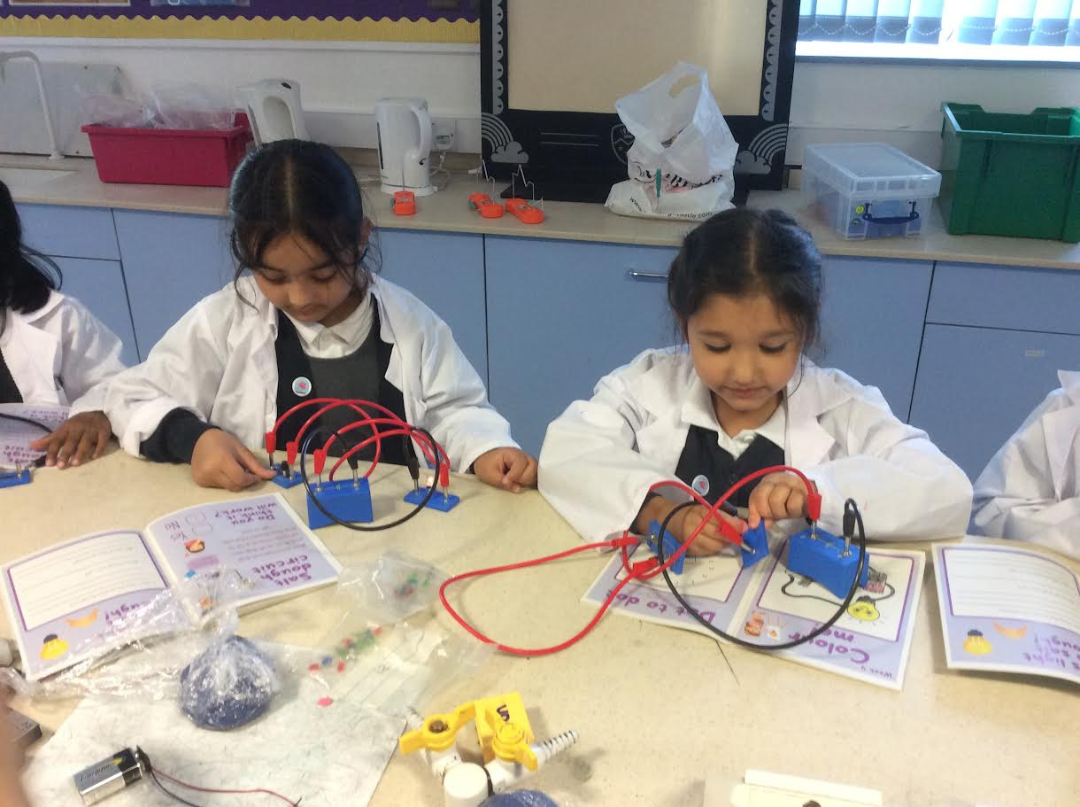
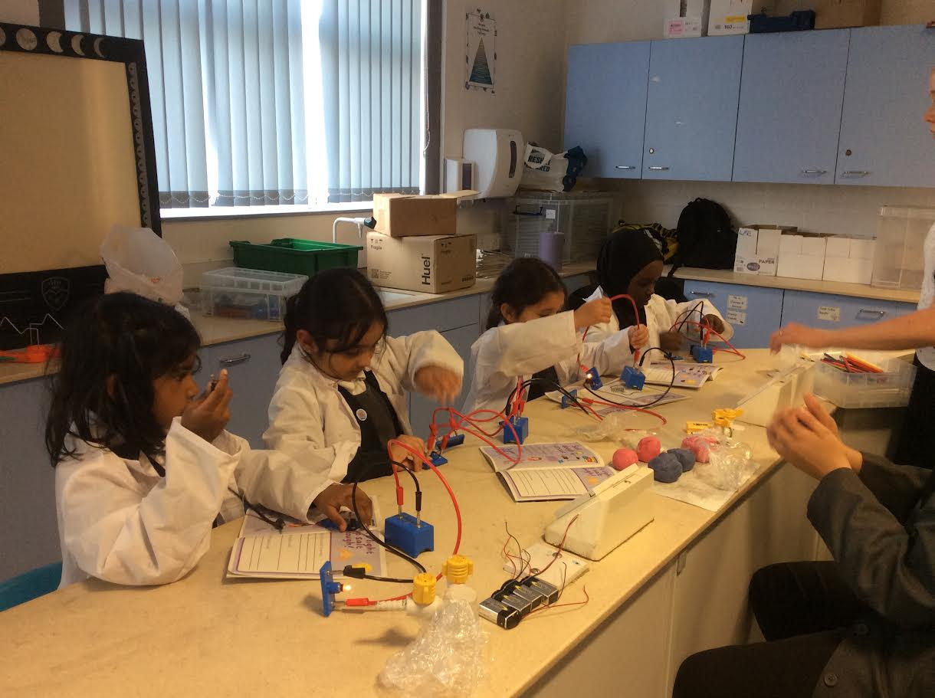
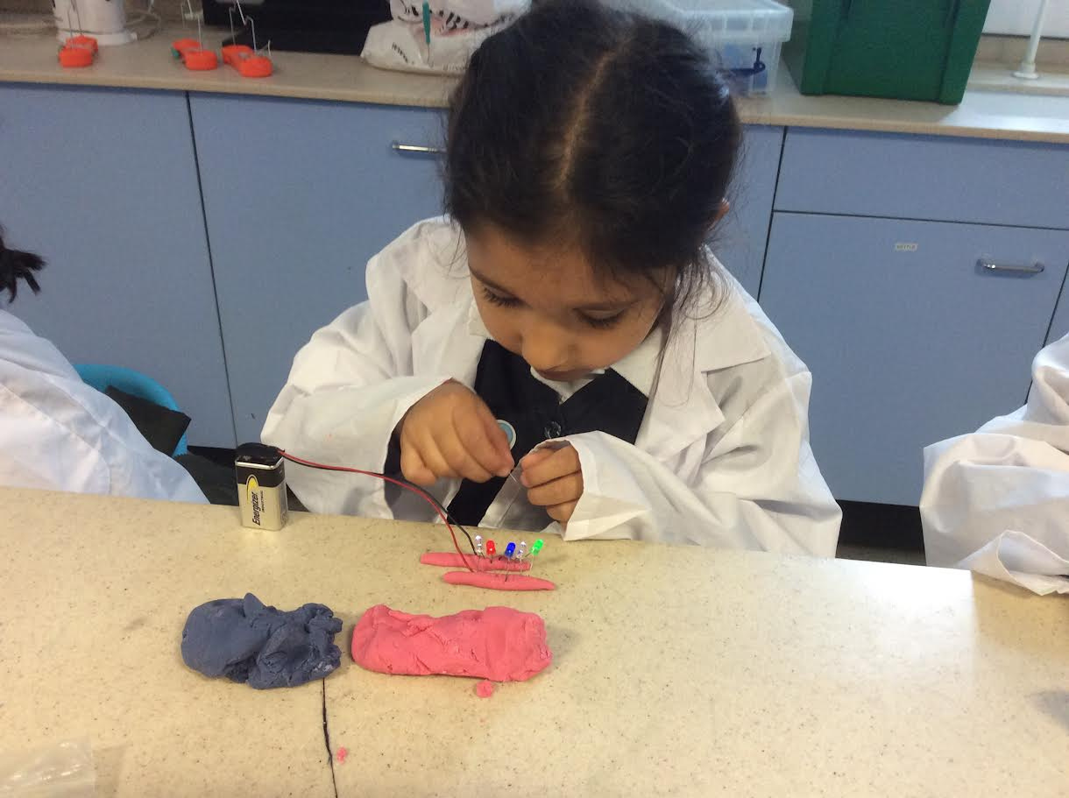
SCHOOL NEWS
Y1 Physics Club
Y1 Physics science club at Sharples High school was a success this week.
We were learning about electricity and what would conduct it..... who would have thought that salt dough does.

Slide 10

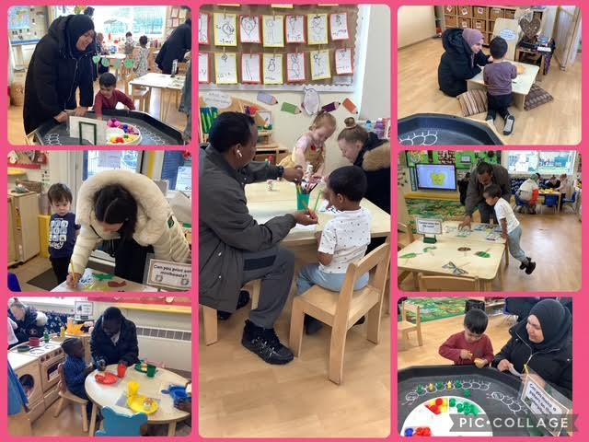
SCHOOL NEWS
Nursery
Stay & Play

Slide 11
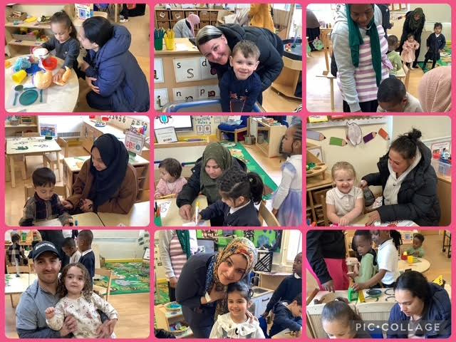
SCHOOL NEWS
Nursery
Stay & Play

Slide 12
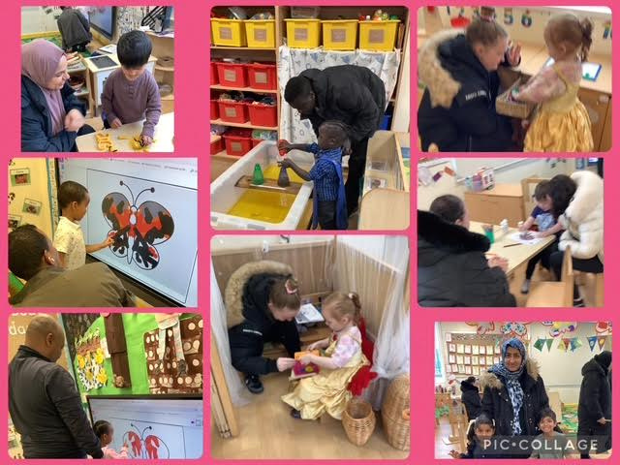
SCHOOL NEWS
Nursery
Stay & Play

Slide 13

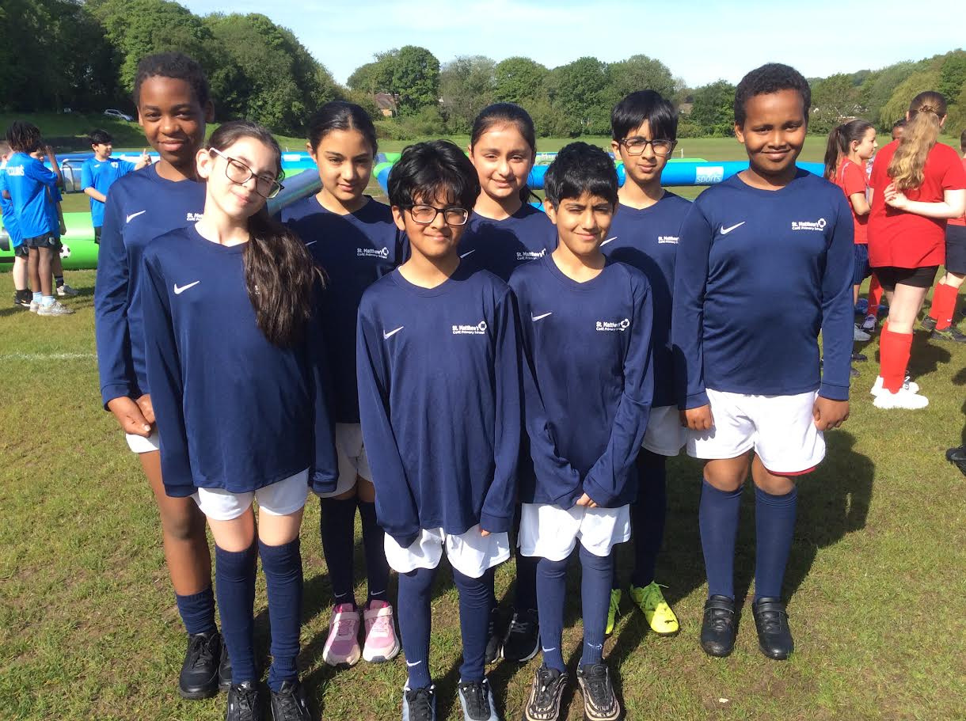
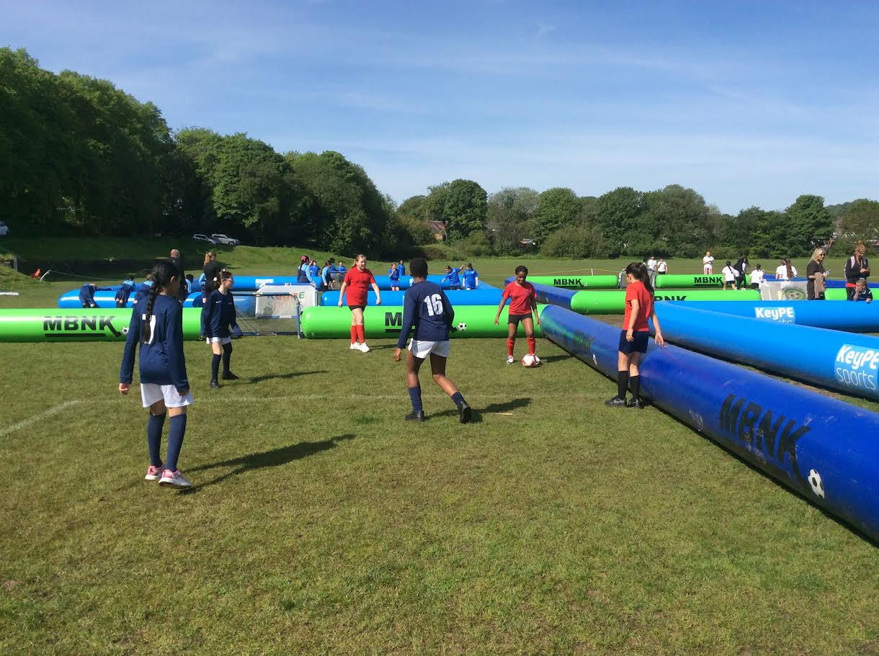
SCHOOL NEWS
Year 6 - Football Festival
Y6 took part in a football festival at Moss Bank Park. We played many games against lots of different schools from Bolton. It was a great morning.

Slide 14
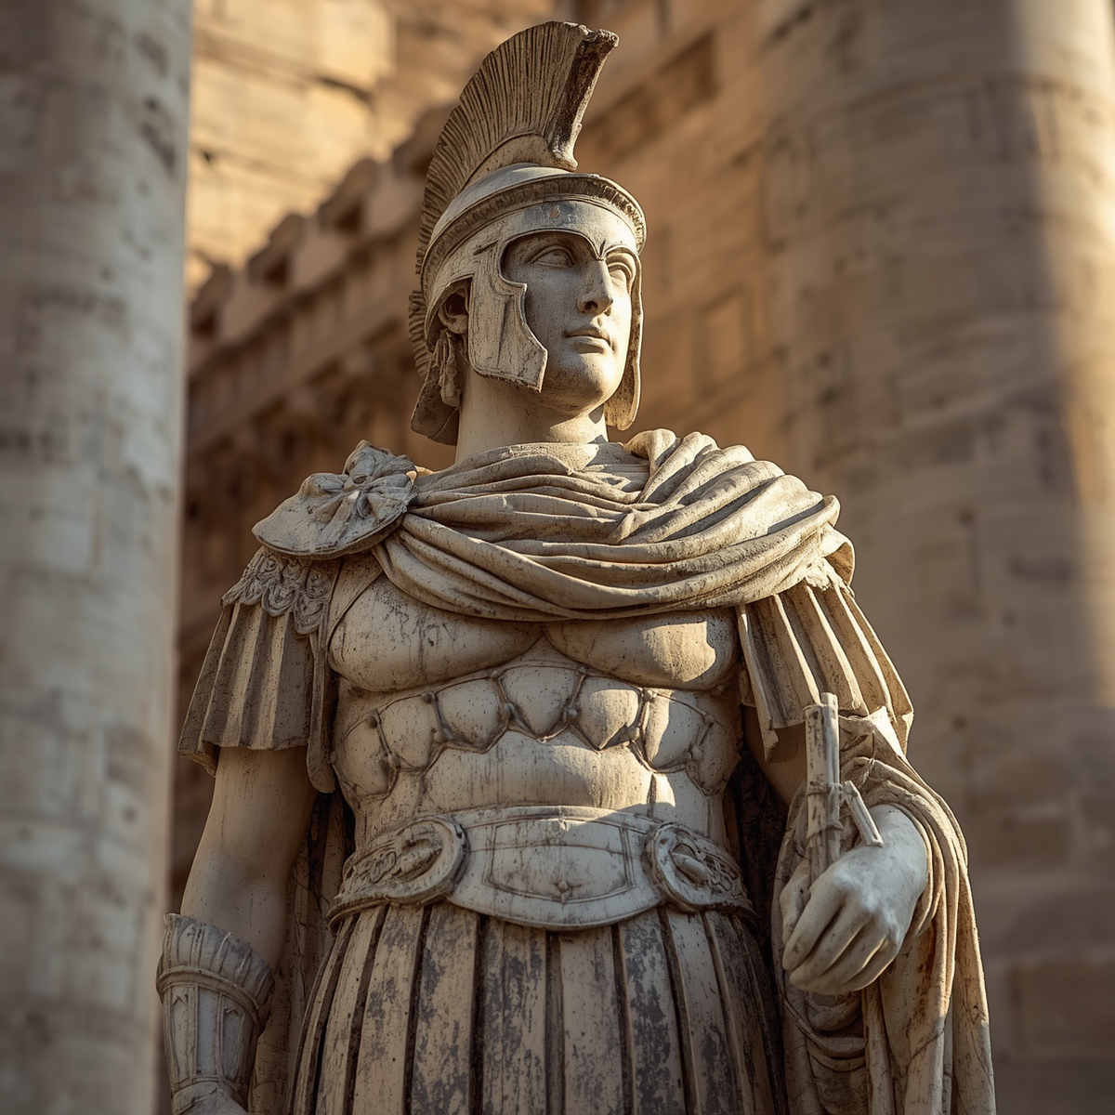
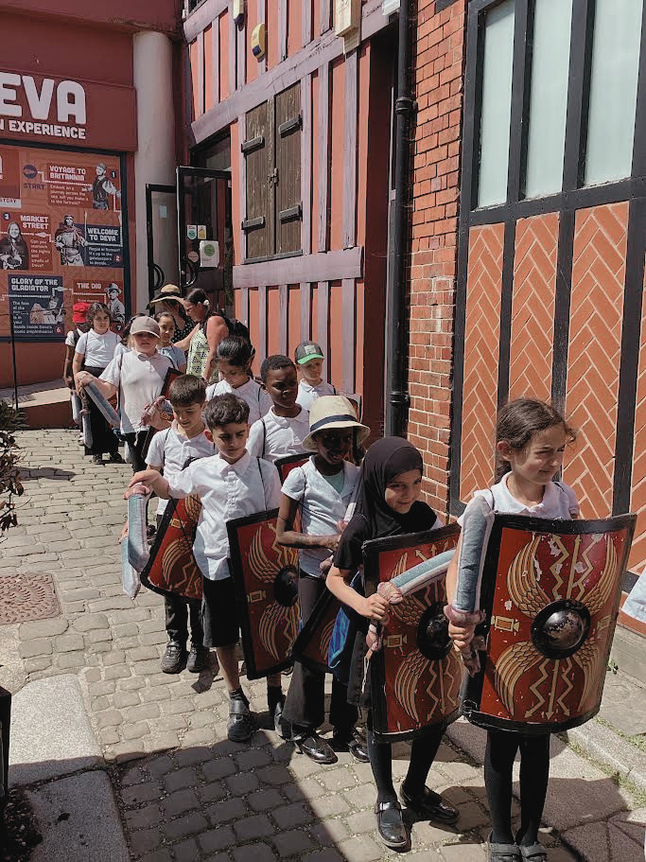
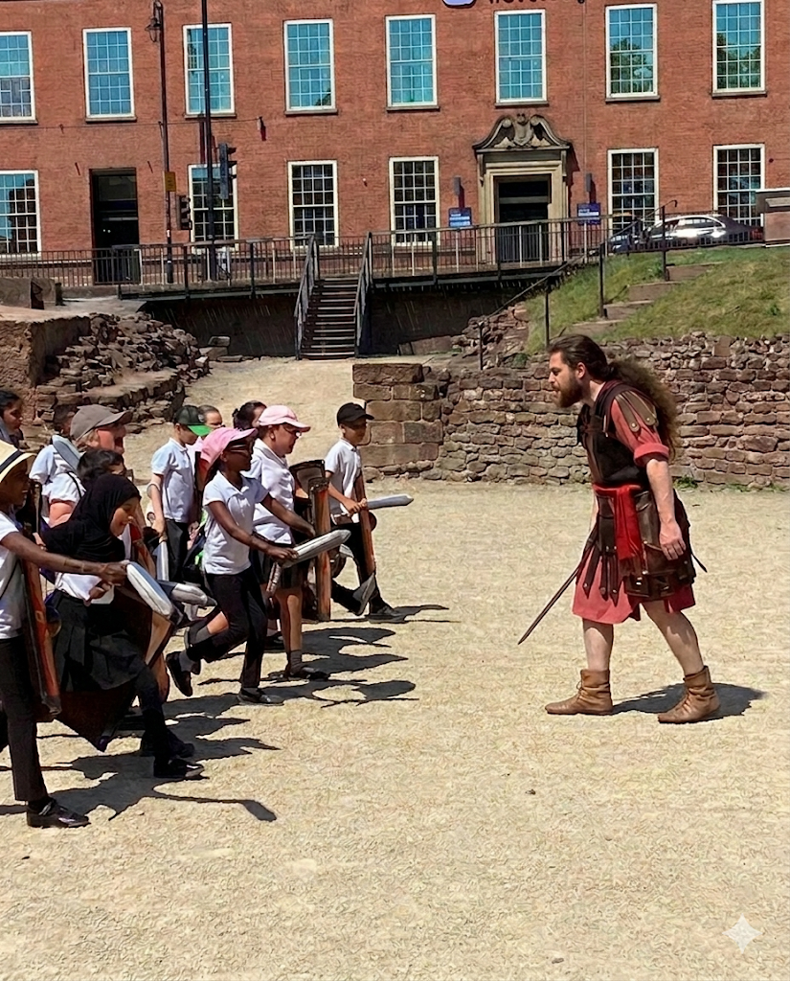
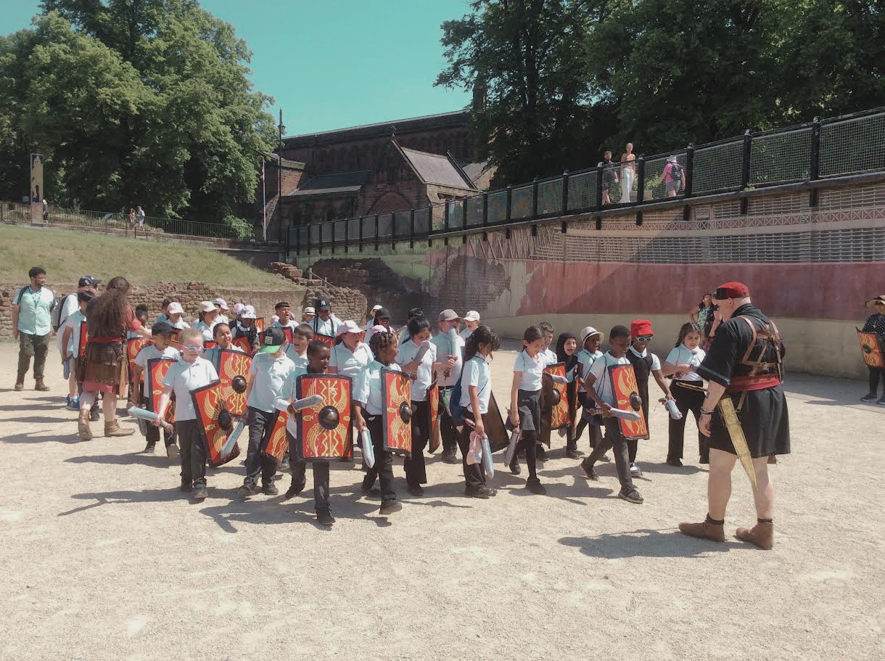
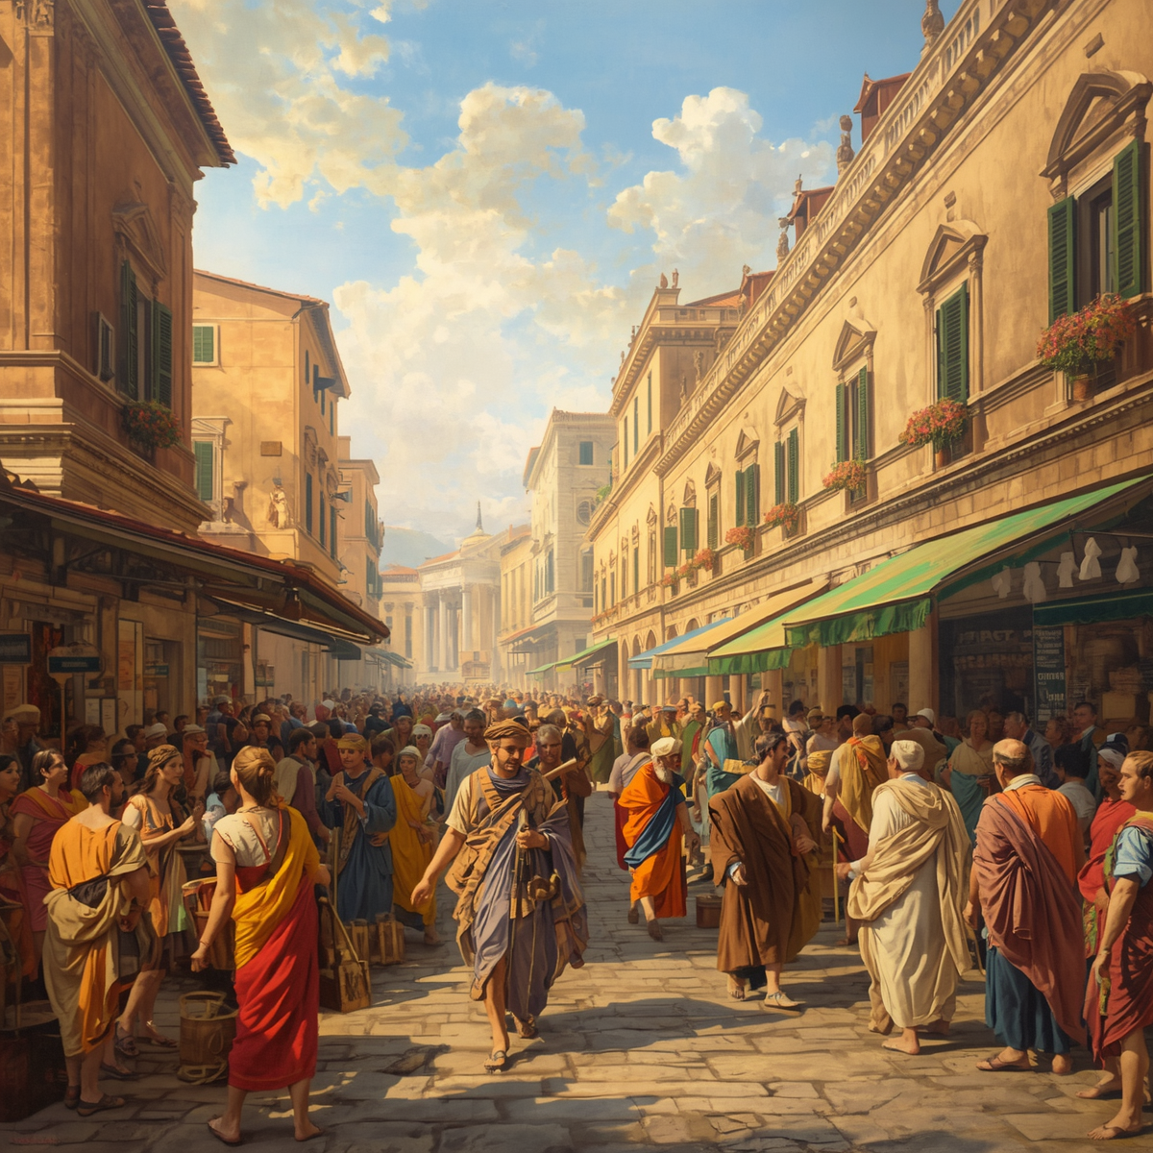
SCHOOL NEWS
Year 3 Roman Deva Experience
Year 3 went to the Roman Deva Experience in Chester. We learnt about life in Roman time and got the opportunity to join the Roman army, We marched through the streets of Chester with our swords and shields.

Slide 15


