Slide 1


Newsletter
July 2026
www.st-matthews.bolton.sch.uk
We are an Operation Encompass School, which means that we receive reports from the police when there has been an incident in a home where a child lives.
MESSAGE FROM THE
HEADTEACHER
In our final newsletter of this academic year, we have lots to celebrate across the school after such a busy half-term! We are very proud to share the news that we have successfully achieved the Inclusive Attendance Bronze Award. This is in recognition of our whole school approach to working with children and families to improve school attendance.
We have continued to host a range of workshops linked to neurodiversity for parents and carers this term as part of the PINS project. Thank you to all our families who attended - we hope you found the sessions useful.
Eddie Kavanagh from Bolton Council's 'Five Ways Happy Days' initiative has also been delivering a series of parental workshops recently, with a focus on how to support your mental health. In September, Mrs. Boyd and Miss. Rostron will also be launching the project with the children across school.
Many of our classes have enjoyed visits out of school this half-term, including Bury Fire Training Centre, the beach at Lytham, Little Lancashire Village, Smithills Farm and The Anderton Centre.
A huge welcome back to Mrs. Elliot and Mrs. Bradley, who have both returned from maternity leave. Goodbye and good luck to some of our staff who leave today: Mrs. Berry- good luck in your retirement, and Mrs. Clarkson- enjoy your new adventures in Wales. We also send our congratulations to Miss.May, who is getting married in August.
Finally, I'd like to wish all our families and staff a safe and restful summer break. Thank you so much for making me feel so welcome at St. Matthew's. It really is a special community with such dedicated members of staff, and I wish you all the best of luck for the future.
Mrs. Lister
School Term Dates
2026-2027
School gates will open on January 5th at 8:35 AM
Gates will close at 8:45 AM
DATES ARE INCLUSIVE
AUTUMN TERM – 2026
Tuesday 1st September - School Closed to pupils - Staff Training Day
Term Begins - Wednesday 2nd September 2026
Half Term - Monday 26th October to Friday 30th October 2026
Term Ends - Friday 18th December 2026 – School closes at 1pm
SPRING TERM - 2027
Term Begins - Tuesday 5th January 2027
Half Term - Monday 15th February to Friday 19th February 2027
Term Ends - Thursday 25th March 2027 – School Closes at 1pm
SUMMER TERM – 2027
Term Begins - Monday 12th April 2027
Bank Holiday - Monday 3rd May
Monday 31st May
Half Term - Monday 31st to Friday 11th June 2027
Term Ends - Friday 23rd July 2027 – School closes at 1pm
Important Notice
If you're driving your child to school please make sure you park safely, legally and considerately.
Please do not block the school gate as you are preventing staff from getting to school on time and do not use the garages near school to turn your vehicle around or drop off, this is for local residents.
Please don't park across household driveways near schools and always park safely. We don't want to see anyone hurt.

Slide 2



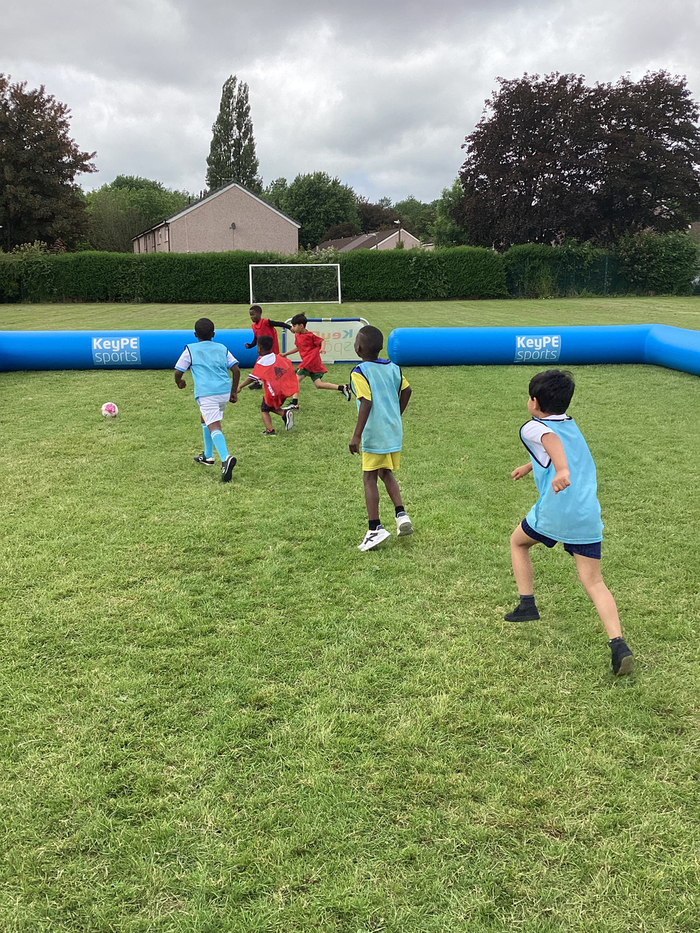
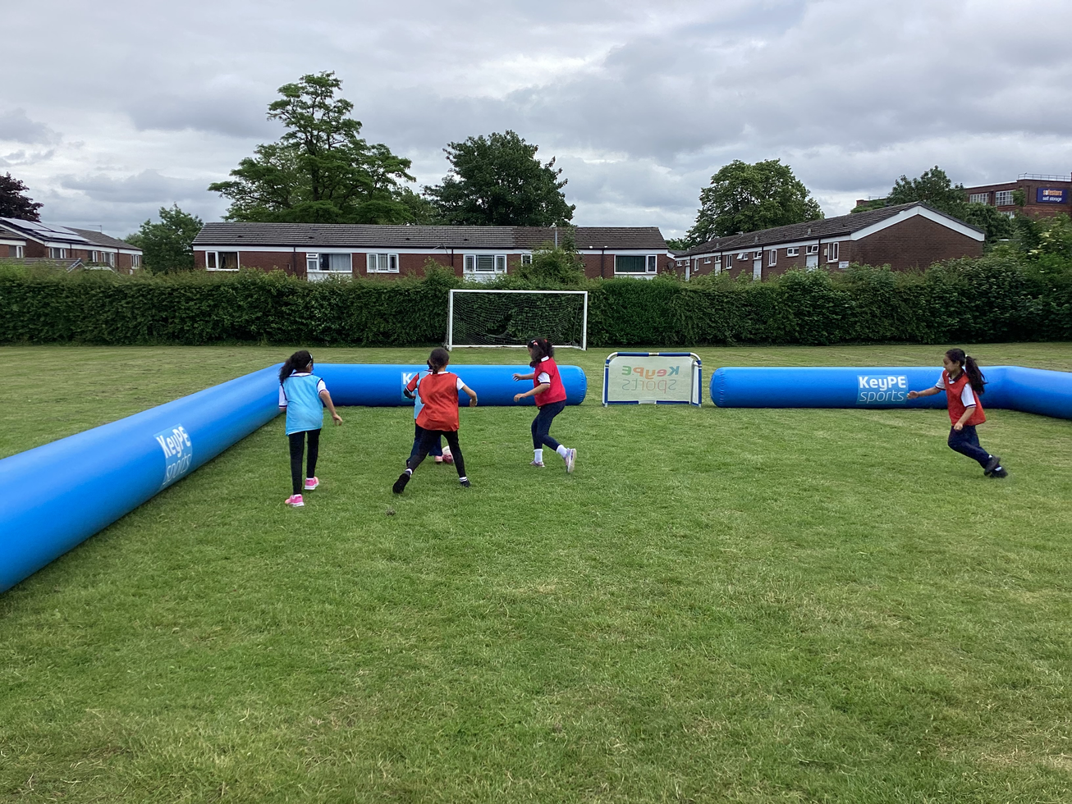
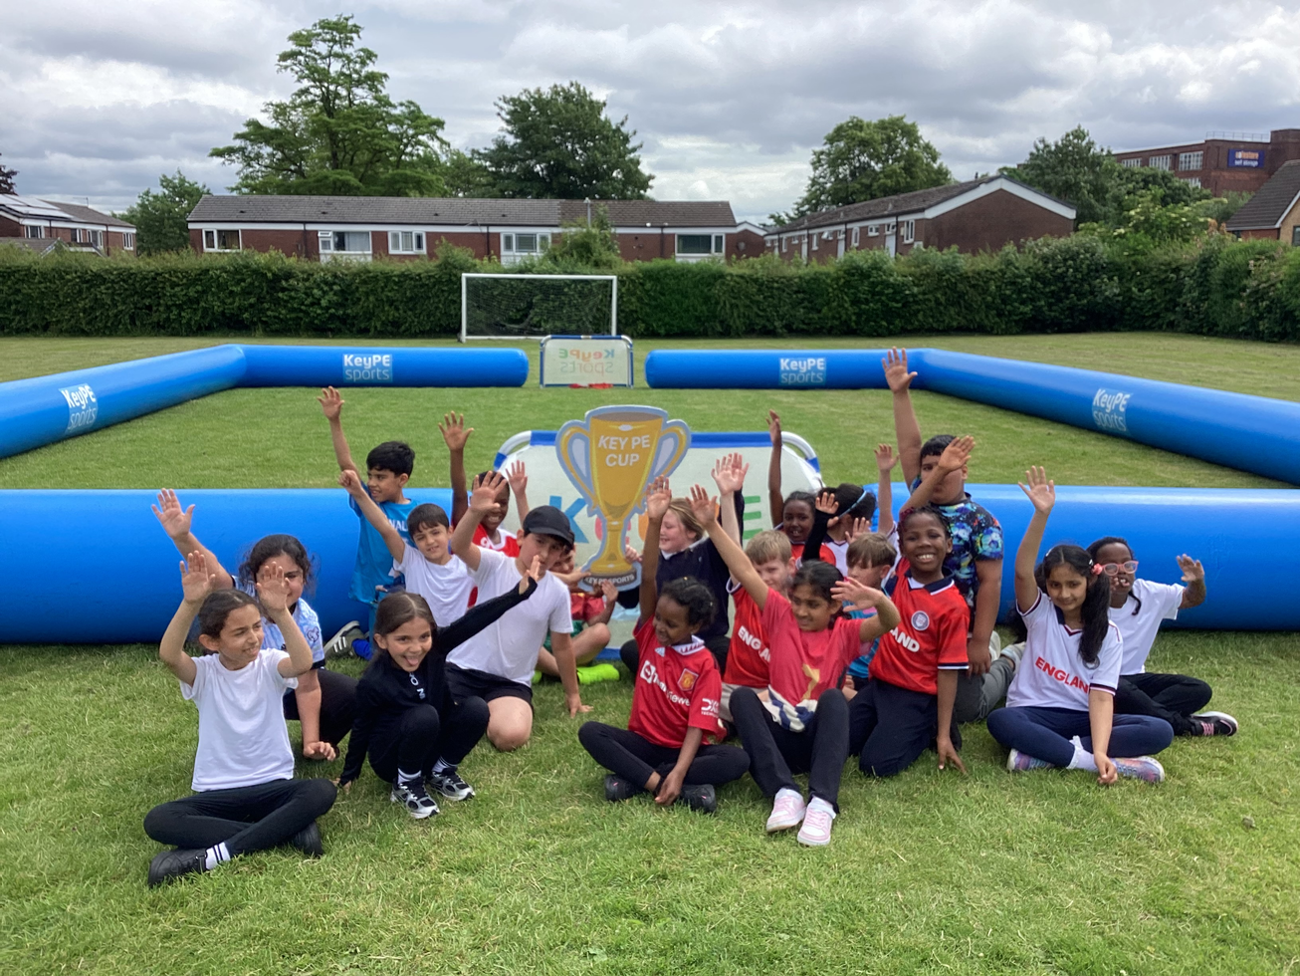
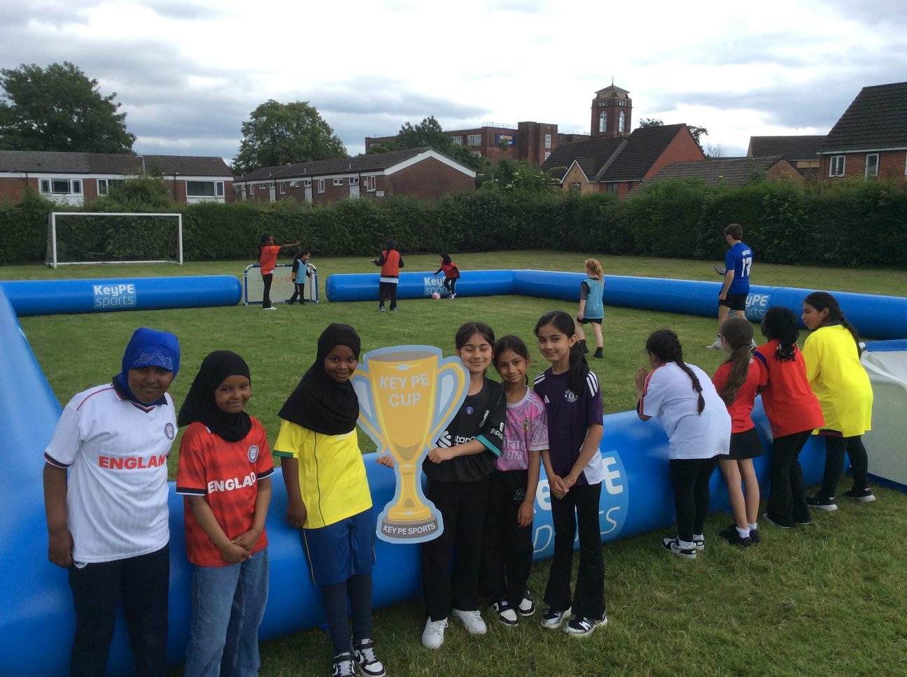

SCHOOL NEWS
World Cup Day
In School
Today we have held a special World Cup Day in school. We wore our sporty clothes and had football games in inflatables on the field. Everyone has had a great day.

Slide 3

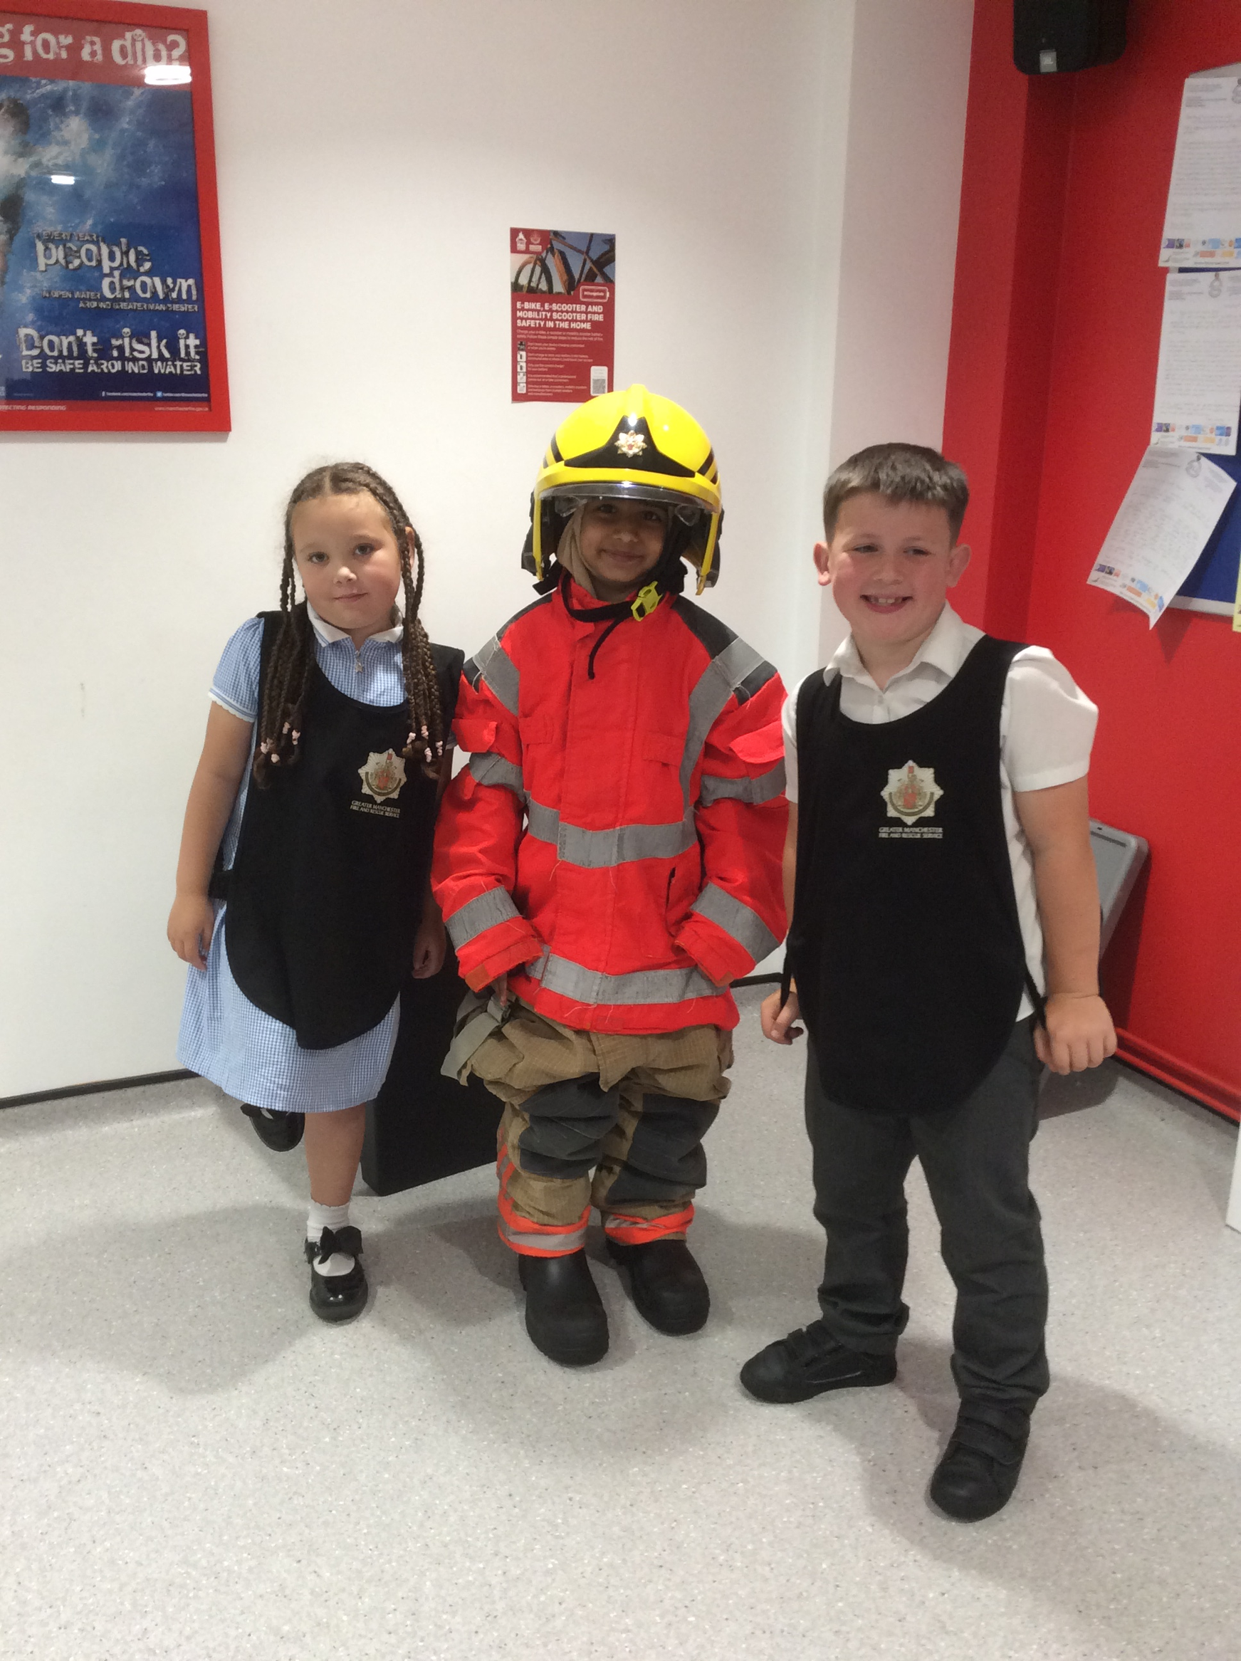
SCHOOL NEWS
Year 2 Visits
Bury Fire Station
2 visited the Bury Fire Training Centre to attend a 'Little Life Saver' workshop. We learnt lots of important information such as: we ring 999 for emergency help in England, we stop drop and roll if our clothes catch on fire and if there is a fire in your home Get Out - Stay Out - Ring 999.

Slide 4

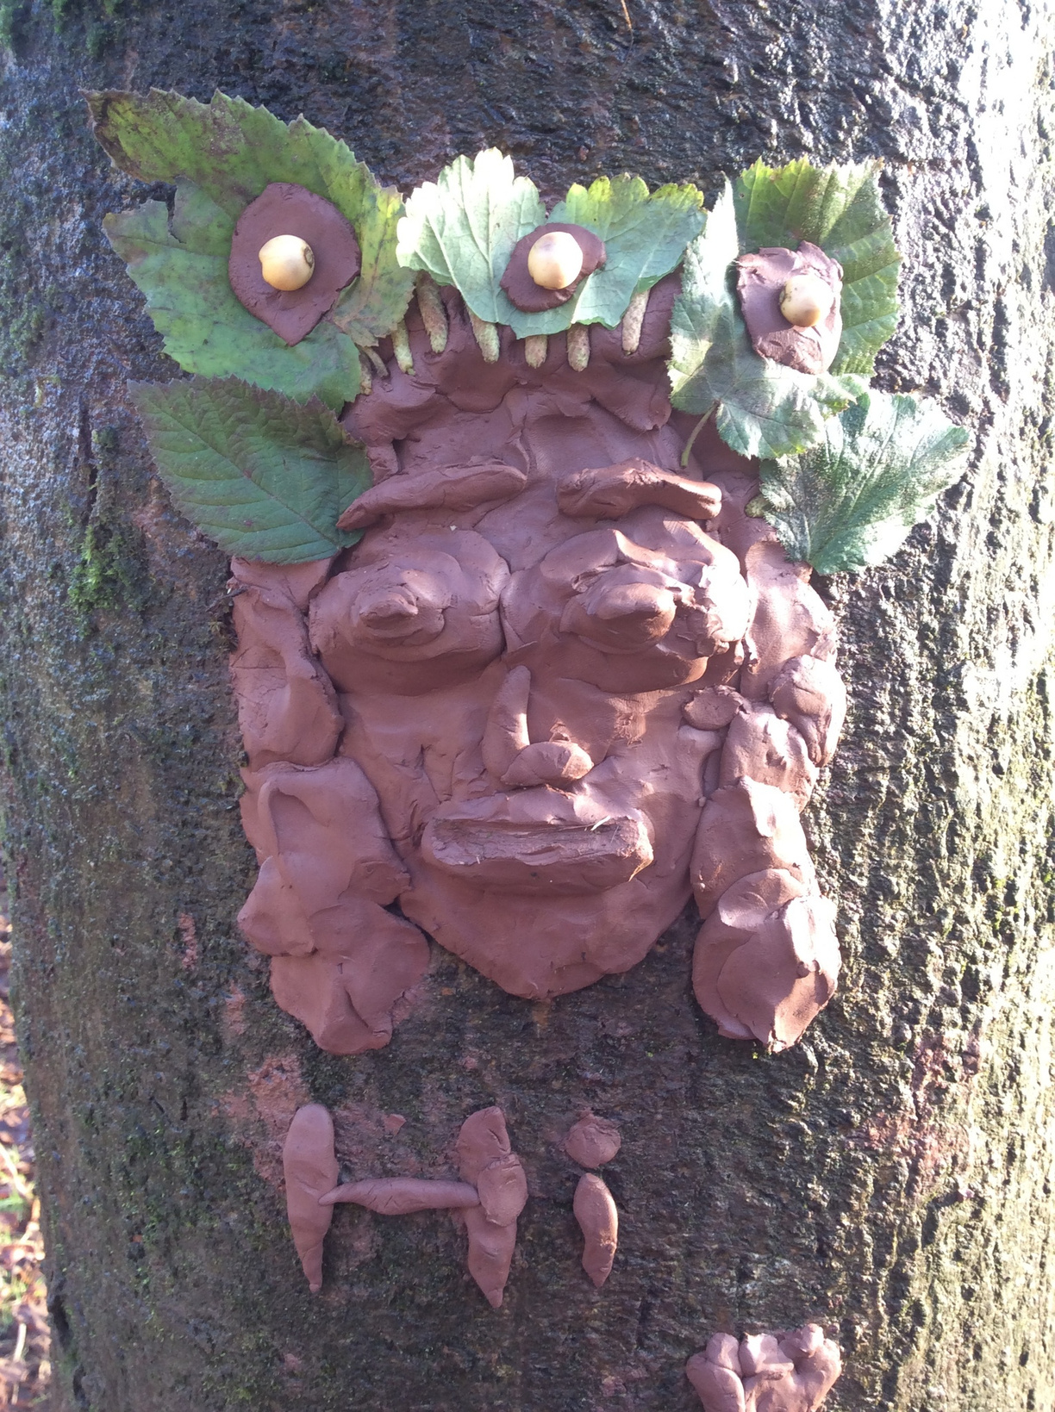
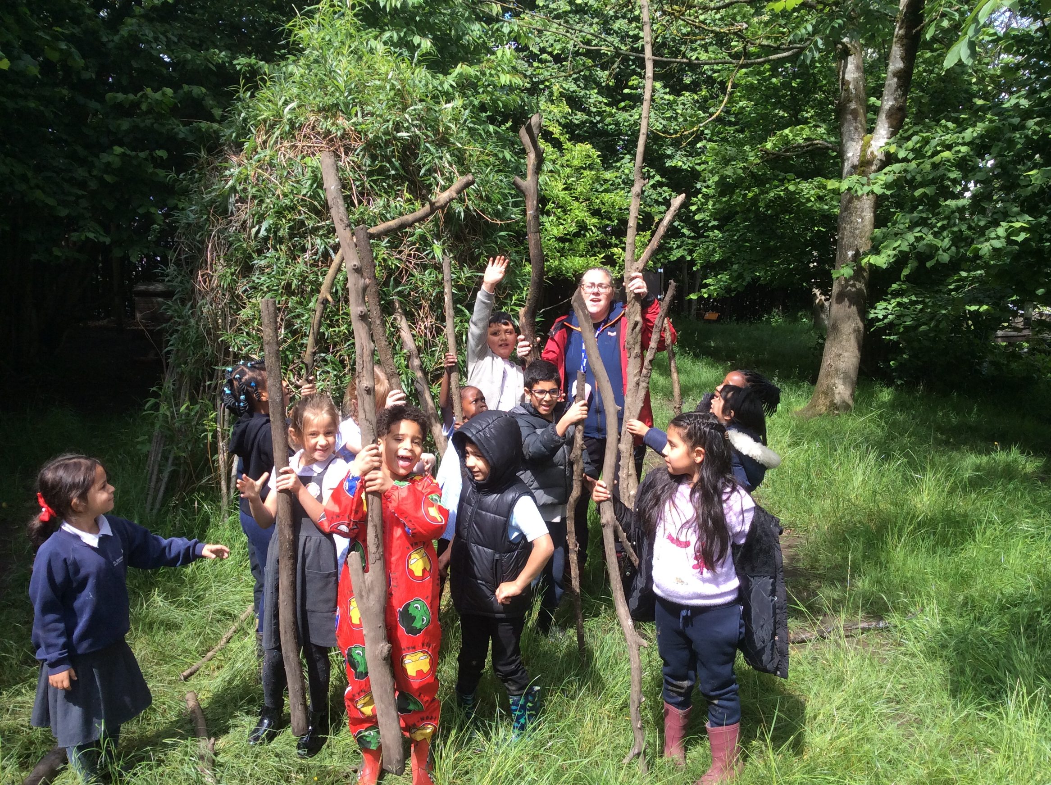
SCHOOL NEWS
Forest School
Year 1D are having fun in forest school this half term. On our first week we had a challenge to find the longest stick, Mrs Ozard won this.

Slide 5

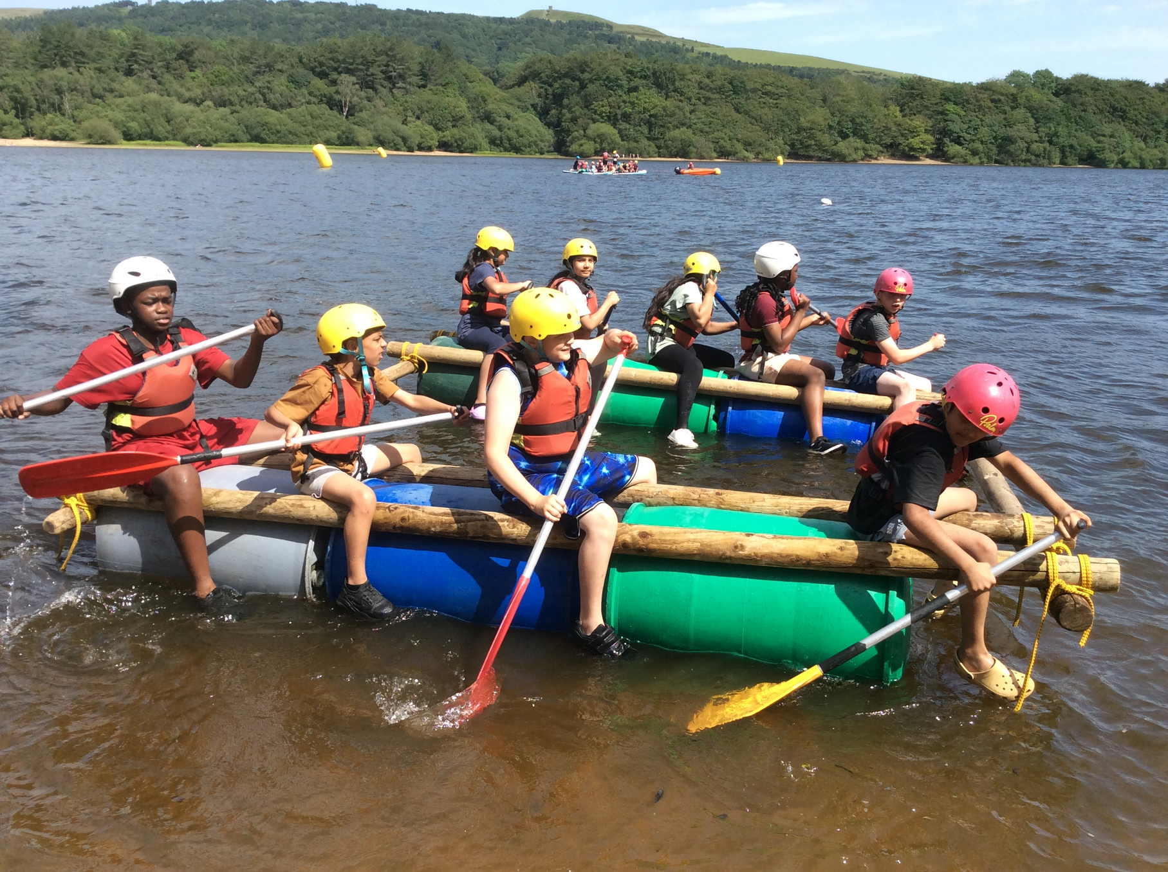
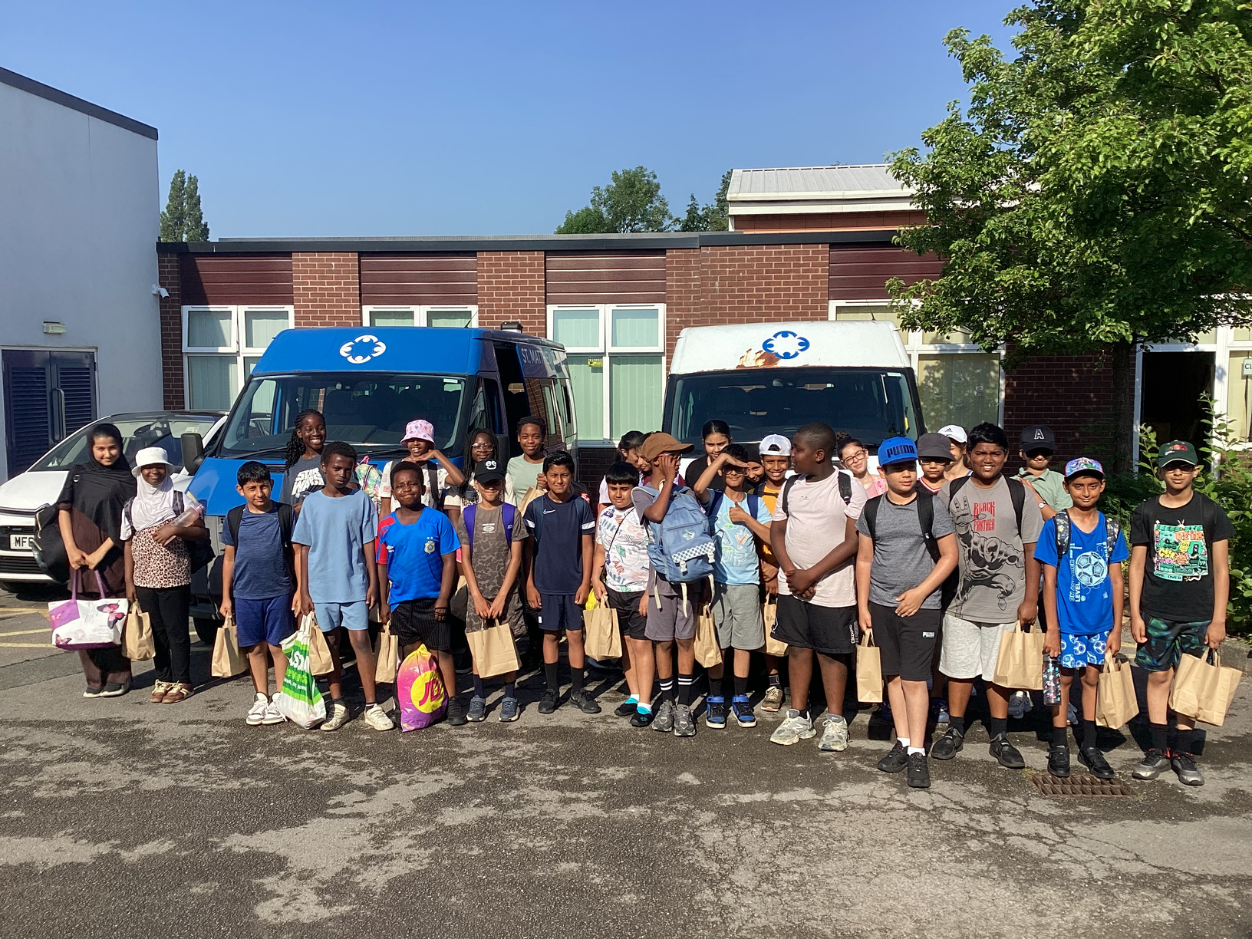
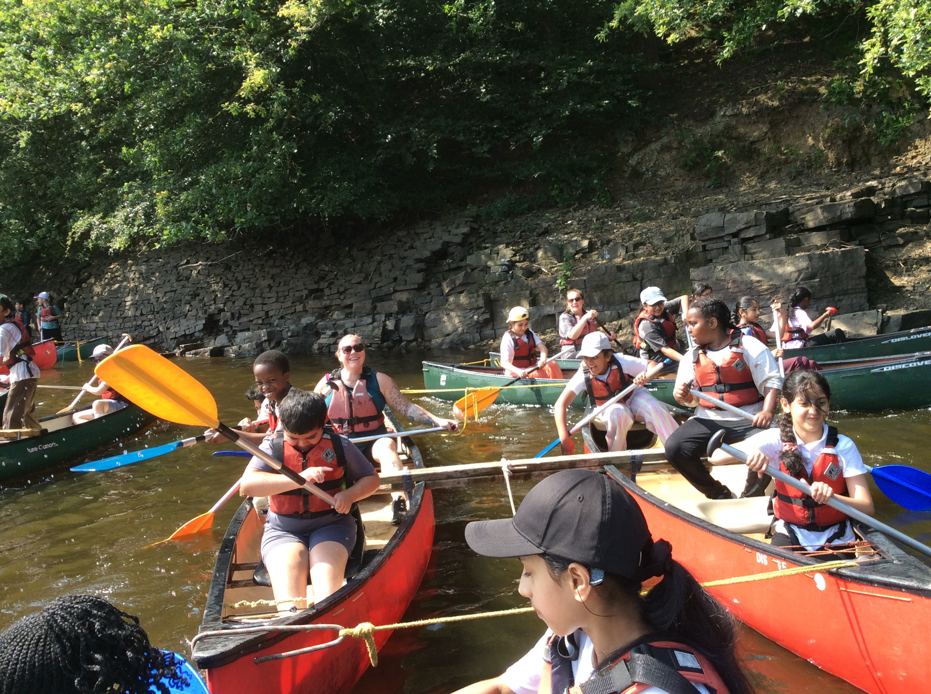
SCHOOL NEWS
Forest School
Our year 5 and 6 classes all attended the Anderton Centre for one day each. Everyone had a brilliant time. We were canoeing, raft building, tree climbing, axe throwing and doing archery.

Slide 6
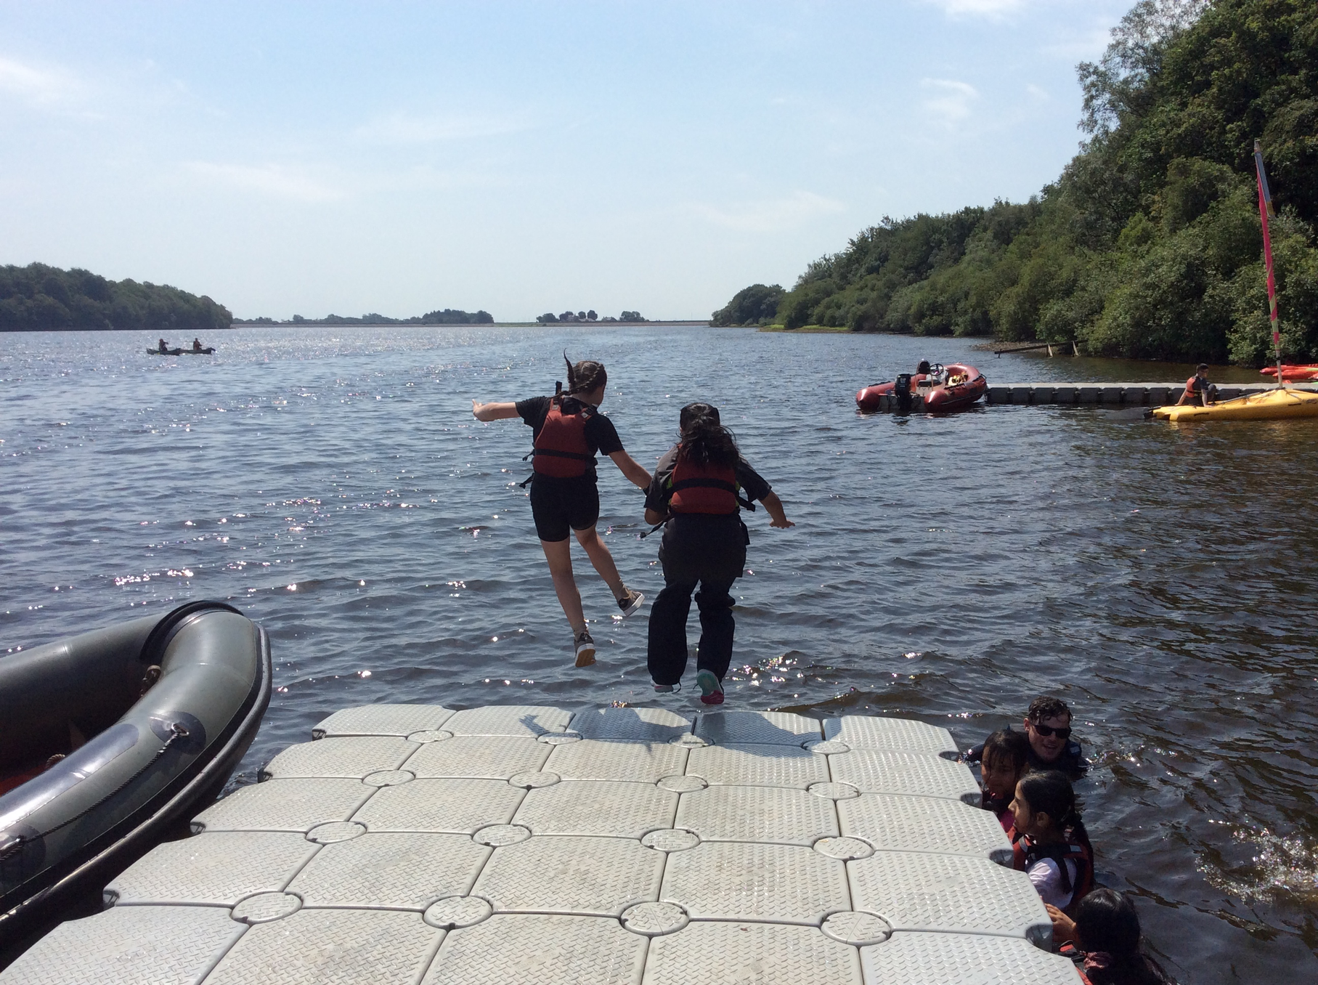
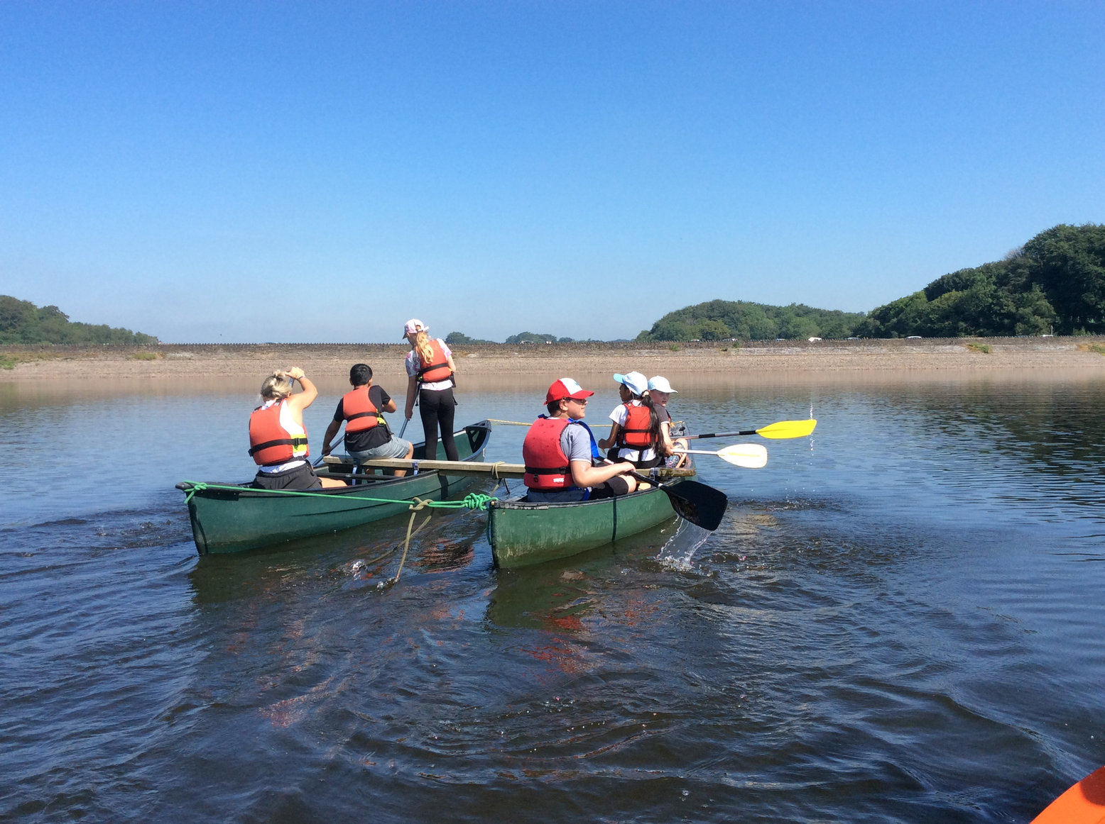
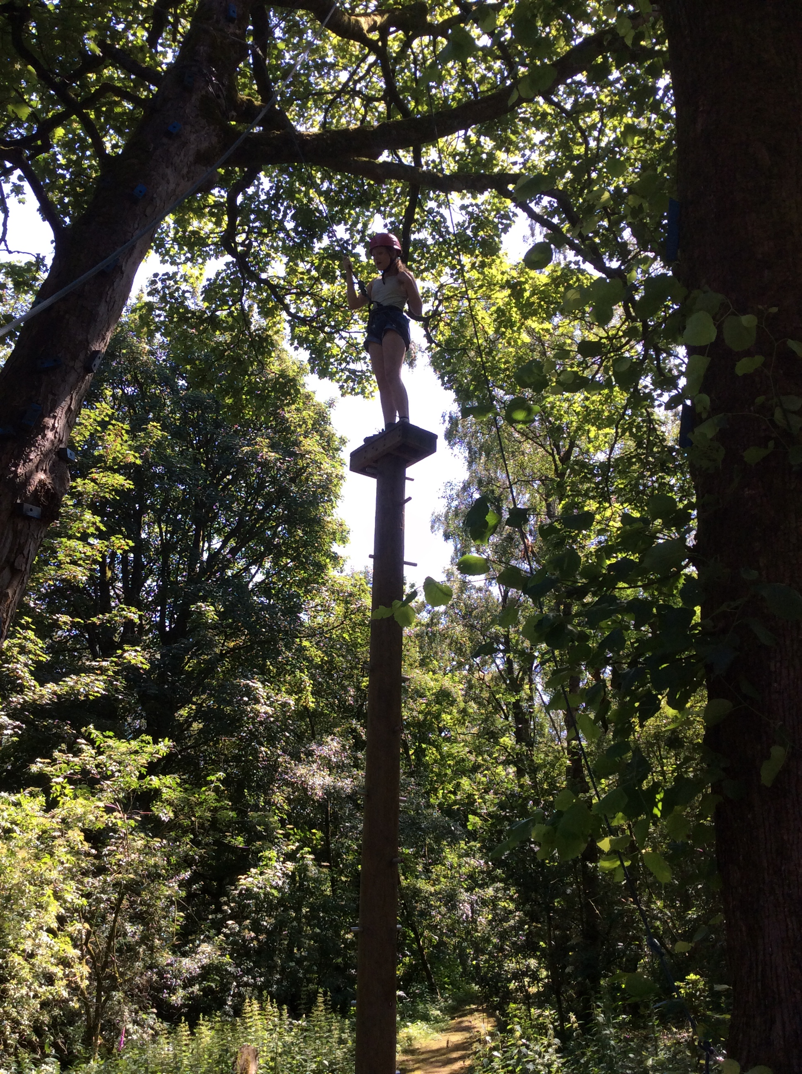
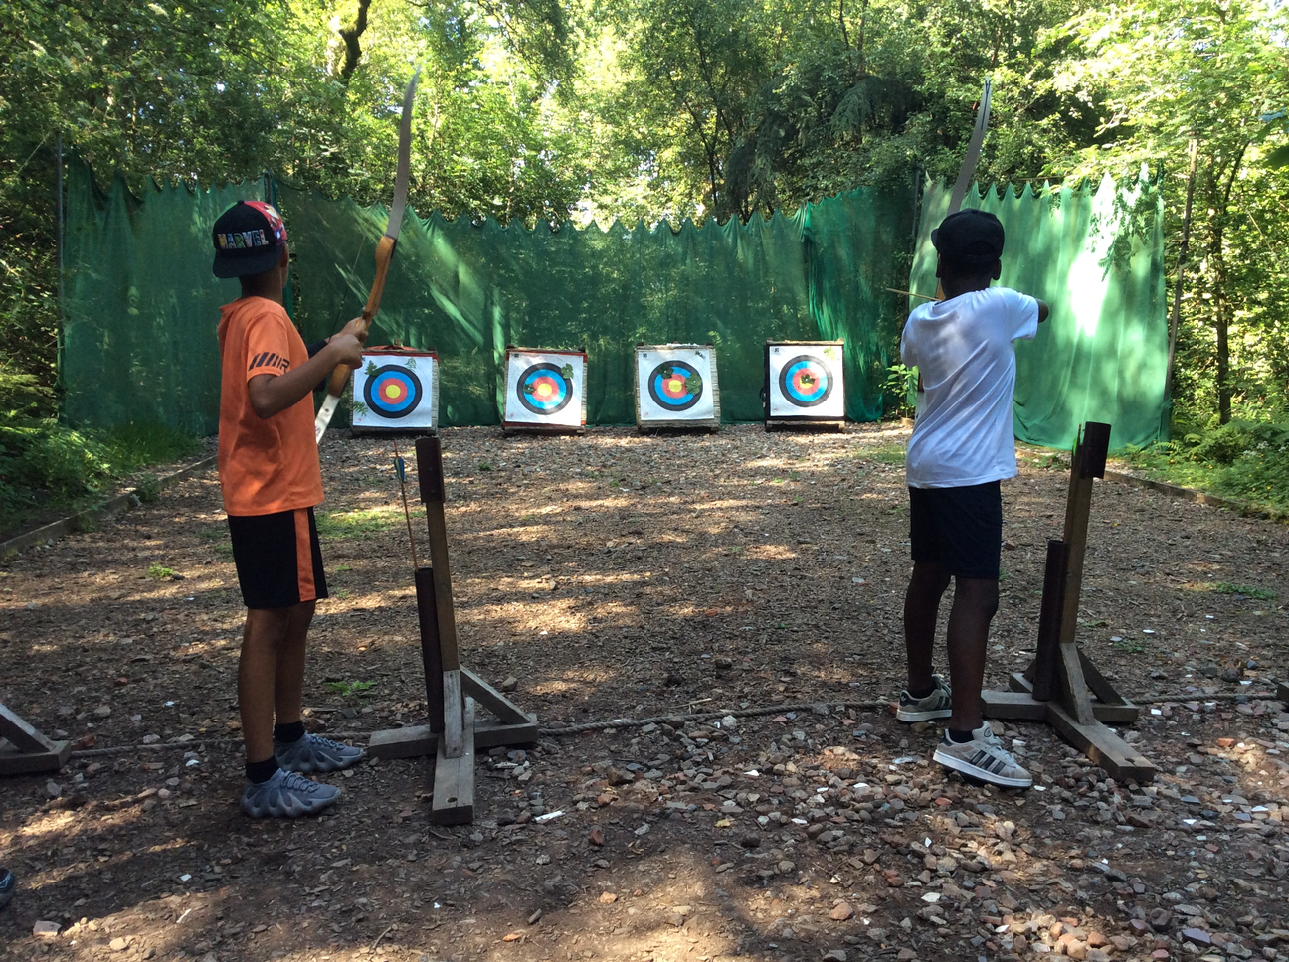
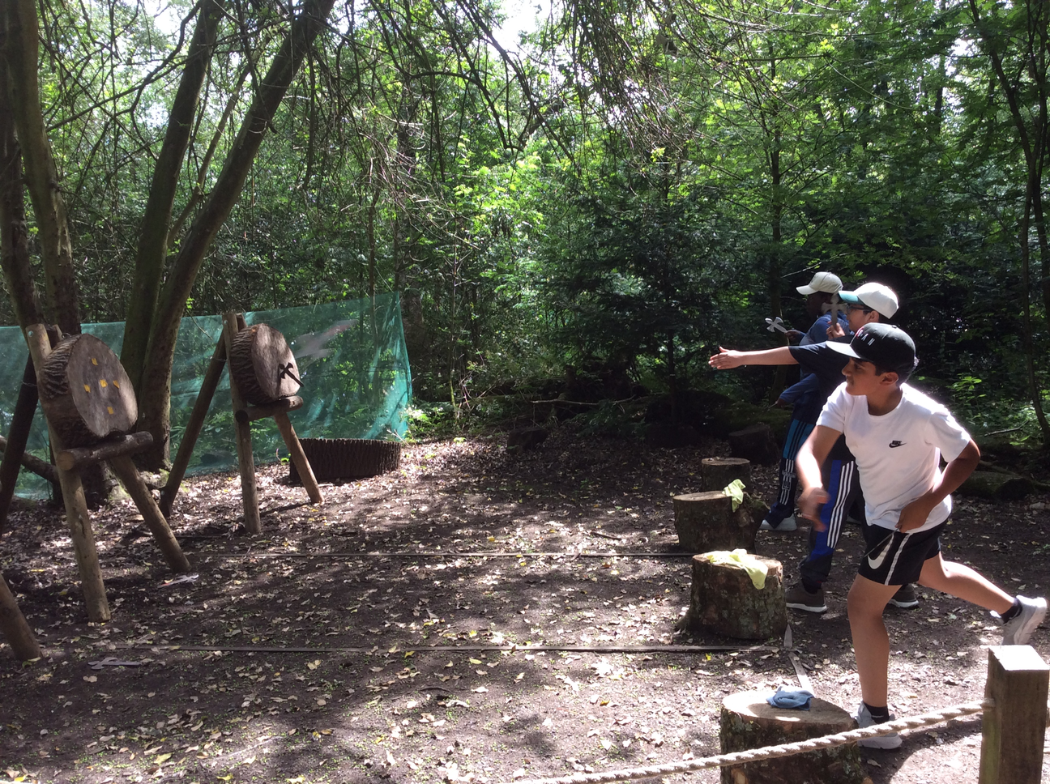
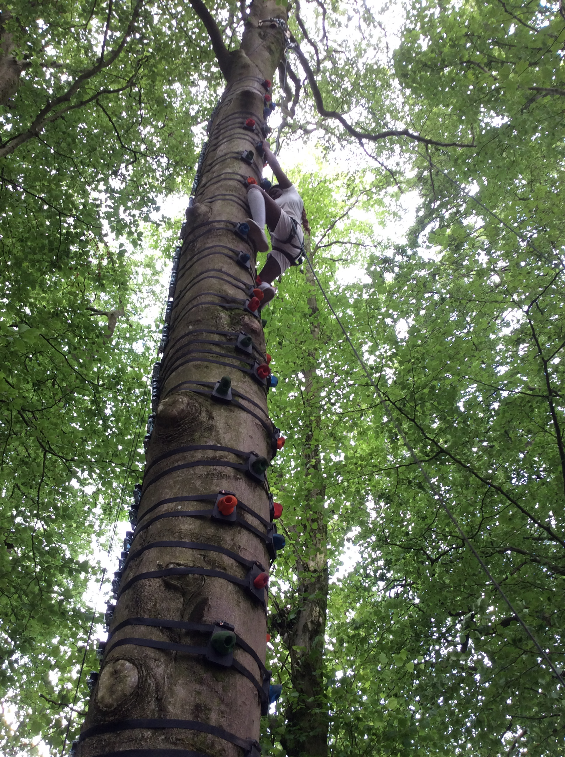
SCHOOL NEWS

Slide 7

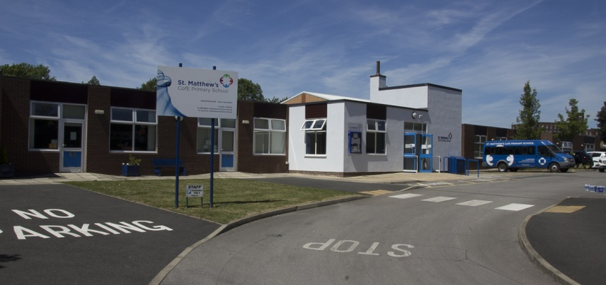

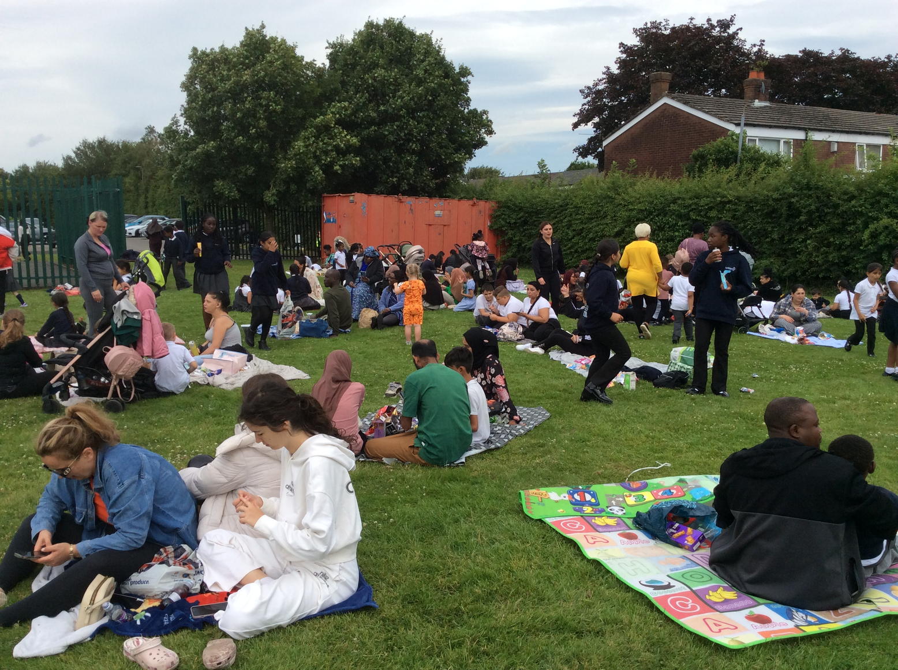
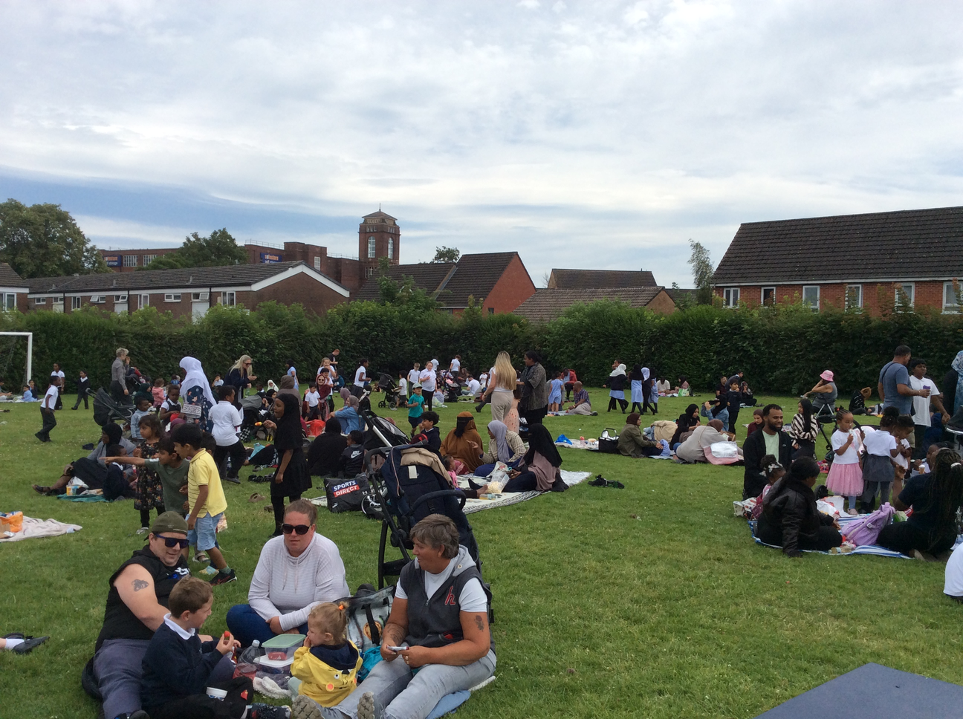
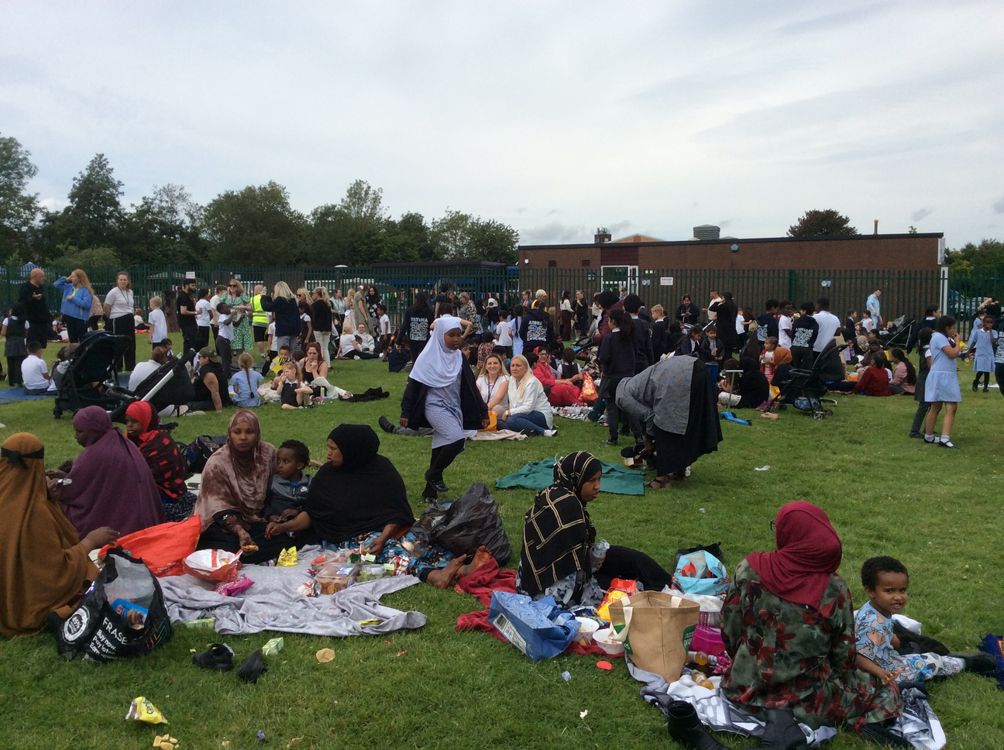
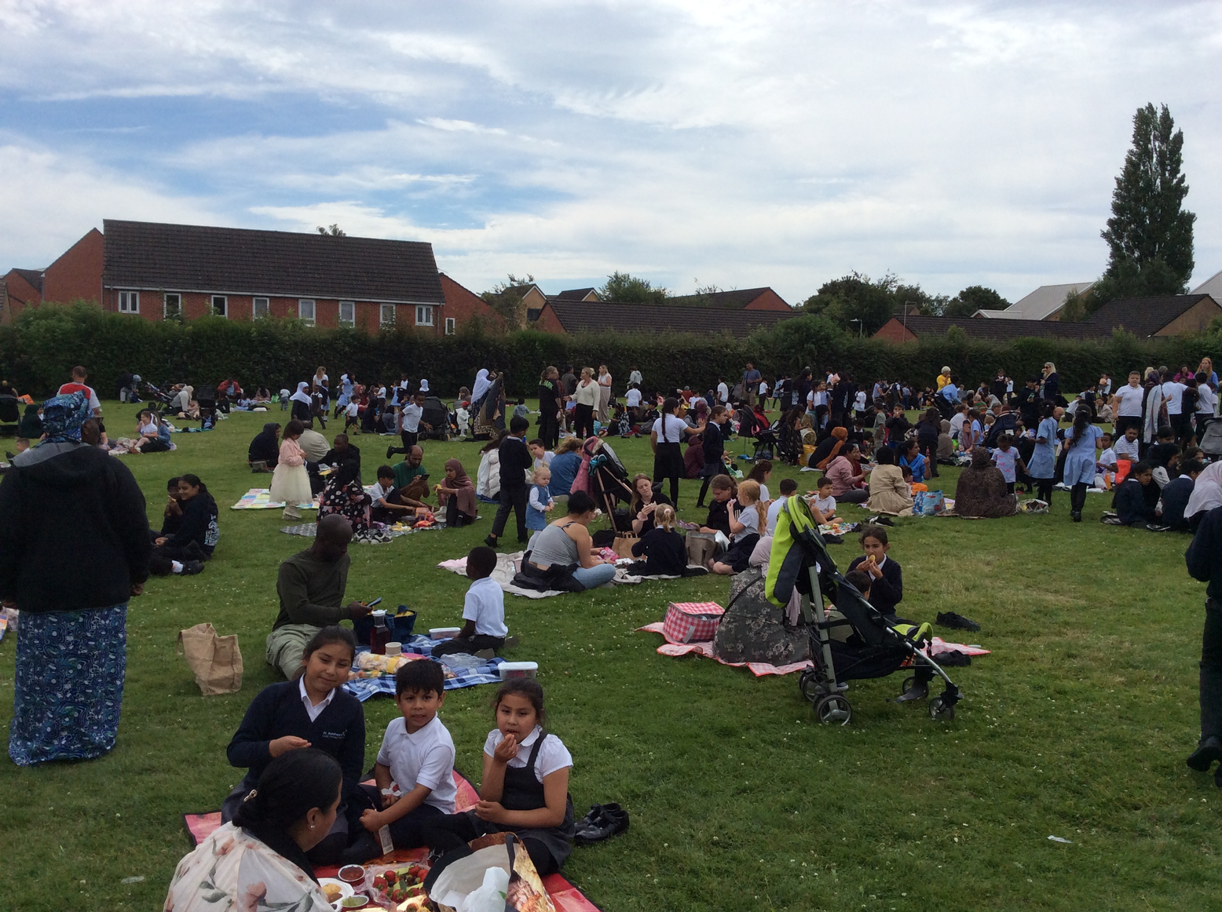
SCHOOL NEWS
Family Picnic
We hosted our summer family picnic this week.
What a great success. Thank you to everyone who attended.

Slide 8

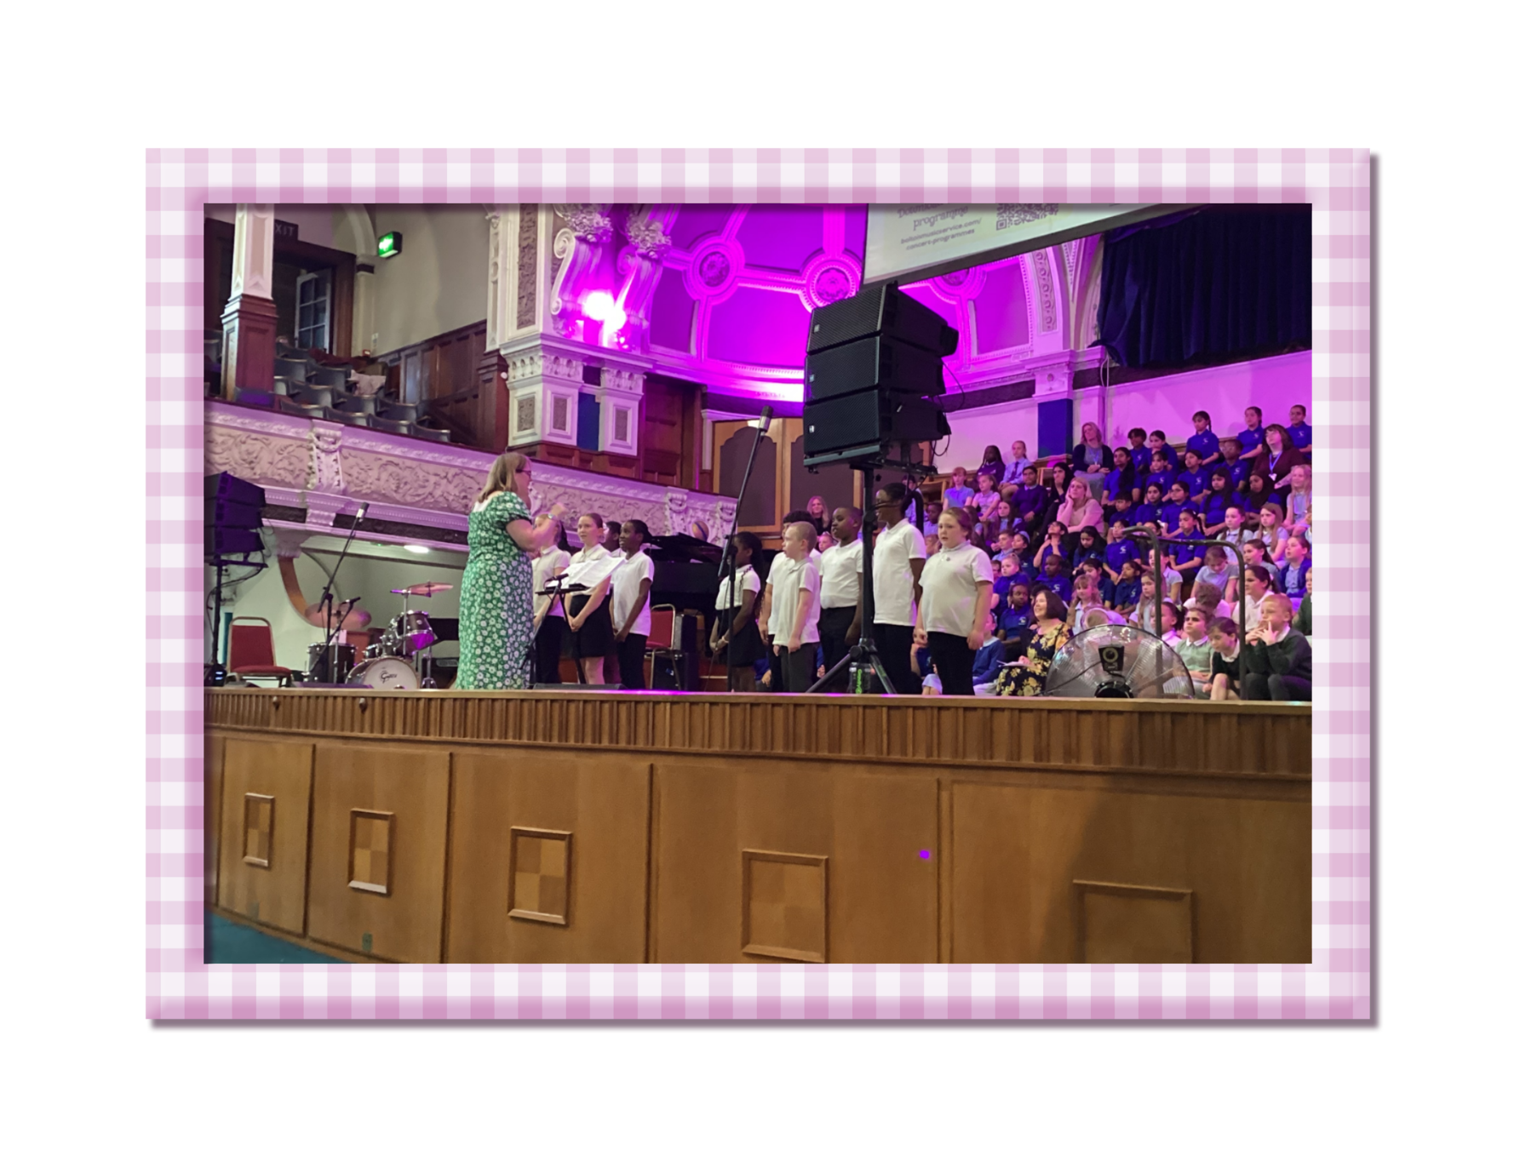
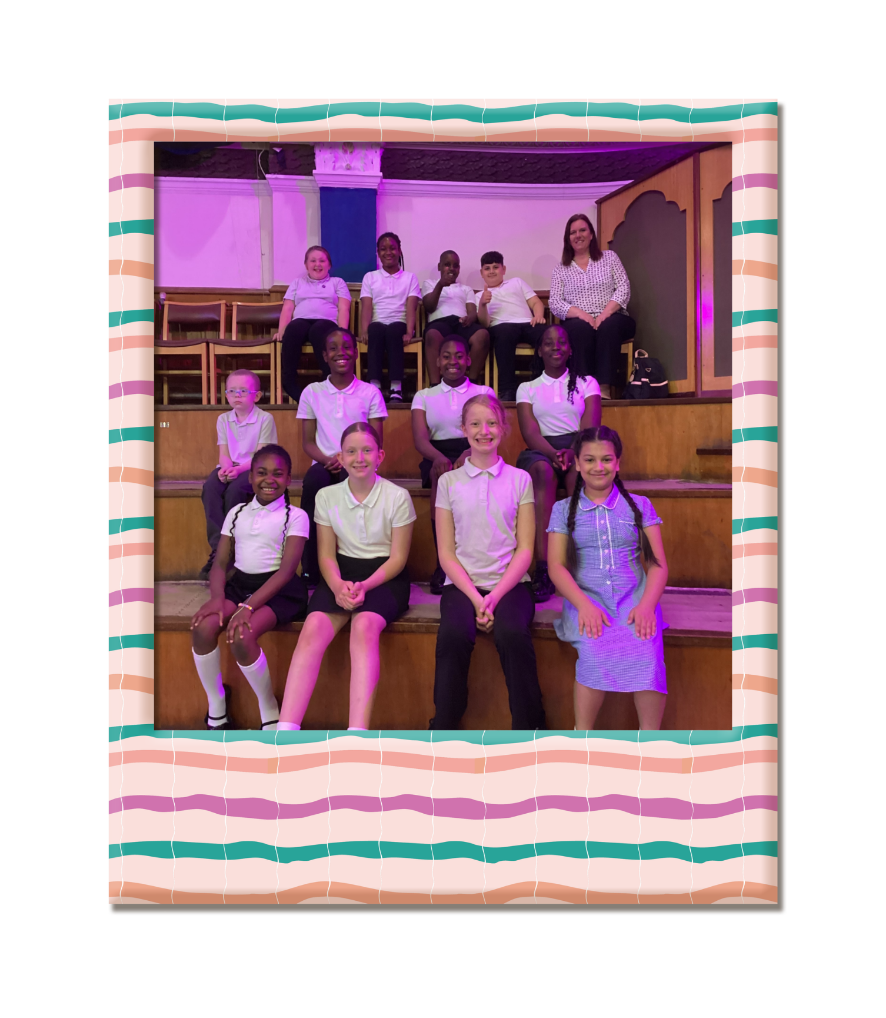
SCHOOL NEWS
Choir
On Thursday 18th June, the choir sang in Bolton Music Festival at Victoria Hall. They worked really hard learning six group songs, and their own song 'True Colours' and made the staff very proud of them all

Slide 9


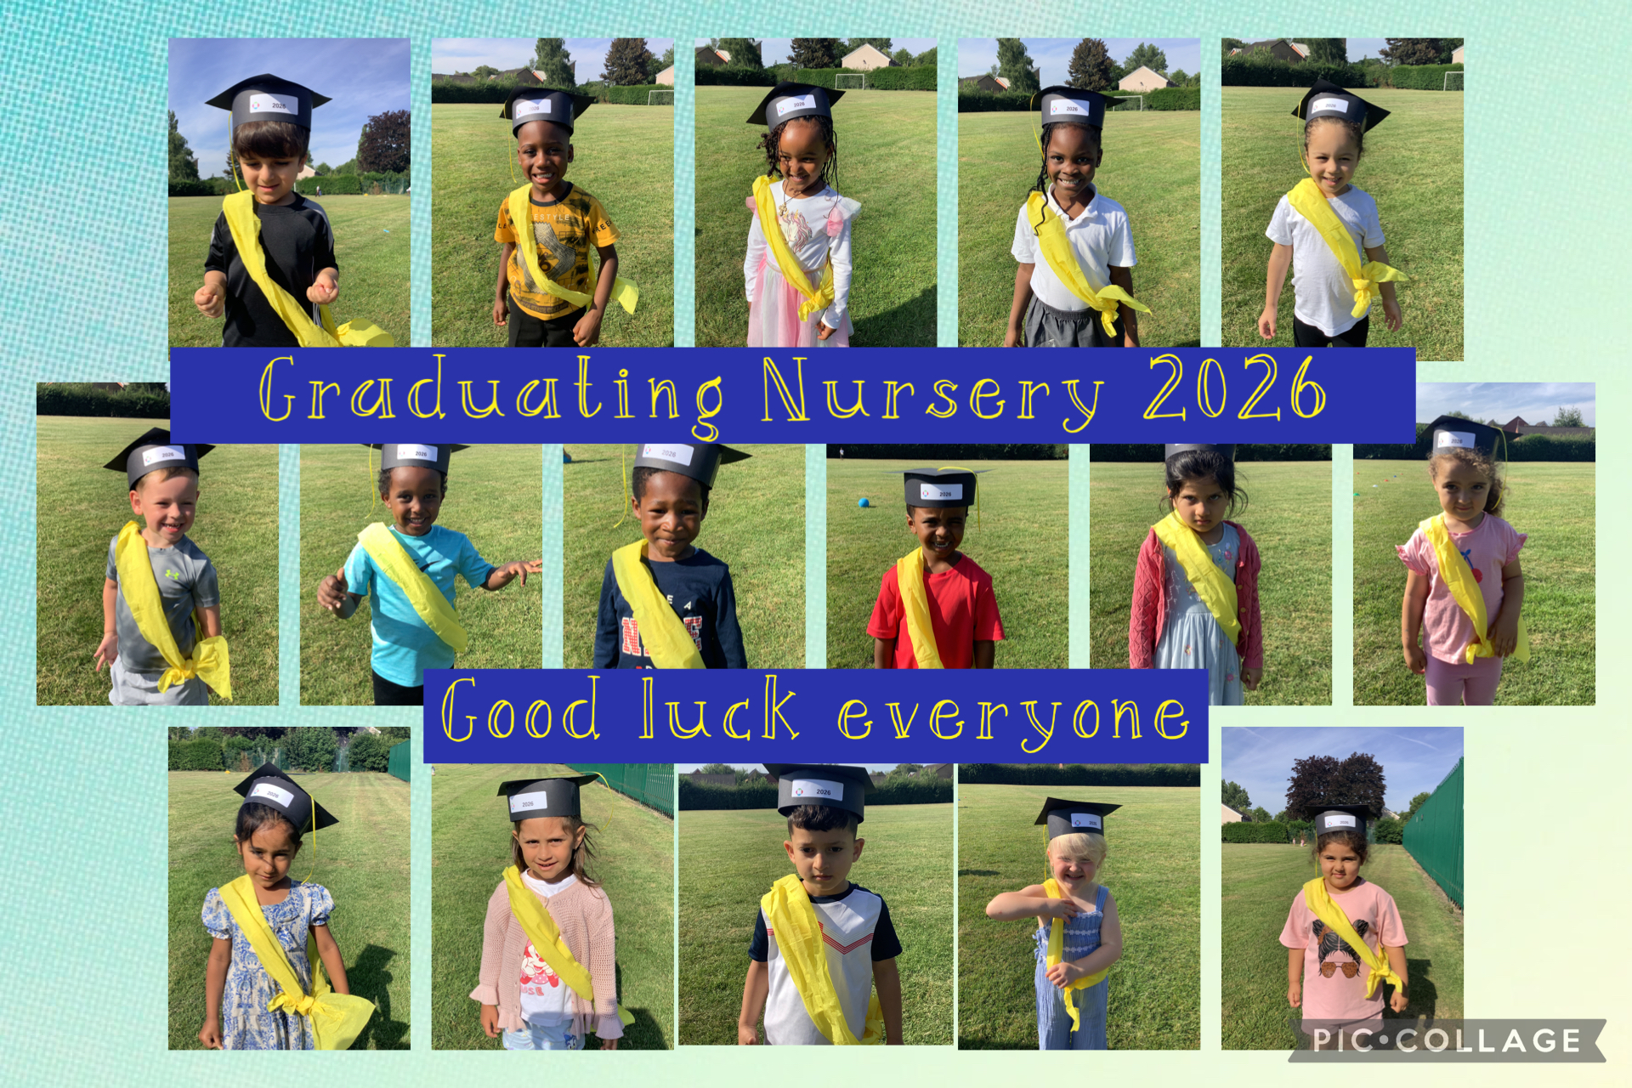
SCHOOL NEWS
Graduating
Nursery 2026

Slide 10
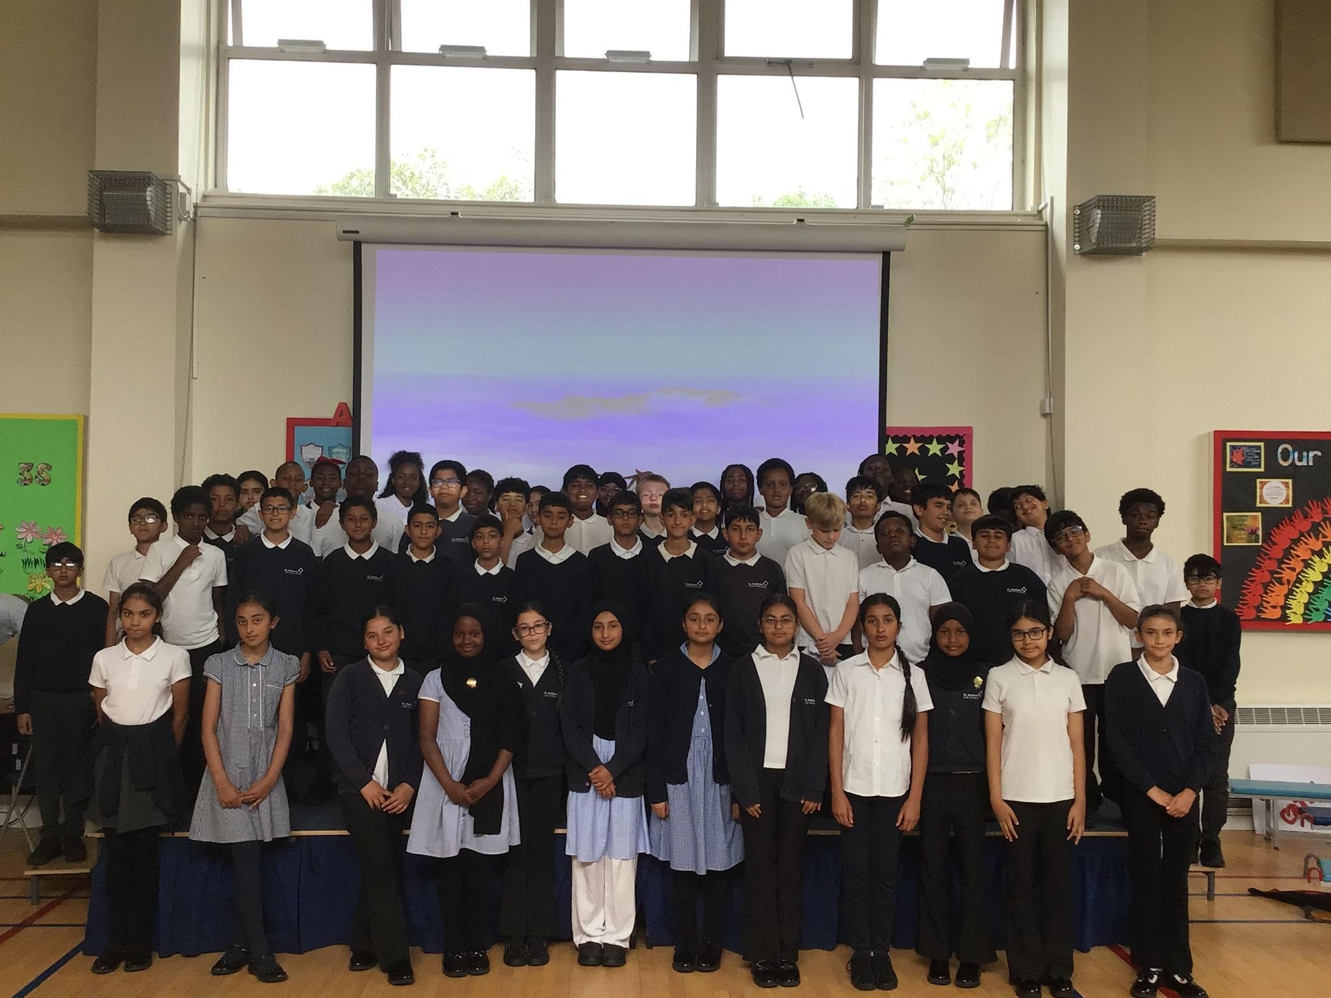
SCHOOL NEWS
Graduating
Year 6 - 2026

Slide 11
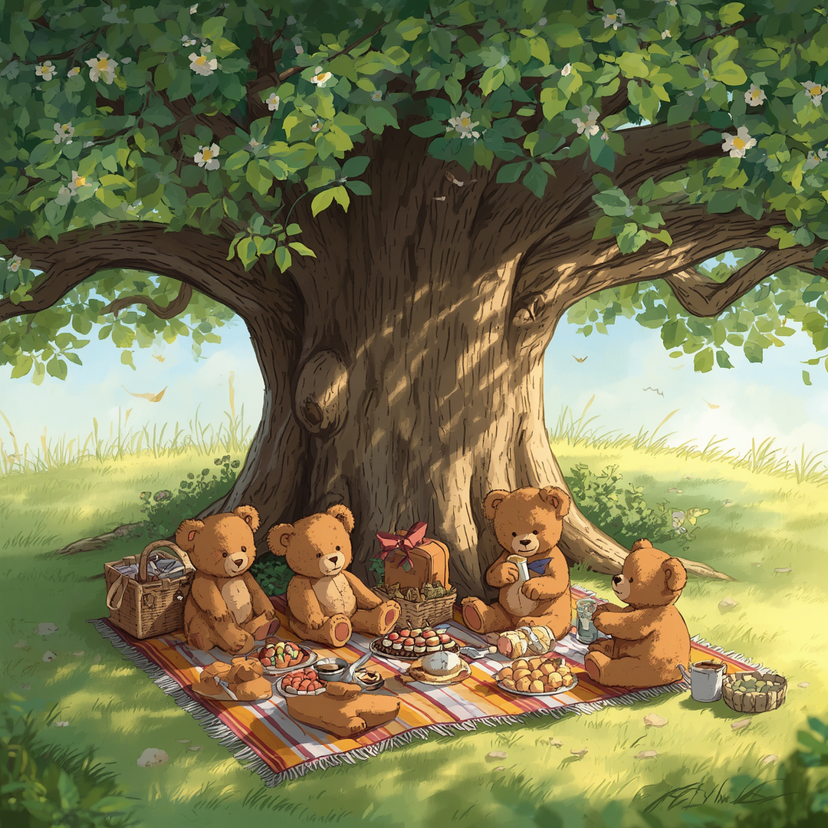
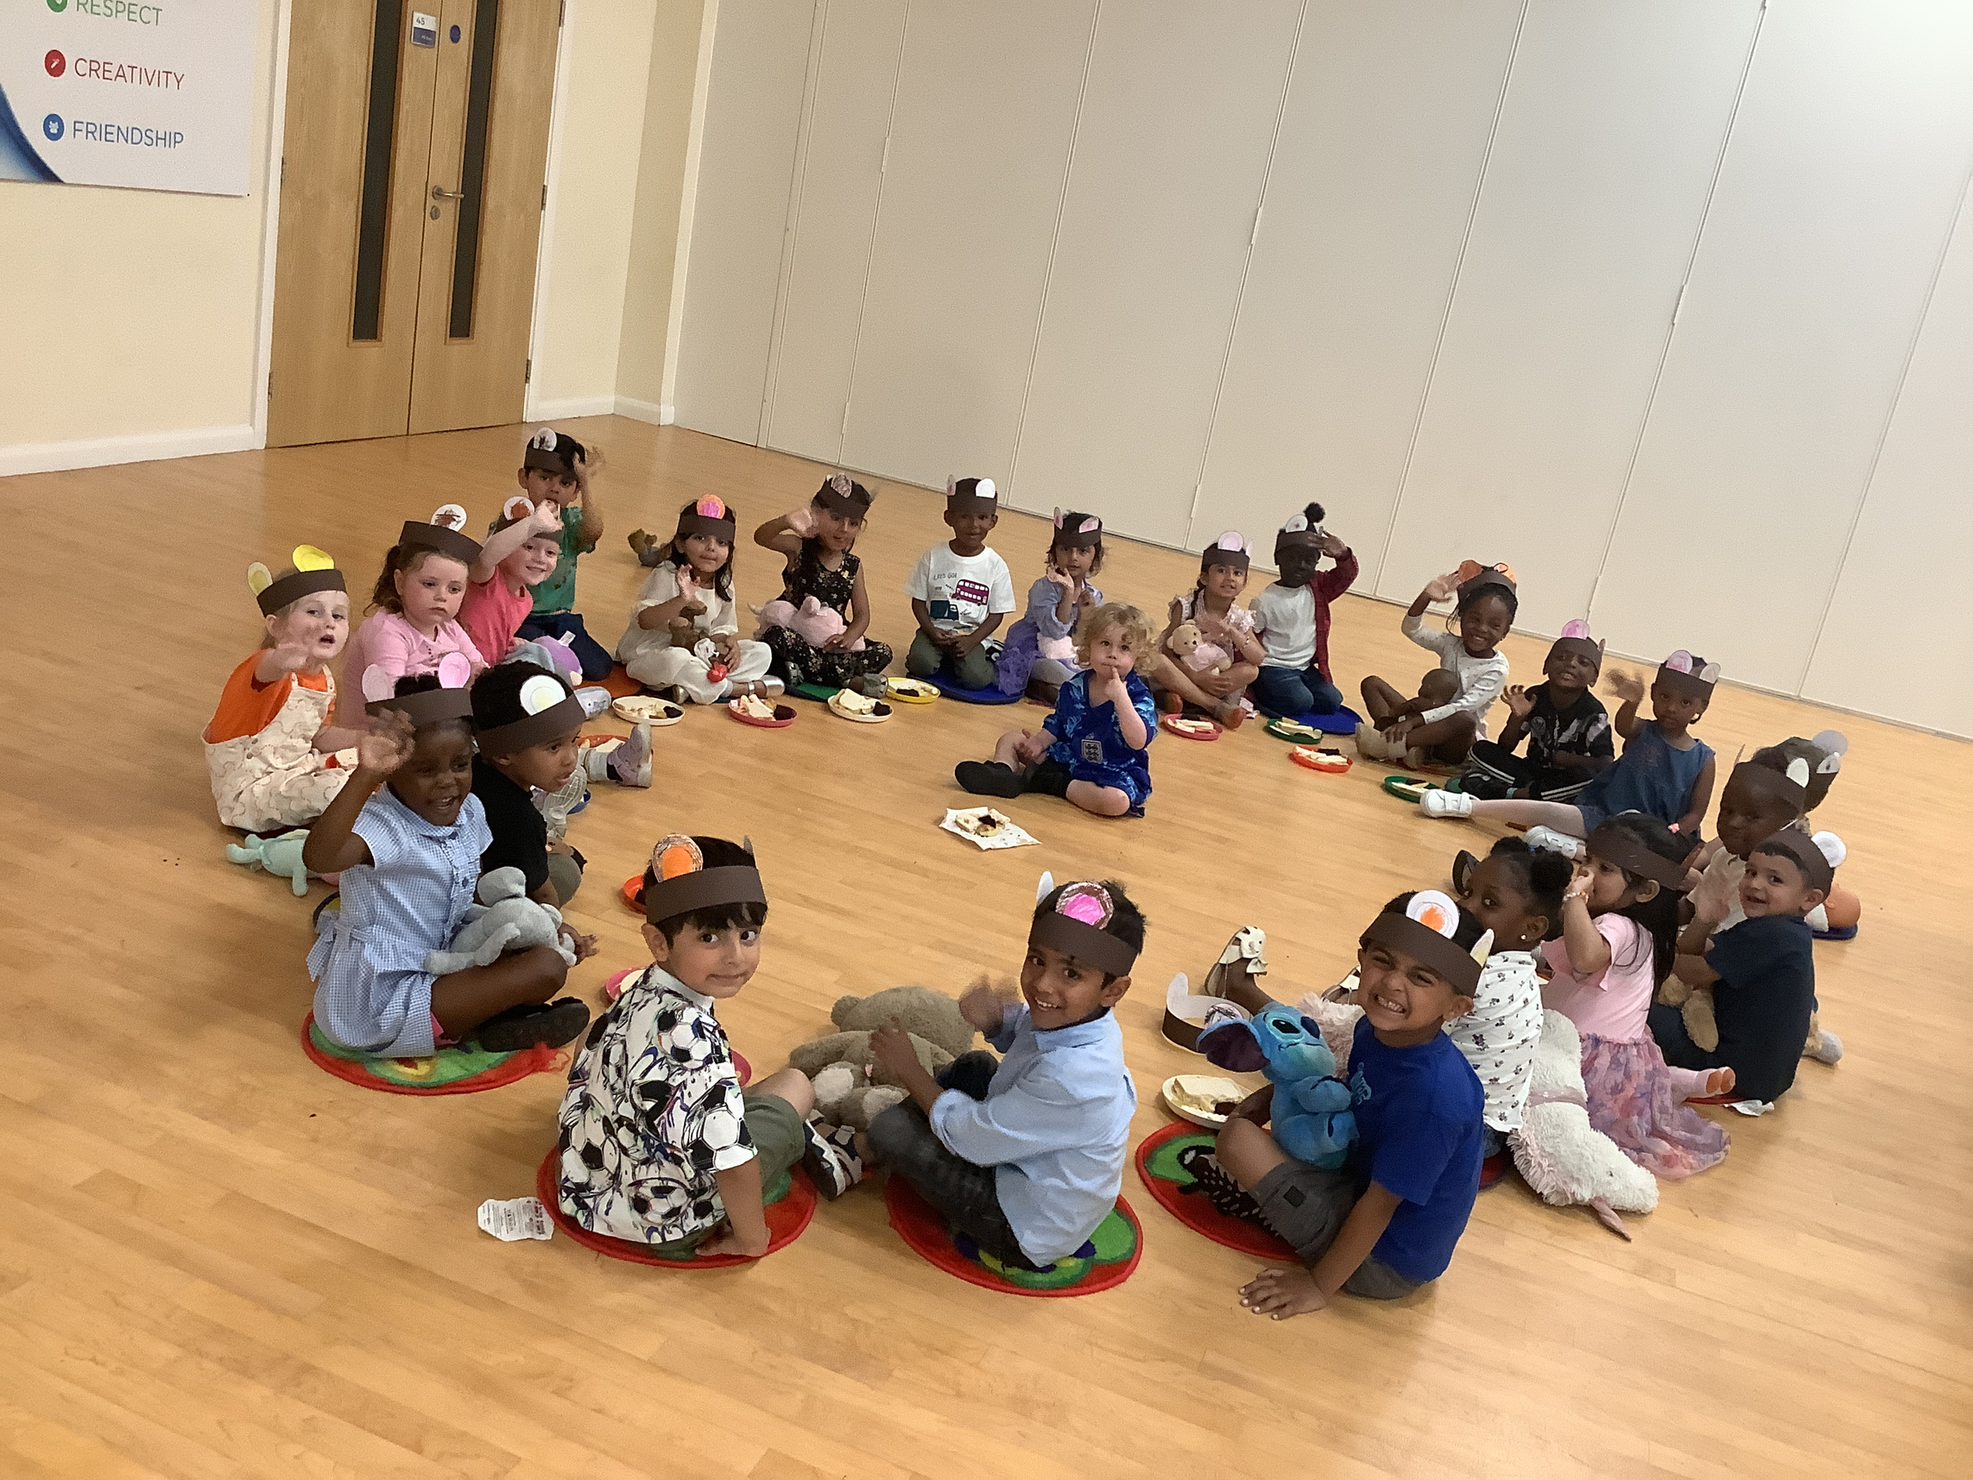
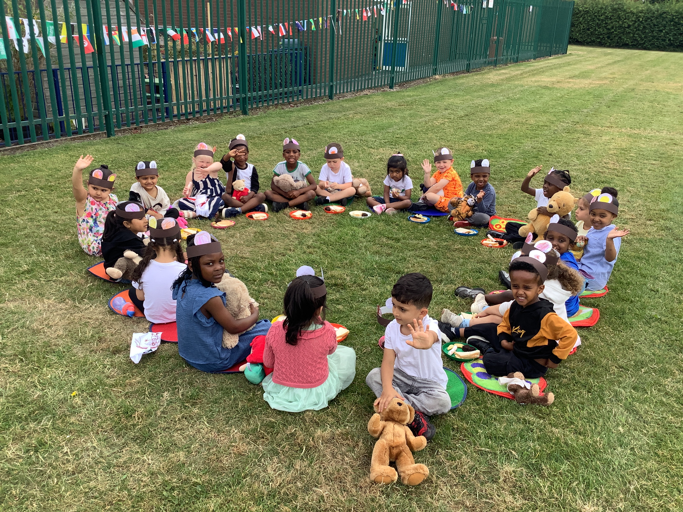
SCHOOL NEWS
Teddy Bears
Picnic - Nursery

Slide 12
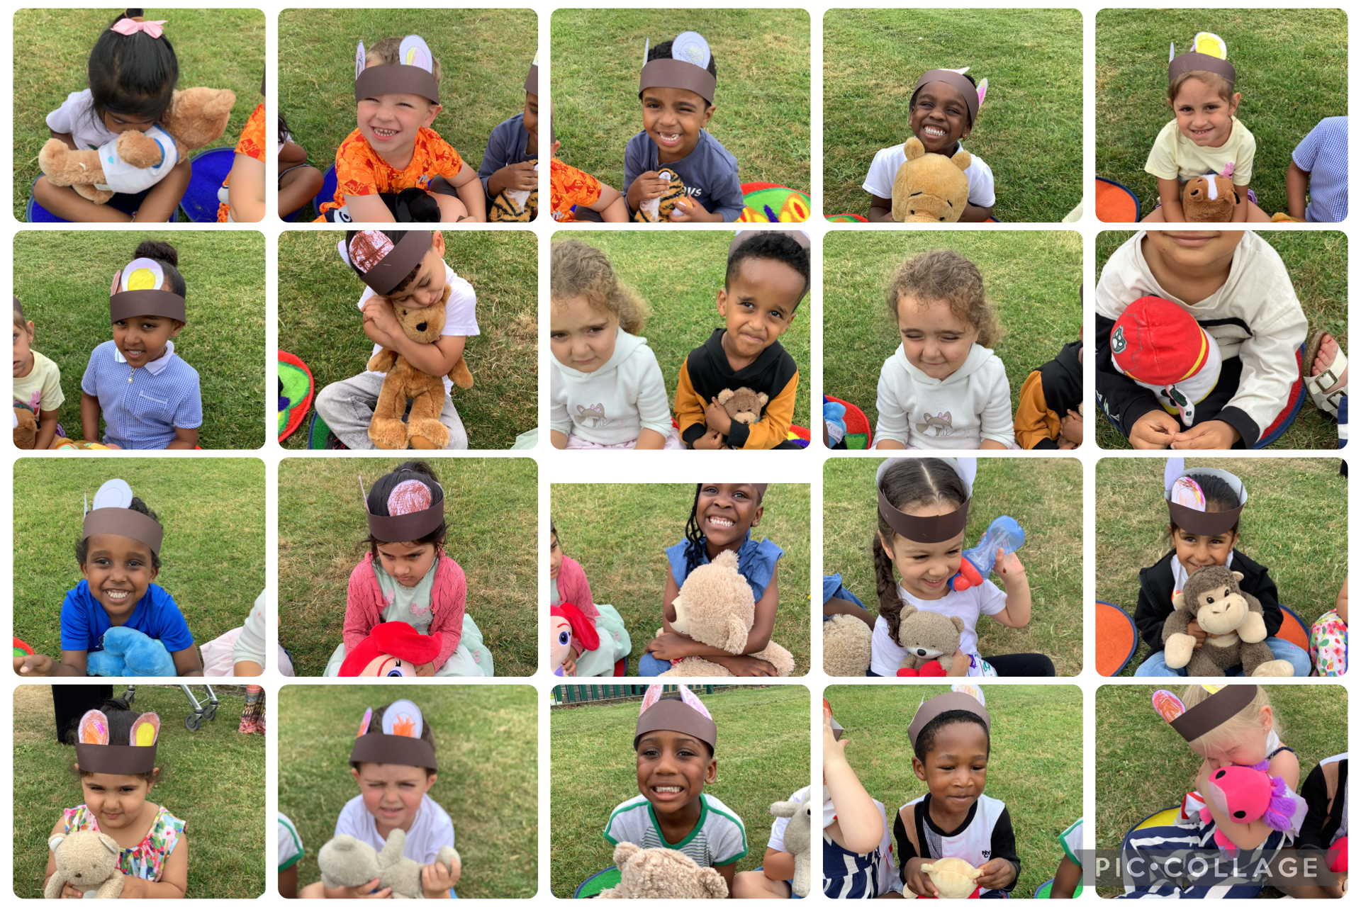
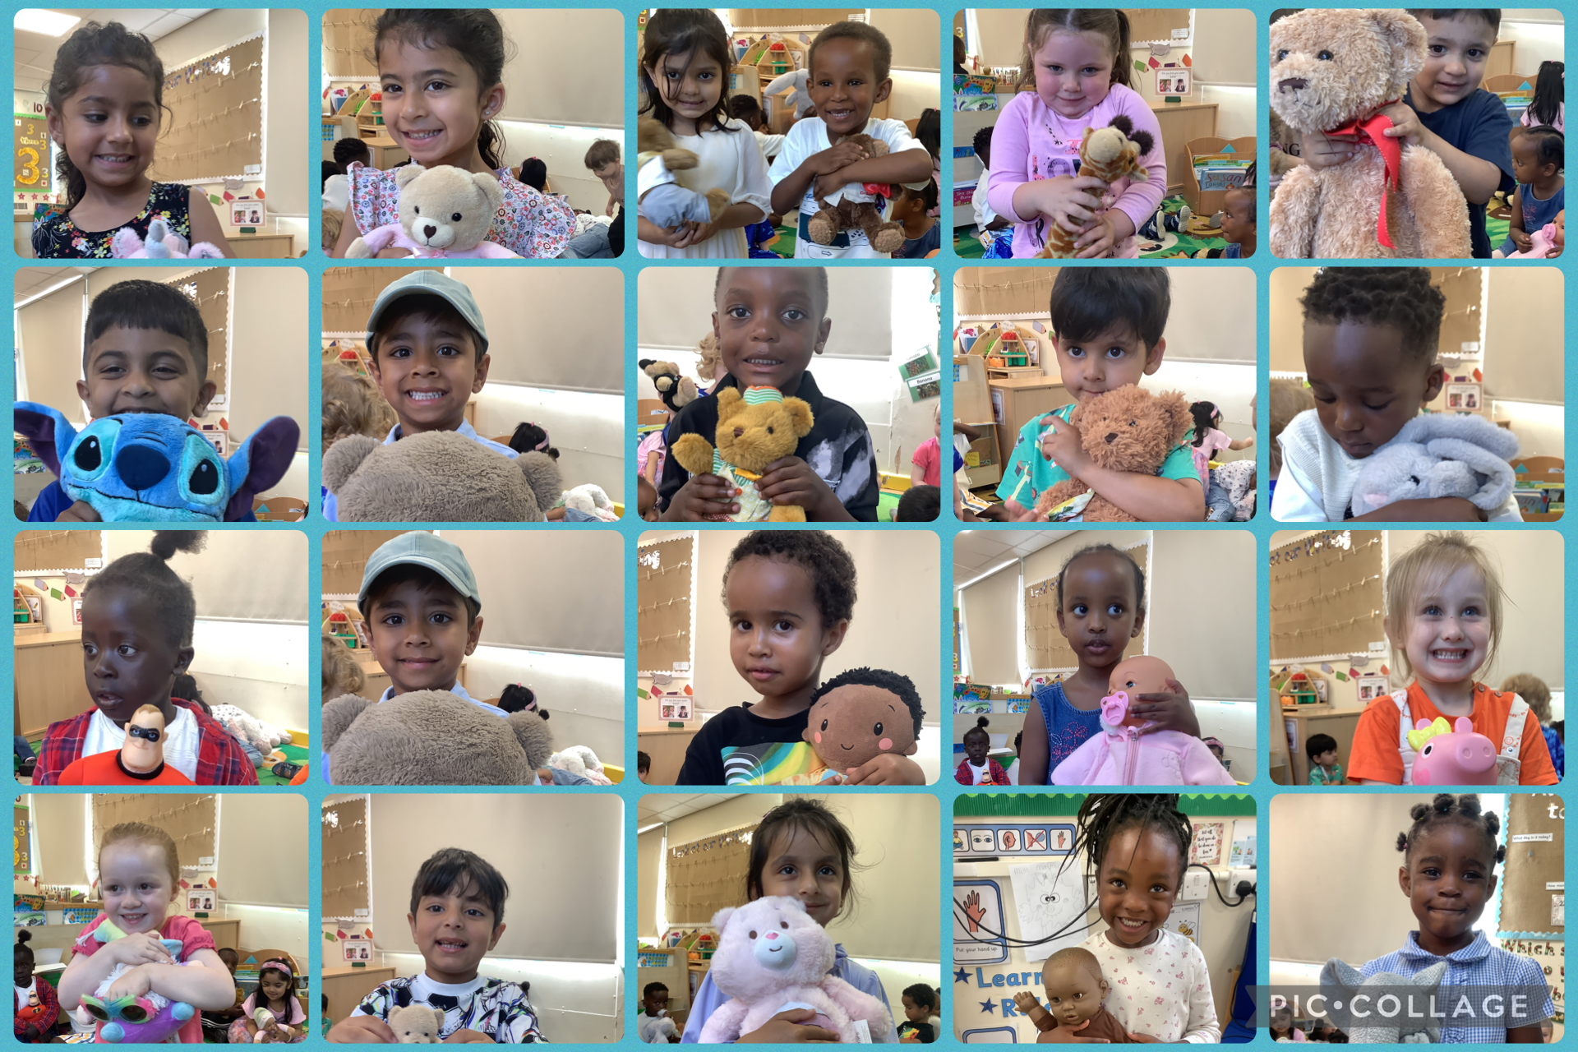
SCHOOL NEWS
Teddy Bears
Picnic - Nursery

Slide 13


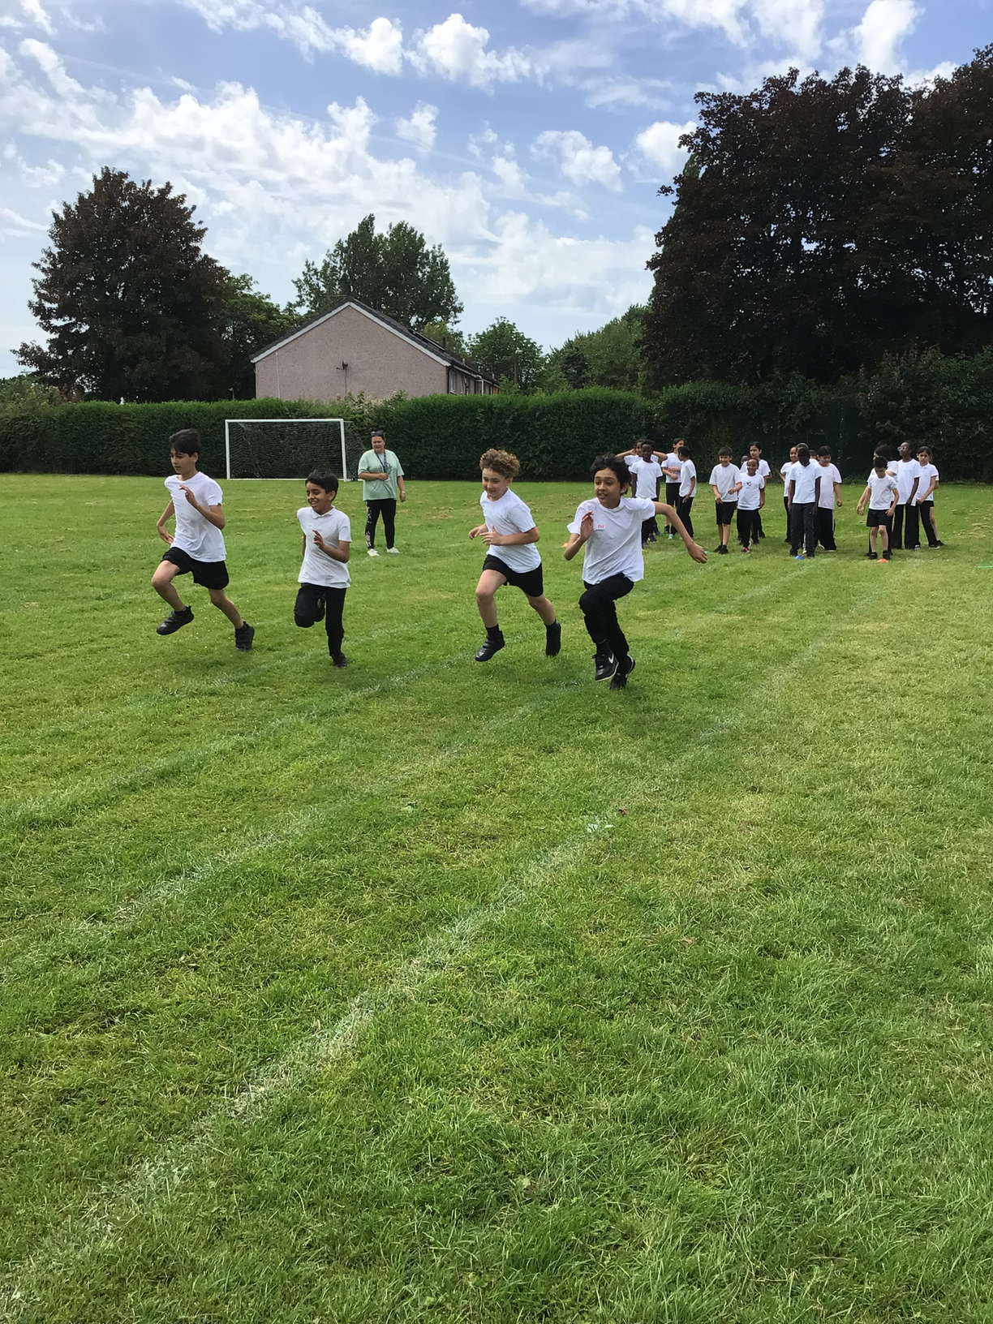
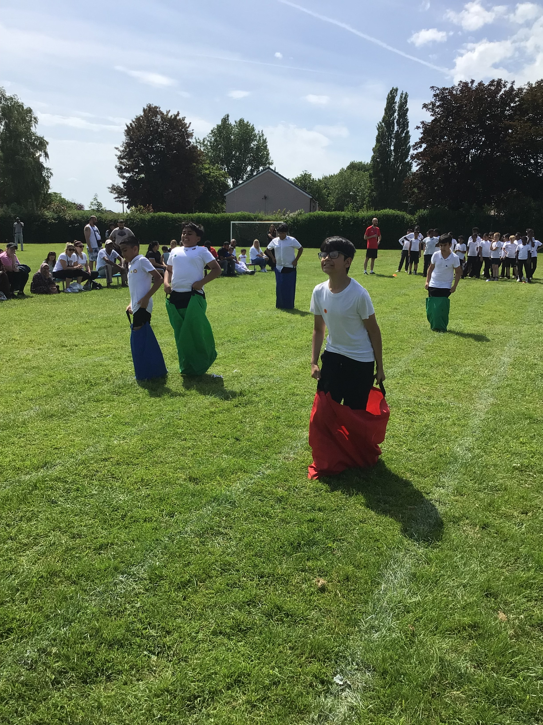
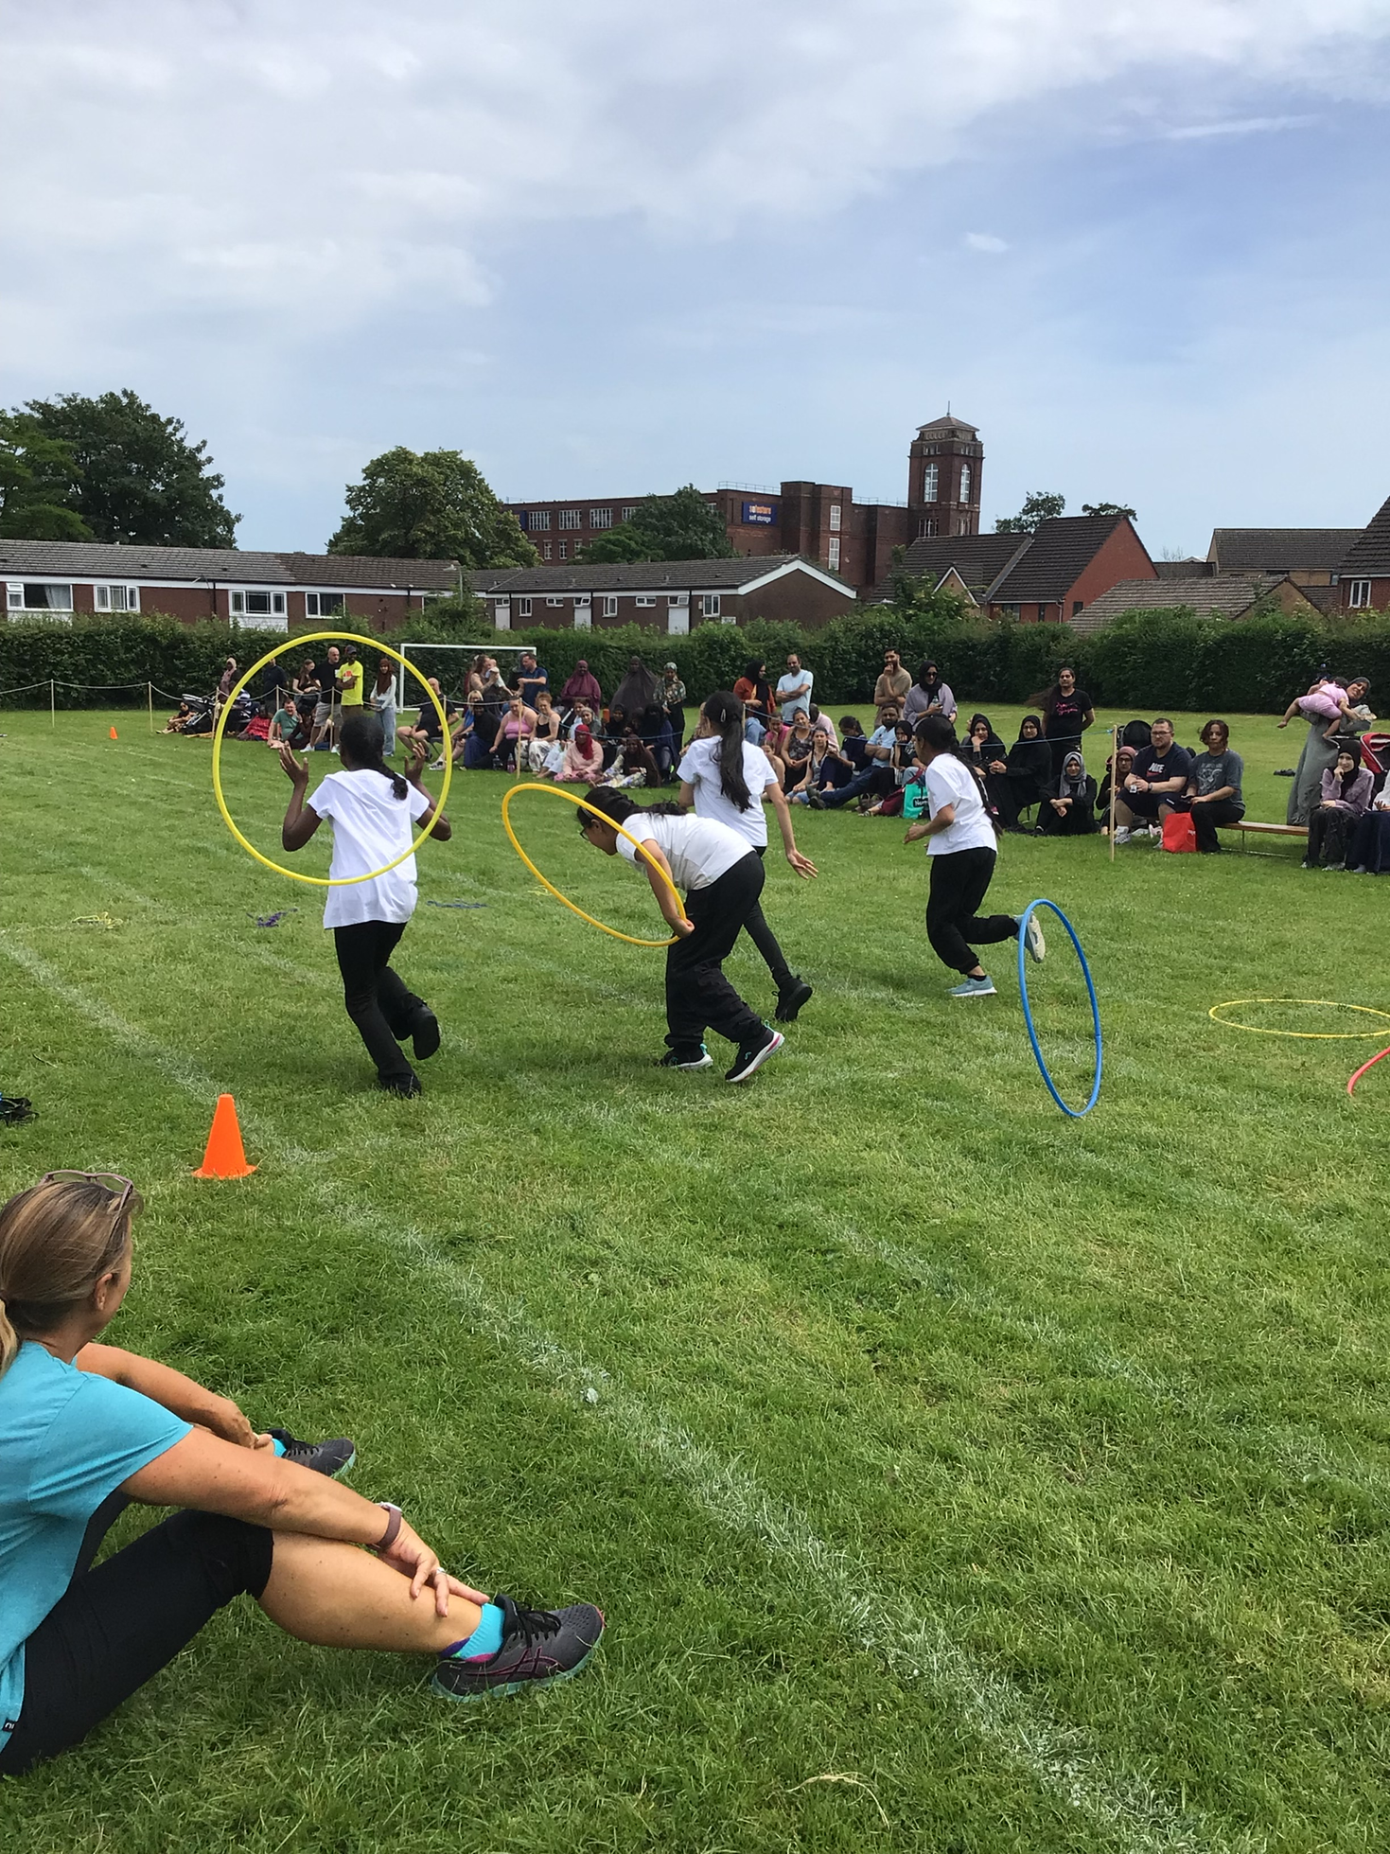
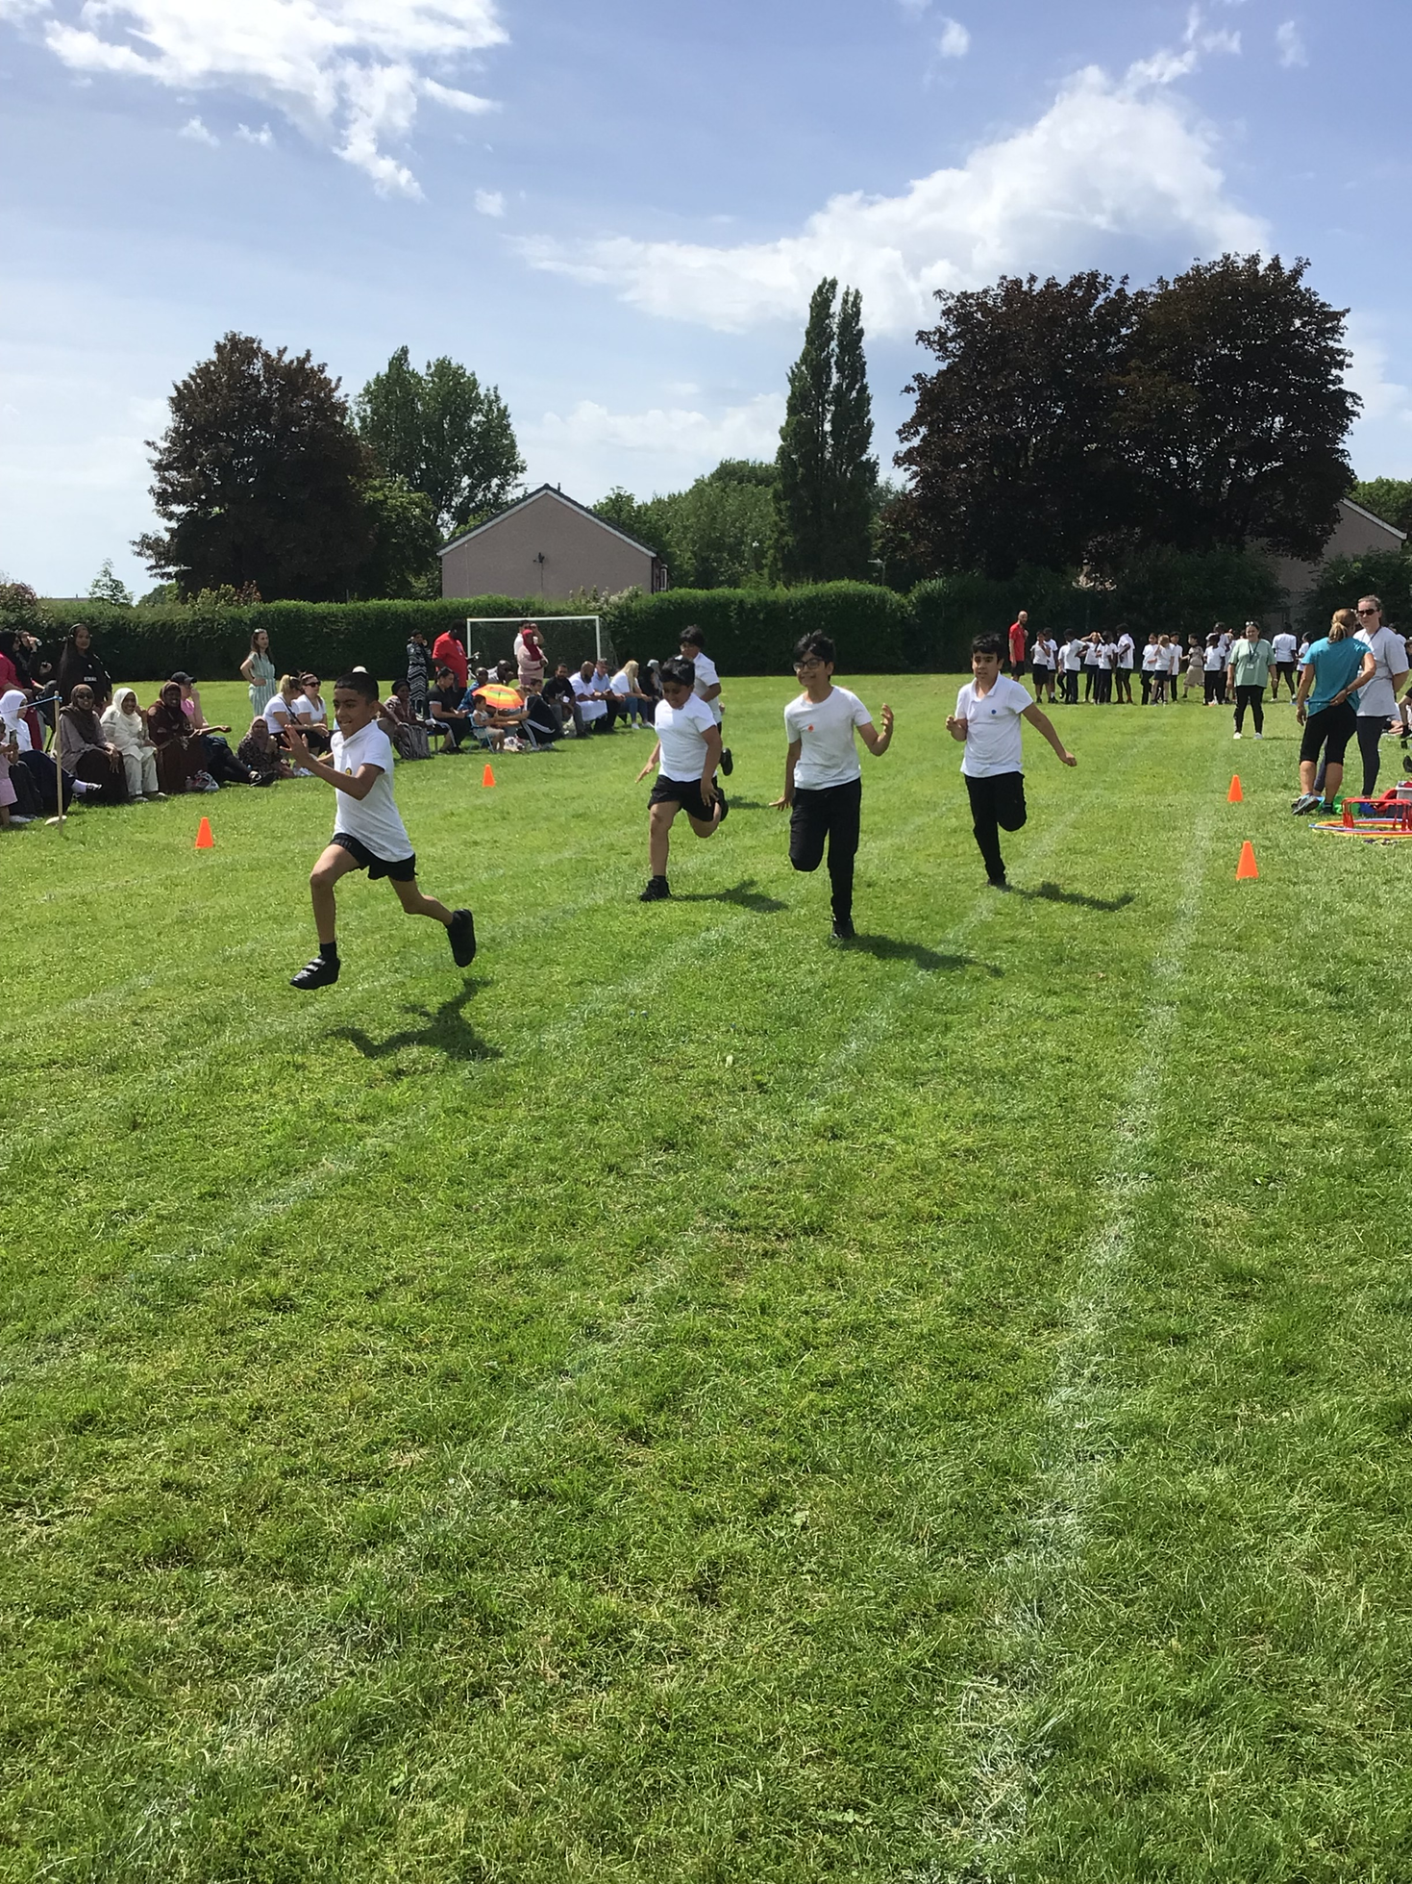
SCHOOL NEWS
Sports Day
Y5 and Y6 had their sports day. Everyone joined in all
of the races and we had so much fun.
Thank you to all the parents who came to support us.

Slide 14

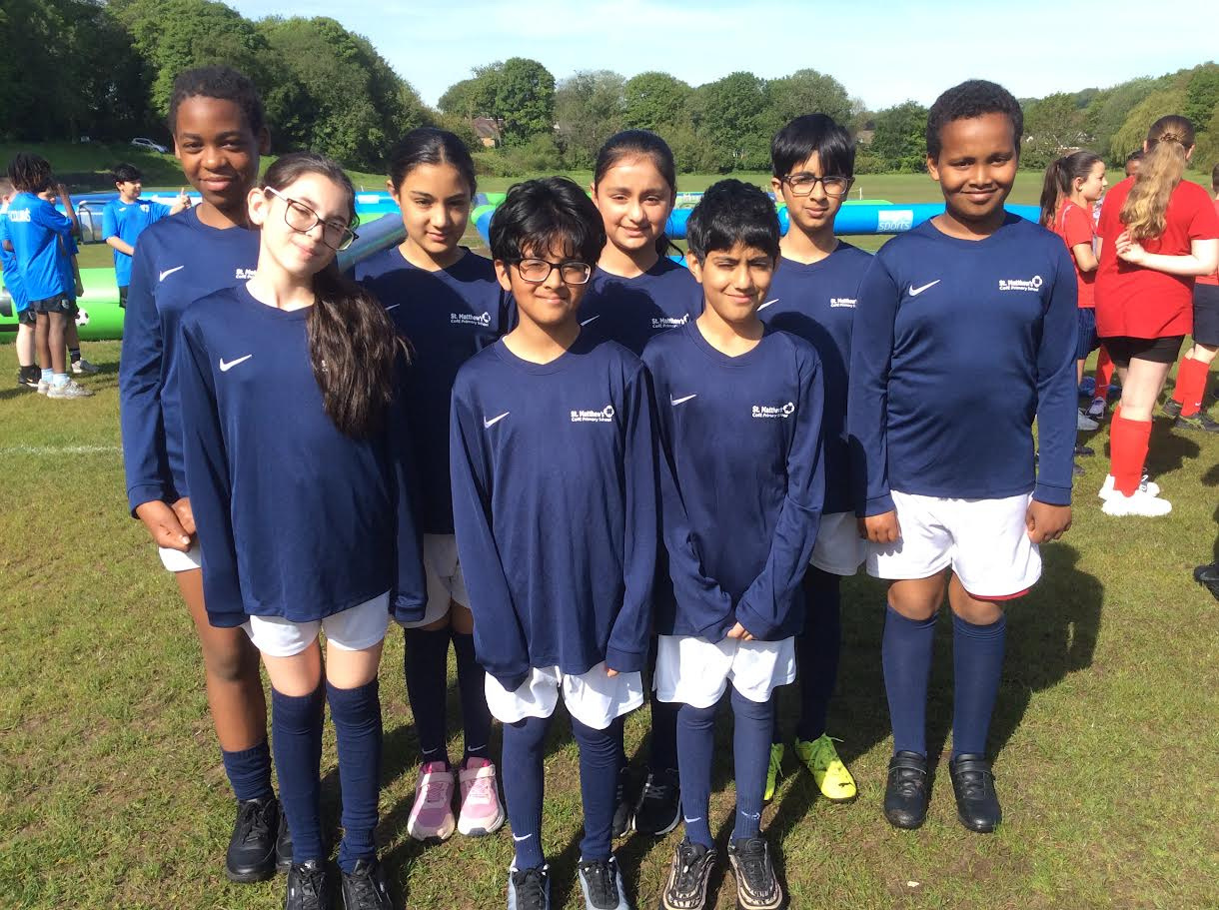
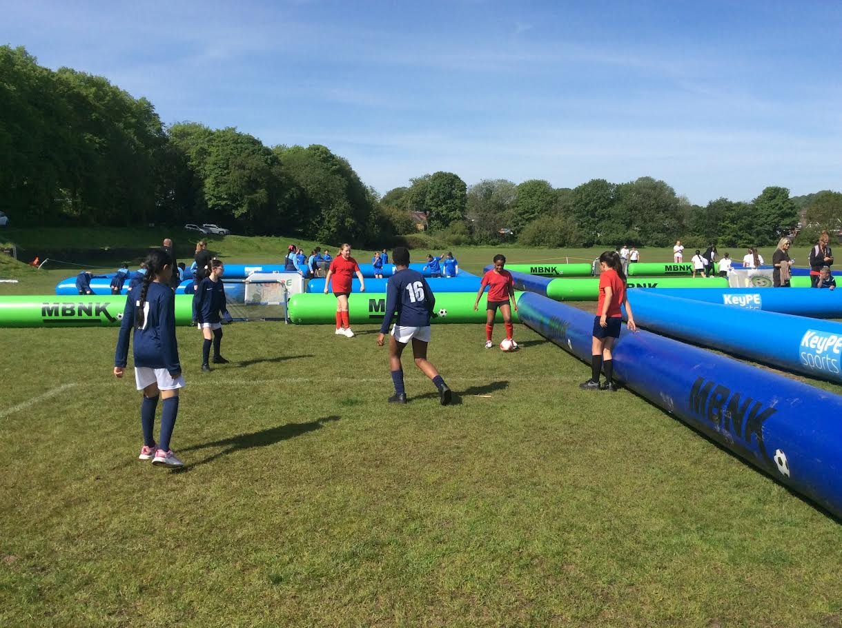
SCHOOL NEWS
Year 6 - Football Festival
Y6 took part in a football festival at Moss Bank Park. We played many games against lots of different schools from Bolton. It was a great morning.

Slide 15


Slide 16


