Slide 1
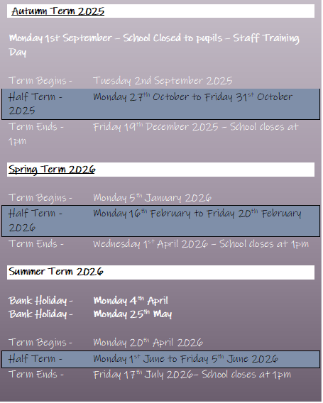

Newsletter
24th October 2025
www.st-matthews.bolton.sch.uk
MESSAGE FROM THE
HEADTEACHER
School Term Dates
2025-2026
Dear Parent / Carers,
As we come to the end of the first half-term of this year, I would like to say a huge thank you to our staff and children for all your hard work. Many of our classes have already taken part in a wide range of enrichment activities linked to the curriculum, with lots more planned for after half-term.
This month, our sports teams have been busy taking part in football and dodgeball events in Bolton with Mr. Mistry.
Year 3 visited Bolton Museum to take part in an Egyptian workshop linked to their learning in History. Our Reception classes had a visit to Bolton Library this week and Year 4 visited the circus at Blackpool Tower.
A huge thank you to the families who attended the Nursery 'stay and play' this week. We had some lovely feedback from the visit and look forward to welcoming you again soon.
Have a lovely half-term break, and we look forward to seeing everyone back in school on Monday 3rd November at 8.40am.
Best wishes,
Mrs Lister
Important Notice
If you're driving your child to school please make sure you park safely, legally and considerately.
Please do not block the school gate as you are preventing staff from getting to school on time and do not use the garages near school to turn your vehicle around or drop off, this is for local residents.
Please don't park across household driveways near schools and always park safely. We don't want to see anyone hurt.

Slide 2

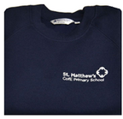
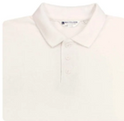
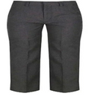
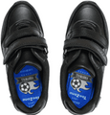
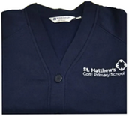
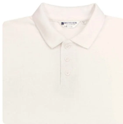
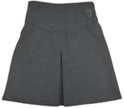
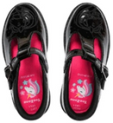
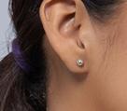
St. Matthew’s School Uniform
Boys
Trousers (grey/black)
Sweaters/sweatshirts/fleece (navy blue)
Shirts/polo-necked shirts (white)
Socks (white/grey/black)
Footwear – black shoes/trainers (all black including laces, no obvious logos)
Girls
Trousers (grey/black)
Skirts/pinafore dresses (grey/black)
Sweaters/sweatshirts/fleece/cardigans (navy blue)
Shirts/polo-necked shirts/ blouses (white)
Socks/tights (white/grey/black)
Footwear – black shoes/trainers (all black including laces, no obvious logos)
Jewellery
No jewellery should be worn at school apart from a pair of small plain studs earrings (large or hoop earrings are not allowed for health and safety reasons) and a simple watch (no smart watches)

Slide 3


INFORMATION FOR PARENTS
Autism Spectrum Parent Workshop-
Developing Play Skills
Fri 21st Nov 9.30-10.30
£15 per family
Book here: www.woodbridgesend.co.uk/training

Slide 4
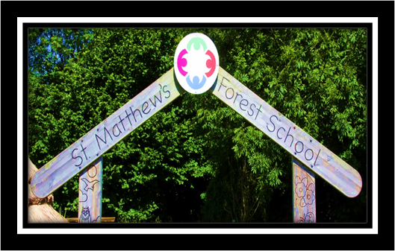
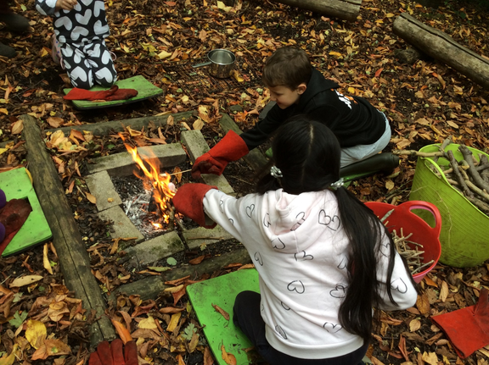
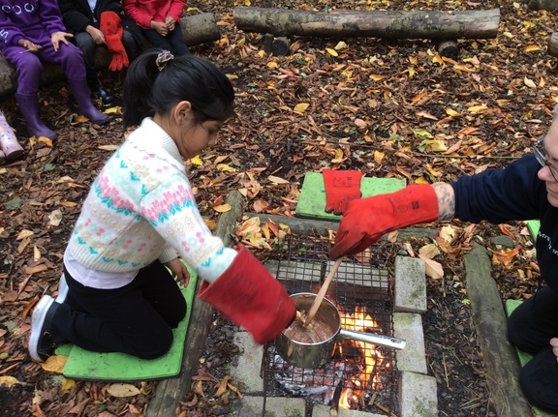
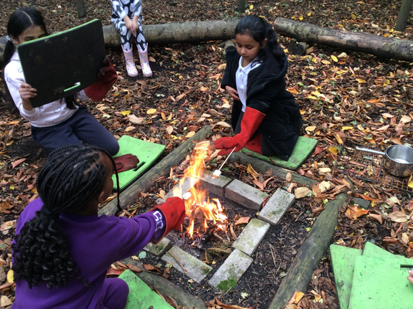
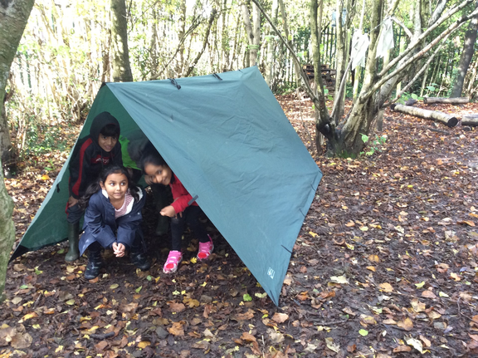
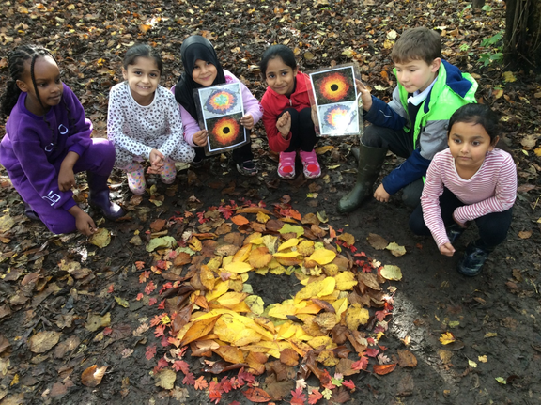
SCHOOL NEWS
FOREST SCHOOL
In Forest School 3J had a fire this week. We toasted marshmallows, melted chocolate and dipped apple slices in it: which we had picked from one of our apple tress
Year 3J have also created leaf art in Forest School and we also made shelters

Slide 5
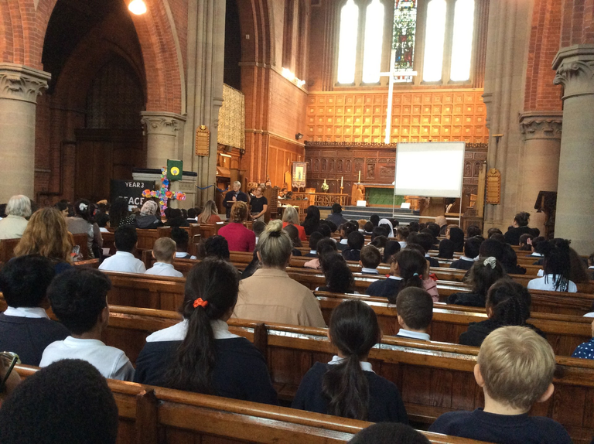
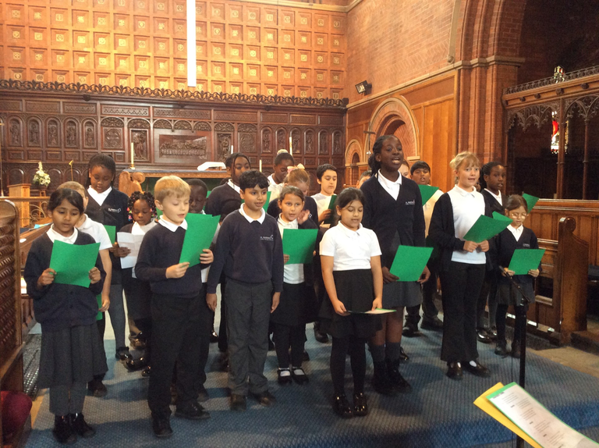
SCHOOL NEWS
HARVEST
FESTIVAL

Slide 6
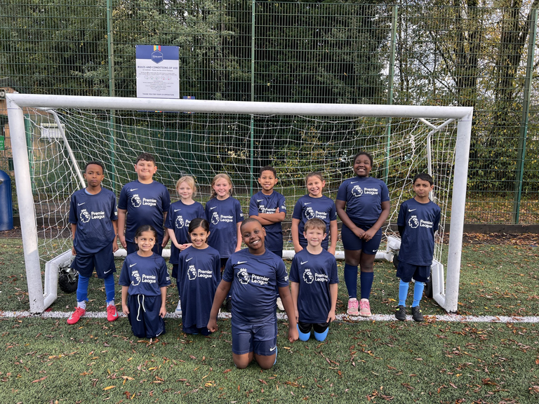
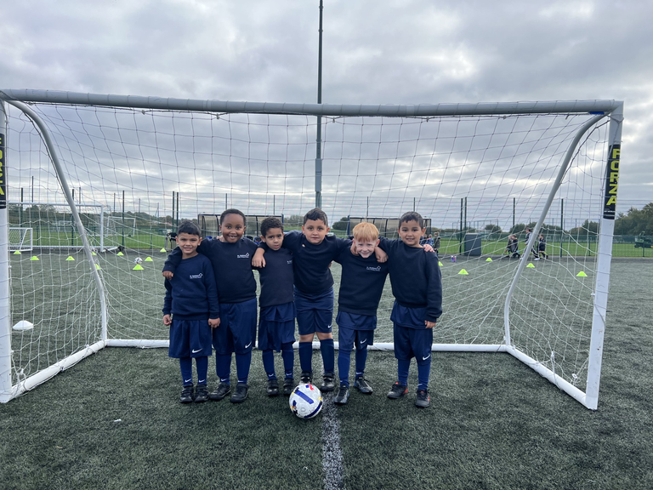
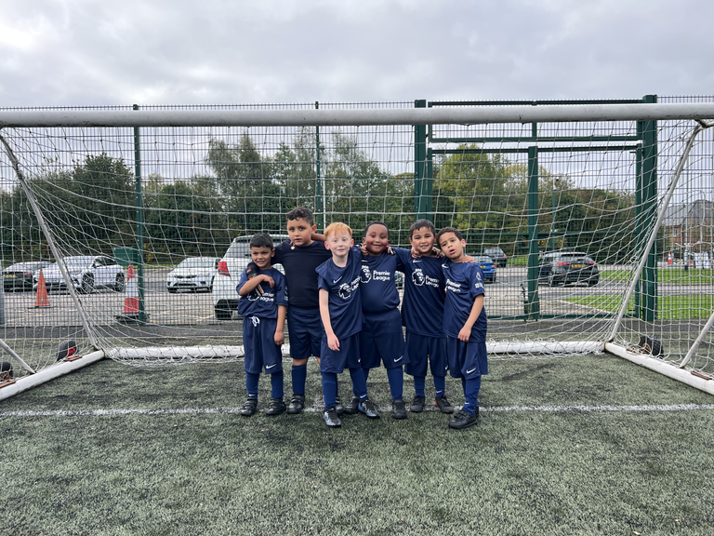
SCHOOL NEWS
SPORTING
EVENTS
Cluster Football
On the 22nd October, our school took part in an exciting
football cluster event against local schools. It was a fantastic
evening filled with energy, teamwork, and great sportsmanship!
Our team played brilliantly, showing excellent passing, determination, and support for one another throughout every match. We’re so proud of how everyone worked together and represented our school so well.
A special mention to Lilleyah, Ishaal, and Barento for scoring some superb goals! ⚽👏
Well done to the whole team for their fantastic effort and positive attitude — you all did us proud!
Year 1 Football
Event on 8th October

Slide 7
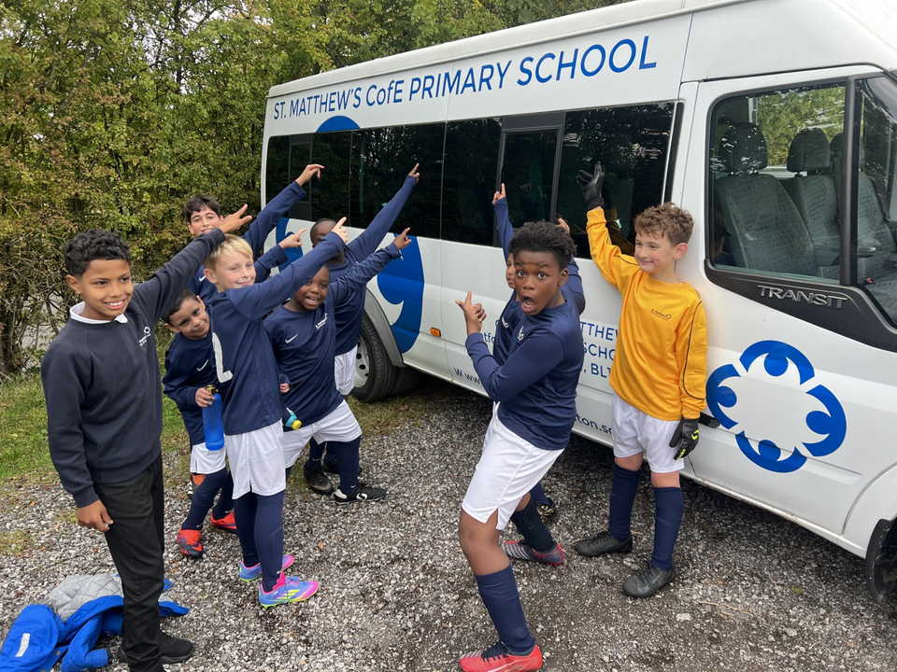
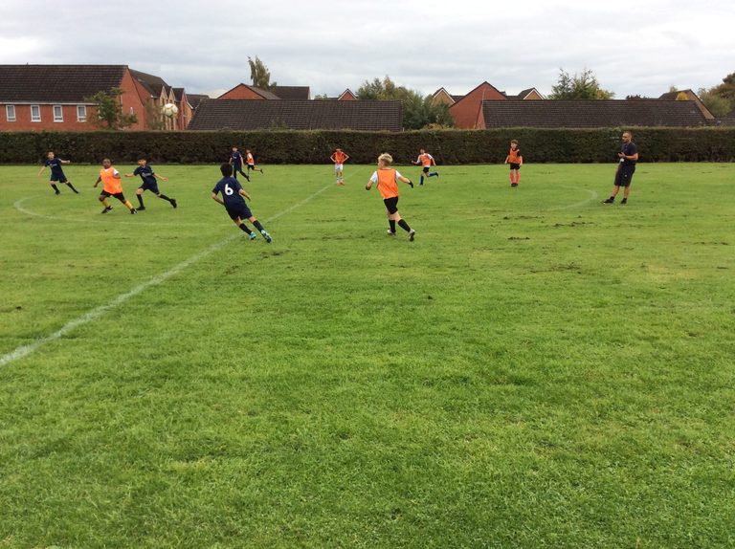
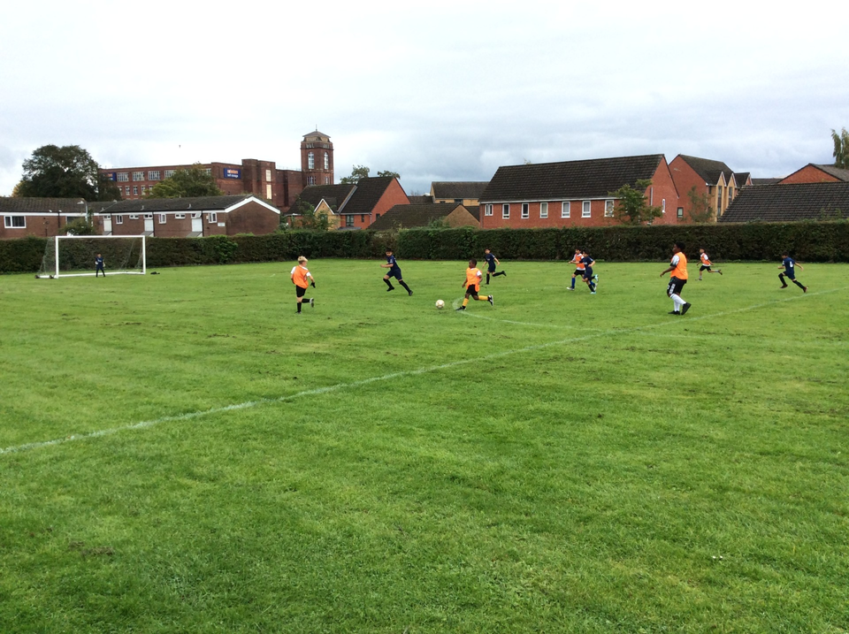
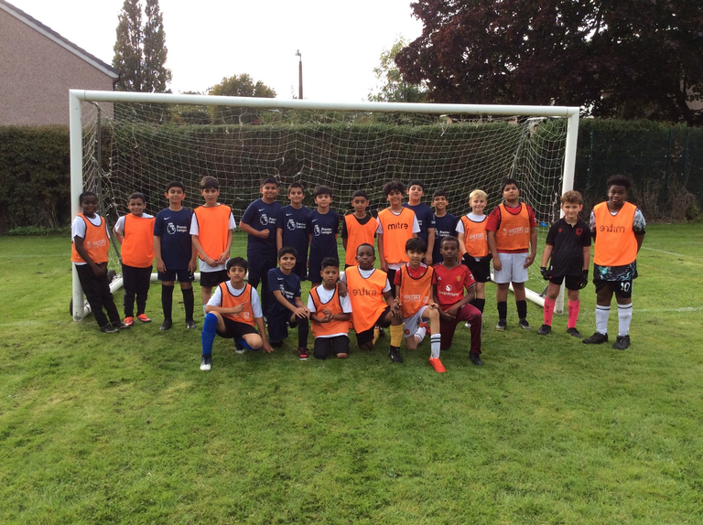
SCHOOL NEWS
SPORTING
EVENTS
Cluster Football
On the 2nd October we played The Olive tree in
a close and intense game in the football
league cup.
We won 1-0. Verry happy boys on the way
home yesterday.
Year 5 & 6
1st October 2025. During our football training session with year 5 and 6 we invited the Olive school for a friendly match.

