Slide 1
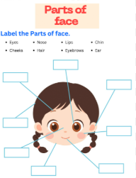
Science
In science we are looking at the human body.
Can you use a mirror and draw a picture of your face?
Can you label the parts of your face?

Slide 2
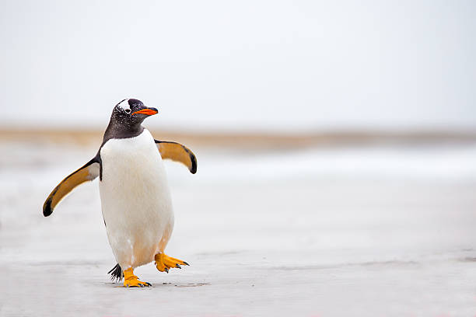
English
Write a description about penguins and describe what they look like and their different features.
Remember to use finger spaces, full stops and capital letters in your writing.

Slide 3

Maths
Practise number formation 1-10.
*Challenge – with numbers 1-5 can you create an addition sum. For example 1+3 =4.

