Slide 1
Year 3 Meet the Teacher
Monday 15th January 2024

Slide 2
Staff
In 3J the teacher is Mrs Johnson and the teaching assistant is Mr Manning.
In 3B the teacher is Mrs Bradley and the teaching assistants are Mrs Jones and Miss Harris.
Mrs Buksh will be taking small groups out for interventions.
On Wednesdays Mrs Johnson and Mrs Bradley will have some planning time in the afternoon so Mrs Bullen and Mr Manning will be in 3J and Mrs Jones, Miss Harris and Mrs Buksh will be in 3B.
We have an open door policy. If you have any issues please speak to a member of staff at 3pm.

Slide 3
Attendance and Punctuality
The school door opens at 8.40am for 15 minutes. Your child is late after this.
The minimum national attendance expectation is 96%.
Please ensure that your child attends school everyday to keep their attendance above 96%.
Every day is important so please try to book holidays and appointments out of school hours.
If they are not in school then they are not learning and are missing out on learning valuable new skills.

Slide 4
Uniform
Please remember that all footwear should be plain black.
Please write your child’s name in all their belongings.
Headscarves need to be plain and short.
Nail polish is not worn for school.
Only stud earrings should be worn for school.
No other jewellery should be worn.

Slide 5
Values
We expect the pupils to follow the values of our school:
Respect,
Friendship,
Love,
Creativity.
Anyone who does not follow our values will have consequences.
4 children a week will wear the Values badge as a reward for following the values.
Please support our values at home too.

Slide 6
Rewards
Children will earn dojos for good manners, being helpful, working hard, doing homework, making the right choice… When they get 20 dojos they get a prize from the box.
Children can also get stickers for hard work too.
One child a week will also be chosen to receive a Headteacher’s certificate for being amazing.
4 children a week will wear the values badges as a reward for following the values.

Slide 7
Timetables
Year 3 children do:
1 hour of maths daily,
1 hour of English daily,
Story time and guided reading/ phonics daily.
2 hours of PE a week and running the daily mile daily,
RE 1 hour a week,
Spelling practice and handwriting each week,
Science, computing and French weekly.
1 hour of drumming a week with a specialist teacher,
We teach history, geography, art, design technology, music, dance and drama though our themes.
We do some form of worship every day in the hall or in the classroom.
Each week we have a spelling test, a times table test, a grammar test and a basic skills/ arithmetic test.

Slide 8
Maths
Power Maths- 1 hour a day.
Focus on multiplication and division, length, perimeter, mass, capacity and fractions.
Weekly Year 3 arithmetic and basic skills tests.
In Year 3 we work with numbers up to 1000.
At the start of Year 3, children should know their 2, 5, and 10 multiplication facts.
By the end of Year 3 they should know their 2, 3, 4, 5, 6, 8, and 10 x tables off by heart.
Please practise at home (Children have passwords in their reading records for Times Tables Rockstars and Mathsflex).

Slide 9
English - Writing
Children are taught 1 hour of English daily and guided reading every day for half an hour.
Spelling test day is a Friday. We will practise at school, can you also practise at home please?
Handwriting is also practised weekly, please work on this at home. We use the cursive font.
There is a large focus on grammar skills – they need to be hearing correctly modelled English as much as possible.
Over the year we will cover lots of different non-fiction, fiction and poetry topics.
Please practise writing at home.

Slide 10
English – Reading
Our current whole school focus at St. Matthew’s is reading and getting children to enjoy reading.
What we do:
Guided reading daily.
Story time for 10 minutes every day.
One to one reading weekly.
Please bring reading books every day.
Reading at home – they need to be reading at home every evening and sign the reading record. (If the child reads at home 5 times a week, they will get dojos.)
Class novel read in English lessons.

Slide 11
Spellings
Children learn new spellings every week.
You have had the whole half term’s spellings already. (If you need another one ask and they are on the website too.)
They need to practise these at home each week. (e.g. look, cover, write in their red books.)
Spelling test every week on a Friday.

Slide 12
Theme
Our Curriculum is called Learning Means the World:
Autumn 1 – Law and Order- Rules and Rights
Autumn 2-May The Forces Be With You- Science
Spring 1 – A World of Difference- Religious Festivals
Spring 2 – Lindow Man- The Story of Prehistoric Man
Summer 1- Lightning Speed- The World Wide Web
Summer 2 – Under The Canopy- Rainforests

Slide 13
Spring Term
World of Difference
This is a unit with a focus on religious festivals. we will be looking at Hinduism, Buddhism, Judaism, Christianity and Islam. We will explore their origins, places of worship, how they worship, holy books, festivals and core beliefs.
Lindow Man- The Story of Prehistoric Man
This is a unit looking at the Stone, Bronze and Iron Ages with a focus on history. We will be looking at the similarities and differences between the 3 time periods.

Slide 14
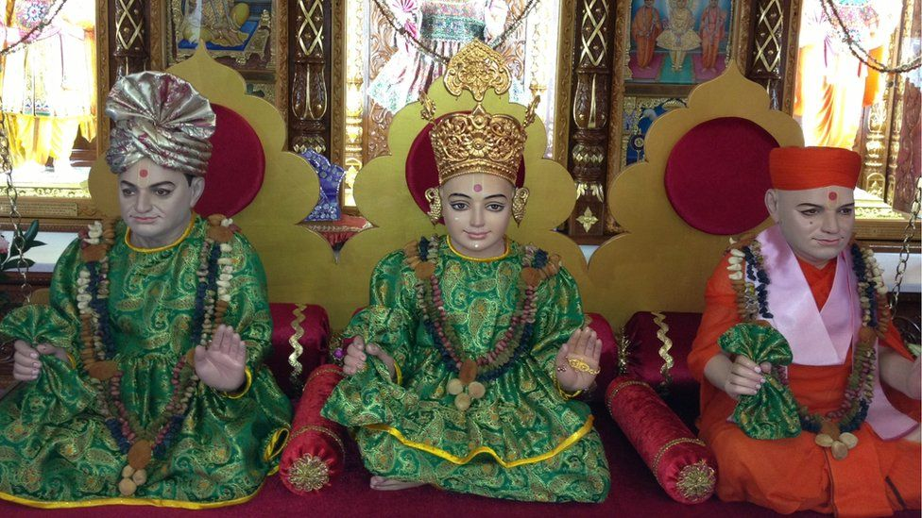
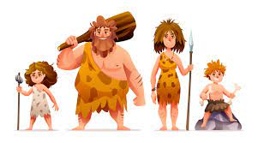
Trips/ visitors
Throughout the year we will go on lots of trips and invite visitors to our school. We will let you know when we book our trips.
We are going to visit some places of worship in the Spring term and take part in Stone Age Day.

Slide 15
Report Language
On the reports there are special codes to show your children’s achievement.
This will be measured against national expectations for their age.
The vocabulary that will be used is:
entering (4),
emerging (3),
expected (2),
exceeding (1).

Slide 16
Homework
Children will get maths and English homework every Friday based on what they have been learning about in class. Please remind children to hand it in.
Family Maths homework books come home on a Friday to be handed in by the next Wednesday.
Children get dojos for doing their homework and bringing it back.
Come and see us with any problems.

Slide 17
P.E Kits
Children MUST bring their full kit in school in a bag on a PE day and take it home again at the end of the day.
Black/navy shorts or leggings, white t-shirts and black pumps. (Trainers if outside)
Ear-rings/ jewellery must be removed.
PE days are:
Thursdays and Fridays

Slide 18
Website
Check the website regularly as this will show you what we have been learning about and tell you what we are learning about next.

Slide 19
Thank you for coming. We will do our very best to make sure that this year is a success for the children. We are a partnership home and school. Please work with us to make this a successful year. If your mobile number has changed please can you inform the school, it is very important that we can get hold of you at any time. Any questions?

