Slide 1
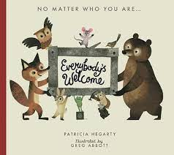
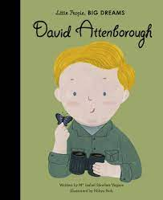

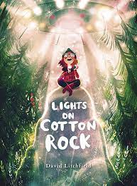
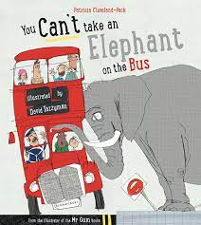

PHONICS
We follow the Read Write Inc phonics scheme and lessons are taught daily. The children are put into groups which suit their reading ability, so the new sounds and words they are learning are pitched at the correct level for each child. If your child did not pass the phonics screening check at the end of Year 1 then they will retake it at the end of Year 2. If you are unsure if your child will be retaking the test, please ask their class teacher.
These are the books we will be reading as part of our Five reads this half term.
MATHS
We will be following the White Rose Maths scheme of work and will be looking at Place Value, Addition and Subtraction and Shape.
Please help your child learn to count in, 2s, 3s, 5s and 10s.
PATHWAYS TO WRITE
We will be using the Pathways to Write scheme to write diary entry about a Space flight. The book we will be focusing on is ‘Look Up!’ by Nathan Bryon. Three times a week the children will participate in writing activities which will help them reach the end goal of writing a diary entry.
HISTORY
Our History topic this half term is ‘How were schools different in the past?’ We will be looking at schools past and present, and comparing them to identify the similarities and differences.
Year 2
Science
This term we will be learning about the different types of animals and how we can identify them. We will also learn about what different animals eat. As part of our science learning we will be going on a trip to Blackpool zoo.
ART
In art this half term the children will be learning how they can create different tones and textures in their drawings.
DT
In Design Technology the children will be making moving monsters using levers and pivots.
Computing
This term we will be investigating how we stay safe online.
Geography
This term we will be looking at the differences between hot and cold places.
P.E
2H – Monday and Friday
2M– Monday and Thursday
PE kit – white t-shirt, black/navy shorts or leggings, and PE pumps. No earrings please. This term through our Key PE curriculum we will be developing our ‘Fundamental Movement Skills’.
RELIGIOUS EDUCATION
This half term we will be looking at special books from a range of religions, with a focus on the Bible. We will be looking at the New Testament and the Old Testament, focusing on the stories told. We will also be looking at the Christmas story, and talking about good news.

