Slide 1
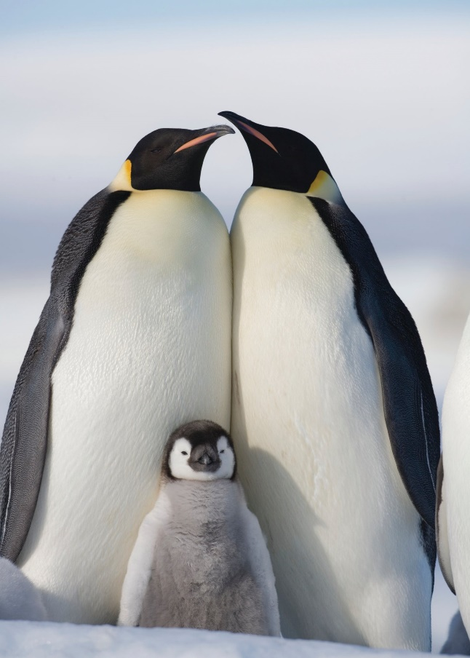
What do you know about penguins?
What else would you like to find out about them?
Find out 5 facts about penguins.
Challenge – write a sentence about one of the
facts you have found out.

Slide 2
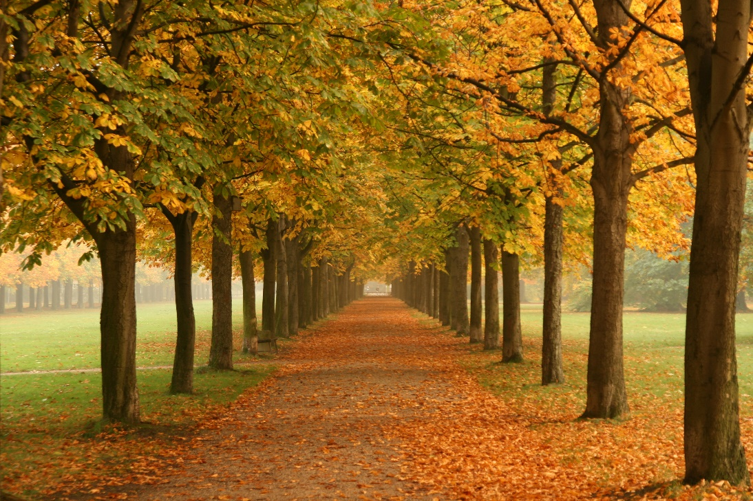
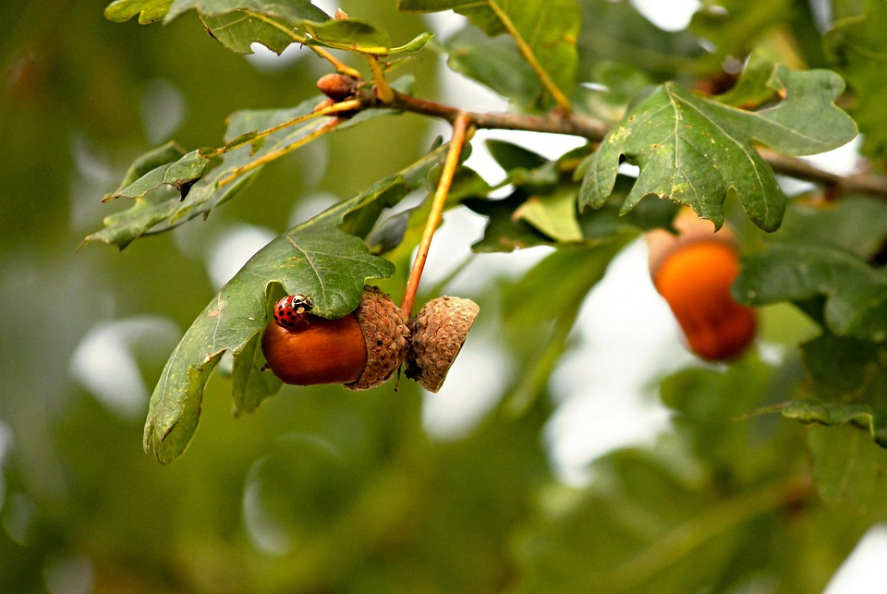
Go on an Autumn Walk. How many Autumn
things can you find?
How can you sort the items you have found?
Draw a picture of how you sorted them

