Slide 1






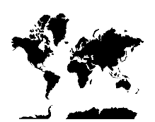





















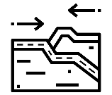








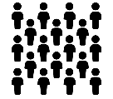


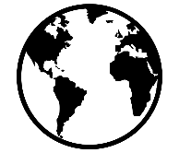





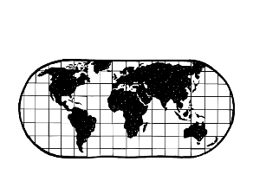











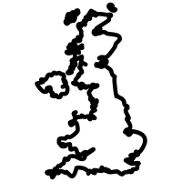

How can energy supply be more sustainable?
Where are areas of surplus and deficit located globally?
How and why does energy availability vary?
How can we classify natural resources?
Geography Learning Journey
What are the impacts of a North South divide?
Where do we find natural resources?
What factors affect energy consumption?
How does the UK impact the wider world?
How can we close the development gap?
How can we measure world development?
FIELDWORK: To what extent does coastal management stop Longshore Drift in Hendon
Why do rivers flood?
YEAR
How does a river shape the land?
11
How has the UK economy changed?
How has development changed NEEs?
How do NEE’s develop?
How can we measure world development?
FIELDWORK: To what extent does tourism have economic impacts in South Shields
How can we solve river flooding?
What are the landforms created by rivers?
How can we manage the coast?
What landforms are created by coastal processes?
How do coastal processes shape the land
What are Natural Hazards?
Why do the impacts of Earthquakes differ between HICs and LICs?
How do we monitor Earthquake’s?
What are the impacts of tropical storms?
What is the impact of climate change?
YEAR
10
What is Fieldwork?
What are coastal processes?
Why do we use graphical skills?
How are Volcanoes and Earthquakes formed?
Why do people live areas of hazard risk?
How do tropical storms form?
Why is the UK weather more extreme?
How can we solve climate change?
How can Tourism help a country develop?
Why do we use map skills?
How can city living be sustainable?
What are the reasons for living in NEEs?
How can we reduce the impacts on cold environments?
What are cold environments like?
How can we sustainably manage the rainforest?
Why do people live in UK cities?
Why are tropical rainforests so unique?
What is done to help LIC/NEE’s develop?
Why are countries developing at different rates?
How are cities in the UK regenerated?
How can living be improved in NEEs?
Where do people live?
What are the threats to cold environments?
What are the threats to tropical rainforests?
What influences the survival of an ecosystem ?
FIELDWORK: How healthy is our ecosystem
What are resources?
How do we use resources?
How does resource use impact our world?
How was the UK covered in ice?
How will ice impact our world in the future?
What are the impacts of volcanic eruptions?
YEAR
9
What are Biomes?
Where are the world’s earthquakes and volcanoes?
How do the impacts of volcanoes differ around the world?
FIELDWORK: How does litter damage our environment
How can we use resources more sustainably?
What features are formed by ice?
What is the structure of the Earth?
What is world development?
Why do different countries have different population statistics?
How can we measure population development?
How can coasts be managed?
What processes shape the coast?
How do these processes create landforms?
Why is the coast important?
How does development differ around the world?
Why is development uneven?
Where do people live in the UK?
How has the world population changed?
What is population density?
What are the impacts of coastal erosion?
How do rivers change downstream?
YEAR
8
Why are maps important?
How can places and height be shown on a map?
YEAR
How do rivers make places vulnerable?
How can we read a map?
How can we measure the weather?
How has weather impacted on the world?
What will the weather be like in the future ?
What causes flooding?
How can the impacts of river flooding be reduced?
How have maps changed?
How can we see where we are going on a map?
What is the difference between weather and climate?
FIELDWORK: How does the weather change in a small area
Why do we now have more extreme weather?
How do these processes create landforms?
Where is the North-East?
Where are countries located in the world?
How do we damage and protect our environment?
What is a good Geographer?
Why are rivers important?
YEAR
7
How does a river change downstream?
What processes shape rivers?
Why is our local area important?
Where is the UK?
Why is Geography important?
What is the difference between Human and Physical Geography?
‘ Geography is the subject which holds the key to our future. ’ MICHAEL PALIN

