Slide 1

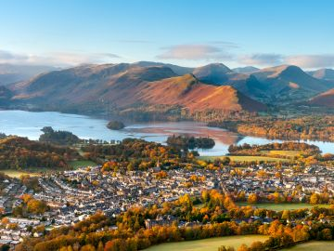
Subject: Geography Year 7 Term: Autumn
Assessment: Autumn Assessment Length of Assessment: 30 marks
Information about this Assessment:
Areas assessed:
Types of Geography
World Countries
Question types and guidance:
Describe - set out main purpose (say what you see)
Discuss - consider the positives and negatives of a scheme and come to a decision
Explain - give reasons for your answer (Say why)
Identify - indicate the main key idea
Label - draw arrows to the key point (your arrow much touch the point)
Use examples – give specific facts and figures about an issue (e.g. human and physical geography of Teesside)
Must know Key words:
Atmosphere
Capital city
Communications
Continent
Country
Economic
Ecosystems
Environmental
Europe
European Union
Geographer
Geography
Human Geography
Landforms
Natural Hazard
North East UK
Physical Geography
Population
Quality of Life
Recycling
Settlement
Social
United Kingdom
What do I need to revise for this assessment?
Introducing Geography | Where in the World
1) What is physical geography 2) What is human geography 3) Environmental geography problems and solutions 4) what makes a good geographer | 1) 7 continents of the world 2) Countries and their capital cities 3) Europe (the continent) 4) The European Union 5) The United Kingdom 6) The North East UK 7) Our local area
Assessment Examples:
Explain the Human and Physical geography found in the image
This photograph showcases a picturesque view of a town nestled within a natural landscape, which contains both human and physical features. The image shows a town with a network of streets, buildings, and homes. These human settlements are arranged along the lower part of the image, with the houses and infrastructure clearly visible. This is likely a residential area, with the town spreading across a relatively small section of the landscape. The roads are visible, weaving through the town and connecting various areas, indicating communication through transport. In the background, there are rolling hills and steep mountain ranges, indicating the physical geography of the area. The mountains are covered with grass and trees, showing natural features that are characteristic of the Lake District region in the UK, where this photo could have been taken. There is a body of water in the middle ground, likely a lake, which reflects the surrounding landscape. This feature adds to the scenic beauty and shows how
natural elements blend with human settlements.
Where can I find help with revision?
Your exercise books contain all the information to help you revise
Your class team
BBC Bitesize

