Slide 1
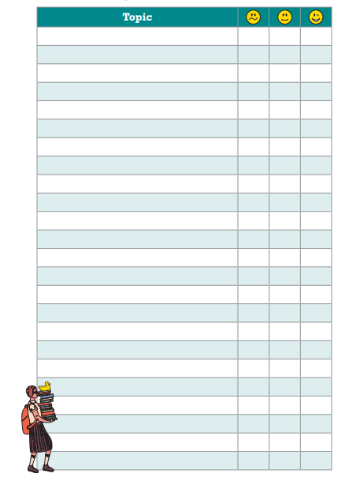
Mock Revision Checklist
Health and Social Care
Service users rights
The 6 C’s
Definition of person-centred values
Active listening and its benefits
Choice, independence and respect
Specialist methods of communication
Empowerment and self-esteem
Needing an advocate
Valuing individuality
Security measures
Personal hygiene
Why we use DBS checks
Safeguarding
Confidentiality
How PPE protects care workers
Types of care settings

