Slide 1




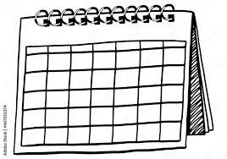
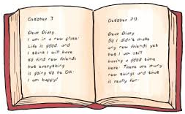











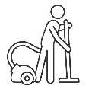




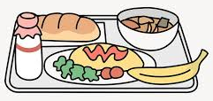






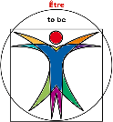


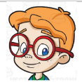








I can use the present, future and conditional tenses. I can express opinions with simple justifications. I can include some qualifiers, time phrases and connectives. I can make comparisons. I have developed an understanding of the Spanish Speaking culture and I have compared it to my own identity.
Year 7 Spanish
Revision
End of Year Assessment
Ordering an ice-cream
Arranging to go out – using modal verbs
A diary entry
UNIT 3B
FREE TIME
Ordering drinks & snacks
What I would like to do
Alternative arrangements
End of unit test
Sorts
JUGAR
Reasons I like/don’t like sports
What I am going to do next weekend
UNIT 3A
FREE TIME
Revision
End of unit test
Sports
HACER
My free time activities
What I do at the weekend
Ideal jobs
Weekend jobs
Household chores
Revision
UNIT 2B
SCHOOL AND WORK
Jobs & Careers
Pocket money
Telling the time
Revision
School subjects
Teachers
Mealtimes
End of unit test
UNIT 2A
SCHOOL AND WORK
End of unit test
Likes and dislikes
Describing school
Facilities
Describing others
ser
Pets
My personality
Describing what I look like
Revision
Describing others
tener
My family
Pencilcase & School bag
Classroom language
The alphabet in Spanish
Days & months
Countries and nationalities
End of unit test
UNIT 1B MYSELF, FAMILY AND FRIENDS
Age and birthday
Numbers up to 31
Colour preferences
Revision
UNIT 1A
MYSELF, FAMILY AND FRIENDS
Greetings, introductions
By the end of this year, you will be linguistically competent to talk about yourself and others, your pets, your school subjects and teachers, your free time activities and plans for the weekend.
“If you talk to a man in a language he understands, that goes to his head. If you talk to him in his own language, that goes to his heart.” Nelson Mandela

