Slide 1


Reception Autumn Scheme of Learning

Slide 2
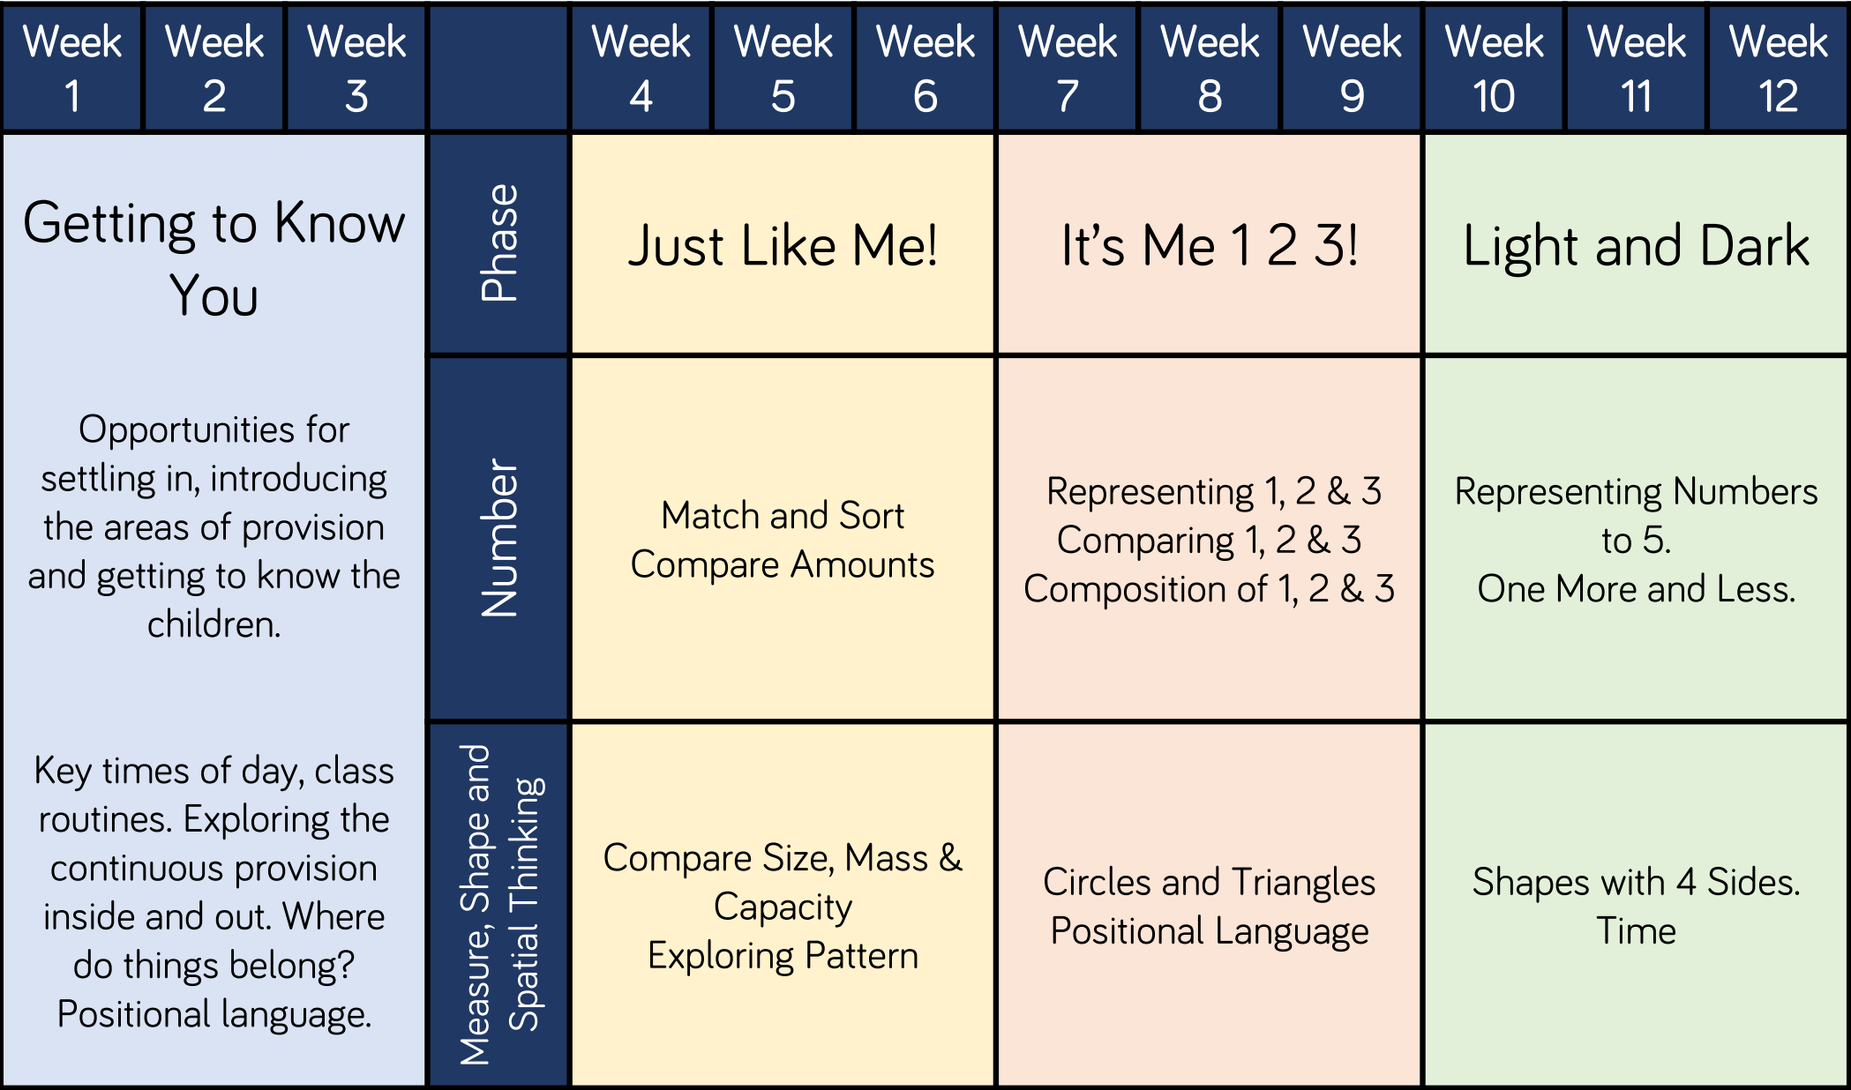
Reception

