Slide 1


Year 6 Autumn Scheme of Learning

Slide 2

Year 6

Slide 3
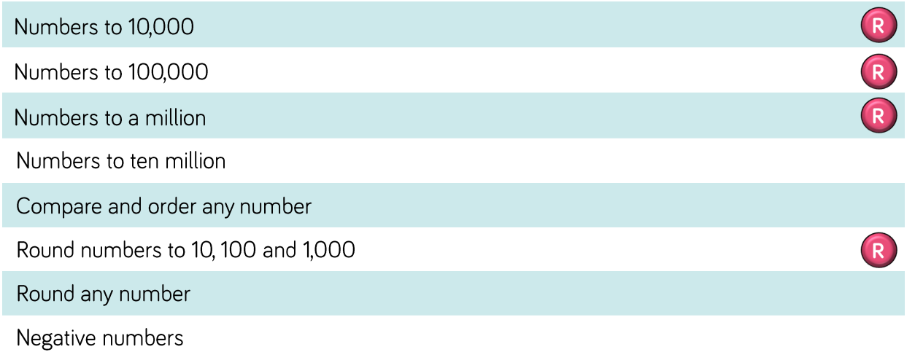
Year 6

Slide 4
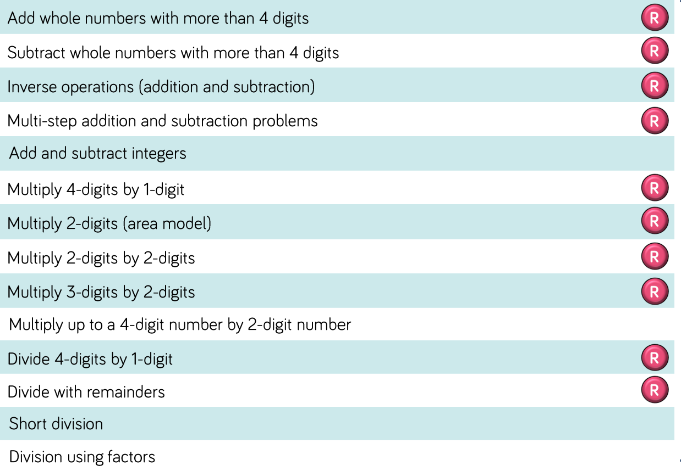
Year 6

Slide 5
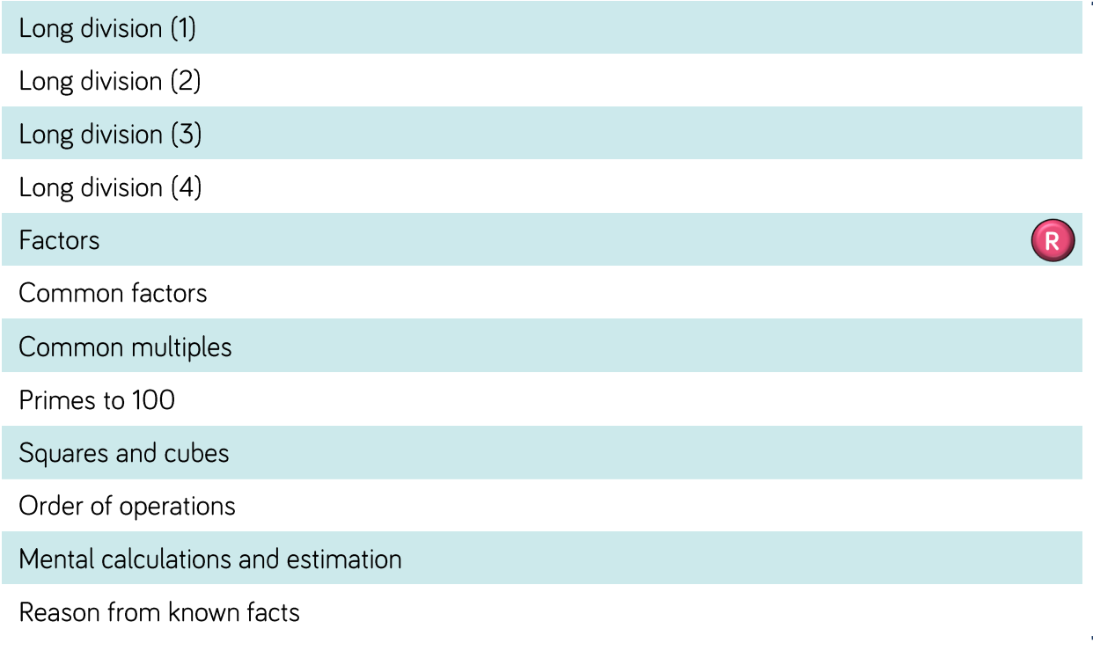
Year 6

Slide 6
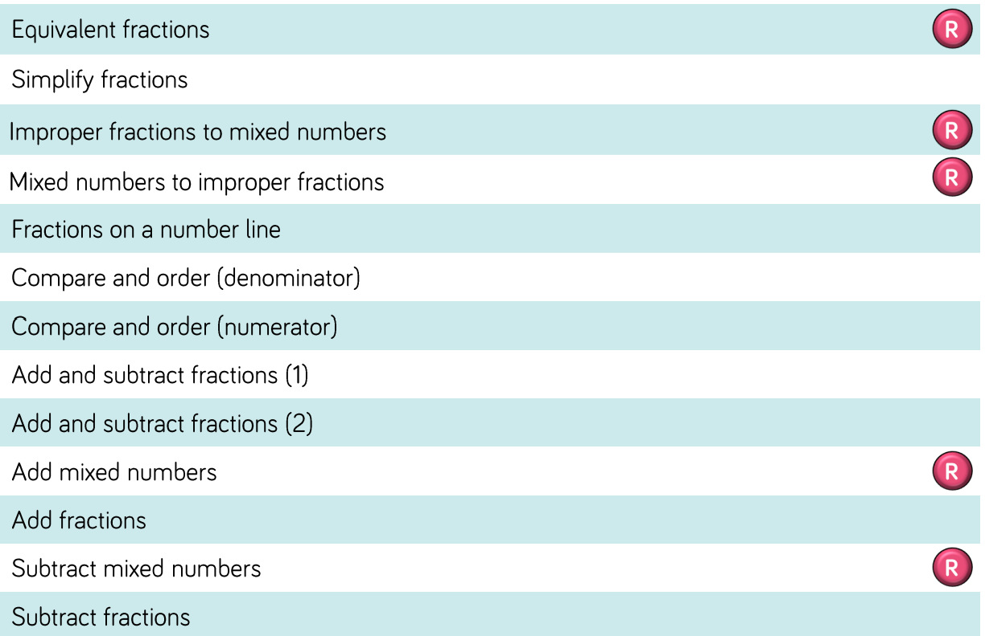
Year 6

Slide 7
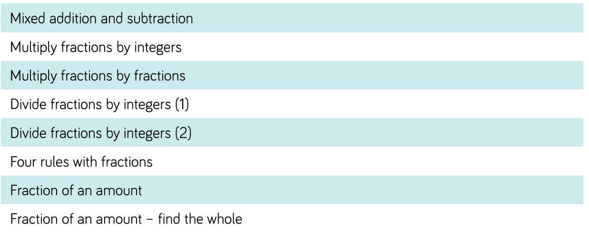
Year 6

Slide 8

Year 6

