Slide 2
Would You Rather?
Have no Christmas for one year?
Have no birthday for one year?
Explain your reasons.

Slide 3
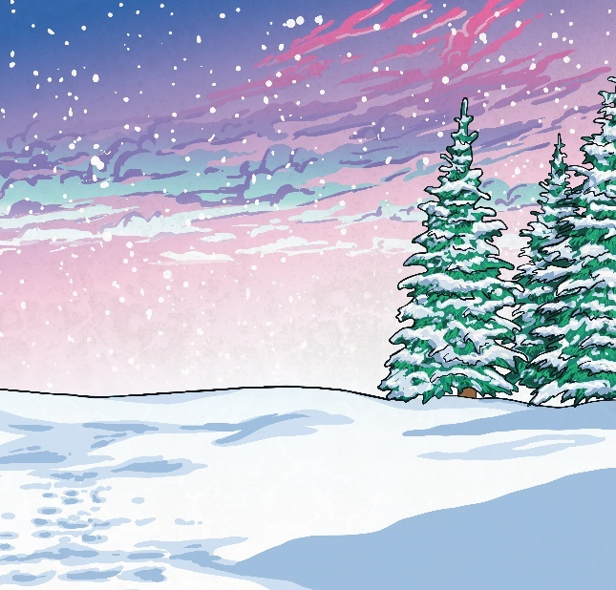
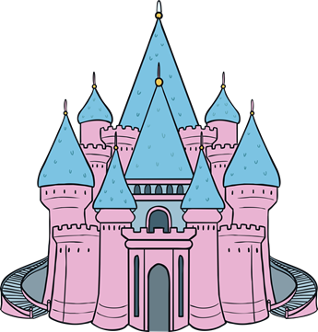
Would You Rather?
Go to Lapland?
Go to Disneyland?
Explain your reasons.

Slide 4
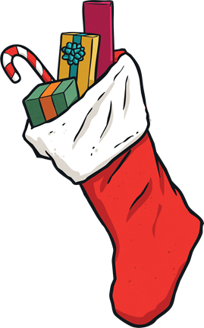
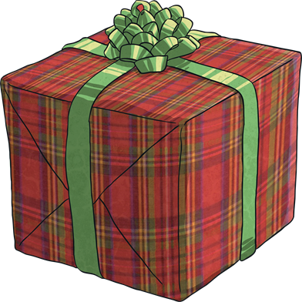
Would You Rather?
Have lots of small presents?
Have one big present?
Explain your reasons.

Slide 5
Would You Rather?
Have elf ears for a week?
Have a beard like Santa for a week?
Explain your reasons.

Slide 6
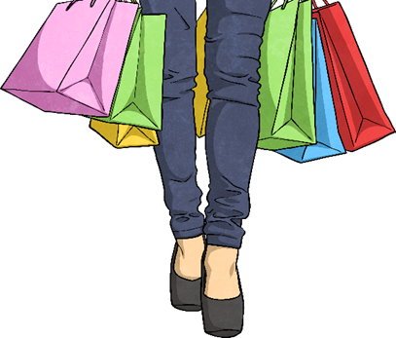
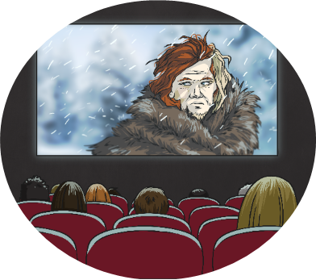
Would You Rather?
Do seven hours of Christmas shopping?
Watch ten hours of Christmas movies?
Explain your reasons.

Slide 7
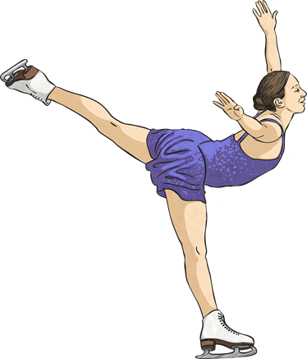
Would You Rather?
Make snow angels?
Go ice skating?
Explain your reasons.

Slide 8
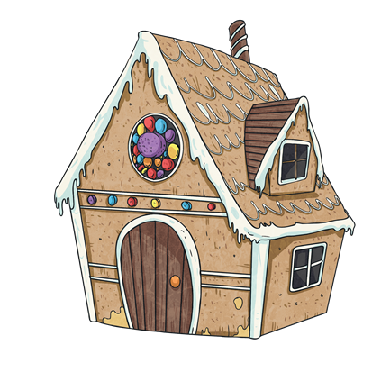
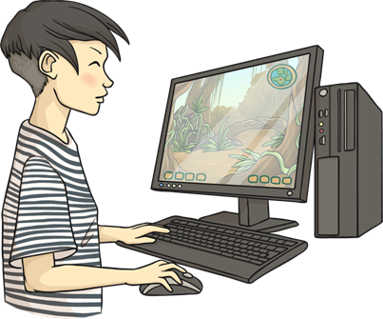
Would You Rather?
Spend a week in a gingerbread house?
Spend a week in a computer game?
Explain your reasons.

Slide 9
Would You Rather?
Wear a hat made of mistletoe for a day?
Wear jingle bells tied to your shoes for a day?
Explain your reasons.

Slide 10
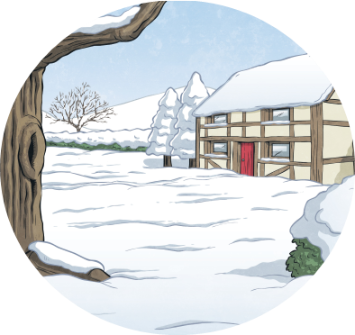
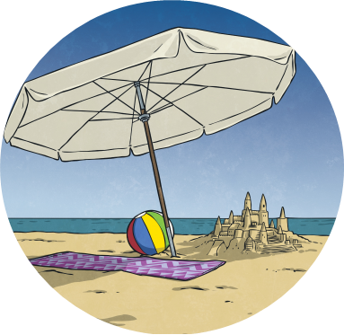
Would You Rather?
Be snowed in with your family?
Be marooned on a beach with the family?
Explain your reasons.

Slide 11
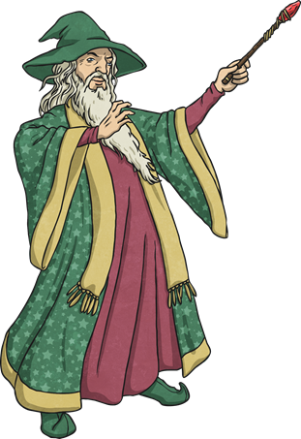
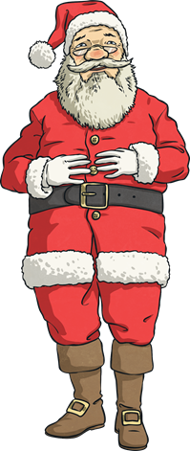
Would You Rather?
Spend a day with a wizard?
Spend a day with Santa?
Explain your reasons.

Slide 12
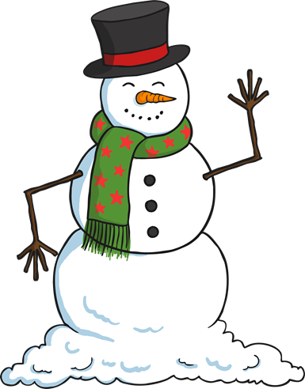
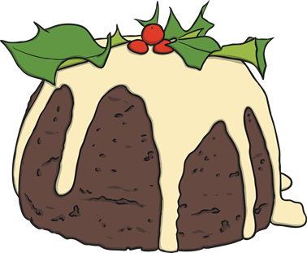
Would You Rather?
Build a snowman?
Bake a Christmas pudding?
Explain your reasons.

Slide 13
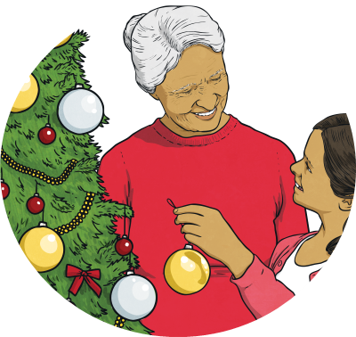
Would You Rather?
Wrap a hundred presents?
Decorate ten Christmas trees?
Explain your reasons.

Slide 14
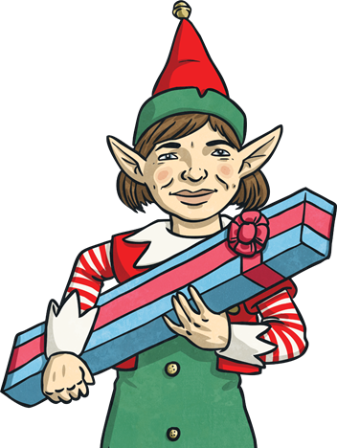
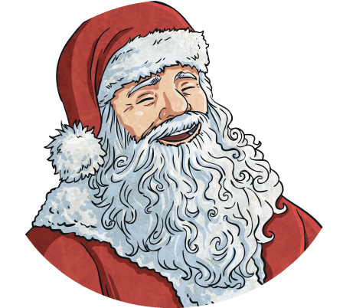
Would You Rather?
Laugh like Santa?
Talk like an elf?
Explain your reasons.

Slide 15
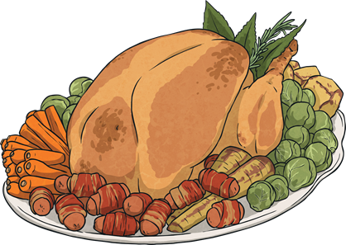
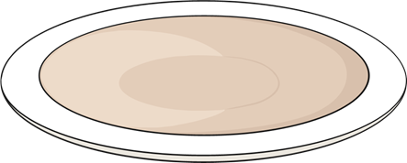
Would You Rather?
Have Christmas dinner every day for a month?
Never have Christmas dinner again?
Explain your reasons.

