Slide 1
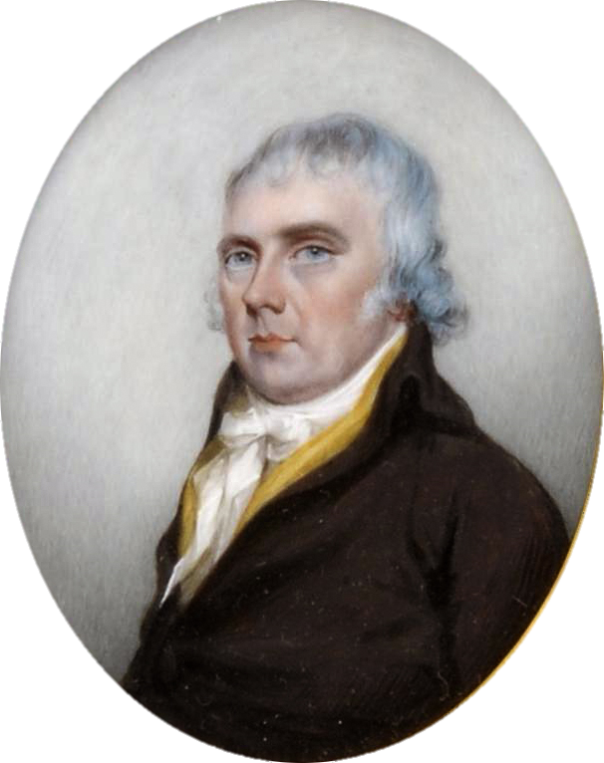
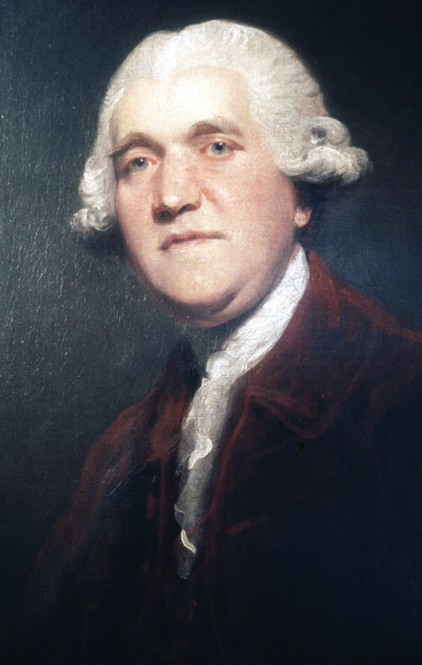
St Peter’s Primary School
The Potteries Retrieval Practice

Slide 2

The Potteries Retrieval Contents:
Significant Individuals Anagrams
The Potteries Quiz
Positives and Negatives of the Industrial Revolution
Wordsearch: Josiah Wedgwood’s Achievements
Missing Words: Bottle Kiln
Cops and Robbers
True or False
Picture Links: 1
Picture Links: 2
Word Sorts
Noughts and Crosses

Slide 3
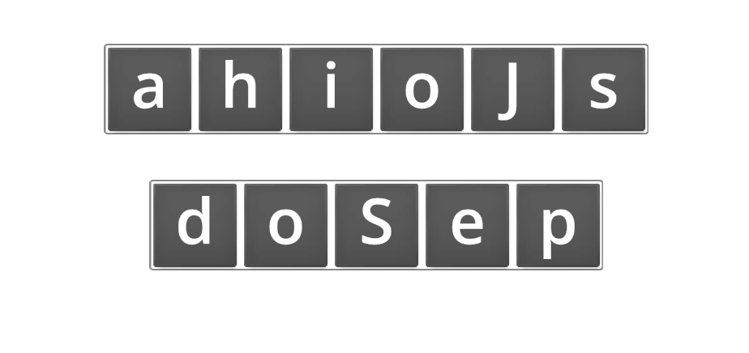
Significant Individuals Anagrams:
Can you identify the significant individual? - Anagram (wordwall.net)

Slide 4
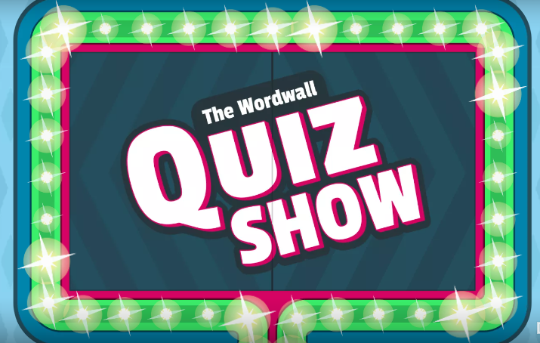
Quiz Show
The Potteries Quiz - Gameshow quiz (wordwall.net)

Slide 5
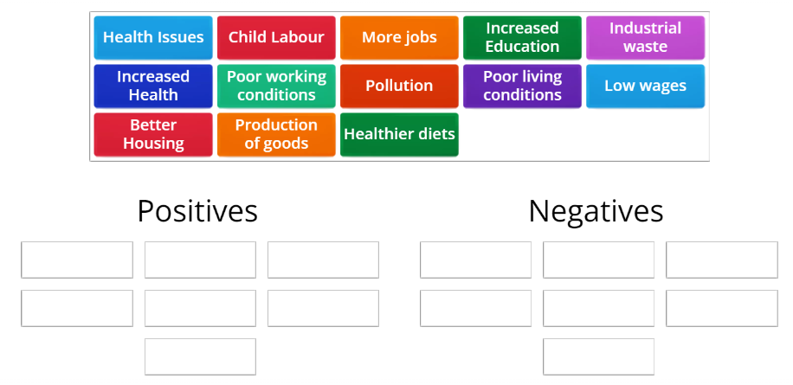
What were the Positives and Negatives of the Industrial Revolution?
What were the Positives and Negatives of the Industrial Revolution? - Group sort (wordwall.net)

Slide 6
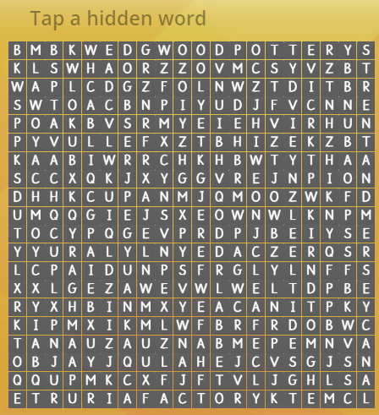
Wordsearch: Josiah Wedgwood’s Achievements
Wedgwood's achievements. - Wordsearch (wordwall.net)

Slide 7
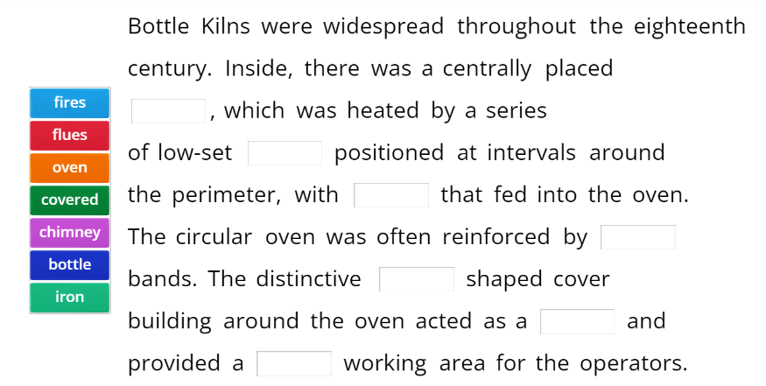
Missing Words: Bottle Kilns
s: Bottle Kiln - Missing word (wordwall.net)

Slide 8
Cops and Robbers
Who was Josiah Wedgwood and what did he do?
Who was Josiah Spode and what did he create?
What were the positives and negatives of the Industrial Revolution/ Pottery Industry?
What was it like to live during the Potteries?
Own recalled knowledge | Stolen knowledge
You need to write as much knowledge as you can about the question in the first column.
Then you will be given 30 seconds to steal someone else's ideas and place them in the column on the right.

Slide 9
True or False:
Statement: | True or False
The Pottery Industry in Stoke-On-Trent started in the early 1600s.
Thomas Whieldon was the leading potter of early potteries.
Josiah Wedgwood lost his leg due to an attack of bird flu.
The Pyrometer was invented by Josiah Spode.
The cheapest houses were mainly back-to-back terraces, which rarely had clean, running water access.
Thomas Minton created the Willow Pattern.
Fine Bone Chine was created by Josiah Wedgwood.
The pottery factory at Etruria closed in 1950.

Slide 10
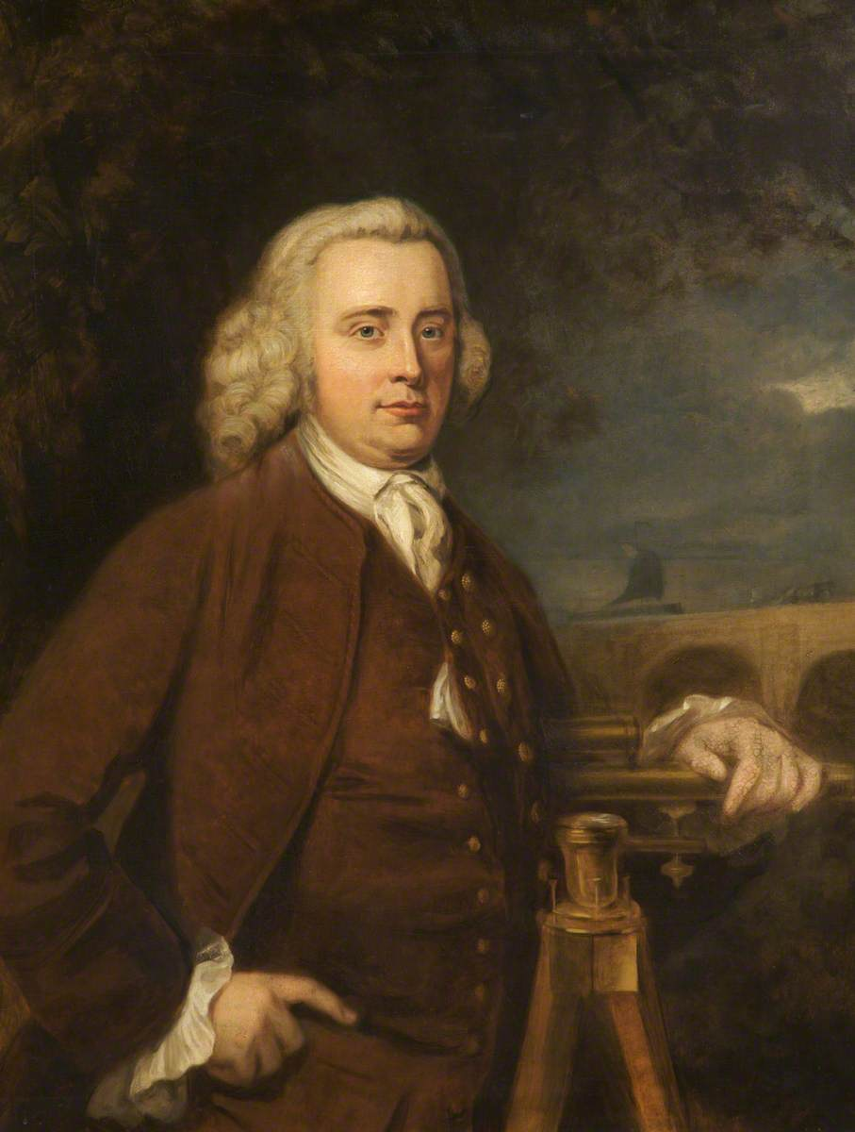
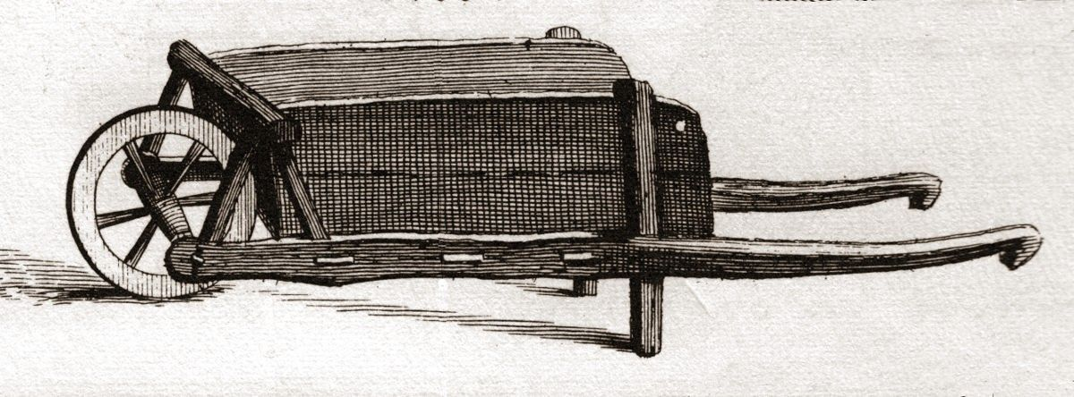
Picture Links: 1
What links these pictures?

Slide 11
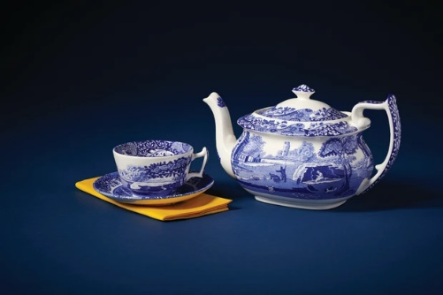
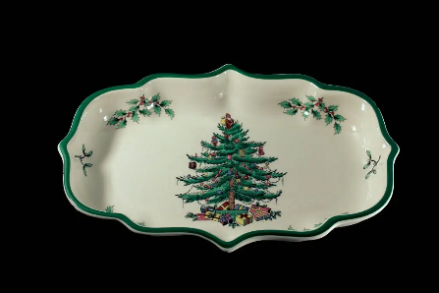
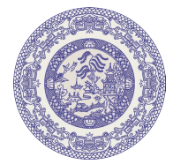
Picture Links: 2
What links these pictures?

Slide 12
Word Sorts
wares
How can we group these words? Are there any words that don’t fit into this topic?
Kiln
Thrower
Glaze
Clay
Cabal
slabs
Doublet
Corset
Bumrawle
Potter
Ruff
Dipper
Cardinal
Saggar
Potter’s wheel
Pedlars
Pewter
Slip-casting

Slide 13
Noughts and Crosses
When was Josiah Wedgwood born?
When did the Industrial Revolution begin?
Who created Fine Bone China?
What were three positives of the Industrial Revolution?
Why did Josiah Wedgwood support the building of the canal?
Who was Josiah Spode?
Who invented the Pyrometer? And what did it do?
When did the Pottery industry begin in Stoke-On-Trent?
What were three negatives of the Industrial Revolution?

