Slide 1
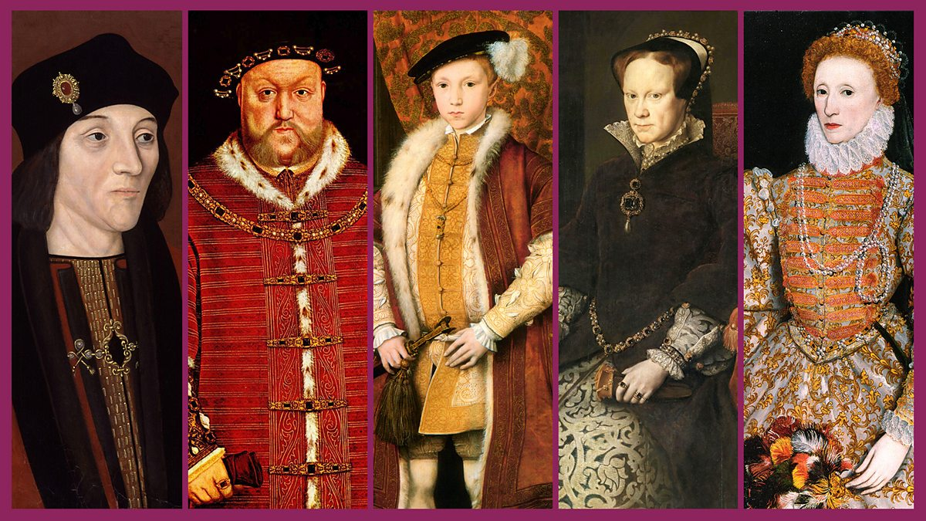
St Peter’s Primary School
Tudor Retrieval Practice

Slide 2

Tudor Retrieval Contents:
Tudor Anagrams
Tudor Monarchs: Whack-a-mole
Tudor Order: Rank Order
Tudor Timeline: Monarchs
Tudor Timeline: Events
Quiz 1
Missing Words: Henry VIII
Quiz Show
Cops and Robbers
True or False
Picture Links: 1
Picture Links: 2
Word Sorts
Noughts and Crosses

Slide 3
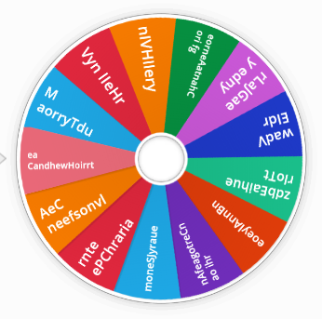
Tudor Anagrams:
Tudor anagrams - Random wheel (wordwall.net)

Slide 4
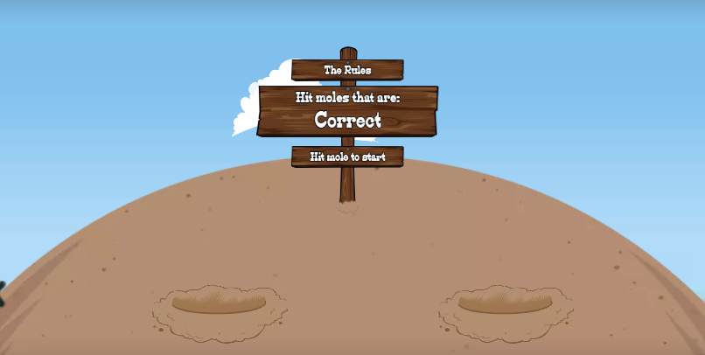
Tudor Monarch: Whack-a-mole
Tudor Monarchs - Whack-a-mole (wordwall.net)

Slide 5
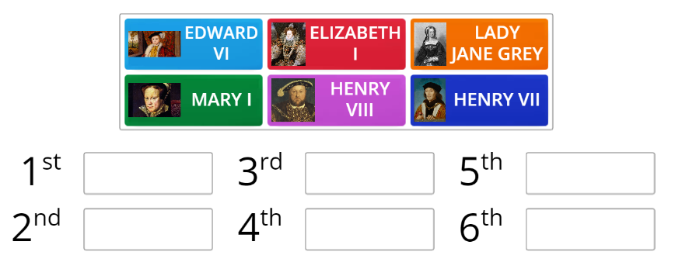
Tudor Timeline: Monarchs
Tudor Timeline - Rank order (wordwall.net)

Slide 6
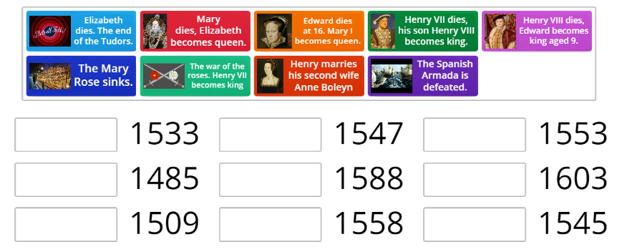
Tudor Timeline: Events
Tudors - Random wheel (wordwall.net)

Slide 7
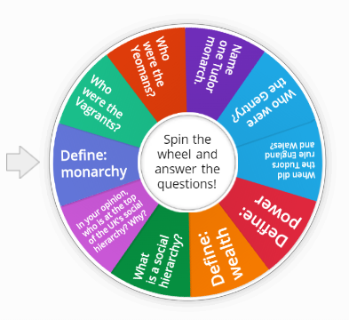
Tudor Quiz 1
Tudors - Random wheel (wordwall.net)

Slide 8
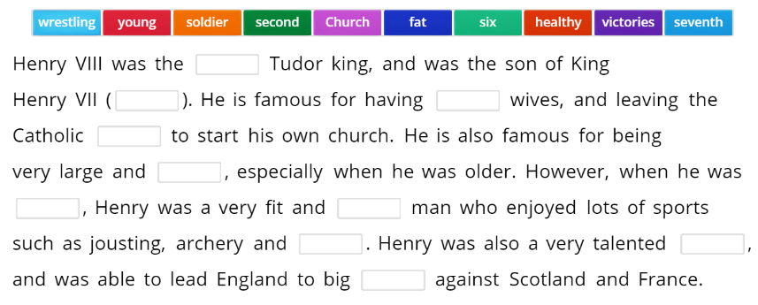
Missing Words: Henry VIII
Who was King Henry VIII? - Missing word (wordwall.net)

Slide 9
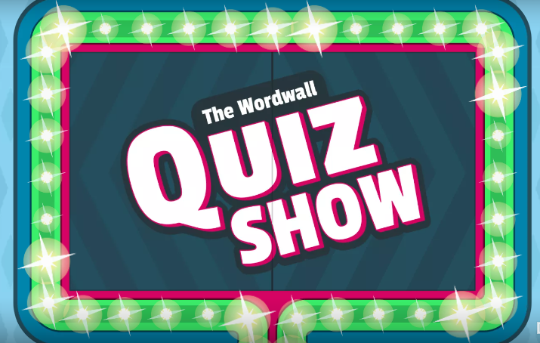
Quiz Show
I Tudor - Quiz (wordwall.net)

Slide 10
Cops and Robbers
Who were Henry VIII wives and what happened to them?
What items of clothing did the Tudor people wear?
What was it like to live in the Tudor period?
What was the Spanish Armada?
Own recalled knowledge | Stolen knowledge
You need to write as much knowledge as you can about the question in the first column.
Then you will be given 30 seconds to steal someone else's ideas and place them in the column on the right.

Slide 11
True or False:
Statement: | True or False
The Tudors started in AD 1485 with Henry VII, with the defeat of Richard III at the Battle of Bosworth.
Anne Boleyn was mother of Edward VI.
Henry VIII broke with Rome because he no longer wanted to be Catholic.
Catherine Howard was Henry VIII’s final wife.
The Spanish Armada was in 1588 and was where Spanish ships tried to invade England, but failed.
William Shakespeare was the man who tried to help Henry VIII get a divorce.
Elizabeth I died in 1603 and her heir Lady Jane Grey took the throne.
James I was the first monarch to rule over both England, Wales and Scotland.

Slide 12
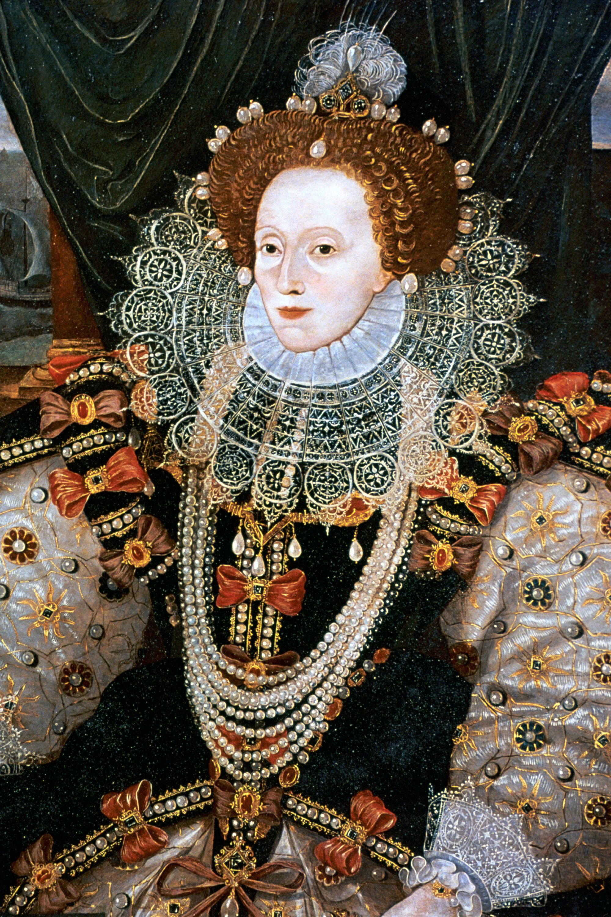
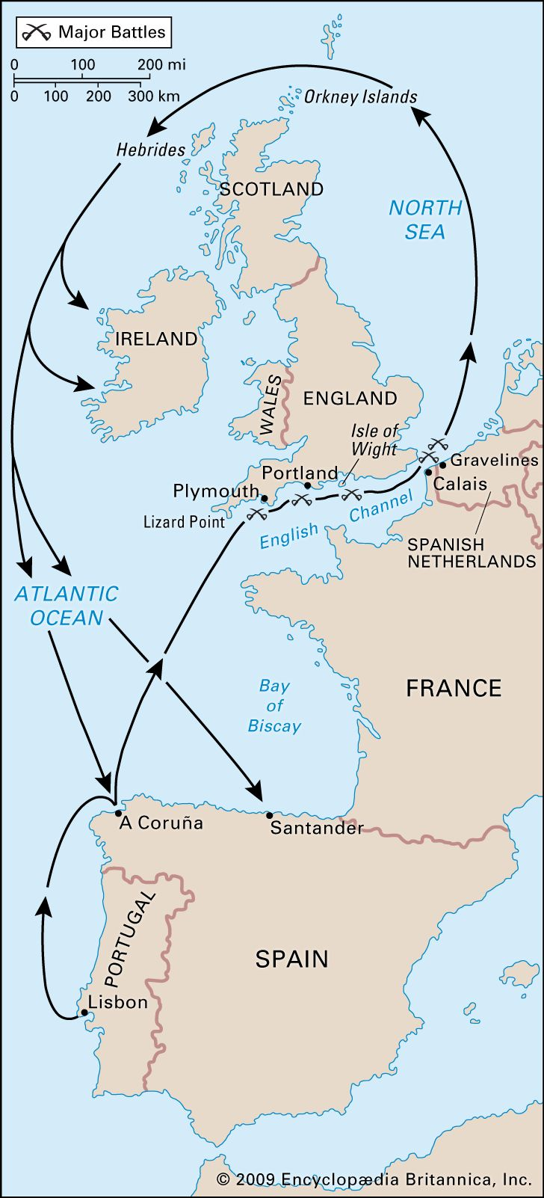
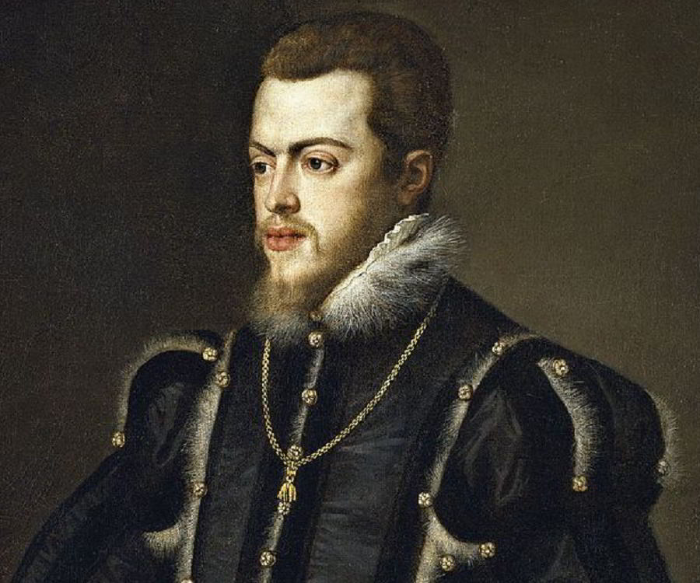
Picture Links: 1
What links these pictures?

Slide 13
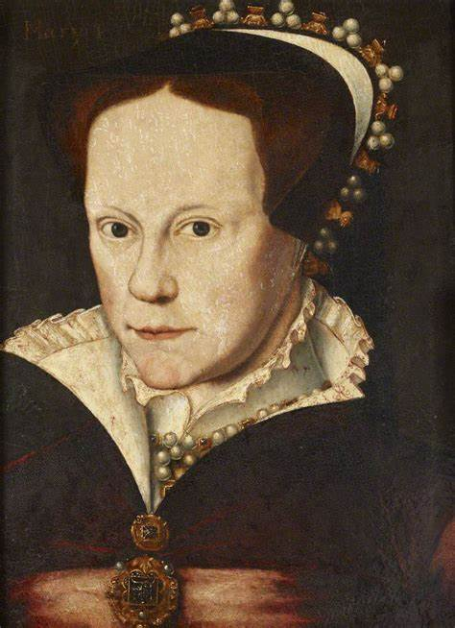
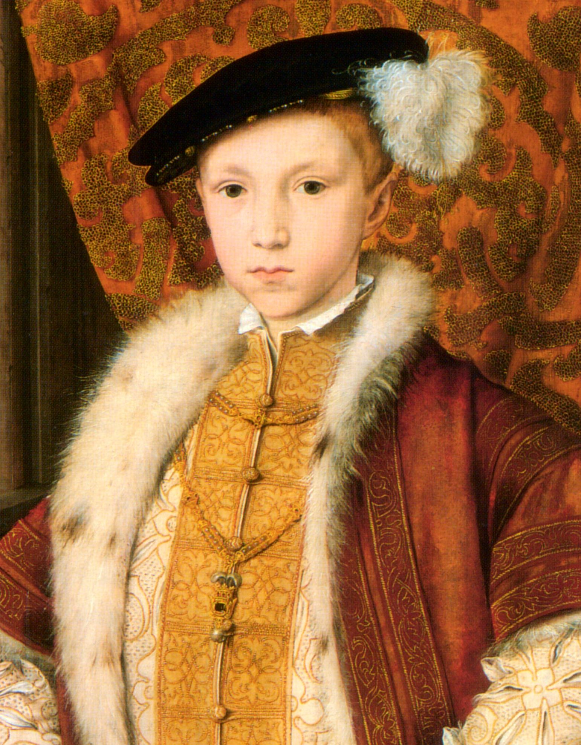
Picture Links: 2
What links these pictures?

Slide 14
Word Sorts
Catholics
How can we group these words? Are there any words that don’t fit into this topic?
Kiln
Yeoman
Vagrant
Clay
Heir
Breeches
Doublet
Corset
Bumrawle
Watchman
Ruff
Dipper
Cardinal
Saggar
French Hood
Pedlars
Kirtle
Protestants

Slide 15
Noughts and Crosses
When did the Tudor reign begin?
Who was William Shakespeare?
Why did Henry VIII Break with Rome?
Name three items of clothing from the Tudor period.
What was the Spanish Armada?
Who was Henry VIII?
What happened at the end of the Tudor Period?
Name all six of Henry VIII’s wives, in order.
When did the Tudors end?

Slide 16
Resources
Tudor - Teaching resources (wordwall.net)

