Slide 1
Welcome to Reception
September 2023
Our Mission Statement
We the family of St Peter’s, united by our faith in God, love, learn and grow together.

Slide 2
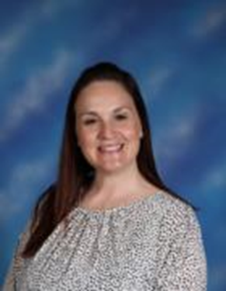
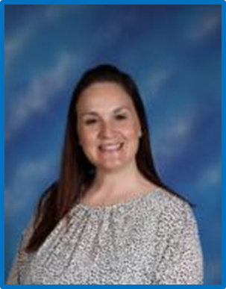
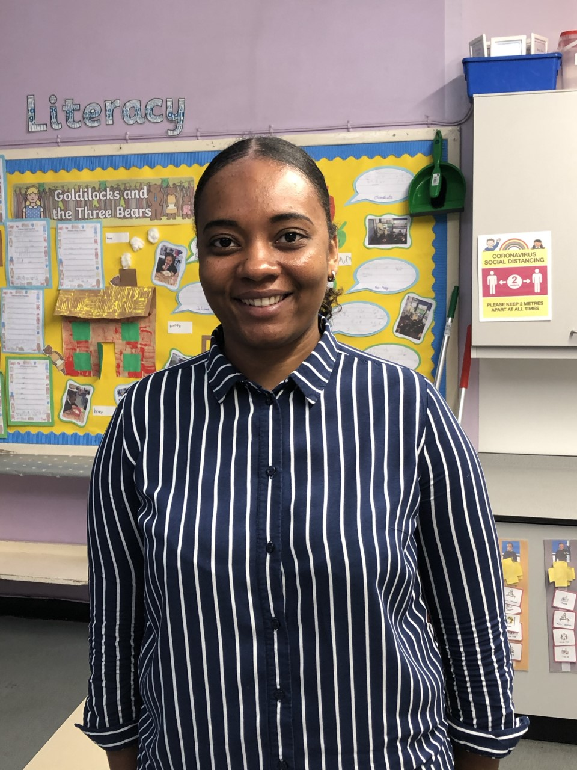
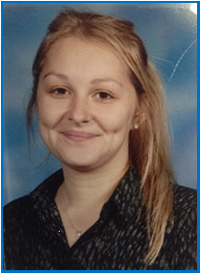
Meet the Staff
At St Peter’s we recognise that early experiences and opportunities lay the foundations to a child’s confidence, attitudes to learning and future academic success. Our Team of professionals are carefully chosen to help nurture a love for Learning.
Mrs F Sapiano
Nursery Teacher
EYFS Lead
Safeguarding Officer
Miss Sango-Jackson
RS Class Teacher
Miss Jenkins
RJ Class Teacher

Slide 3
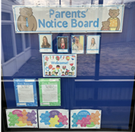
Communication between home and school.
Parent’s Notice Board
Each classroom has a Parent’s notice board displayed in the window by the classroom entrance. This will be updated to inform you of any upcoming events, trips, workers of the week and any other important information.
Half- Termly newsletters
Every half-term we will be learning about a new topic in class. We will send home a newsletter, updating you on our learning and giving you some ideas of things you can do at home to prepare for this.

Slide 4
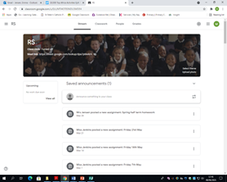
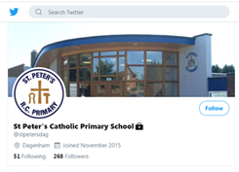
Google Classroom
We adopted Google Classroom, an online learning platform, during both lockdown period’s last year. This enabled us to communicate between home and school, teach live lessons and post assignments. We will continue to use this platform, to assign the children weekly homework and also to post regular updates of your child’s learning. We will also post important messages here too!
Twitter
Check out our school Twitter page. We will update this page with pictures and videos of the children enjoying their learning environment and when there are special events taking place at school.
Group Call
We have a Group Call system whereby we will contact you with important school information. To be able to benefit from this service it is essential we have your current mobile phone number and email address.

Slide 5
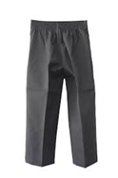
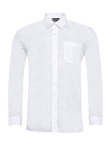
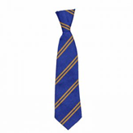
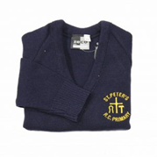
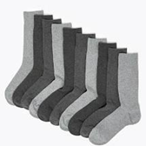
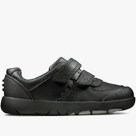
Reception Uniform
We have two official uniform stockist for St Peter’s Catholic Primary school.
Castle Green-Gale Street, Dagenham, RM9 4UN.
Telephone: 020 87241500 www.castle-green.org.uk/product-category/st-peters-catholic-primary-school
Premier Schoolwear-688-690 Becontree Avenue, Dagenham, RM8 3HD. Telephone: 02085920141 www.premierschoolwear.co.uk/primary-schools/st-peters-catholic-primary-school.html
Boys need to wear grey trousers, white shirt, elasticated school tie, navy jumper, with the school crest, grey or black socks and black Velcro shoes.
All clothing and bags must be labelled with the child’s name!

Slide 6
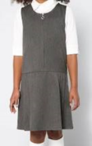
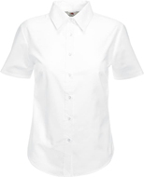
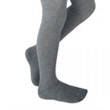
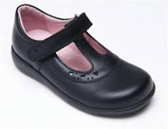
Reception Uniform
Girls need to wear grey pinafore or skirt, white blouse, elasticated school tie, navy cardigan, with the school crest, grey tights or socks and black Velcro shoes.
All clothing and bags must be labelled with the child’s name!

Slide 7
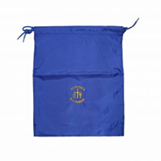
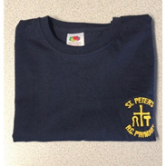
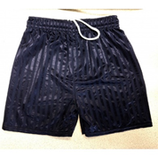
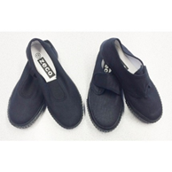
Reception PE kit and other uniform
P.E. bag, Navy t-shirt with the school crest, navy shorts and black plimsolls.
No earrings
.

Slide 8
Reception PE
• Children must bring in their PE kit by Wednesday and they will take them home every Friday. This allows them to be washed over the weekend. Some PE in EYFS is done as part of our learning provision and will be done on various days so they will not always change for these.
• If staff are absent or on a trip PE may not be able to take place on Wednesday as stated so please allow for this and bring their PE bag in as early in the week as possible.
• Children cannot wear earrings during PE and will not be allowed to take part with them in. Adults are not allowed to take them out for them.
• Please ensure their PE kit and all items inside are labelled clearly – They will go missing and are easier to return with a name. Even socks and tights!
.

Slide 9
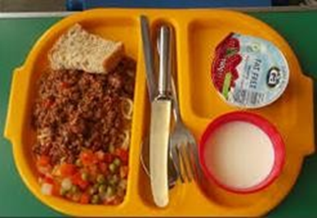
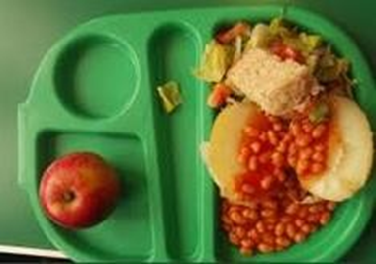
Reception Lunch
From Reception, right through to the end of Year 2, all children can have a free school dinner. They will pick their own dinner everyday. The middays will inform us if they have not eaten anything.
Please let us know of any allergies your child has or dietary requirements e.g. no pork, vegetarian but can eat fish etc.
If you choose to provide your child with a packed lunch instead, please follow our healthy school policy. Please do not give your child glass bottles, fizzy drinks, sweets, chocolate or any food that contains nuts.

Slide 10
Reading
• Parents or older siblings (16+) are able to sign your child’s Reading Record
• Reading Records need to be signed at least 3 times a week, ideally every night. This just needs to be a signature or you can write a comment if you would like e.g. Joshua could recognise the ‘s’ sound in his book.
• Books will be changed on a Monday but please bring these in everyday as we will read with the children throughout the week.
• They will have 2 reading books – one which will be at a level appropriate for their phonics and another one which they have chosen themselves.
• The books will be given in a folder that they must be kept in. The phonics books were brand new last year and there is a fine for lost books. Only 2 were damaged last year in the whole school!

Slide 11
Letters & Notices
We get a lot of information that we need to pass onto you. PLEASE do read the letters that they will give to you. Some are for things that your children will miss out on and or changes that will impact you e.g. half days / non uniform days / inset days.
Information e.g. assembly notices will also be displayed on our parent notice board.

Slide 12
Assemblies
We will be having a class assembly at the end of the year which you are invited to attend.
RJ – 24th June
RS – 1st July
Every Friday the whole school meets for a celebration assembly. You are invited to join us, however, Reception will not be attending for the first few weeks – we will let you know when we start going.

Slide 13
Birthdays
Your child is invited to wear their own clothes on their birthday. If their birthday is on a weekend or half term you can choose a day close to their birthday for them to wear their own clothes in school.
Only 1 packet of sweets per child is allowed to be brought in to give out. We are not allowed to give other things out due to allergies.

Slide 14
What to do if you have a concern
If you have a concern and would like to speak to your child’s teacher please email them on the emails below…
EYFS@st-peter.bardaglea.org.uk
We like to work with the children as soon as they come in, in the mornings, so if you have any queries please catch us at the end of the school day AFTER all the children have been dismissed.
We do have to ensure all children are collected by the correct adult and all messages are given so please be patient with us when we do this at the end of the day.

