Slide 1
Welcome to Reception
September 2024
Our Mission Statement
We the family of St Peter’s, united by our faith in God, love, learn and grow together.

Slide 2
Starting School
In September:
Individual meetings with class teacher prior to start.
Staggered start in small groups over a one week period in September.
Curriculum meeting with parents at the end of September.

Slide 3
Key Staff
Mrs Scott – Headteacher
Miss Anthoney – Deputy Headteacher
Mrs Sapiano – SENCO/Assistant Headteacher
Mrs Jensen – EYFS Phase Leader
Mrs Brown and Miss Bullen – Office Staff
Miss Cosburn – Breakfast and afterschool club leader

Slide 4
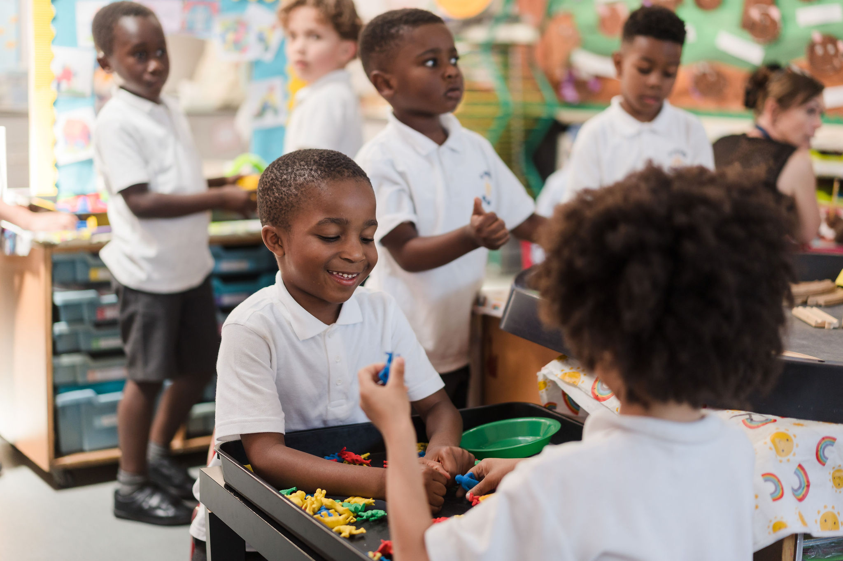
Breakfast and After School Club
Breakfast club opens 7.30am until 8.45am (last entry at 8.30am)
£3.50 per session
Payments to be made in advance via Parent Pay
Registration forms need to be completed before the children attend (see office)
After School club runs from 3.15pm until 5.30pm
£10.00 per session
Payments to be made in advance via Parent Pay
Registration forms need to be completed
before the children attend (see office)

Slide 5
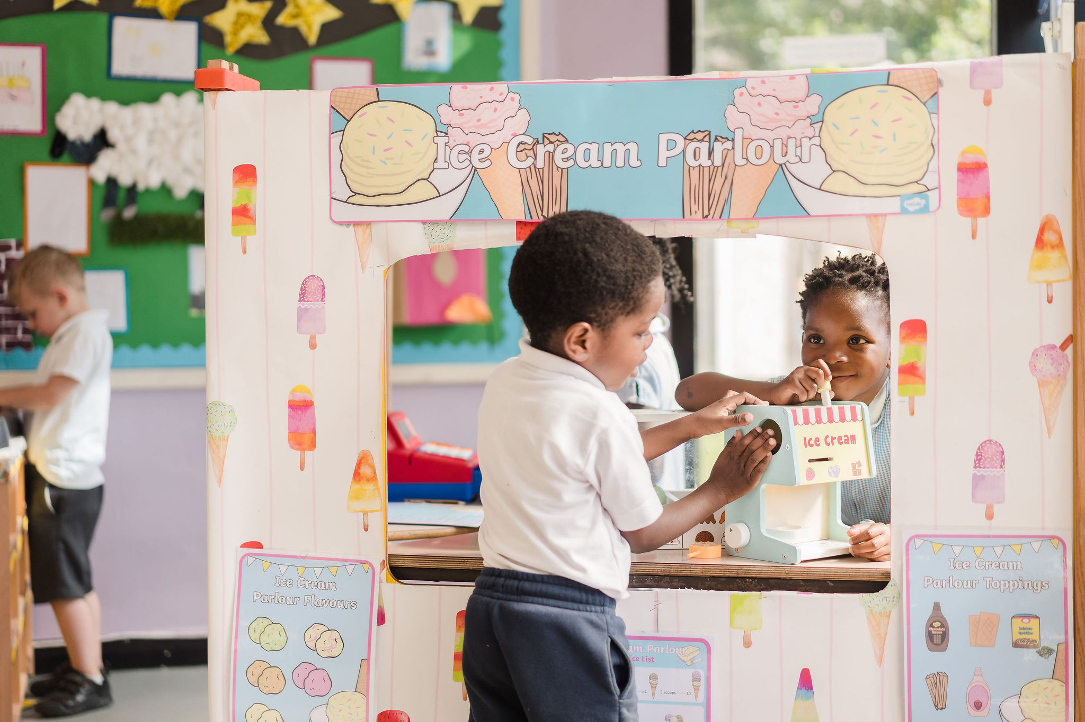
Getting to know your child
EYFS curriculum is slightly different to the rest of the school.
The first half term is all about allowing the children to settle in, make new friends and for us to get to know them through their play.
Admission to Reception is staggered to allow for the children settle into their new environment.
During this time, observations will be carried out with your child which will support us in our future planning and target setting.
We will meet with you at the end of the first half term to talk through what stage of learning your child is at and how we are going to continue to observe and support them through the EYFS Profile.
Please do not worry if it takes a while for your child to settle, we will get there by working together.

Slide 6
The Early Years Foundation Stage
The EYFS Curriculum is made up of:
3 Prime Areas:
Personal, Social and Emotional Development
Communication and Language Development
Physical Development
4 Specific Areas:
Literacy
Mathematical Development
Understanding the World
Expressive Art and Design

Slide 7
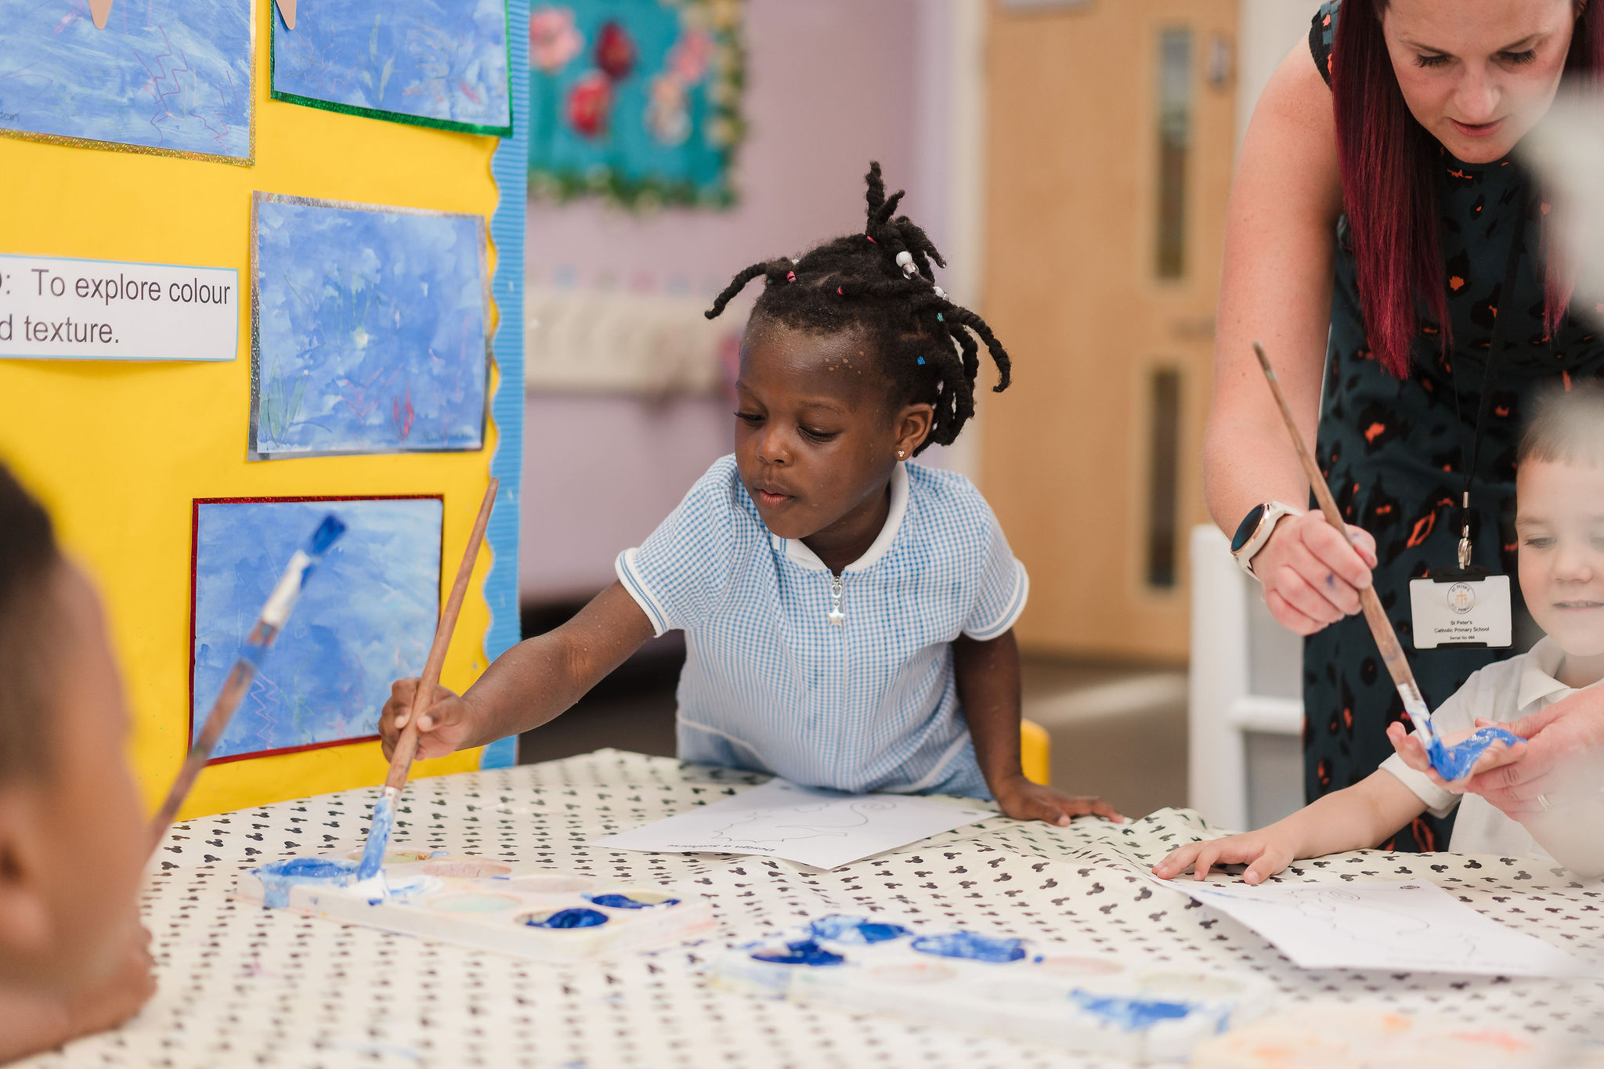
The Typical Day in Reception
8.45-9.15: Welcome/Self-Registration
9.15-10.15: Learning time
10.15-10.30: Snack time
10.30-11.00: Phonics
11.00-11.30: Story time/preparing for lunch
11.30-12.30: Lunchtime
12.30-2.45: Learning time
2.45-3.15: Story time/getting ready for home time
3.15—Home time

Slide 8
Reading and Phonics
Reading starts with talking. Spending time looking at picture books, talking about what is happening and what the children can see.
At St Peter’s, we use Little Wandle to teach the children to read. There will be a meeting in September to share more information but if you would like to find out more before then, please visit the website below:
https://www.littlewandlelettersandsounds.org.uk/resources/for-parents/

Slide 9
Reading at home
We ask parents to read with their child at least 3 times a week and sign their reading records.
We appreciate that you are all very busy but if you could spend 5 minutes in the evening reading with your child, it will make a huge difference to their learning.
“Parents who read one picture book with their child every day will expose their child to approximately 78,000 different words each year. From birth to Reception, those children will have been exposed to 1.4 million more words than children who are not exposed to books.”

Slide 10
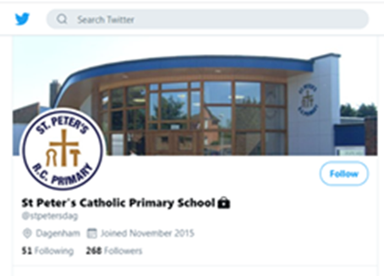
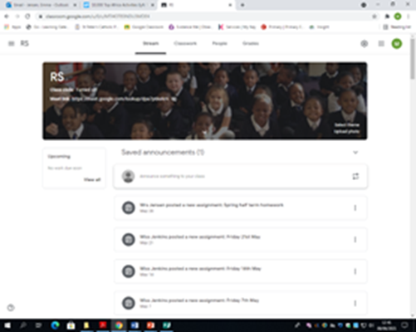
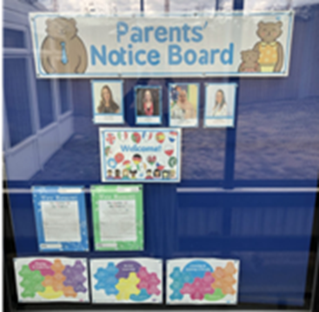
Parents as Partners
We recognize the importance of parents and carers in a child’s development. You are your child’s first educators and we greatly value any input, opinions and information you can share with us about your child’s learning and progress.
We provide many opportunities for parents and carers to take an active part in the children’s education. These include:
Stay and Play sessions
Parent Workshops
Family Fun Days
Educational Visits – parent helpers
School Twitter Page
Google Classroom
Parent Noticeboard
Newsletters

Slide 11
Reception Uniform
We have two official uniform stockist for St Peter’s Catholic Primary school.
Castle Green-Gale Street, Dagenham, RM9 4UN.
Telephone: 020 87241500 www.castle-green.org.uk/product-category/st-peters-catholic-primary-school
Khalsa Schoolwear - Unit 1, Cromwell Centre, Selinas Lane, Dagenham, RM8 1QH
https://khalsaschoolwear.co.uk/
All clothing and bags must be labelled with the child’s name!

Slide 12
Boys Uniform

Slide 13
Girls Uniform

Slide 14
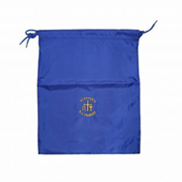
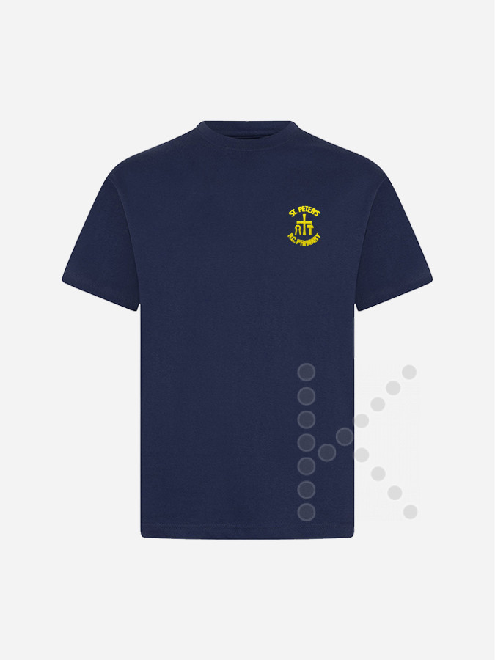
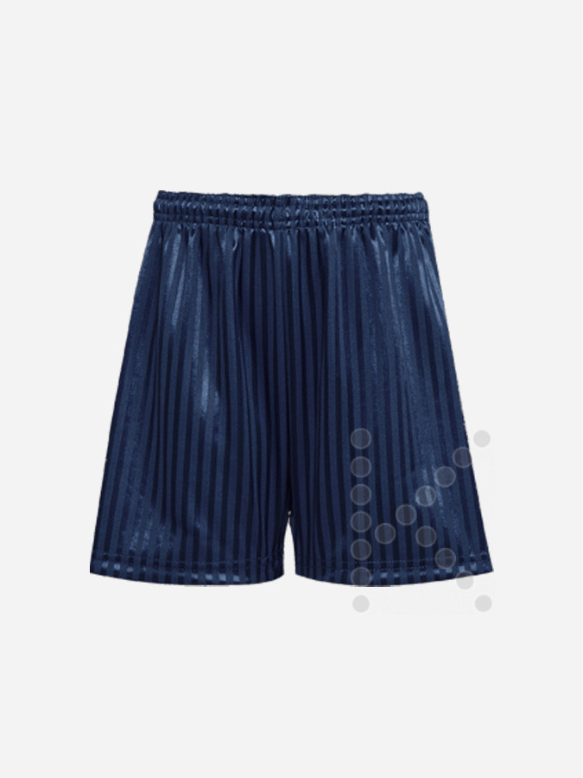
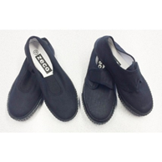
Reception PE kit and other uniform
P.E. bag, Navy t-shirt with the school crest, navy shorts and black plimsolls. No earrings!
.

Slide 15
Reception PE
• All children must bring in their PE kit as they will not be able to safely take part if they are wearing their uniform. Some PE in EYFS is done as part of our learning provision and will be done on various days so they will not always change for these.
• Children cannot wear earrings during PE and will not be allowed to take part with them in. Adults are not allowed to take them out for them.
• Please ensure their PE kit and all items inside are labelled clearly – They will go missing and are easier to return with a name. Even socks and tights!
.

Slide 16
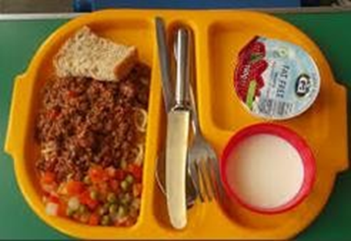
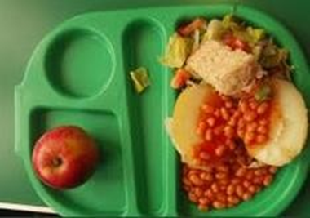
Reception Lunch
From Reception, right through to the end of Year 6, all children can have a free school dinner. They will pick their own dinner everyday. The middays will inform us if they have not eaten anything.
Please let us know of any allergies your child has or dietary requirements e.g. no pork, vegetarian but can eat fish etc.
If you choose to provide your child with a packed lunch instead, please follow our healthy school policy. Please do not give your child glass bottles, fizzy drinks, sweets, chocolate or any food that contains nuts.

Slide 17
Letters & Notices
We get a lot of information that we need to pass onto you. PLEASE do check the children’s book bags every day and read the letters that they will give to you. Some are for things that your children will miss out on and or changes that will impact you e.g. half days / non uniform days / inset days.
Information e.g. assembly notices will also be displayed on our parent notice board.

Slide 18
Assemblies
We will be having a class assembly at the end of the year which you are invited to attend (dates to follow)
Every Friday the whole school meets for a celebration assembly. You are invited to join us, however, Reception will not be attending for the first few weeks – we will let you know when we start going.

Slide 19
Birthdays
Your child is invited to wear their own clothes on their birthday. If their birthday is on a weekend or half term you can choose a day close to their birthday for them to wear their own clothes in school.
Only 1 packet of sweets per child is allowed to be brought in to give out. We are not allowed to give other things out due to allergies.

Slide 20
What to do if you have a concern
If you have a concern and would like to speak to your child’s teacher/key worker please email them on the emails below…
EYFS@st-peter.bardaglea.org.uk
We like to work with the children as soon as they come in, in the mornings, so if you have any queries please catch us at the end of the school day AFTER all the children have been dismissed.
We do have to ensure all children are collected by the correct adult and all messages are given so please be patient with us when we do this at the end of the day.

Slide 21
Being Reception Ready
Encourage your child to have a go!
Develop self-help skills by encouraging your child to take off and put on their own clothes, practice doing up zips, buttons and poppers.
Encourage your child to take their shoes and socks on and off independently.
Support your child in getting to the toilet in time, wiping themselves, flushing the toilet and washing their hands. Please talk to a member of staff if your child has any additional needs that prevent them from being able to use the toilet independently.
Encourage your child to blow their nose themselves, put the tissue in the bin and wash their hands. If reinforced at home and school this will become the norm and your child will develop a healthy routine.
Try to establish a good sleep routine.
We really hope your child enjoys their time in Reception with us. If you do have any concerns or questions please speak to your child’s Teacher.

Slide 22
Being Reception Ready
Complete and return all paperwork to the school office.
Make sure you collect your letter to show the class and start date your child has been allocated.
Check your email following this meeting for our welcome pack, which contains all the information you need.
Please provide any medication and complete all paperwork, ready for the first day.
Buy all uniform ready for their first day
Clearly label Uniform ready for their first day.
Purchase a school bag and named water bottle.
Lunchbox- easy to open and labelled.
.

