Slide 1


EYFS Information Evening
Thursday 24th September 2026

Slide 2
Our School Prayer
Fill me with your happiness and joy,
Let your Spirit live within me,
In the secret of my heart, teach me wisdom,
And keep me true to your Word,
Forgive the wrong that I do,
And in your goodness, be with me always
Amen

Slide 3

EYFS organisation
Our Nursery and Reception aged pupils are ‘based’ in the main school building, sharing provision (in and outdoors) in 2 ‘mixed’ classes of Nursery and Reception children

Slide 4

School organisation
Key Stage One: ‘mixed year group’ classes (Year 1 and Year 2 children in each class). ‘Open plan’ space which continues and builds on EYFS principles and practise and incorporates continuous provision.
Lower Key Stage Two: ‘mixed year group’ classes (Year 3 and Year 4 children in each class).
Upper Key Stage Two: ‘mixed year group’ classes (Year 5 and Year 6 children in each class).

Slide 5




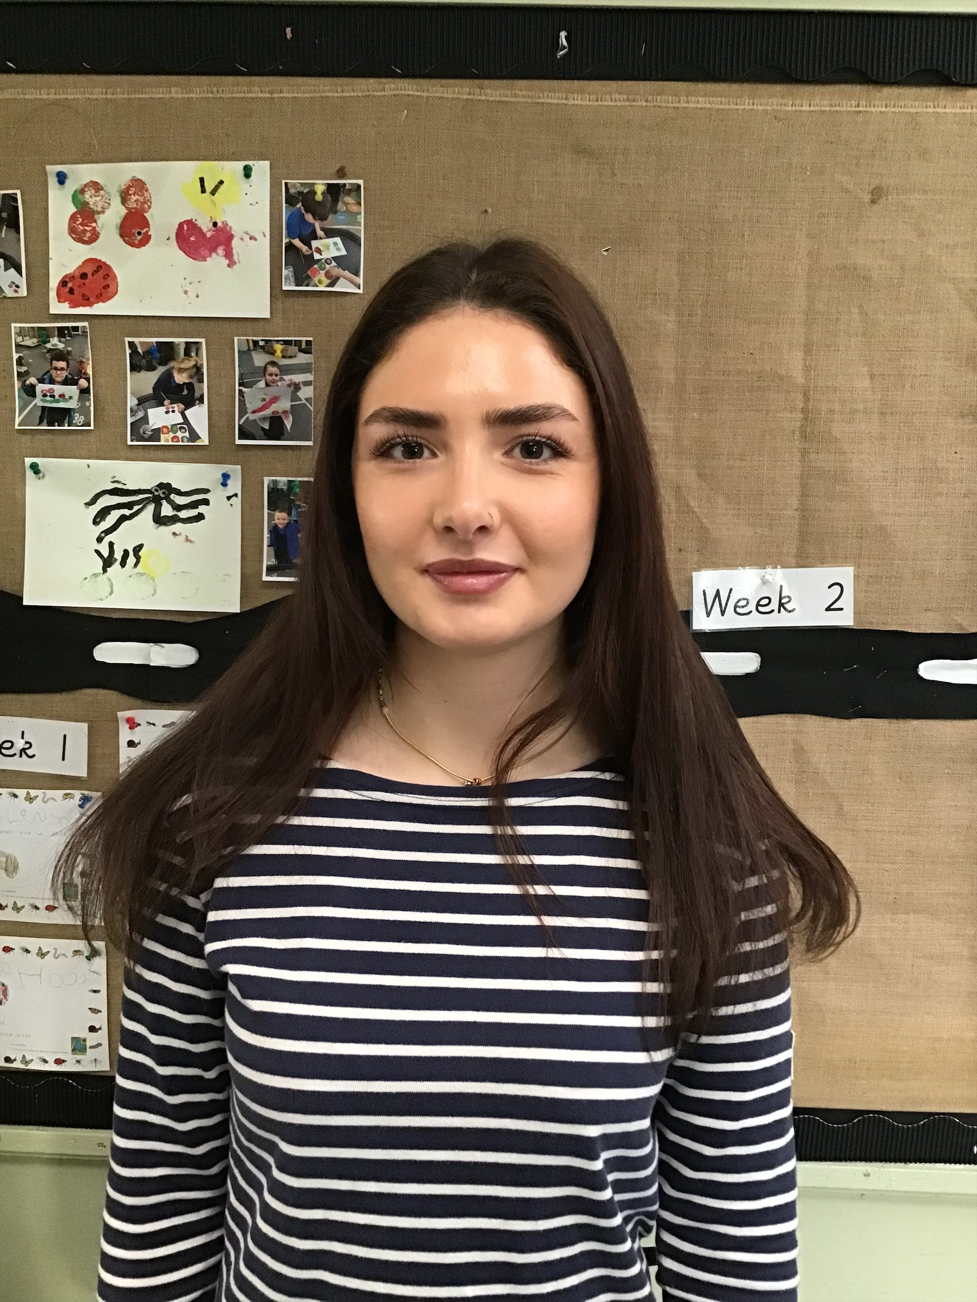
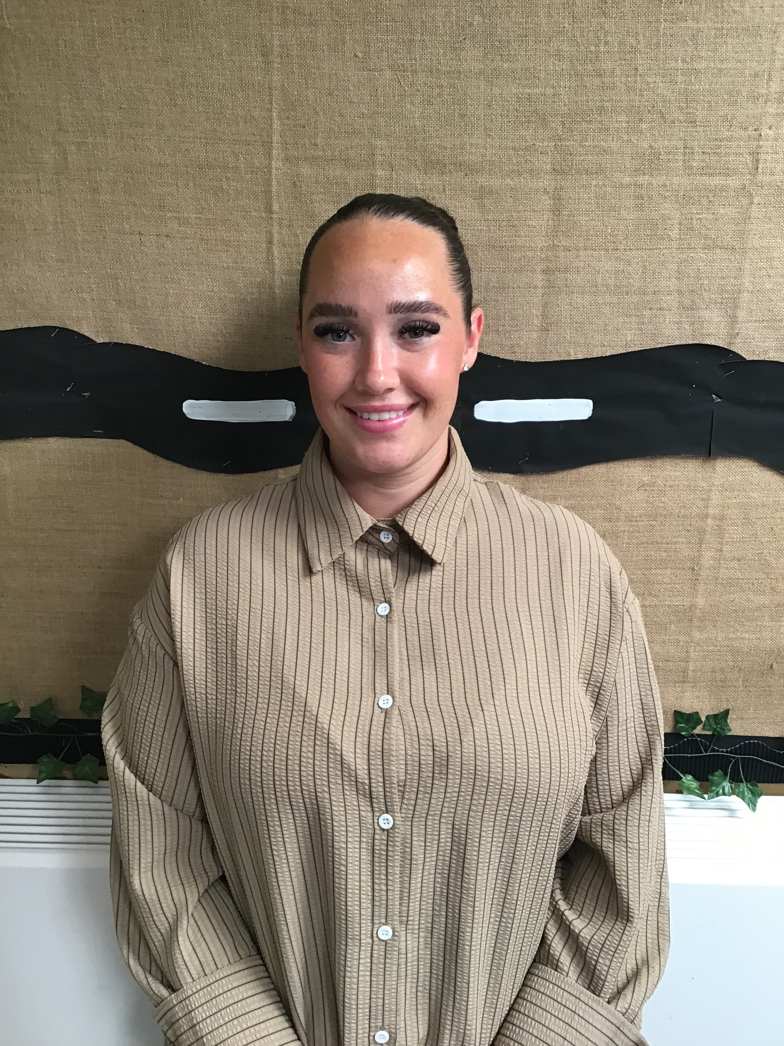
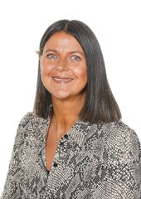
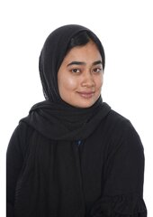
The Early Years Team
Miss Barran Mrs Coughlan Miss Jones Miss Crowley Mrs Patterson
Mrs Pennells Mrs Begum

Slide 6

Early Years Foundation Stage (EYFS)
Prime Areas:
Personal, Social & Emotional Development
Communication & Language
Physical Development
Specific Areas:
Literacy
Mathematics
Understanding the World
Expressive Arts & Design

Slide 7
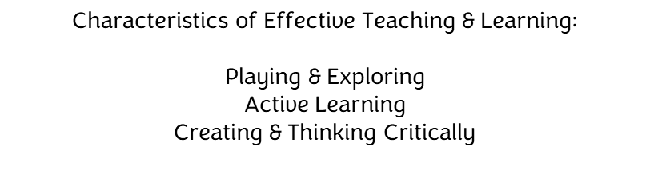
Early Years Foundation Stage (EYFS)

Slide 8
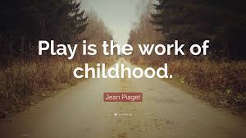

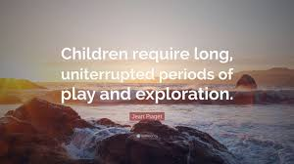
Learning through Play
“The EYFS is about what children learn, as well as how they learn. Effective practice is a mix of different approaches. Children learn through play, by adults modelling, by observing each other and through adult-guided learning. .” (DfE, Statutory Framework for the EYFS, 2026)
Play is recognised as so important to their well-being and development that the right to play is set down in the United Nations Convention on the Rights of the Child (1989), and play is a fundamental commitment within the Early Years Foundation Stage.” (DCSF, Learning, Playing & Interacting, 2009)

Slide 9
Our timetable
Time | Monday | Tuesday | Wednesday | Thursday | Friday
8.40am-8.50am | Arrival at school, continuous provision | Arrival at school, continuous provision | Arrival at school, continuous provision | Arrival at school, continuous provision | Arrival at school, continuous provision
8.55am – 9.10am | Registration/ Prayer & Worship | Registration / Prayer & Worship | Registration / Prayer & Worship | Registration / Prayer & Worship | Registration / Prayer & Worship Celebration Assembly
9.10am-9.45am | Nursery – Wiggle me into a Squiggler/Dough Disco & Phase 1 Reception - Phonics | Nursery – Wiggle me into a Squiggler/Dough Disco & Phase 1 Reception - Phonics | Nursery – Wiggle me into a Squiggler/Dough Disco & Phase 1 Reception - Phonics | Nursery – Wiggle me into a Squiggler/Dough Disco & Phase 1 Reception - Phonics | 9:30 onwards Nursery – Wiggle me into a Squiggler/Dough Disco & Phase 1 Reception - Phonics
9:45am – 10am | Snack Time | Snack Time | Snack Time | Snack Time | Snack Time
10am – 11:10am | Continuous provision indoor and outdoor | Continuous provision indoor and outdoor | Continuous provision indoor and outdoor | Nursery – BLAST/Continuous Provision Reception – PE/Continuous Provision | Continuous Provision indoor and outdoor
11.10am-11.30am | N&R - My Happy Mind | Nursery - Maths Reception - Maths | Nursery - Maths Reception - Maths | Nursery - Maths Reception - Maths | Nursery - Maths Reception - Maths
11.30am-12.30pm | Lunch 12.10pm Nursery – Input & Continuous Provision | Lunch 12.10pm Nursery – Input & Continuous Provision | Lunch 12.10pm Nursery – Input & Continuous Provision | Lunch 12.10pm Nursery – Input & Continuous Provision | Lunch 12.10pm Nursery – Input & Continuous Provision
12.30pm- 1pm | Registration, Prayer &Worship, Literacy/Theme | Registration, Prayer & Worship, Literacy/Theme | Registration, Prayer & Worship, Literacy/Theme | Registration, Prayers RE | Registration, Prayer & Worship, RHE
1.00pm-2.30pm | Continuous provision indoor and outdoor | Continuous provision indoor and outdoor | Continuous provision indoor and outdoor | Continuous provision indoor and outdoor | Continuous provision indoor and outdoor BLAST Music Enrichment
2.30pm-3pm | RE/Mark 10 Mission/Prepare for home | RE/Prayer & Worship/preparation for home | Story time/Theme input/Prayer & Worship/preparation for home | Story time/Theme input/Prayer & Worship/preparation for home | Story time/Prayer & Worship & preparation for home

Slide 10
Your child’s day
Morning
Enter school, organise belongings and work in the areas of provision
Registration, Collective Worship, ‘carpet time’, Dough Disco
Nursery – Phase 1 Phonics & Wiggle me into a Squiggler
Reception – RWI Phonics
Children work in the areas of provision (inside & outside)
Focussed groups throughout the mornings
Snack time
Nursery & Reception – daily Maths session
MyHappyMind – weekly sessions (Nursery & Reception)
Story time/singing/morning review/RE/Collective Worship

Slide 11
Your child’s day
Afternoon
Registration & Collective Worship
Nursery – Circle Time/Literacy
Reception – Talk through Stories
Children work in the areas of provision (inside and outside)
Focussed groups
RE sessions
RHE sessions (Reception)
Music sessions
Reception - Weekly PE session
Topical/themed inputs
Story time/preparation for Home Time

Slide 12

Phonics and early reading
We follow the Read Write Inc. (RWI) phonics scheme
Nursery – RWI Phonics begins in the Summer term, we do lots of pre-phonics work over the course of the year (Phase 1 Phonics)
Reception – RWI daily Phonics sessions
Initially in whole class sessions, moves to smaller groups after around 4-6 weeks
https://home.oxfordowl.co.uk/reading/reading-schemes-oxford-levels/read-write-inc-phonics-guide/
How the Read Write Inc. phonics works - a parent/carer’s guide (youtube.com)

Slide 13
Phonics and early reading
RWI’s Nursery scheme is designed for Nurseries and Pre-Schools to teach phonics the term before children start in Reception (Summer Term).
Prior to this, we focus on Phase 1 which concentrates on developing children's speaking and listening skills and lays the foundations for the later phonic work. The emphasis during Phase 1 is to get children attuned to the sounds around them and ready to begin developing oral blending and segmenting skills.

Slide 14
Phonics and early reading
Children in Reception will begin with learning the Set 1 sounds – each session follows a similar routine which includes learning to see and say the new sound, oral blending, sound blending and letter formation.
As part of the scheme, we encourage and model saying the sounds in the ‘purest’ form:
Read Write Inc.: How to say the set one, set two and set three sounds (youtube.com)
As the children progress, they will begin to read ‘green’ and ‘red’ words – ‘Word Time’, ‘Ditties’ and story books.

Slide 15
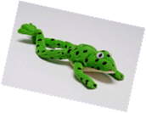
Phonics and early reading
‘Word Time’ – as soon as children have learnt a few initial sounds, they begin to learn to blend the sounds together to read real words. Each word time session involves oral blending before we show the words written on green cards – ‘green words.’
Children practise ‘Fred talking’ until they become able to read them on sight.
Fred plays an important part of our Phonics sessions, he is only able to speak in sounds, not whole words.
Children can start blending sounds as soon as they know a small group of letters well. We start with blending oral sounds then progress to reading the letters and blending them together to say the word.
‘Ditty’ sessions follow on from this where children who are becoming confident with reading single words are introduced to reading sentences.

Slide 16
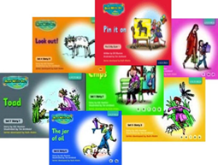
Phonics and early reading
The next stage of RWI phonics is for children to read storybooks that are linked to their developing phonic knowledge.
The storybooks consist of green words linked to the sounds they have been learning and red words – words that are not decodable.
Activities such as comprehension, questions, partner work and writing activities follow.

Slide 17
Phonics and early reading
Spelling with ‘Fred Fingers’ – we teach the children to use their fingers to aid them as they write words. The children say the sounds out loud and break the word down into individual sounds.
If a word has three sounds, children hold up three fingers, fours sounds, four fingers etc.
Children pinch each finger as they say the sounds needed in the word. Then they write the letters that represent each sound.
Letter formation is covered each day using the ‘letter formation rhyme’ linked to the sound cards.

Slide 18

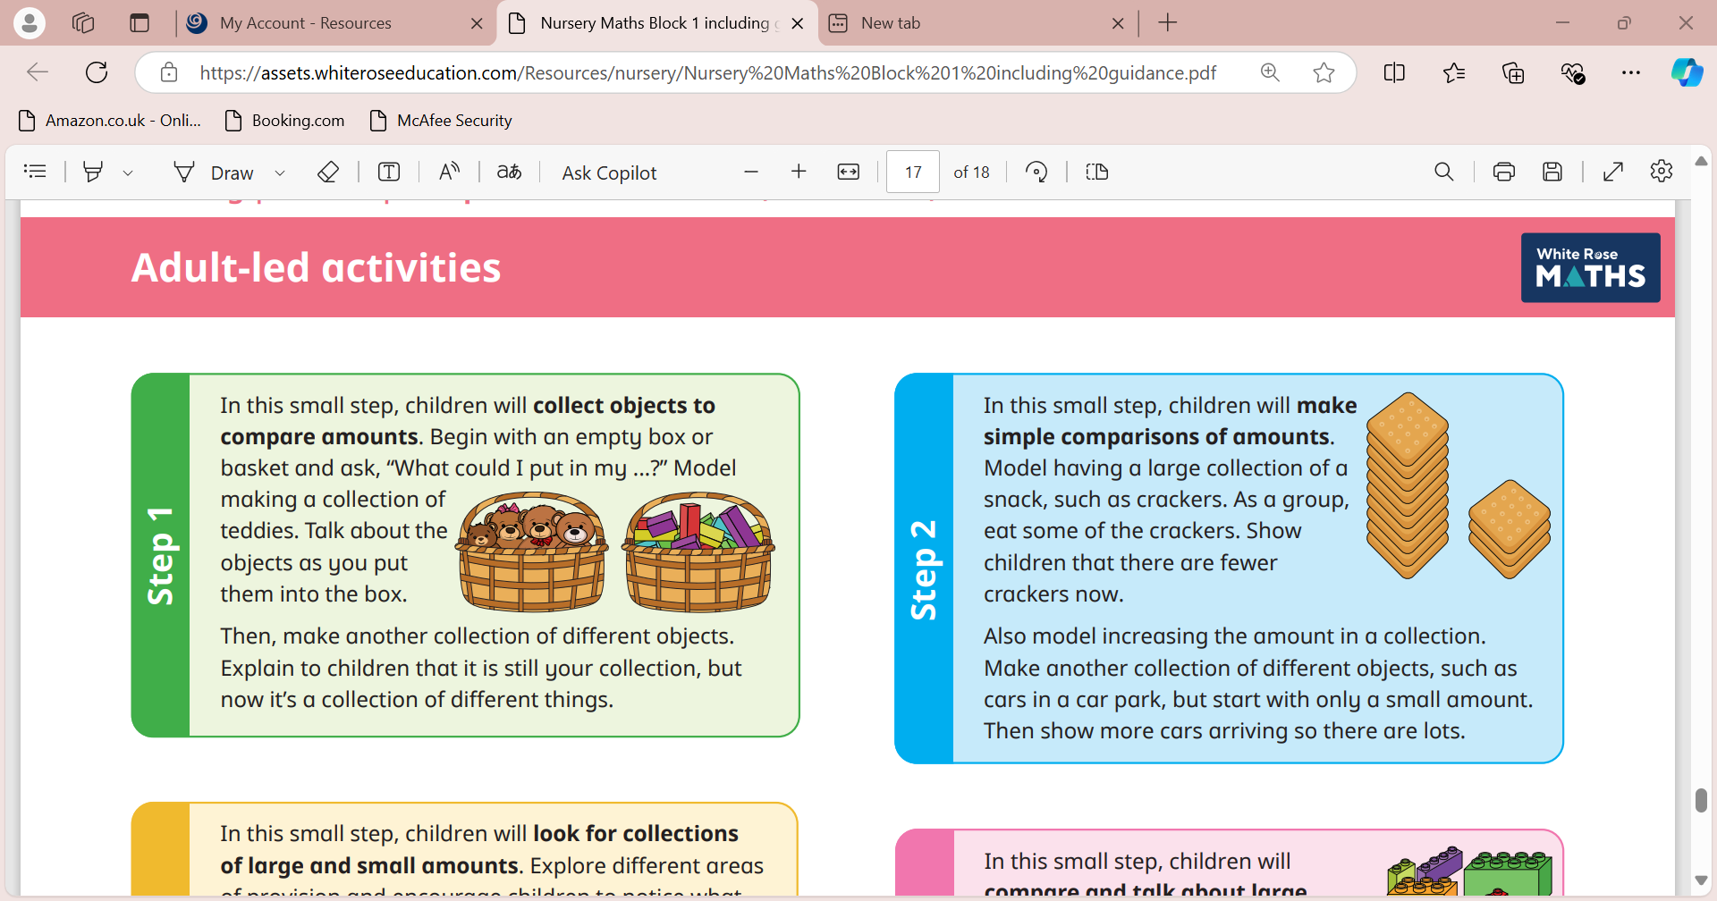
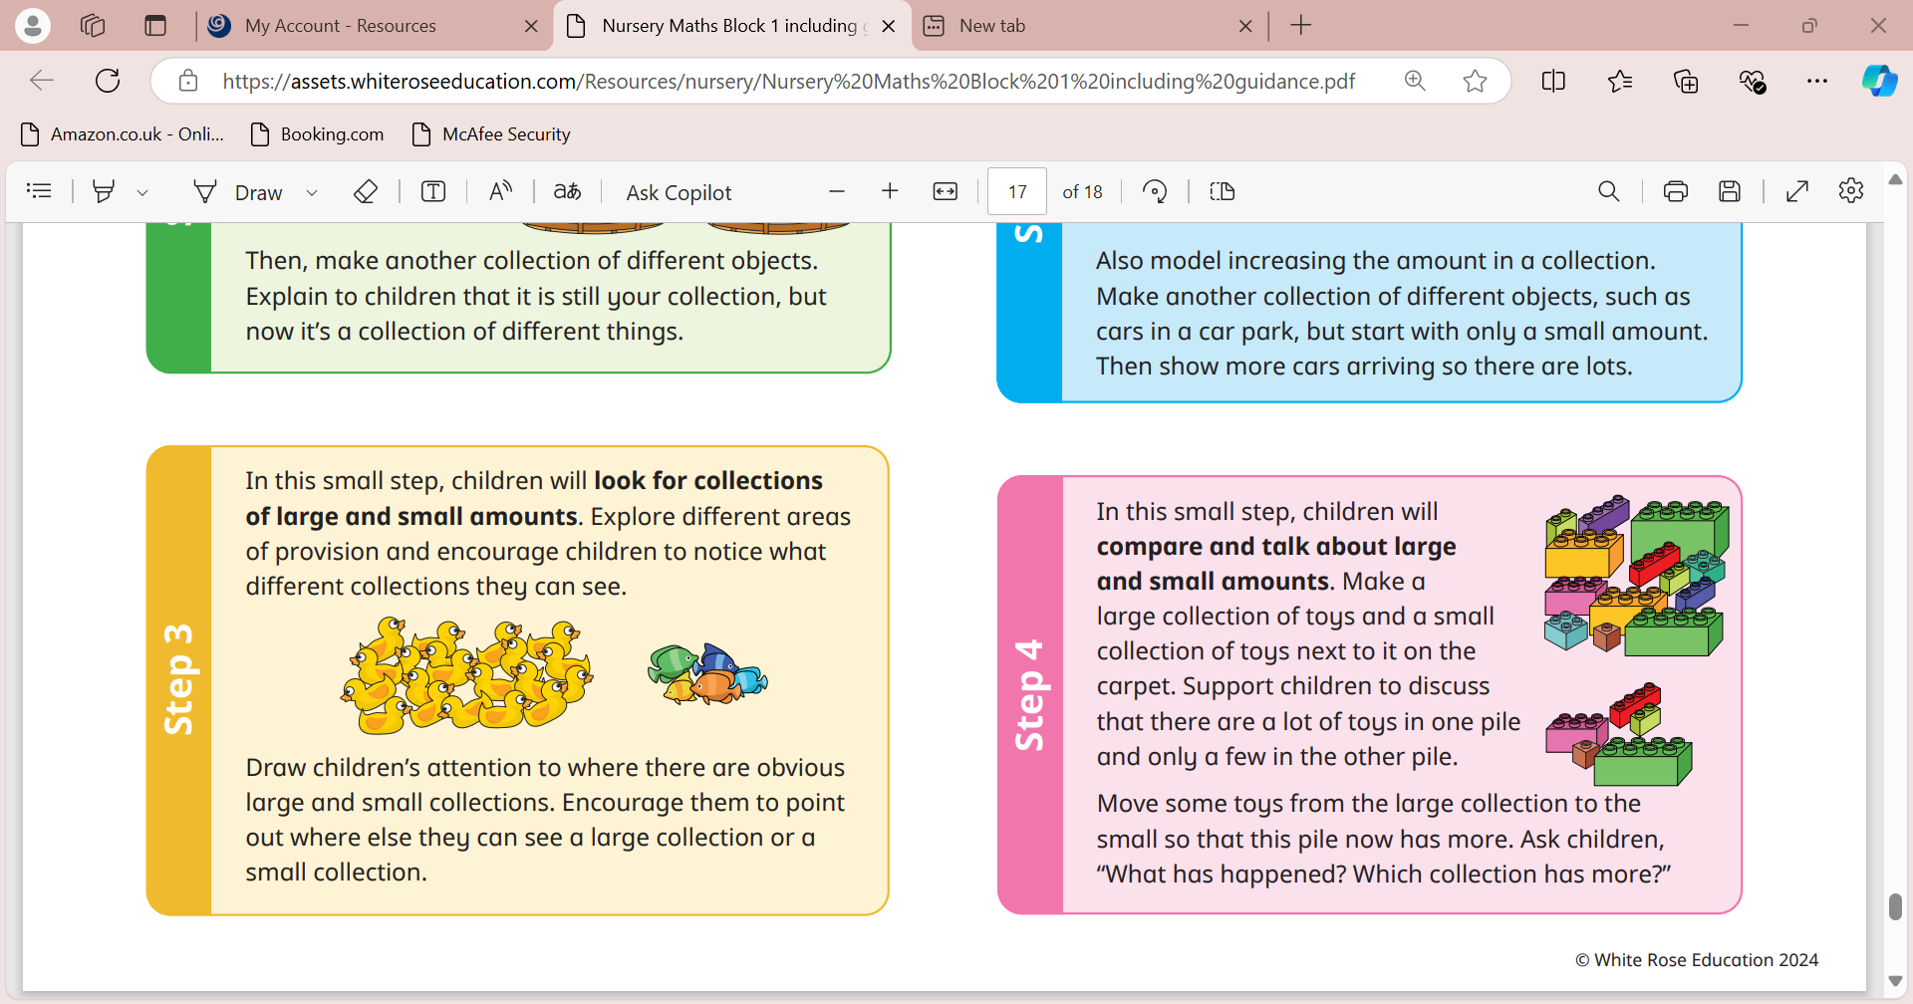
Maths
We have daily focussed maths sessions for both Nursery and Reception aged pupil. However, we weave maths throughout our daily routine and conversations. The children have access to maths opportunities throughout the day and they can access the ‘Maths Area’ whilst working in continuous provision to further practise and embed the skills they are developing.
For Nursery children, we use the White Rose Maths scheme which is based on stories, ensures a practical ‘hands on’ approach, developing key mathematical concepts and ‘talk’ throughout the year.

Slide 19

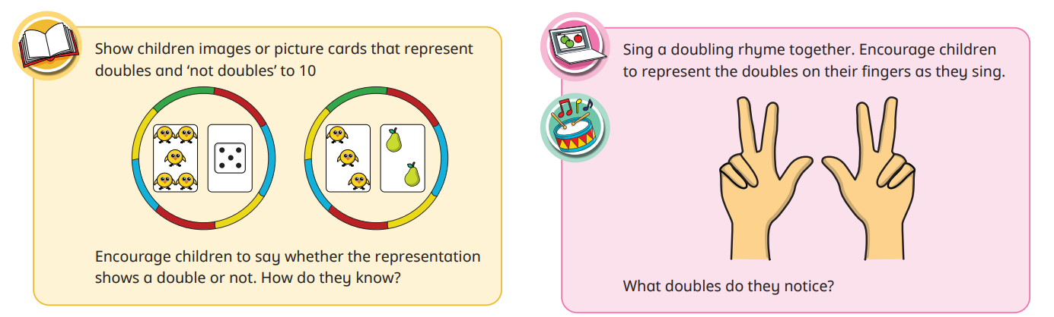
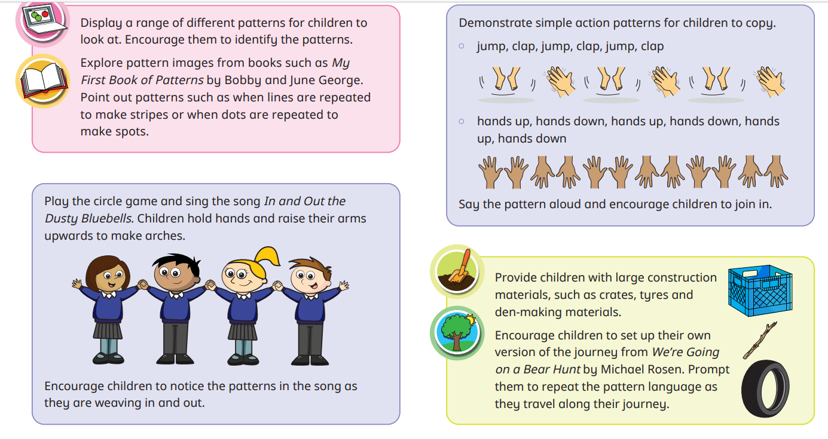
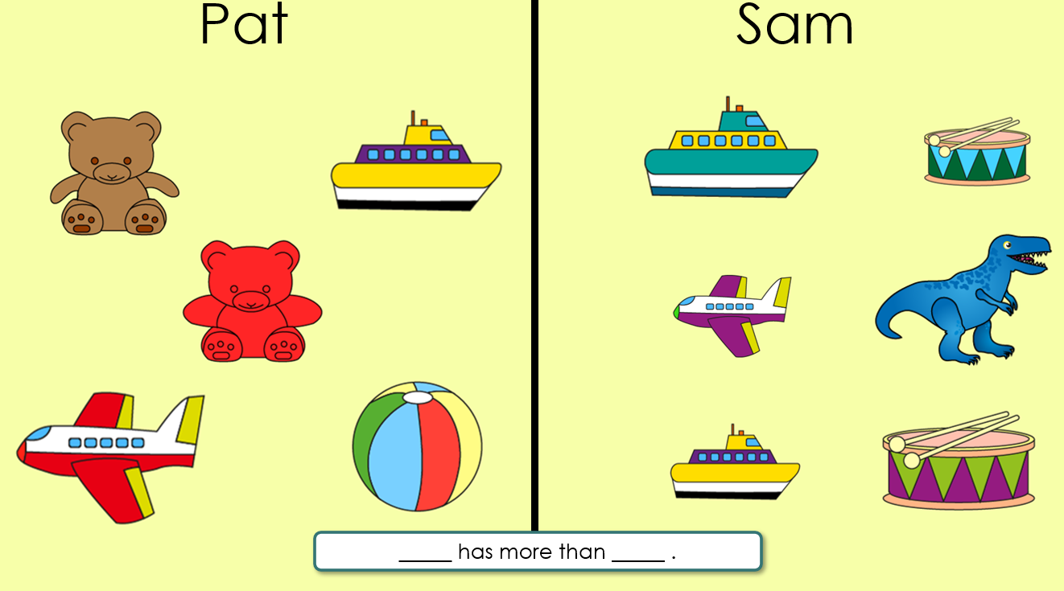
Maths
For Reception children, we use both White Rose Maths and NCETM Mastering Number schemes enabling the children to develop and demonstrate good number sense, develop firm mathematical foundations, develop fluency and develop shape, measure and spatial thinking in a practical, ‘hands on’ approach.

Slide 20

Morning ‘drop off’
Morning ‘drop off’
School gates open from 8:30am, please ‘drop’ your child off via the outdoor area (under canopy). We encourage the children to enter the building independently and ‘hang up’ their own belongings.
When ‘dropping off’ please take note of the ‘stands/signs’ and ensure that the entrance door remains clear for all children to enter the building safely.
If you need to speak to a member of the team, please wait until all children have entered the building safely.

Slide 21
Afternoon ‘pick up’
Afternoon ‘pick up’
School gates open from 3pm, please queue and collect your child from the outdoor area.
When collecting your child, please take note of the ‘stands/signs’ and ensure that the exit door remains clear for all children to exit the building safely.
When collecting your child, the member of the team ‘on the door’ will ask who you have come to collect, please state your child’s name clearly. Your child will be then called from class to exit school.
Please let us know if there will be a different collection arrangement for your child – e.g. the adult collecting your child from school.
We release all EYFS children from the same exit, so please bear with us as we safely release all children from school.

Slide 22
Communication with school
Speaking to the EYFS team and when we need to speak to you
Class Dojo – Class Stories and individual messaging function
Phone calls, text message service, letters and newsletters
Tapestry
Please ensure all contact details are always up-to-date

Slide 23
Behaviour and Readiness to Learn Policy
At St Thomas More we have three school rules
Ready Respectful Safe
Be ready – ready to learn, ready to listen, wear the correct uniform, ready to accept
Be respectful – show respect to all adults, show respect to other children, treat the school building and property with respect
Be safe – behave in an orderly and self-controlled way, follow adult instructions from all members of staff, tell a member of staff when they see or hear something they don’t think is right

Slide 24
Learning Journey’s
Each child has their own Learning Journey file which is a working document including;
Observations and photographs
Pieces of work
To create a fully rounded picture of your child’s development we ask you to contribute to this document.
‘Wow’ moments – please share any ‘Wow’ moments with us by sending us an email or by adding them on ‘Tapestry’

Slide 25
Helping at home
Continue to practise putting on/taking off coat, dressing and undressing, personal care and hygiene, tidying up…
Reading with and to your child and talking about the stories that you have read, discuss the setting, characters, what could happen next etc.
Practise fine and gross motor skills – throwing and catching, carrying objects, construction, threading, cutting etc.
Maths – lots of practical counting activities (not just by rote), look out for numbers in the environment, identify shapes, say the days of the week, look at a calendar, talk about the passing of time, weigh and measure things, baking, cooking, sharing objects, talking about and noticing patterns, handling money, using coins, go to the shops to buy items etc..

Slide 26
Useful information
We are a ‘Nut Free’ environment – if you are sending a packed lunch for your child, please ensure that the items sent in are ‘nut free’
What to do if your child is unwell and what we do if your child is unwell
Please label all items of uniform, water bottles and personal belongings
PE Kits – for Reception children only. Please send your child into school wearing their PE kits each week – we will confirm the day that we will be doing PE and let you know. Please ensure that your child also wears appropriate footwear and has a coat to suit the weather as we will continue to work in and outdoors throughout the day.

Slide 27
Thank you for attending this evening
If you require any further information, please speak to a member of the team or contact the school office

