Slide 1
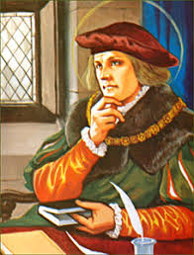
KS1 Parents Information Meeting
Tuesday 7th July 2026

Slide 2
Purpose of the meeting: (may be a refresher for children going into year 2
To introduce the teaching staff working in the department
To give an overview of how the department works
To give general day to day information
Inform you of key dates for the year
To let you know how you can communicate with us
A chance to ask any questions

Slide 3
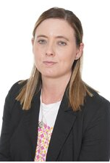
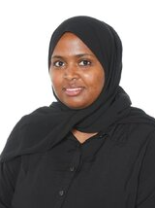
Meet the teaching staff:
Mrs Craven
Miss Kadir

Slide 4
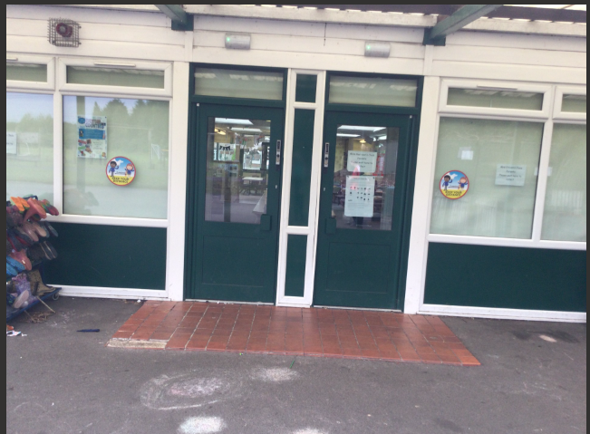
Routines of the day:
We use these 2 doors for all children to enter school each morning and leave school each evening:
Miss Kadir’s class enter and leave via this door
Mrs Craven’s class enter and leave via this door

Slide 5
Start of the day
The children will come into school each morning once we open the doors. They do not need to line up.
Please encourage the children to come into school independently, we will be there to help and support with this.
The children will come in each morning and begin their ‘early morning work’. This will either be handwriting practice or daily arithmetic activities.

Slide 6
End of the day:
We will begin to open the doors and let children out at around 3.05 as this allows us time to stagger letting the children out as the playground can become crowded.
At the start of the year as we get to know you all, letting the children out will take longer while we ensure their safety so please bear with us on this and be patient.

Slide 7
What will your child do each day/week?
Throughout the week the children will engage in a range of lessons and activities:
Phonics lessons
English/writing lessons
Maths lessons
Religion lessons and worship
Topic lessons – history or geography based
Science lessons
PE lessons
Throughout the half term they will also engage in D&T lessons, art lessons, RHE lessons, computing lessons
The children will also engage in the continuous provision areas throughout the week where they will be free to lead their own learning and also engage in set challenges for the week.

Slide 8
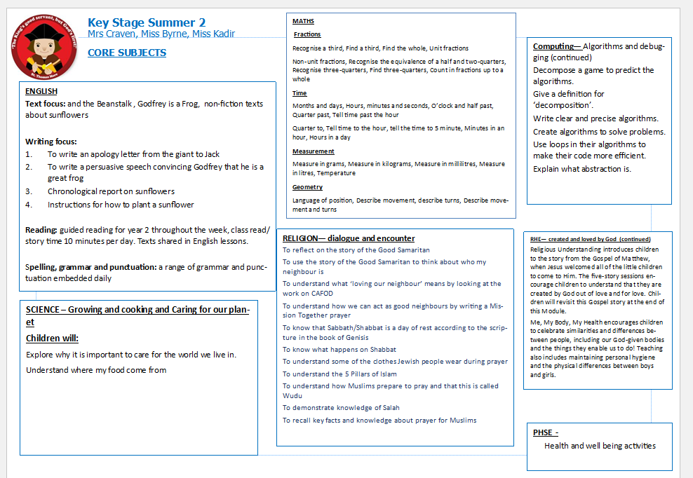
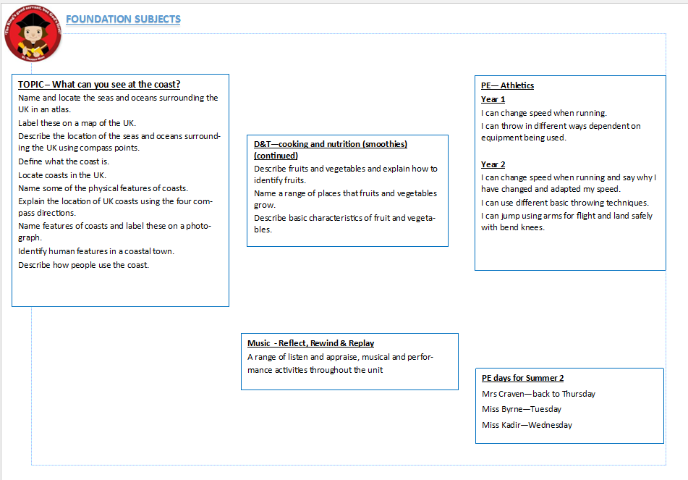
How you will find out about what the children are learning about each half term:

Slide 9
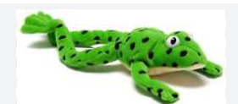
Phonics
The children have been recently assessed (or will be soon) in their phonics and will be grouped into their phonics groups according to these. They will be grouped according to their ‘challenge point’
Each half term the children are re-assessed and re-grouped according to their new challenge point

Slide 10


Home reading books
These go hand in hand with what your child is doing in their phonics group
They will bring home the book they have read in their group the previous week and a book bag book which goes alongside this:

Slide 11



Reading for Pleasure Book
This can be a book they would like to bring home to share with you, a book they would like you to read to them or if you prefer you can read your own book from home with them or perhaps visit the library.

Slide 12
Books they will bring home:
They will home 2 or 3 books each week for their home reading books:
1. The book they have read in their phonics lessons (this is paper so be extra careful with these)
2. A book bag book which matches their phonics level
3. A reading for pleasure book (if they would like to take one)
They will bring home these in their book bag with their reading record. Please comment and sign each week.
We will write in their reading record which day your child should bring their book bag in each week as this is not the same for all children.

Slide 13


TTRS and NumBots
Every child will be given a login which works for both TTRS and NumBots.
We will stick this in the front of their reading records.
Numbots is a great way for children to practice their basic number skills and mental maths
TTRS is a great way to get children started on and practicing their times tables.

Slide 14

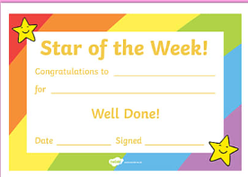
Behaviour and Reward Systems
We focus mainly on the reward aspect of these systems:
Dojos
Recognition
Stars of the week
Saint Award
Other mini certificates – maths star, handwriting star
Phonics star
We do not operate a red and yellow card system, children will be spoken to about behaviour choices in the moment and they may be asked to stay in at break time for 5 minutes to reflect on choices.

Slide 15
At home
Hear them read their 2 phonics books. There are questions in these you could ask them to verbally answer.
Read a reading for pleasure book with them or to them.
Then fill in their reading record and send it in to us on their specified day.

Slide 16
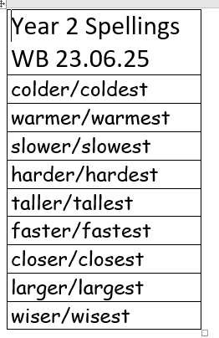
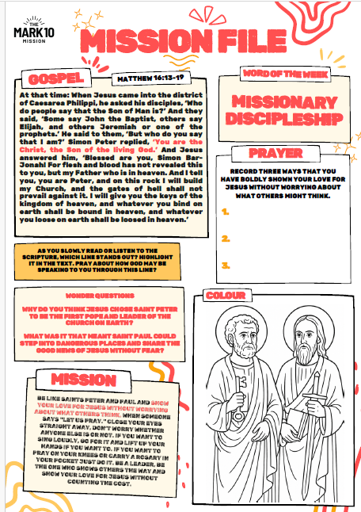
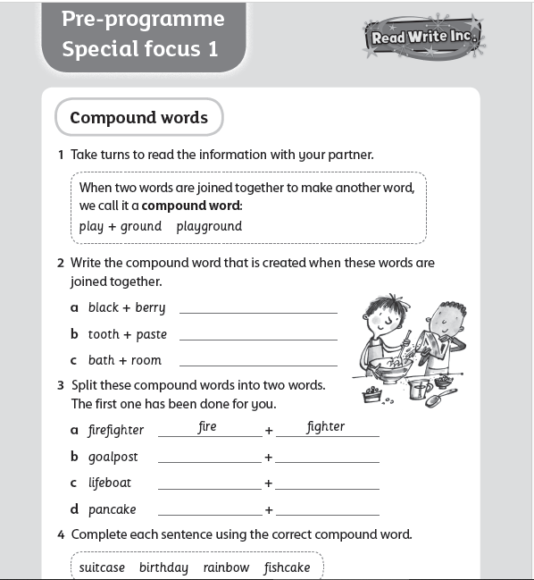
Spellings and Mission File
Spellings and Mission file will be emailed out each week and put on the dojo story. If you would like a paper copy of any of these just let us know.

Slide 17
Phonics One to One Tutoring
If your child in identified for one to one tutoring in phonics, this is a daily intervention to help them make speedier progress in their phonics.
They may last a half term or longer depending on what we feel they need.
If your child is identified and you would like to know more about what sounds and words they are focussing on, please just ask.

Slide 18
Important dates:
Open day in September to come in and see the children in their new environment – date to follow
Phonics meetings for parents – dates to follow
Christmas Concert in December – date to follow
Assessments for phonics every half term
Assessments for reading, writing and maths – every term (December, April, June/July)
Year 1 Phonics Screening Check – June 2027 (parent info zoom before this)
Parents meetings/evenings – November and April
End of year reports – July 2027
Trips – Quarry Bank Mill in November, Beach trip in the summer (info to follow)

Slide 19

General information
PE days are still to be decided, we will let you know well in advance of their first PE lesson. On their PE day children can attend school in their PE kit.
Snacks – some fruit is provided daily but children are welcome to bring in their own healthy snack to eat at break time.
Please send in a water bottle each day for your child. They can be refilled throughout day.
We run a ‘snack fund’ to help supply other snacks and bits for the department for anyone wishing to donate (this is optional). If you do wish to donate a link will be sent at to do so in September.
NAMES ON EVERYTHING! The children are amazing at taking things off or leaving things places and without names they can be very hard to locate again! We spend a lot of time searching for lost property!

Slide 20
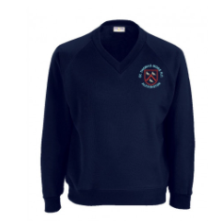
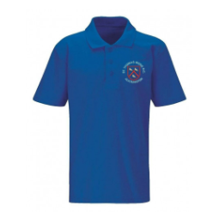
Uniform reminder
Children should be in full school uniform
School shoes
No jewellery including earrings for safety reasons.
Plastic holders for the holes can be worn

Slide 21
Opal Play and Outdoor Provision
For Opal play we will ask that you send in a change of clothes including underwear and socks for their Opal Play bag so that if they get wet or dirty they have a change of clothes in school
These are also great to have if your child has an accident which can still happen at this age
Also, we will ask for a pair of wellies (with names on) to be sent into school for Opal Play as well as outdoor provision and a waterproof coat (also named) that we can keep in school.

Slide 22
How to contact us:
Via email:
ccraven@stthomasmorerc.rochdale.sch.uk
hkadir@stthomasmorerc.rochdale.sch.uk
Ring the office
We will get back to you as soon as we can.

Slide 23
Join us on class dojo
We will share key information on class dojo as well as photos of what we have been up to throughout the week.

Slide 24

Any questions…
Type them in into the chat
Email us
If we can’t answer a question we will get back to you via phone call
or email.

