Slide 1


Welcome to St Thomas More
EYFS New Parents Meeting – Tuesday 16th June 2026

Slide 2
Our School Prayer
Fill me with your happiness and joy,
Let your Spirit live within me,
In the secret of my heart, teach me wisdom,
And keep me true to your Word,
Forgive the wrong that I do,
And in your goodness, be with me always
Amen

Slide 3

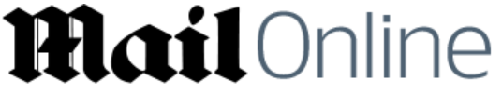


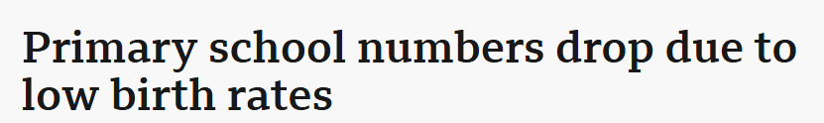
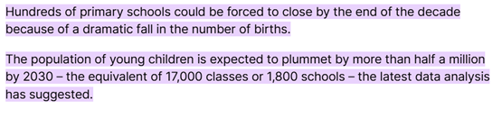

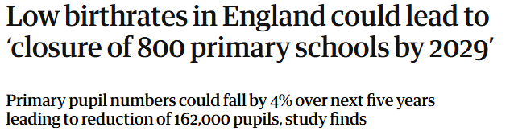
EYFS organisation
National, regional and local picture - falling birth rates
Our EYFS structure for September 2026:
Our Nursery and Reception aged pupils will be ‘based’ in the main school building, sharing provision (in and outdoors) in 2 ‘mixed’ classes of Nursery and Reception children

Slide 4

School organisation
Key Stage One: 3 ‘mixed year group’ classes (Year 1 and Year 2 children in mixed classes). ‘Open plan’ space which continues and builds on EYFS principles and practise and incorporates continuous provision.
Lower Key Stage Two: 3 ‘mixed year group’ classes (15 Year 3 children, 15 Year 4 children in each class).
Upper Key Stage Two: mixed year group’ classes (15 Year 5 children, 15 Year 6 children in each class).

Slide 5
Stay and Play – Wednesday 1st & Thursday 2nd July 2026
On Wednesday 1st and Thursday 2nd July 2026 we will host two ‘Stay and Play’ sessions for all ‘new’ children to our school community.
This provides an opportunity for you and your child to meet the team, their new friends and explore the environment.
Each session is for forty-five minutes and we are currently able to allow one parent per child to stay for the duration of the sessions.
You are invited to attend both sessions, uniform optional

Slide 6

Starting school in September
 | w/c Monday 31st August 2026 | w/c Monday 7th September 2026
 |  | AM (9am – 11am) | PM (1pm-3pm)
Monday | School closed – Monday 31st August 2026 – Bank Holiday School closed – Tuesday 1st & Wednesday 2nd September 2026 - INSET days | Nursery A | Nursery B
Tuesday |  | Nursery A | Nursery B
Wednesday |  | Nursery B | Nursery A
Thursday | Reception children (Group 1) transition into school | Nursery B | Nursery A
Friday | Reception children (Group 2) transition into school | Friday 11th September 2026 – 9am-1pm including lunch (15h children leave at 11:40am) Monday 14th September 2026 30h children attend ‘full time’ 8:40am-3:10pm 15 h children 8:40am - 11:40am

Slide 7

Starting school in September
Morning ‘drop off’
School gates open from 8:30am, please ‘drop’ your child off via the outdoor area (under canopy). Adults must accompany children until they are safely in the school building.
We encourage the children to enter the building independently and ‘hang up’ their own belongings.
When ‘dropping off’ please take note of the ‘blue stands/signs’ and ensure that the entrance door remains clear for all children to enter the building safely

Slide 8
Starting school in September
Afternoon ‘pick up’
School gates open from 3pm, please queue and collect your child from the outdoor area.
When collecting your child, please take note of the ‘coloured stands/signs’ and ensure that the exit door remains clear for all children to exit the building safely.
When collecting your child, the member of the team ‘on the door’ will ask who you have come to collect, please state your child’s name clearly. Your child will be then called from class to exit school.
Please let us know if there will be a different collection arrangement for your child – e.g. the adult collecting your child from school.
We release all EYFS children from the same exit, so please bear with us as we safely release all children from school.

Slide 9
Reception Baseline Assessment (RBA)
Statutory from September 2021
All Reception aged children undertake the assessment that is produced by the Standards and Testing Agency (STA)
The RBA will be undertaken in the first six weeks of school by a member of the EYFS Team.
The Standards and Testing Agency (STA) explain:
“The RBA is a short, interactive and practical assessment of your child’s early literacy, communication, language and mathematics skills when they begin school. The main purpose is to create a starting point to measure the progress schools make with their pupils. It is not about judging or labelling your child or putting them under any pressure. Your child cannot ‘pass’ or ‘fail’ the assessment.
The Department for Education uses the assessment data when your child has reached the end of year 6, as a baseline to measure the progress of your child’s year group from reception to year 6. The data from the assessment, including numerical scores, is not shared with you, pupils, teachers, schools or other external bodies. There will also be no published scores at pupil, school or national level” (Standards and Testing Agency, 2025)
More information can be found on:
https://www.gov.uk/government/publications/reception-baseline-assessment-information-for-parents

Slide 10
School lunches and snacks
School lunches:
Reception aged children are entitled to Universal Free School Meals - free entitlement to a school lunch time meal
Nursery aged children do not qualify for the Universal Free School Meals – but you are welcome to have a school meal at a charge of £1.90
Lunches provided by Rochdale Council and prepared on site at school
Parents chose the meals daily with your child (online app)
You can bring own packed lunch if you would prefer – we advise to pack around 4 items (including a drink)
EYFS children will eat their lunches in the school hall
Snacks:
A drink of milk or water and a snack is available during the course of the morning for the children
Voluntary snack and resources fund – text will be sent via the school office with a link to contribute to the fund each half term

Slide 11
Communication with school
Speaking to the EYFS team and when we need to speak to you
Class Dojo – Class Stories
Phone calls, text message service, letters and newsletters
Arbor
Tapestry
Please ensure all contact details are always up-to-date

Slide 12
Useful information
We are a ‘Nut Free’ environment – if you are sending a packed lunch for your child, please ensure that the items sent in are ‘nut free’
The Annex – Breakfast/After School Club
What to do if your child is unwell
What we do if your child is unwell
PE Kits (Reception children only) – further information about PE will be issued in September
Backpacks and bags

Slide 13


Preparing for September
Can your child:
Respond to an adult or ask for help?
Put their coat, jumper, shoes on/off and (with help) manage zips/fastenings?
Go to the toilet and wash their hands independently?
Get a tissue and blow their nose?
Tidy up toys and put things away?
Wait for their turn when an adult is busy with others?
Comply with reasonable adult requests promptly and appropriately?

Slide 14
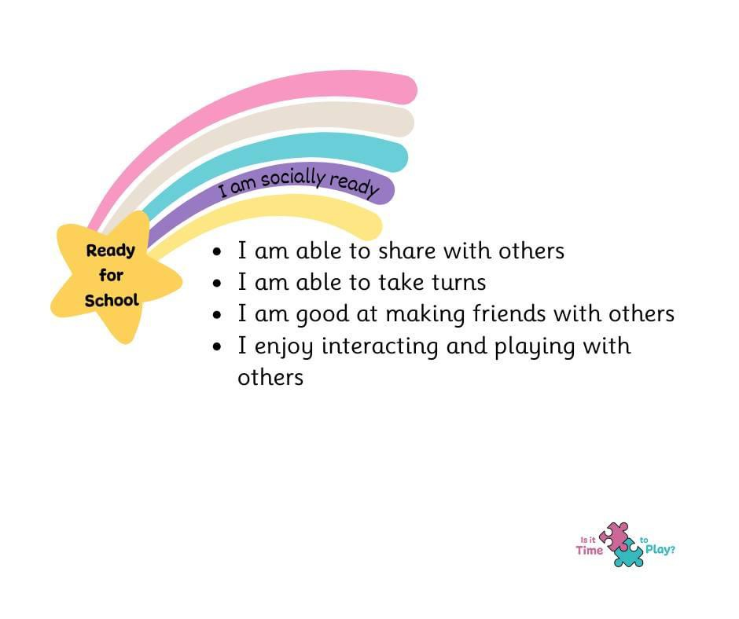
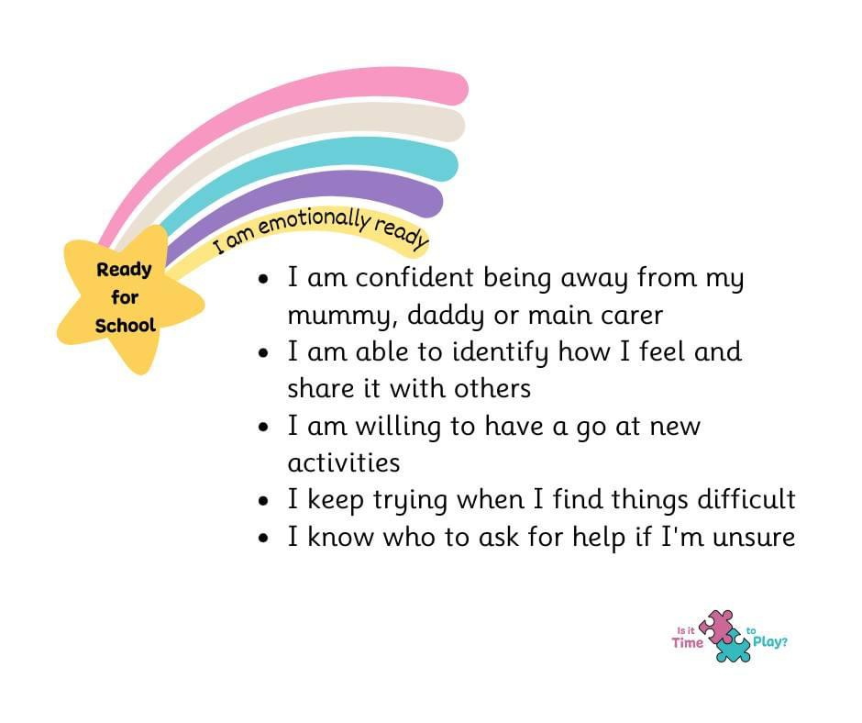
Preparing for September

Slide 15
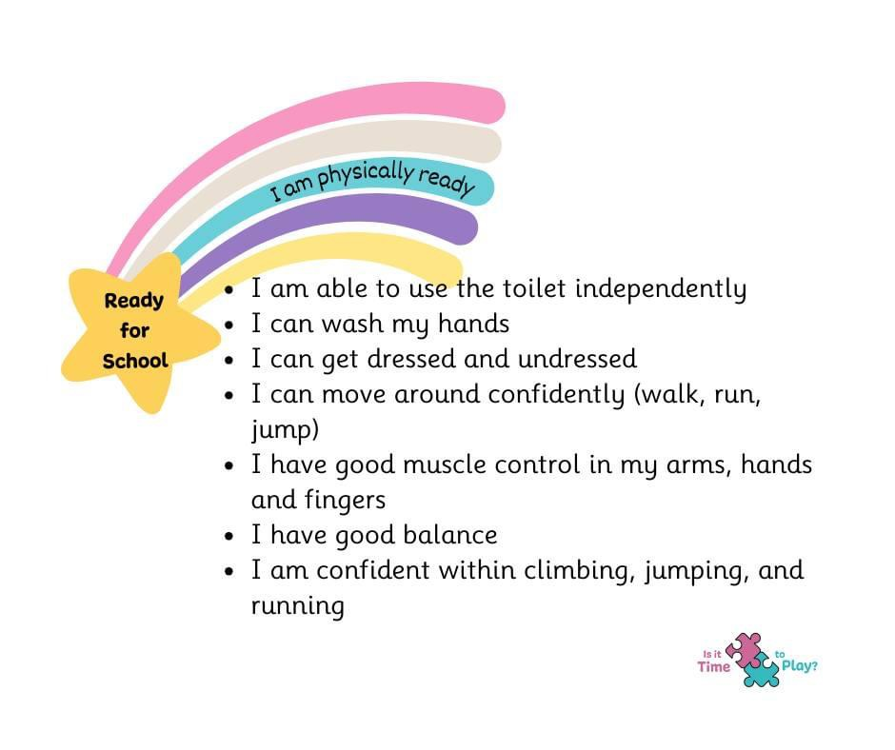
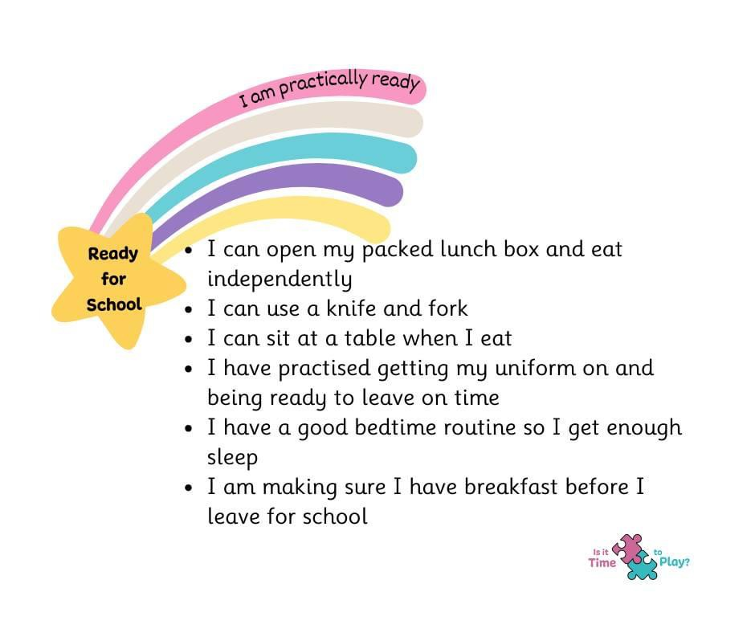
Preparing for September

Slide 16
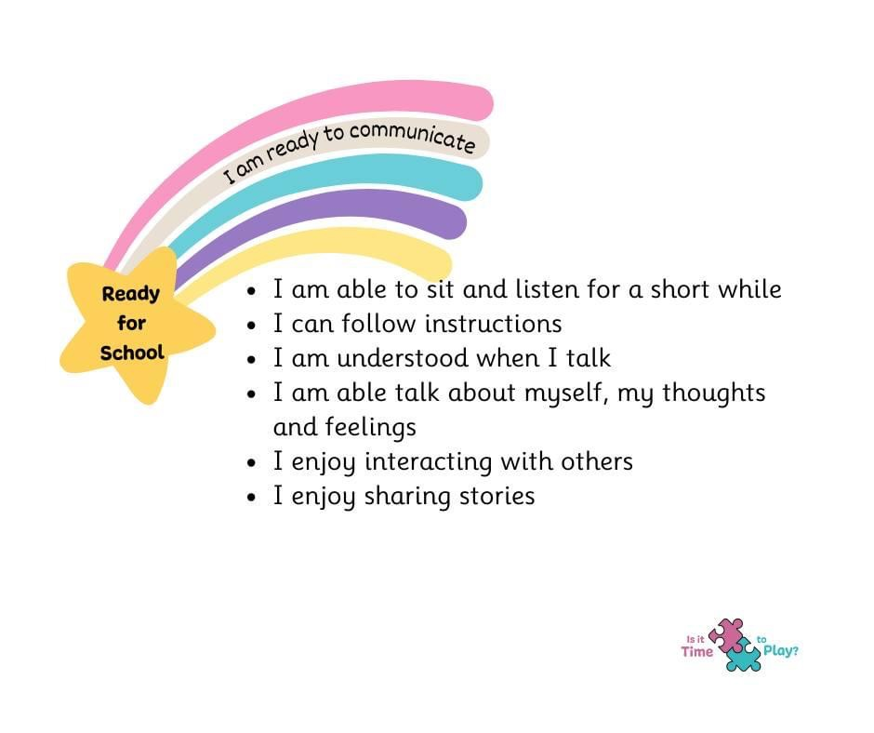

Preparing for September
Preparing for school - Best Start in Life
https://startingreception.co.uk/

Slide 17


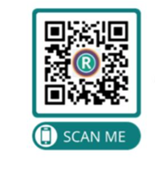
Preparing for September – Reception
Our Rochdale – Get ready with Teddy
As part of our new campaign ‘Get ready with Teddy’, you can now book onto and take part in our free, fun and interactive programme of activities to support your little ones settle happily and confidently into the classroom.
Our programme focuses on all the key skills children need to make a positive transition into school.
From their communication and independence to their physical development and healthy routines, by the end you will have everything you need to prepare your child for school.
We’ll also give you lots of useful tips and activities to practice at home, as a part of your everyday routines.

Slide 18
Things to bring and remember in September
A packed lunch for your child (if applicable)
A pair of wellington boots labelled with your child’s name, that can stay in school
A small bag of ‘spare clothing’ that can stay in school
A labelled water bottle
If your child has an inhaler, please bring relevant medication and equipment
Please, please, please label every item of uniform and belongings!

Slide 19
Thank you for attending this evening
If you require any further information, please speak to a member of the team or contact the school office

