Slide 1
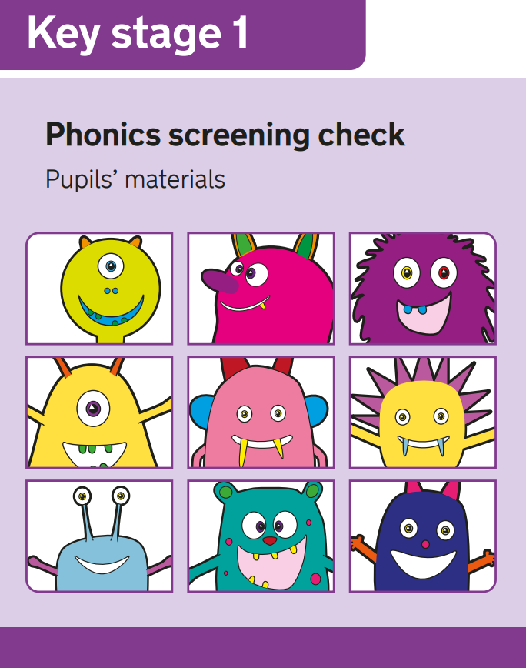
Year 1 Phonics Screening Check
Parents Information Meeting
Wednesday 13th May 5pm

Slide 2
Purpose of the meeting:
What is the phonics screening check?
How and when will the phonics check be administered?
Reporting to parents
A chance to have your questions answered

Slide 3

What is the Phonics Screening Check?
The Phonics Screening Check is a government check designed to confirm whether pupils can effectively blend sounds to read words.
It is designed to identify children who need extra support to improve their decoding skills.
We have our own assessment tools in school which allow us to track the children’s progress in phonics as well as any possible gaps in their sounds or decoding skills.

Slide 4


Real and nonsense words
The phonics screening check contains 40 words divided into two sections of 20 words. Both sections contain a mixture of real words and nonsense words.
Nonsense words are a way for the children to be assessed on their knowledge of sounds and their ability to blend these sounds into words as most nonsense words cannot easily be ‘sight’ read by the children.

Slide 5
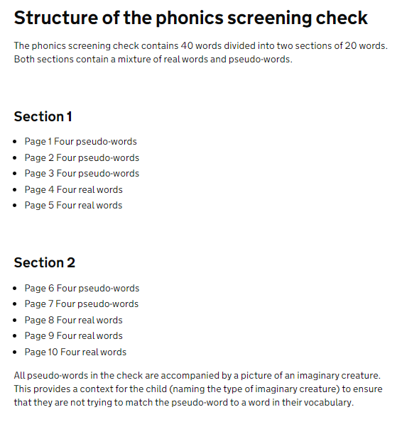
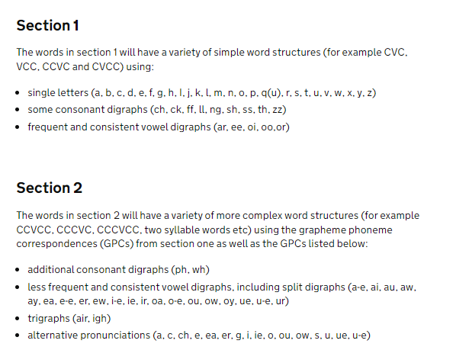
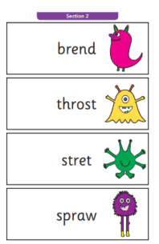
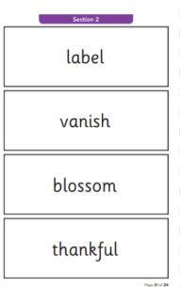
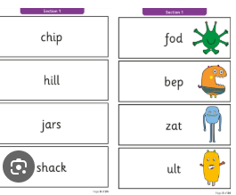
Example words from section 2
Example words from section 1
To see these words simply Google year 1 phonics screening check with a year e.g. 2025. 2024 to see the words from that year.

Slide 6

Expected Standard
There will be a pass mark for the check which will deem children to have reached the expected standard. Over recent years the pass mark has been 32 words read correctly however the pass mark will not be released until all of the tests have been taken
Year 1 children who do not reach the expected standard during the check will retake the check at the end of year 2.
These children will receive additional interventions to support them throughout year 2.

Slide 7

Knowing the children
The test will be administered by myself. All children are familiar with me as the person who carries out phonic based assessments.
This will allow for the children to feel comfortable and confident but also allow for me as a familiar adult to make allowances for children’s speech or accents.
Watch the video: https://www.youtube.com/watch?v=W3ImrUwhzHc
(4.55)
For teachers but good for you to see how it is administered.

Slide 8

How and when will the check be administered?
When – Week beginning 8th June (first week after the half term holiday)
The week after to catch up anyone absent
No timings – take as long as needed but it shouldn’t too long that the children lose interest or become distressed.
If we feel some children need to have a break in between sections, then we can arrange for that
Familiar adult
In a quiet, undisturbed space which is familiar to the children
We will decide ideal times of the day to administer the check for concentration levels.

Slide 9
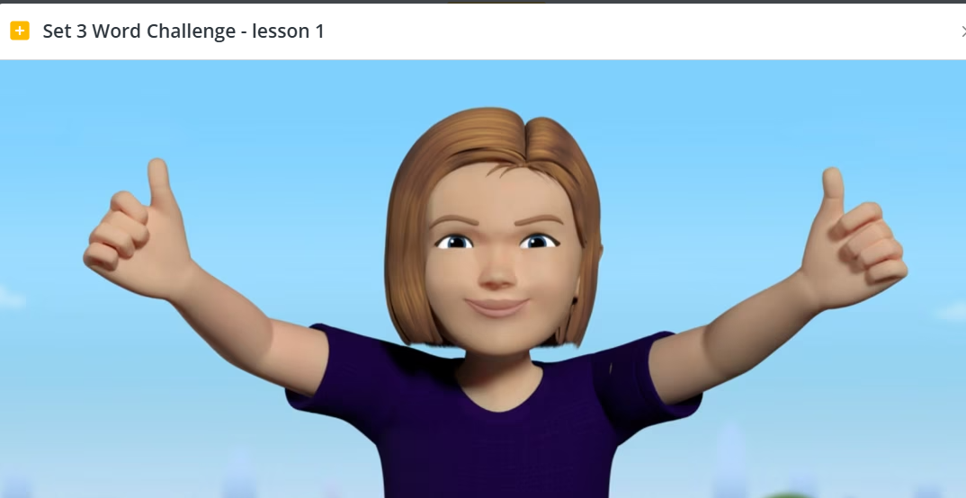
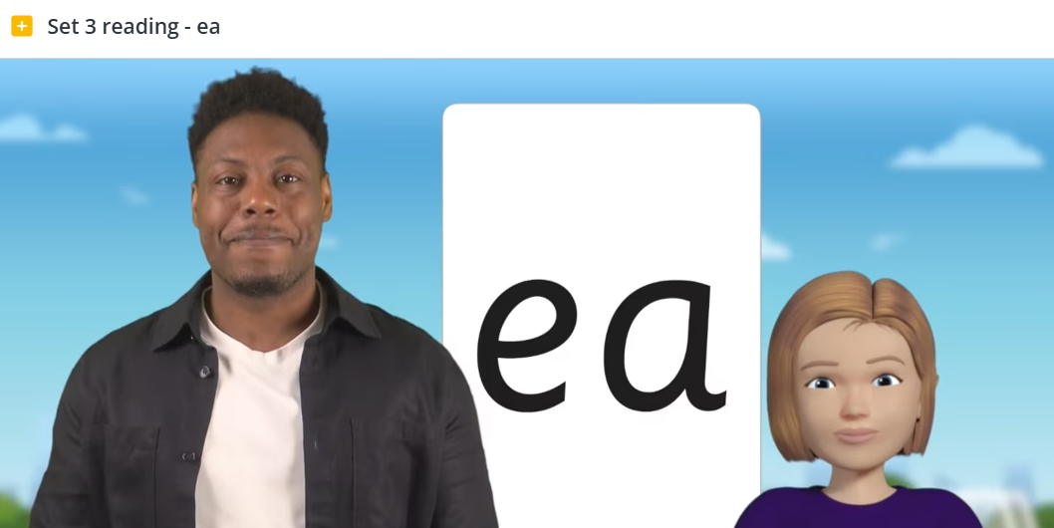
Helping at home
If you have received a QR code then keep the children doing these online lessons as much as possible.
I will send home some set 2 and 3 online lessons for all children for over the May half term.

Slide 10
Reporting to parents
You will receive information on your child’s phonics screening score with their end of year report in July.

Slide 11
Any questions?
You can type these in the chat/ask them by unmuting or if you would rather you can email me on: ccraven@stthomasmorerc.rochdale.sch.uk
If I cannot answer your question I will get back to you

