Slide 1
St. Ursula’s Catholic Primary School & Nursery
Nursery 2021-22
“With God at the heart of our St Ursula’s family, we welcome all as we learn and grow together.”

Slide 2
Welcome to Nursery at St Ursula’s Catholic Primary School. We hope you will spend many happy years with us.
When you first come into the school grounds, you will see the main Office ahead of you.
From the main gate, follow the path to the right to the Nursery. This is the door you will enter through

Slide 3
Inside the Nursery
This is where you hang your coat.
There will be lots of new things to learn, but the Nursery staff will be there to help you.

Slide 4
As a Catholic school, Religious Education is very important to us. You will be learning about the Catholic faith, each week.
We start and end of each day in prayer and, when possible, we attend to Mass at St Dominic’s Church at different times during the year.

Slide 5
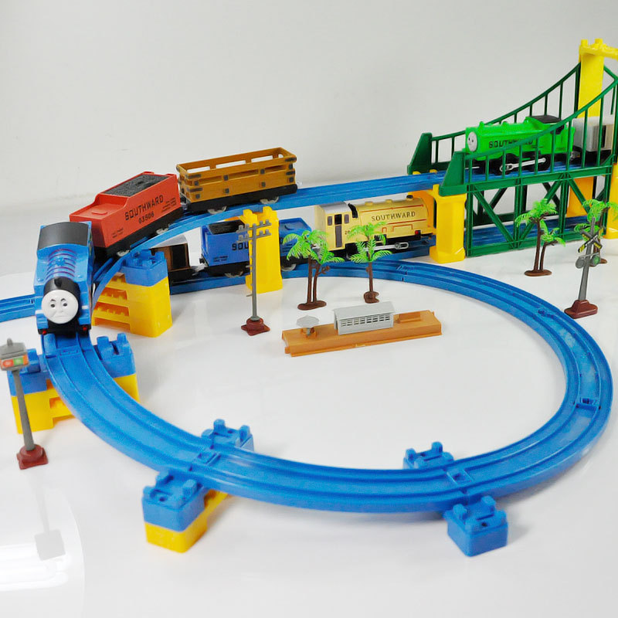
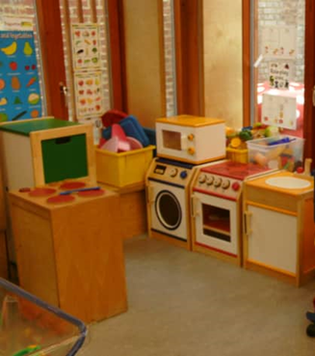
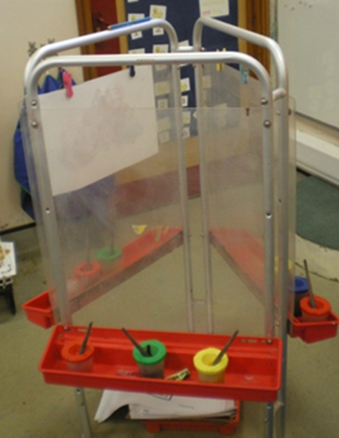
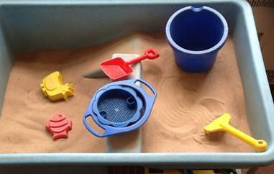
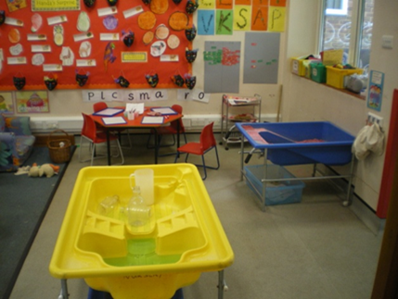
You will do lots of learning through play and we have so many things for you to play with in school!

Slide 6
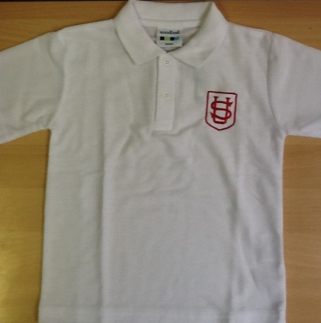
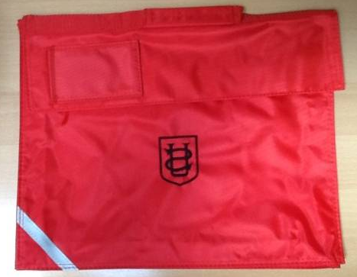
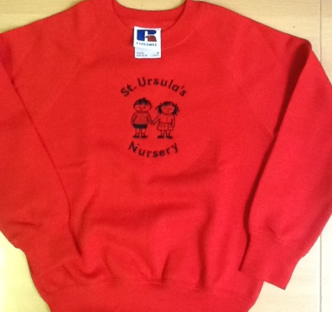
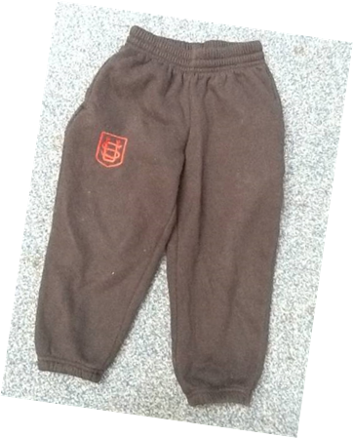
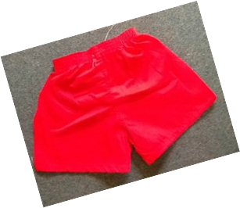
Uniform You will need to wear a uniform every day and you will need a school bag.

Slide 7
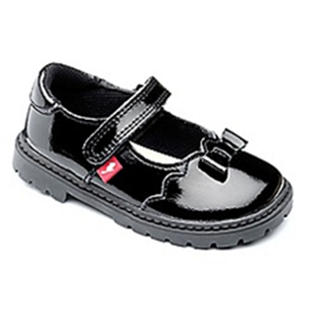
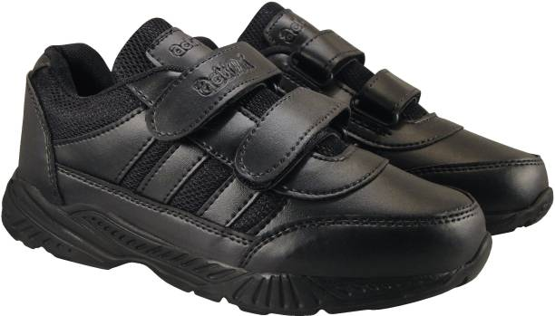
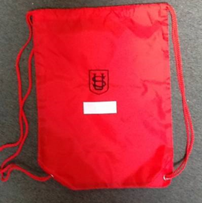
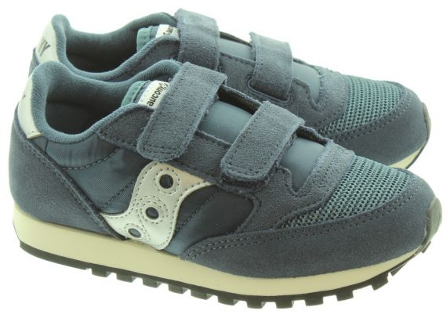
You must wear flat shoes or trainers with Velcro fastenings. (No laces)
You will need to leave a pair of wellies at school to play outside on rainy days.
You will also need a bag with spare clothes to change into (in case the others get wet) and a coat for playing outside.

Slide 8
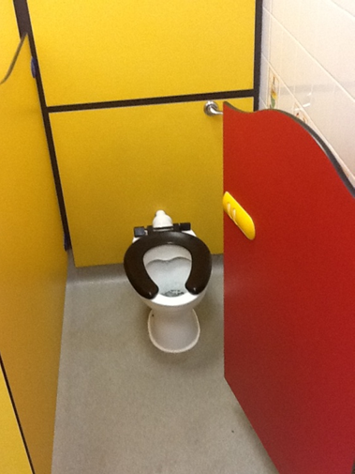
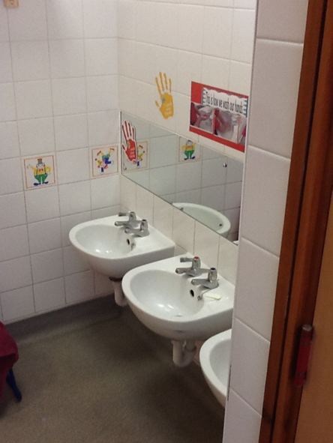
These are the toilets and basins.

Slide 9
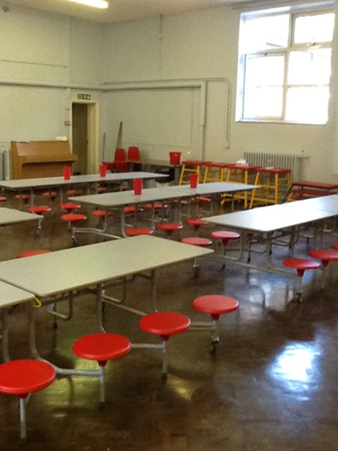
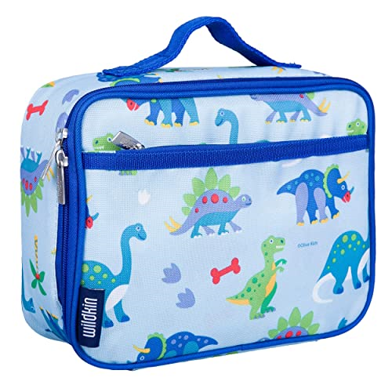
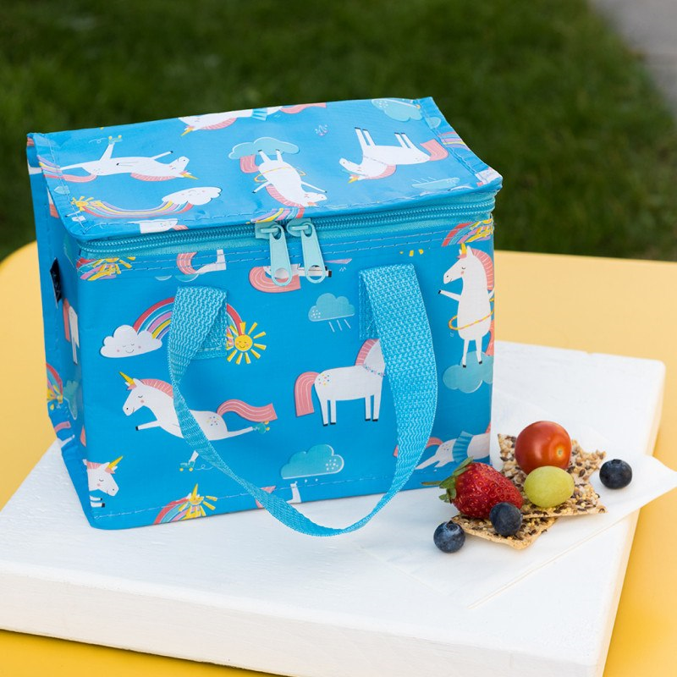
Snack and lunch
You will have a fruit and milk / water at Snack Time. Remember that you may only have water in your water bottle.
At lunch time, you will have lunch in the Dinner Hall with your friends.
Ask an adult to show you where your name in on your lunch bag so that you can find your things.
Work at feeding yourself if you can’t do this yet.

Slide 10
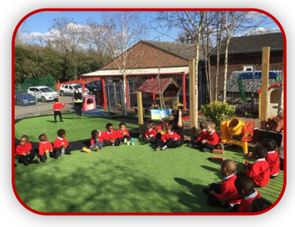
Outdoor Area
You’ll spend lots of time learning and investigating in the Outdoor Area.
A member of staff will soon be calling the adults in your home to find out about the things that you like doing.
Ask the adults to check the website during the week of the 8th of July when we will introduce the Staff who will be with you when you start school.
We know you will have lots of fun and will learn so much! We look forward to meeting you soon!

