Slide 1
St. Ursula’s Catholic Primary School & Nursery

Slide 2
Welcome to the St Ursula’s family. We hope you will spend many happy years with us.

Slide 3
Coming to school
When you first come through the main gates, you will see the Office for the Infant School. Follow the path around to the Nursery door.
Nursery times:
You will be at school for a morning / afternoon session or full time.
Someone will come back to school at the end of the day to fetch you each day.
For parents – Nursery times:
Morning session: 8.45am - 11.45am
Afternoon session: 12.15pm - 3.15pm
Full time: 8.45am - 3.15pm
*Please notify the school if anyone other than the parent is to collect the child from school. Staff will ask you to set up a password.
*Children may not be collected by anyone under the age of 16.

Slide 4
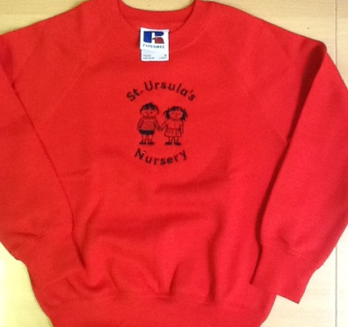
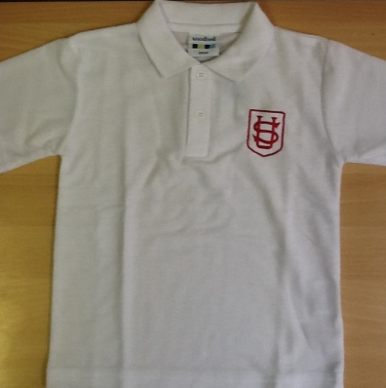
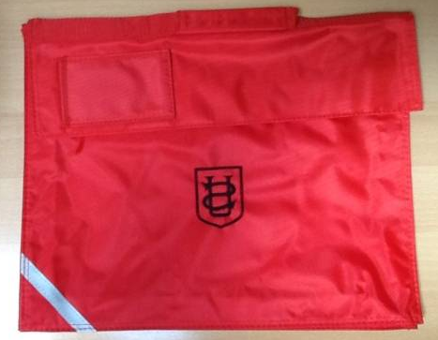
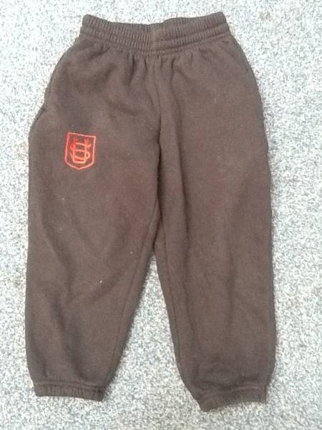
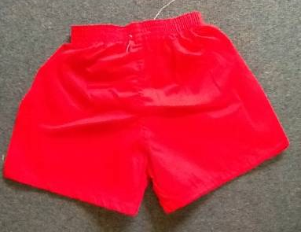
Uniform
You will need to wear a uniform to school each day and will need a school bag.

Slide 5
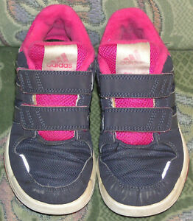
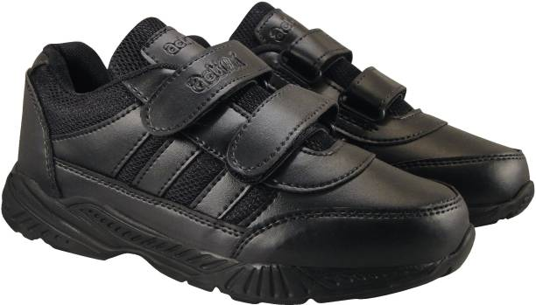
Shoes
You may wear flat shoes or trainers with velcro fastenings. (No laces)

Slide 6
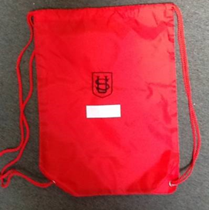
You will also need a bag with spare clothes to change into (in case the others get wet) and a coat for playing outside.
On rainy days you can wear wellies to and from school so that your feet don’t get wet in the puddles, but you must have your school shoes in your bag to wear in school. Your wellies can hang on your peg on rainy days and you can wear them home at the end of the day.
*All clothing, shoes and bags must have your name.
*Adults will have to show you where your name is so that you can find your things.
Parents: Please check clothing regularly to ensure that the names haven’t washed out.

Slide 7
Inside the Nursery
This is where you will hang your coat.
There will be lots of new things to learn, but we will be there to help you.

Slide 8
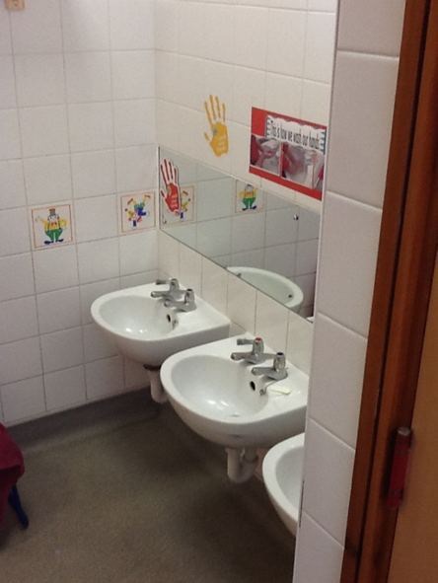
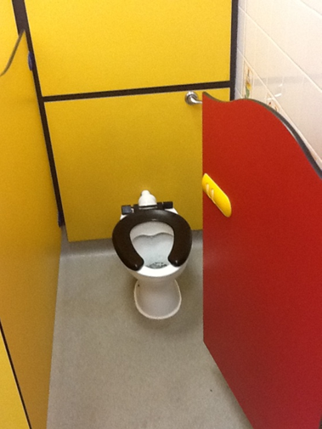
These are the toilets.

Slide 9
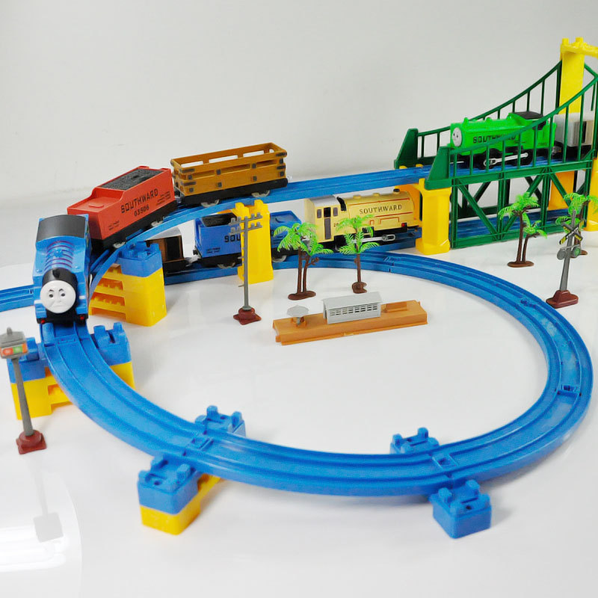
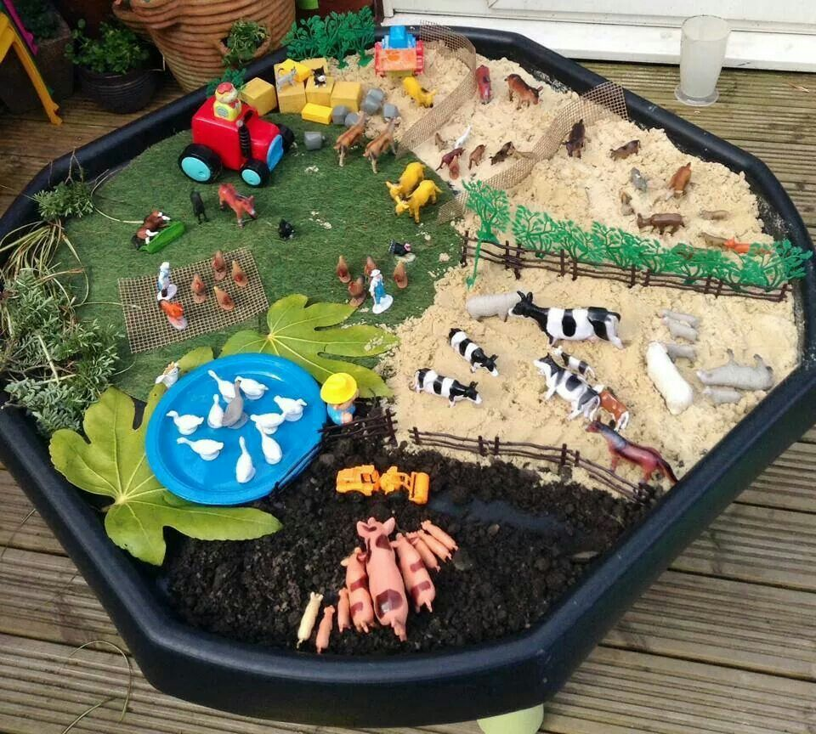
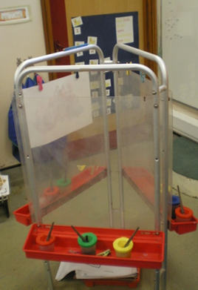
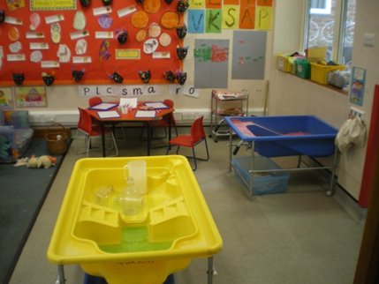
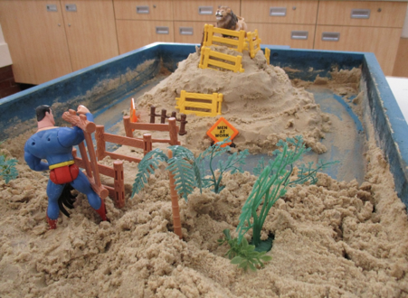
We have lots of toys and things to play with inside school. We know you will have lots of fun and learn so much!

Slide 10
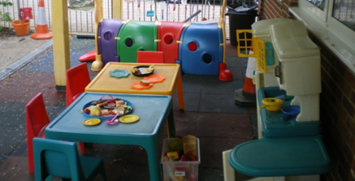
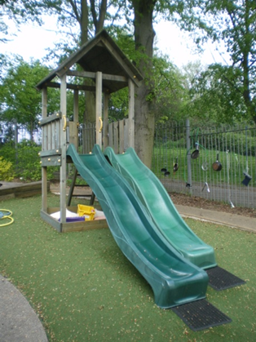
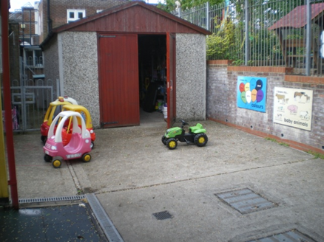
This is the garden; there will be lots of fun things to do outside.

Slide 11
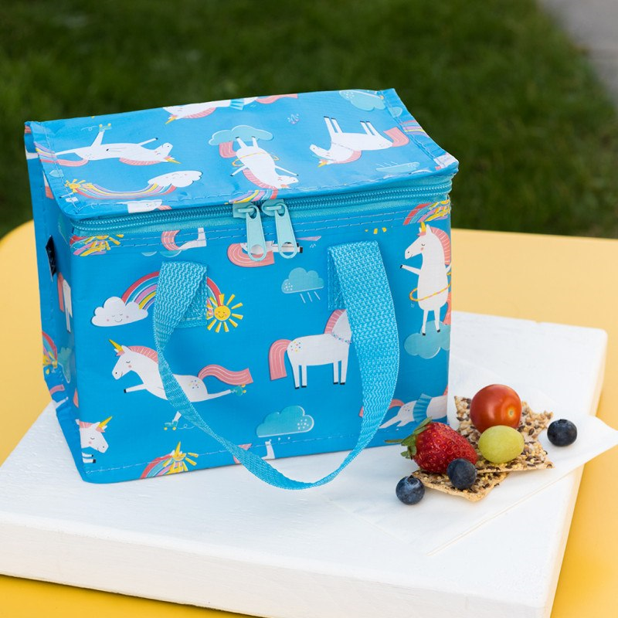
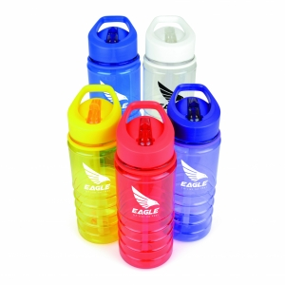
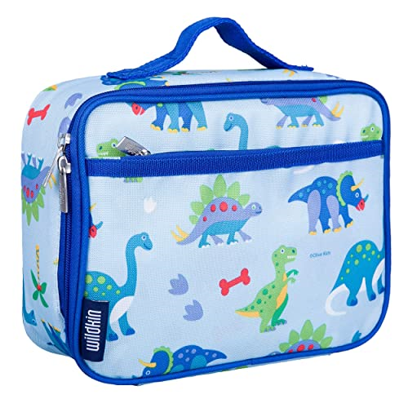
Snack and lunch
*You will have a fruit and milk / water at Snack time.
*You must bring a packed lunch to School for lunch time.
*You will also need to have a plastic water bottle in school each day. It will have to be a bottle that you can drink from without an adult helping you.
*Work at feeding yourself if you can’t do this yet.
*Ask an adult to show you where your name is on the lunch bag and water bottle so that you can know how to find your things.

Slide 12
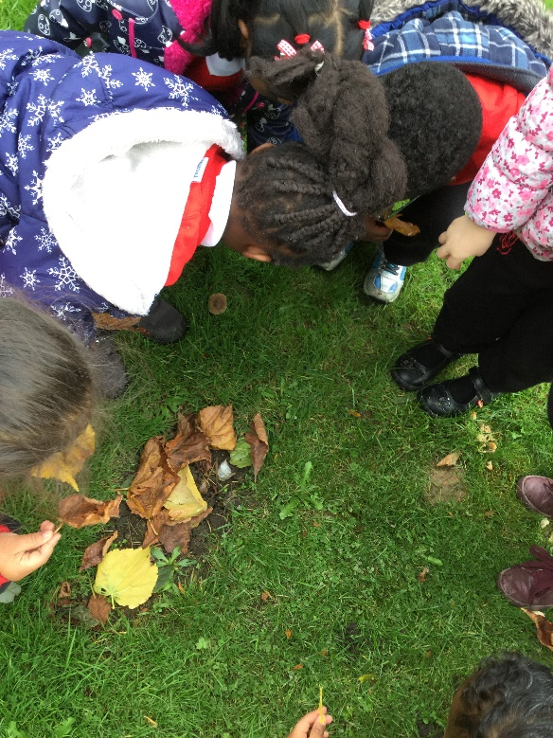
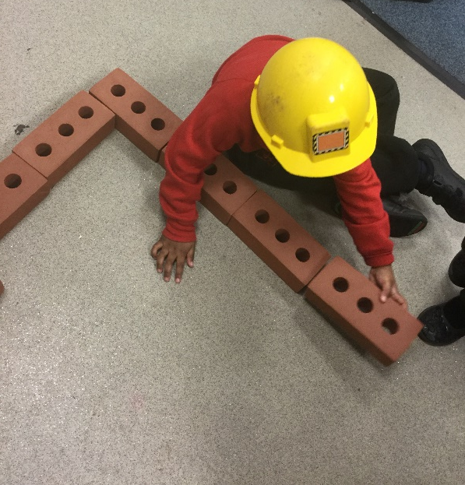
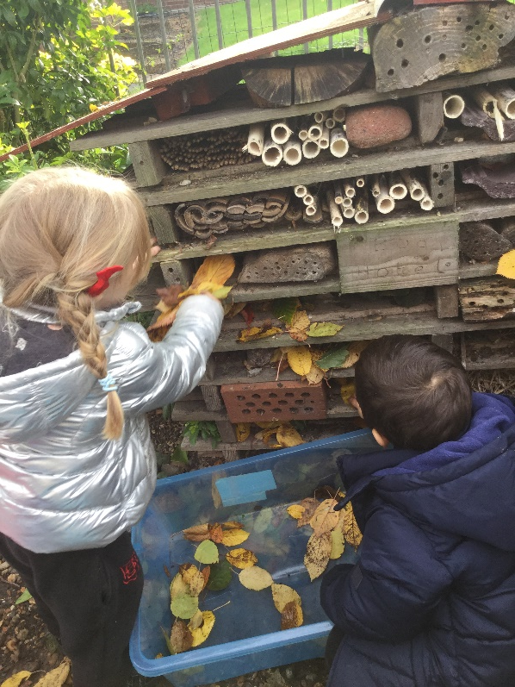
For parents to know:
The children follow a play-based topic curriculum that is child-led. They will be offered opportunities to stimulate their thinking but are encouraged to explore for themselves. Planning is put onto the website on a weekly basis so that parents know what their children are learning and can enhance this through discussion at home.

Slide 13
Getting ready for school
Children should be encouraged to develop their independence
Useful skills to practice with your child in preparation for Nursery:
Saying short prayers;
Attending Mass during the year (once it is safe to do so);
Putting on their own coat;
Taking off their jumper, turning it the right way around and putting the jumper on;
Putting on and taking off their own shoes;
Recognising their own names;
Be fully toilet trained;
Wash and dry their hands;
Blow and wipe their own nose and thrown the tissue in the bin;
Looking at books independently;
Have an awareness of letters, words, shapes and numbers in their environment;
Drawing, painting, cutting out;
Tidying up toys;
Feeding themselves independently.
Talk to children about starting Nursery and explain that they will stay and play with the other children but that someone will come back to collect them each day.

Slide 14
Ask the adults to check the website in July when we will be introducing you to the Staff who will be with you when you start school.
Members of the Nursery Staff will soon be calling the adults in your home to find out about the things that you like doing.
We look forward to meeting you soon!

