Slide 1

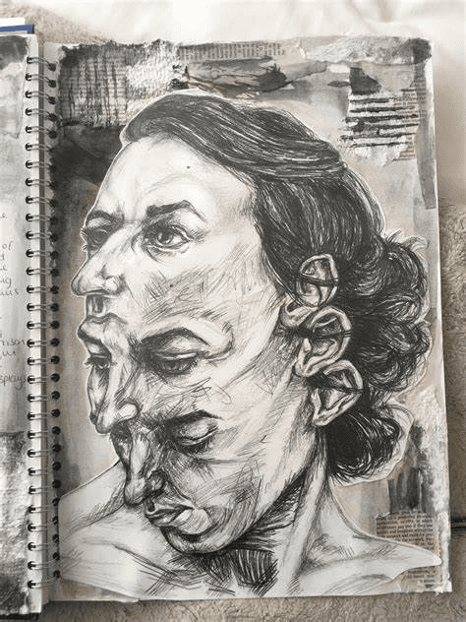
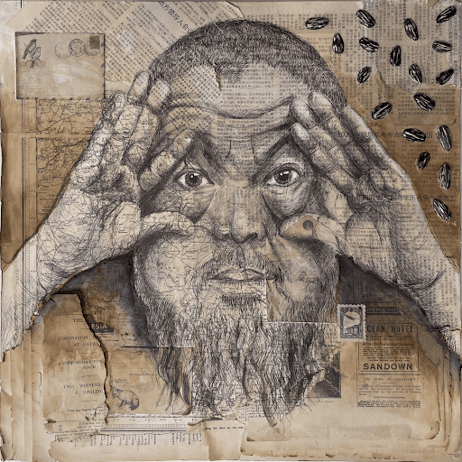
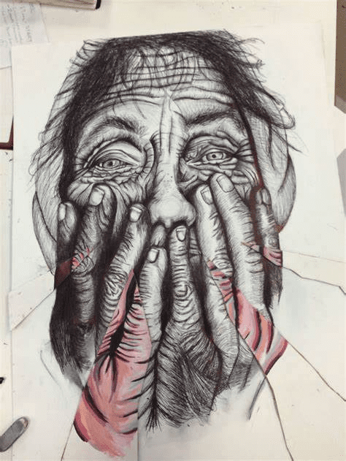
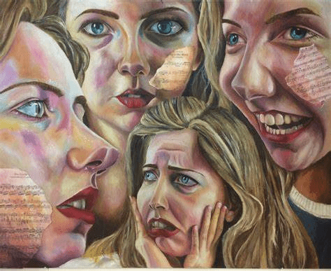
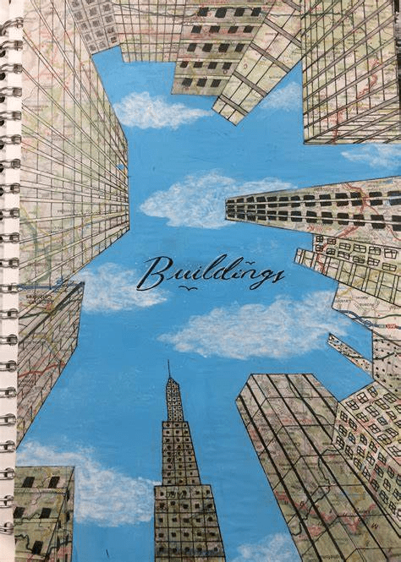
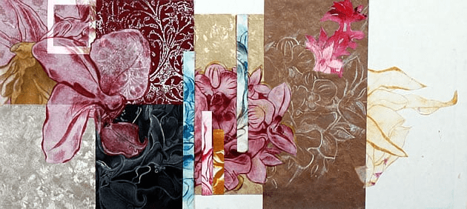
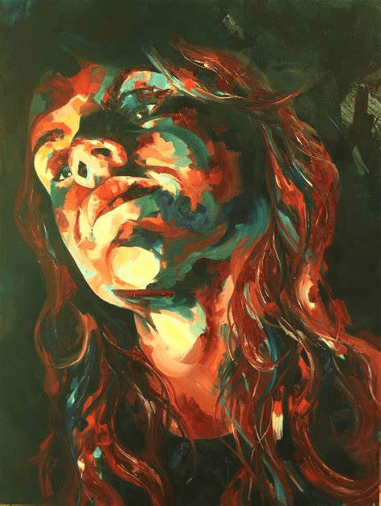
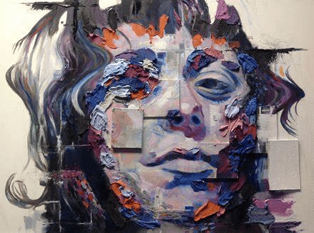
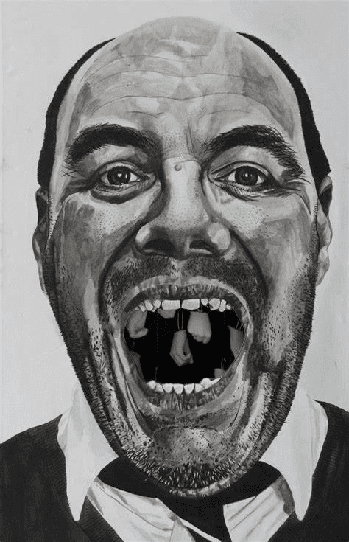
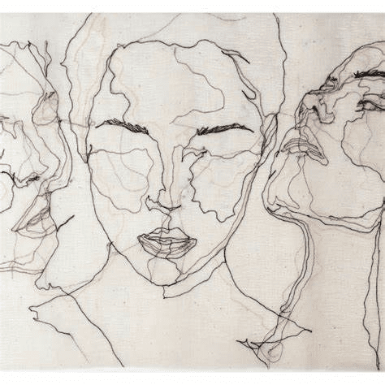
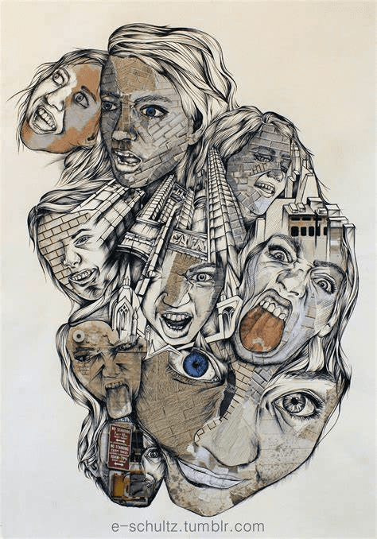
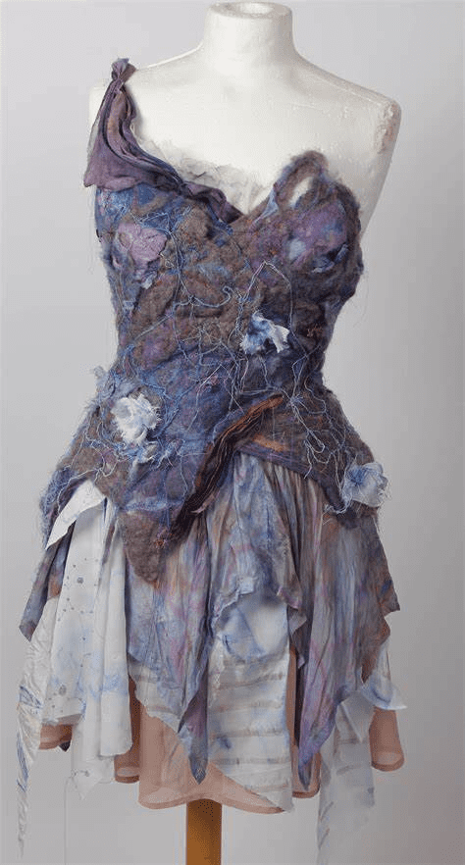

Year 12-13 A Level Art Bridging Unit
What am I going to do?
There will be a series of images which you will draw in tonal pencil and in biro pen. Copy the images as accurately as possible.
Why am I drawing those images?
In Year 12, you will be exploring a Portraiture and Still Life project simultaneously. This is to guide you when deciding what Art you like to draw.

Slide 2
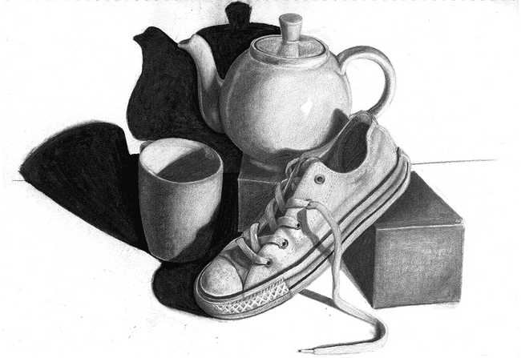
Complete with tonal pencil

Slide 3
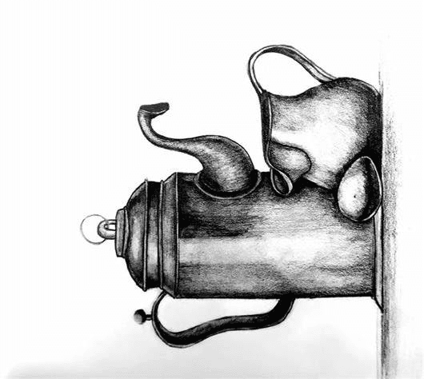
Complete with handwriting pen

Slide 4
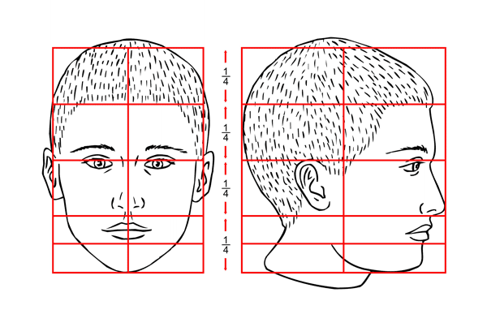
Complete with tonal pencil

Slide 5
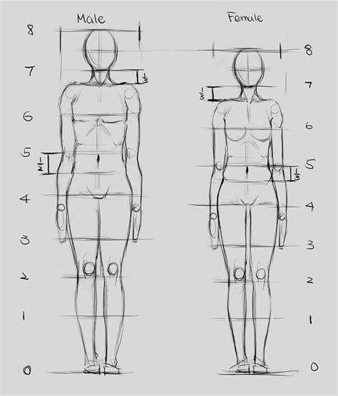
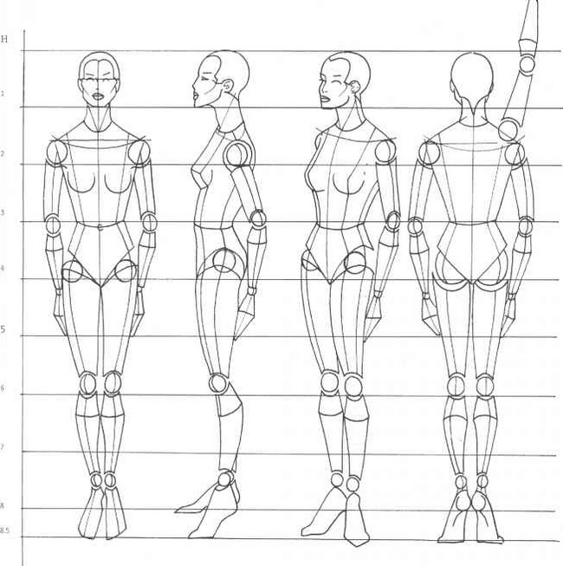
Complete with tonal pencil

Slide 6
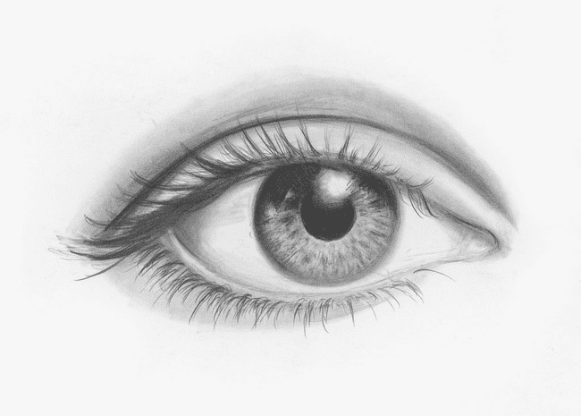
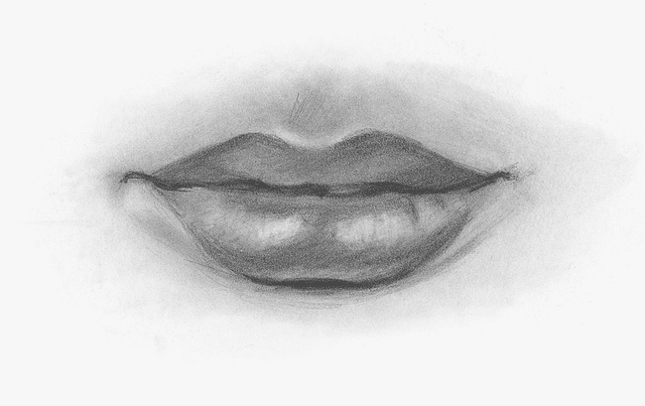
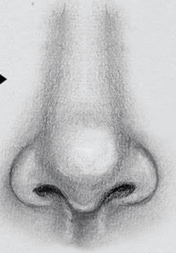
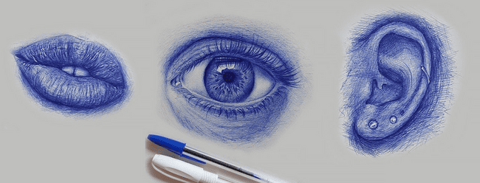
Complete with tonal pencil
Complete with handwriting pen

Slide 7
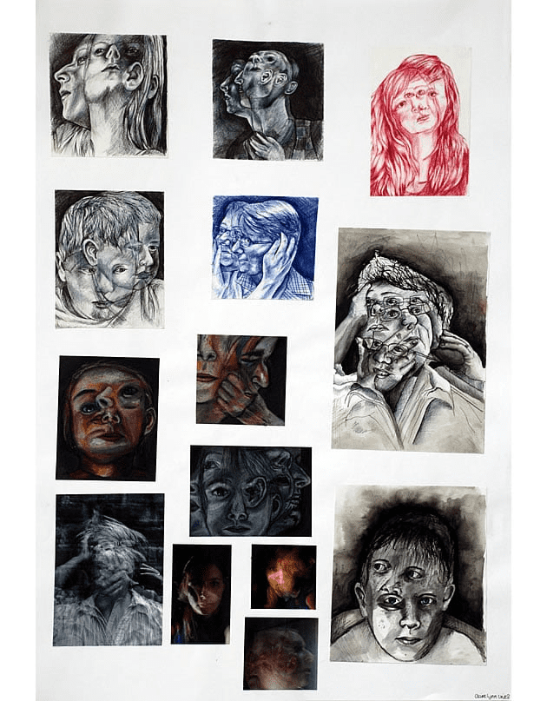
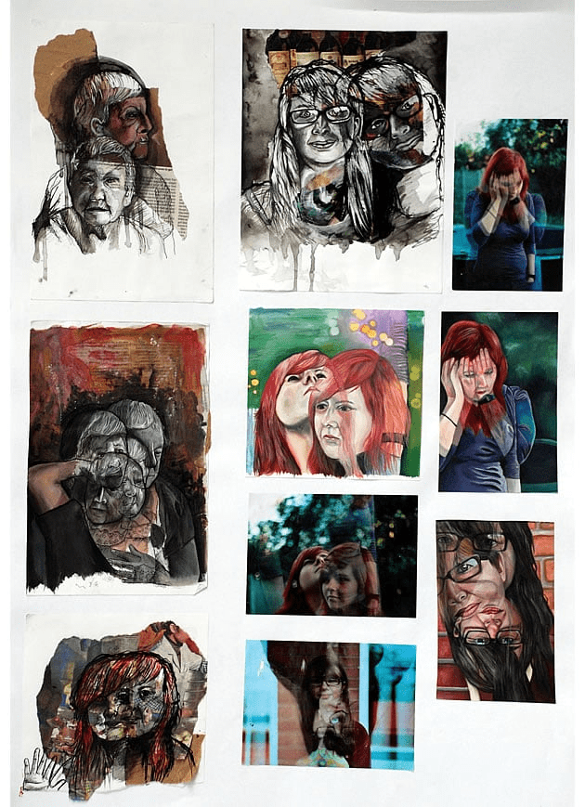
Useful links to help get you prepared
https://www.aqa.org.uk/subjects/art-and-design/as-and-a-level/art-and-design-7201/subject-content/fine-art
https://www.aqa.org.uk/subjects/art-and-design/as-and-a-level/art-and-design-7201/scheme-of-assessment
https://www.cife.org.uk/article/guide-individual-a-level-subjects/all-about-a-level-art/
https://www.studentartguide.com/featured/enjoy-a-level-art-exam
https://www.tate.org.uk/art/student-resource/exam-help
https://www.studentartguide.com/featured/aqa-a-level-art-sketchbook

