Slide 1
BTEC Level 2 Tech Award in Sport
PE Department

Slide 2
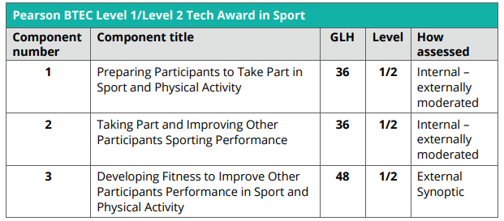
BTEC Level 2 Tech Award in Sport, Activity and Fitness
Course Breakdown

Slide 3
Designing Training Programs
Performance Analysis
Exam
HOW YOU WILL BE ASSESSED
Offering Fitness Guidance to a range of clients
Videos of you officiating and leading a warm up
Videos of your practical performance
Written Assignments

Slide 4
Sports Marketing
Sports Journalism
Physiotherapist
Nutritionist
Dietician
Sports Coach
Sports Development Officer
Careers BTEC Sport can lead you to!
Sports Advertisement
Ground staff/green keeper
Sports Scientist
Professional Sports Person
Leisure centre manager
Physiotherapy
PE Teaching

Slide 5
Is BTEC Sport for you!
You must currently enjoy doing PE at school and bring your kit to every PE lesson.
Need to be aware that there is a mix between practical and theory with the vast majority of content being theory.
This course is a natural progression to BTEC Sport Level 3 at St Wilfrid’s RC College 6th Form
If you have any questions or queries about the course please don’t hesitate to come down to the PE office on a break time.

