Slide 1


A level biology transition pack
Year 11 Year 12
We look forward to welcoming you in September!

Slide 2
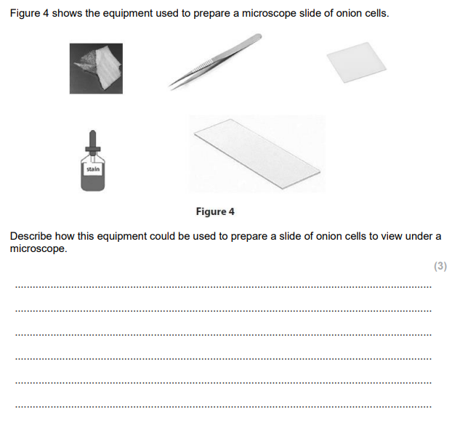
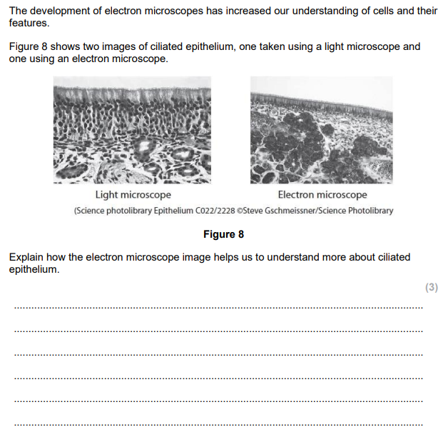
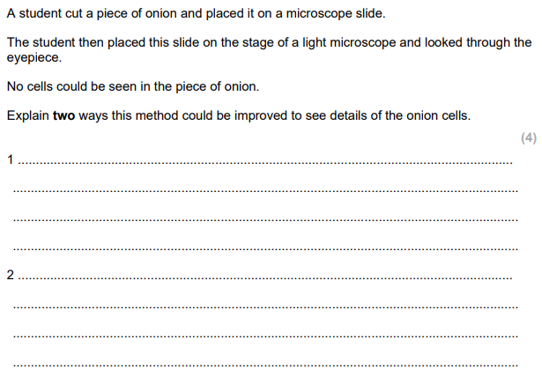
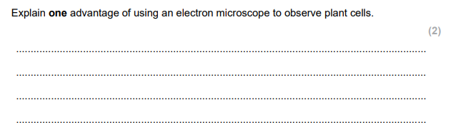
Cells and microscopes – GCSE recap

Slide 3
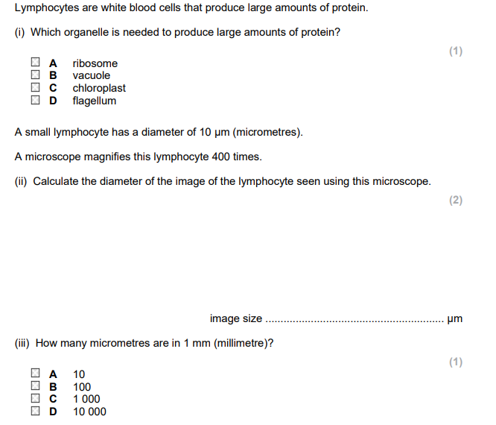
Enzymes and biological molecules – GCSE recap
Complete the table
Polymer | Monomer | Enzyme that digests the polymer
Protein
 | Fatty acids and glycerol
Starch

Slide 4
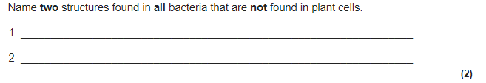
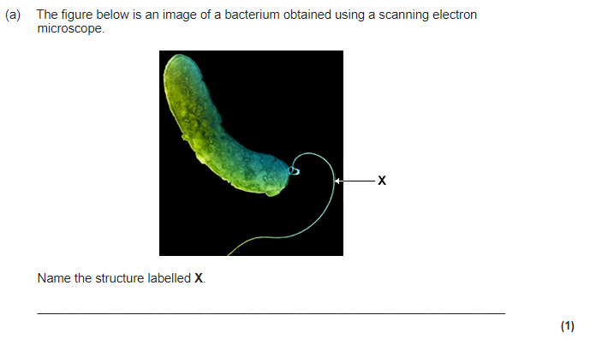
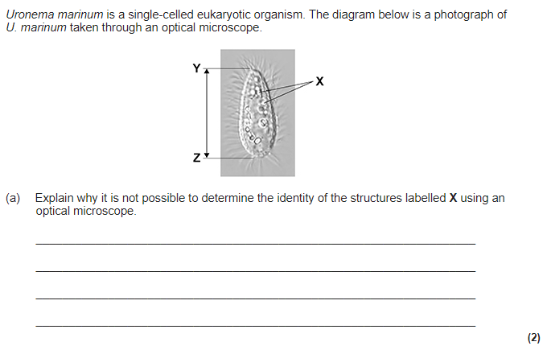
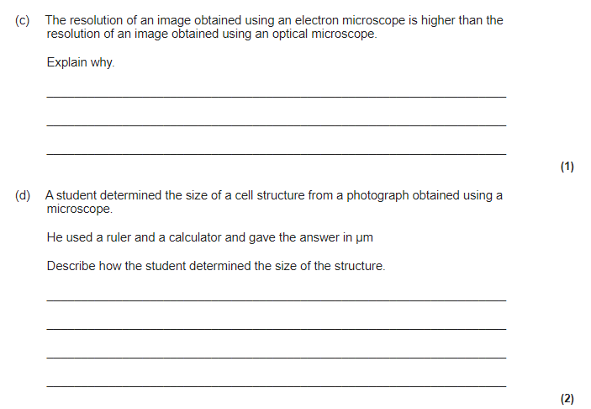
Now let’s try some A level standard questions – you may have to do some research!

Slide 5
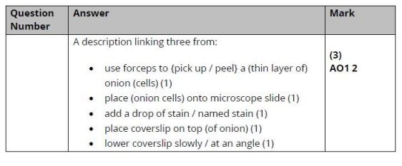
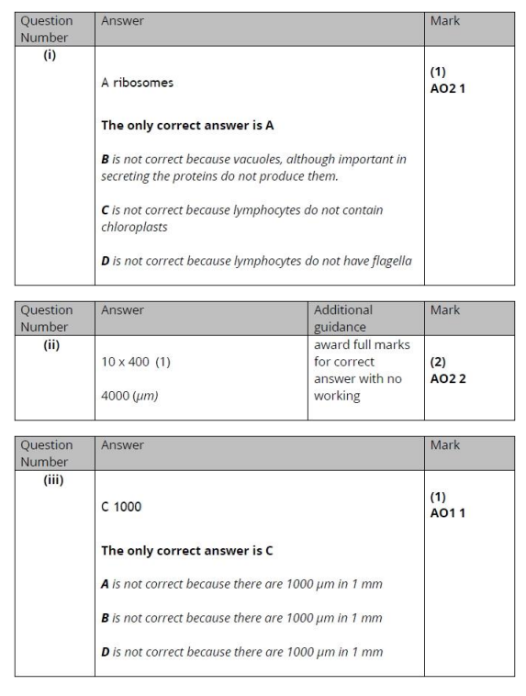
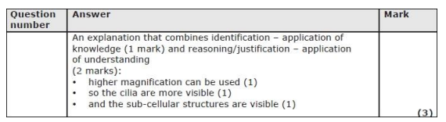
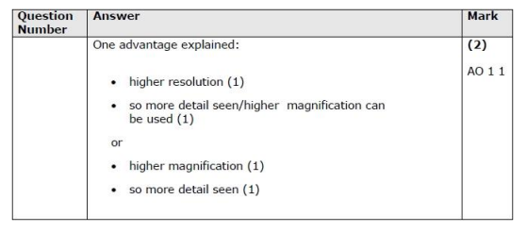

Slide 6
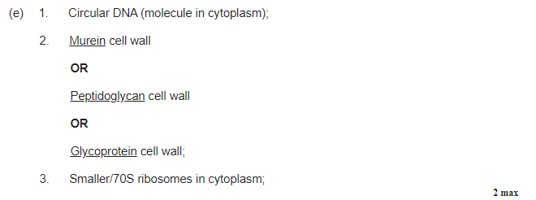
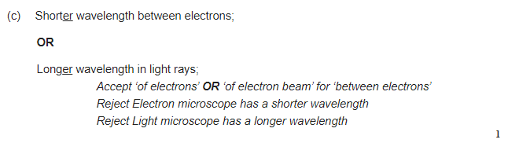

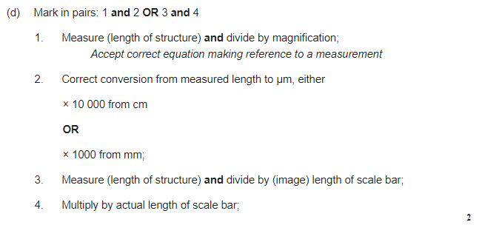
Notice how the terminology is a lot more details than GCSE!

Slide 7
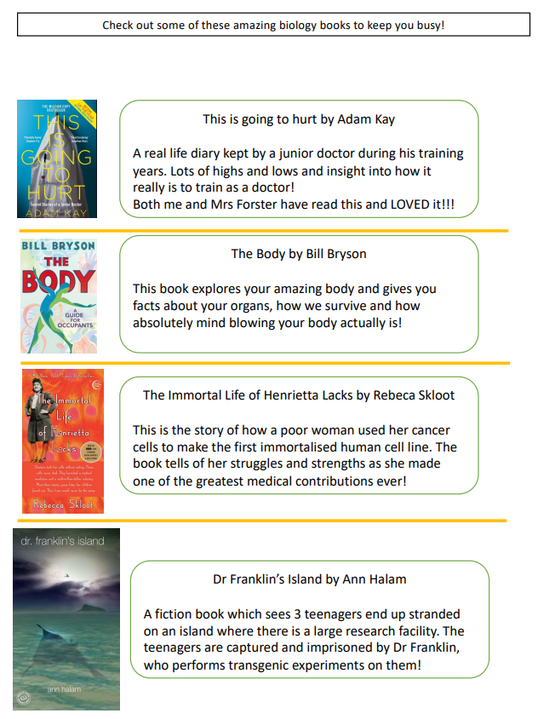
Task 2: Practical skills in year 12
You will complete an enzymes practical and an osmosis required practical in the first module of year 12.
To prepare for this, watch the following videos and answer the following questions for each practical
Enzymes: https://www.youtube.com/watch?v=A8Ts4V_osvo
Osmosis: https://www.youtube.com/watch?v=k1O9jBHgsxs
What is the independent variable?
What is the dependent variable?
Name 3 control variables
State a suitable control for the investigation (remember a control experiment is NOT the same as a variable!)
Suggest an improvement to the method
List 3 safety precautions taken during this practical
Fancy a bit of extra reading?

