Slide 1
CAMBRIDGE NATIONAL IN CREATIVE IMEDIA
YEAR 9 OPTIONS

Slide 2
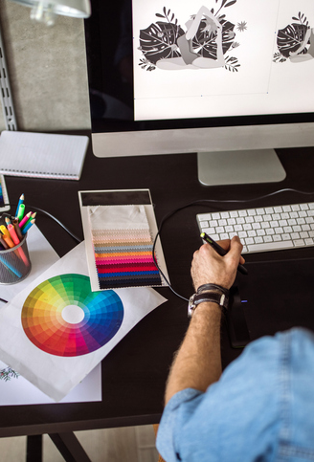
What is Creative iMedia?
Digital Media is a key part of many areas of our everyday lives and vital to the UK economy.
Production of digital media products is a requirement of almost every business so there is huge demand for a skilled and digitally literate workforce.
This course will provide you with the skills for further study in subjects such as media, journalism, design or business.
It also prepares you for a range of creative and technical job roles within the media industry.

Slide 3


Course Overview
There are two mandatory units:
Creative iMedia in the media industry
(Exam - 40%)
Visual identity and digital graphics (Coursework - 25%)
And one optional unit:
Interactive digital media
(Coursework - 35%)

Slide 4

Assessment
GCSE Equivalent Grades
The course is assessed at the end of the qualification and is equivalent to GCSE grading.
All colleges and universities accept this qualification and grading.
Grades are based on assessment across all three units.
Students will be awarded a grade from Pass at Level 1 through to Distinction* at level 2.

Slide 5


Unit R093: Creative iMedia in the media industry
This is a mandatory unit assessed via an exam
In this unit you will learn about the sectors, products and job roles that form the media industry.
You will learn the legal and ethical issues considered and the processes used to plan and create digital media products.
You will learn how media codes are used within the creation of media products to convey meaning, create impact and engage audiences.

Slide 6


Unit R094: Creative iMedia in the media industry
This is a mandatory unit assessed via coursework
In this unit you will learn how to develop brands and visual identities for clients.
You will also learn to apply the concepts of graphic design to create original digital graphics which incorporate your visual identity to engage a target audience.
You will also learn a range pf design skills using the Adobe Creative Suite including Photoshop and Illustrator.

Slide 7

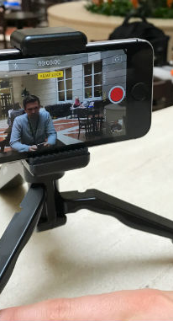
Unit R097: Creative iMedia in the media industry
This is an optional unit assessed via coursework
In this unit you will learn to design and create interactive digital media products for chosen platforms.
Interactive digital media products are found across the media industry, in games, websites and apps, and learning.
You will learn to select, edit and repurpose multimedia content of different kinds and create the interactive elements necessary for an effective user experience.

Slide 8




Why should you study Creative iMedia?
Huge demand for a skilled and digitally literate workforce
Digital media products used in almost every business
A key part of many areas of our everyday lives
Vital to the UK economy that the workforce is equipped with creative people

Slide 9




Photo Collage
For more information contact:
You can also speak to your Computing Teacher.

