Slide 1




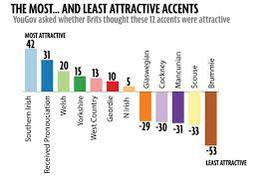

A-Level English Language
Bridging Work
Name: _______________________
Form: ________________________
Instructions
Inside are four tasks to do. Each task should take around 30 minutes to complete. You will need some paper for task two and access to the internet for task three. Please ensure you bring this with you to your first lesson.
Further research
If you have completed these tasks and want to continue some further preparatory research, listen to the Lexis Podcast, especially episodes 1, 2, 3 and 27 to learn more about accents. Or, go on to the blog of linguist Deborah Cameron and begin to find out about issues surrounding language and gender that you will study later in the year.

Slide 2
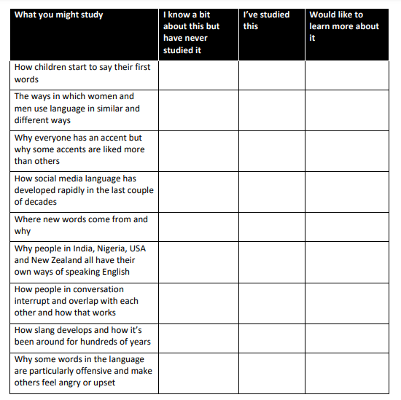
TASK ONE: Becoming a student of English Language
What does an A Level in English Language involve and what does it mean to be a great student of English Language? These tasks will help you find out what’s involved in the A Level and beyond: more importantly, how to enjoy and get the most out of the course.
Use the table below (and on the next page) to get a sense of what might be involved in the A Level English Language course. Tick the things that sound like you might find them interesting and any that you have already studied.
Read the article ‘Becoming an A Level Language Student’ written by one of our chief examiners, Marcello Giovanelli to gain further understanding of the course.
From what you have considered and read, pick one of the areas for language study that you want to study in greater depth. You will have to complete your own area of language investigation for your coursework, so you need to develop your own areas of interest early on. Summarise what you know, why you are interested and how you think you might investigate it.

Slide 3
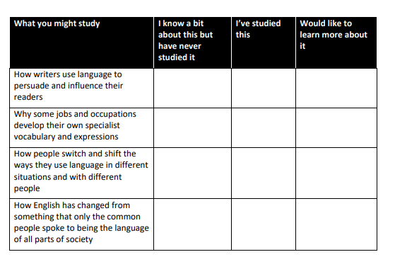
What area of language study are you most interested in? Why are interested in it? What would you like to find out? How might you investigate this?

Slide 4

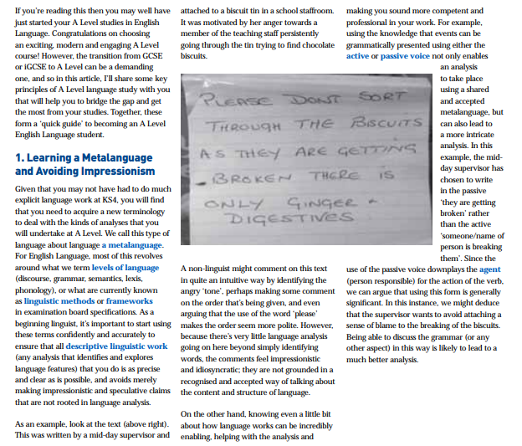

Slide 5
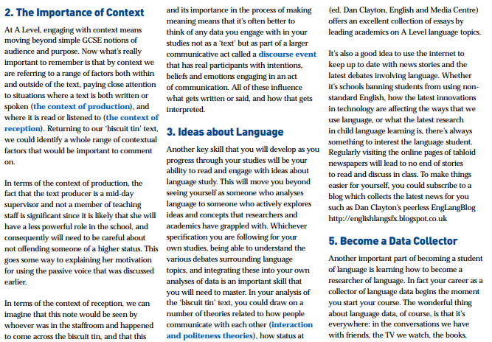
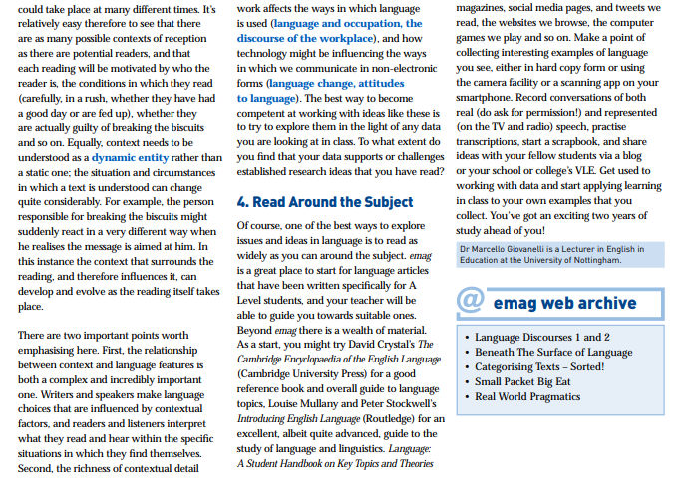

Slide 6
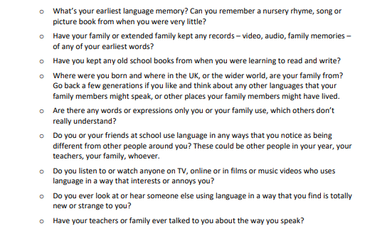
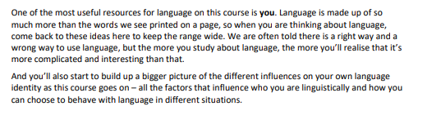
TASK Two: Examining your own language
One of the most interesting aspects of studying A Level English Language is that you learn more about your own language use, especially the way you talk and write.
Create a language profile of yourself. You might want to do this as a mind map, thinking specifically about these four categories:
The way you speak with friends
The way you speak to family or teachers
The way you communicate through mobile phone messaging
The way you write within your school work
You might also want to consider the following:

Slide 7
TASK Three: Accents and Dialects
One of the first units we will study is that of accents and dialects. Use your own knowledge and the internet to complete the following tasks.
Define the two terms accent and dialect. How are they different?
List as many different accents within the UK that you can think of. Then, identify the three accents you like the most, and the three you dislike the most.
Explain what makes you like or dislike some accents over others. Is this to do with the sounds of accents, what you associate with the place it originates, or some other factors?
Look up the YouGov 2014 accent poll. Which accents came out top, and which came out bottom? Are the rankings in this poll similar or different to yours?
Many people argue that we should all speak the same Standard English, no matter where we are from in the country. Do you agree or disagree with this statement? Explain your reasons.

Slide 8

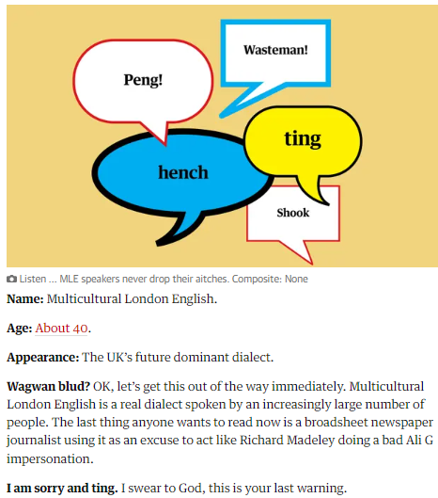
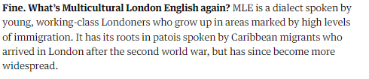
TASK four: MLE
One of the most interesting accents and dialects that has developed in Britain is MLE. Read the following Guardian article that ‘profiles’ MLE and consider the questions as you go.
Questions to consider:
Have you heard any of these words before? Where?
Would you/do you use them yourself? Does this depend on the situation?
Where does it tell us MLE originates?

Slide 9
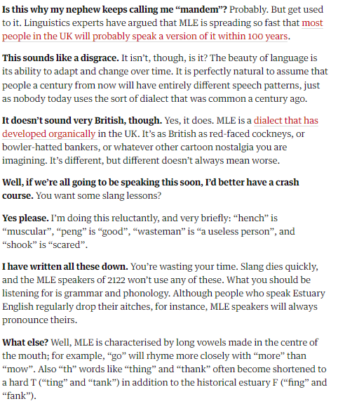
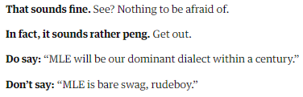
Questions to consider:
Some people are really quite angry at this spread of MLE. Why do you think that might be?
Why does it suggest we shouldn’t ‘write these words down’? What does this imply about language?
Do you think you will speak MLE in the future? Explain your ideas.

