Slide 1


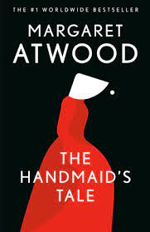
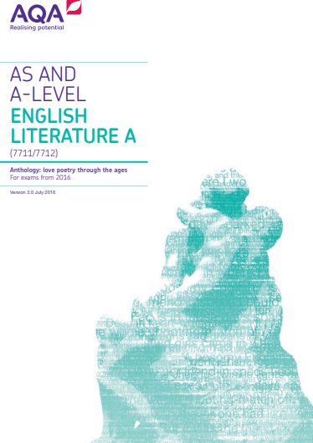
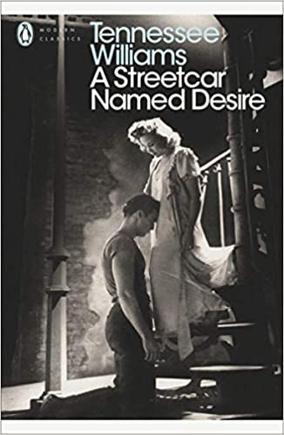
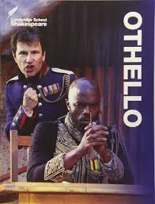
A-Level English Literature
Bridging Work
Name: _______________________
Form: ________________________
Instructions
There are three tasks to complete, each should take around 50 minutes. You will need access to the internet for tasks one and two. Please bring this to your first lesson.
Further reading
If you have completed these tasks, it is recommended that you buy a copy The Great Gatsby and read it – you will be expected to complete this by the end of the first term. Additionally, you will need to complete wider reading as you progress through the course, especially as you will be able to choose your own texts for coursework. Choose one of these recommended texts and read it.
Pre-1900
The Picture of Dorian Gray by Oscar Wilde
Frankenstein by Mary Shelley
Dracula by Bram Stoker
War of the Worlds by H.G. Wells
A Doll’s House by Henrik Ibsen
Post-1900
1984 by George Orwell
Beloved by Toni Morrison
The Bell Jar by Sylvia Plath
A Thousand Splendid Sons by Khaled Hosseini
The Bloody Chamber by Angela Carter

Slide 2
TASK ONE: the background of The Great Gatsby
One of the key texts that you will study is The Great Gatsby. This is quite a complex text, so before you read it, complete the following research and then read the contextual information on the next page.
Find out who wrote the text, when it was published and where it is set.
There are a lot of characters in the text, create a character map below.
Read a number of summaries (Sparknotes, Cliffnotes etc). Summarise the plot below in 10 bullet points.
This novel is often characterised as a novel of the Jazz era. Look up and explain what is meant by this term.

Slide 3
5. Read the biographical context about the author’s life. Highlight important information and bullet point five things you think may have influenced his writing.
Francis Scott Key Fitzgerald was born in 1896 in Minnesota, USA, to a family of some social standing although little money. It seems likely much of Fitzgerald's interest in society life began in his youth in Minnesota when he would play and associate with the rich children of the neighborhood — dancing, sailing, swimming, sledding — all the time knowing he was never entirely a part of their society. Fitzgerald’s father was unsuccessful in business and the family spent much of his youth living off the generosity of their rich relatives, the McQuillans. The McQuillans ensured Fitzgerald had a good education and paid for him to attend Princeton University in 1913. He did not graduate but instead joined the army in 1917, although he never saw action.
In 1918, while assigned to Camp Sheridan, near Montgomery, Alabama, Fitzgerald met and fell in love with then 18-year-old Southern Belle debutante Zelda Sayre. She came from a wealthy family and refused marriage until he was able to support her financially, so Fitzgerald moved to New York and took up work in an advertising agency. He had been writing throughout his youth and his first novel, This Side of Paradise, was published in 1920. Fitzgerald and Zelda married and became synonymous with life in the 1920s: drinking, dancing and extravagant living. They travelled extensively in the USA and Europe and in 1921 Zelda gave birth to the couple’s only child, a daughter named Frances. In 1922, the couple rented a house in the Great Neck, Long Island, and they embarked on a riotous year which provided the background for The Great Gatsby. He was seduced by the wild and extravagant life of the rich, and he wanted to be at the heart of it, like Gatsby, but he was also aware of the moral emptiness and the hypocrisy beneath the excitement. Fitzgerald himself acknowledged that he “was pushed into the position not only of spokesman for the time but of the typical product of that same moment.”
The couple’s drinking habits became excessive and took its toll on Fitzgerald’s writing. Their marriage was also plagued with financial difficulties, and Fitzgerald had to write many short stories for publication in magazines to fund their lifestyle. Zelda began experiencing mental illness in the 1920s, and had to be institutionalized in 1930. She resided in different institutions until her death in 1948. Although he remained married to Zelda until the end, her mental illness redefined their marriage. Fitzgerald could not provide the support she needed at home and worked hard to keep her comfortably in the institutions. He eventually met and fell in love with Sheilah Graham, a movie columnist, with whom he spent the last few years of his life.
The Great Gatsby, Fitzgerald’s third novel, was first published in 1925 to limited success. He continued to write novels, short stories and screenplays until his death in 1940. By then, he had slipped into relative obscurity; his personal life was chaotic and his literary reputation fragile. Despite having once been the golden boy of the Jazz Age, upon his death, many of his obituaries were condescending, capitalizing on his personal hardships. However, after World War II, interest in his work began to grow. By the 1960s, he had risen to secure a place among the great twentieth century American authors.
Five bullet points:

Slide 4
TASK TWO: the setting of The Great Gatsby
The novel is set in 1920s New York.
Research what life was like in 1920s New York and bullet point or mind map this below. You might want to divide this up into different sections such as lifestyle, crime, class and women’s roles.
Read the following critical interpretation about the setting of The Great Gatsby and in another colour, add to your list or mind map anything you have further found out about the significance of the New York setting.

Slide 5
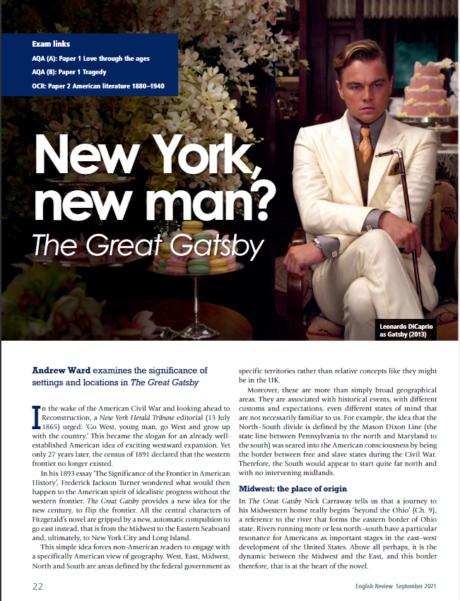
TASK TWO: the setting of The Great Gatsby

Slide 6
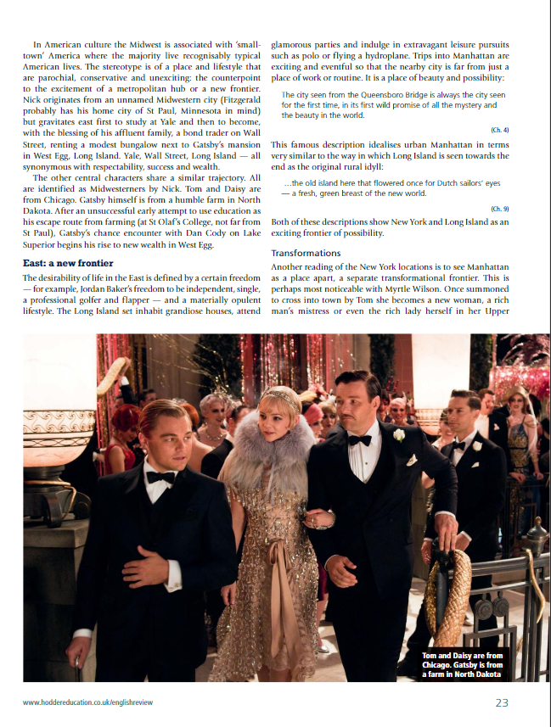

Slide 7
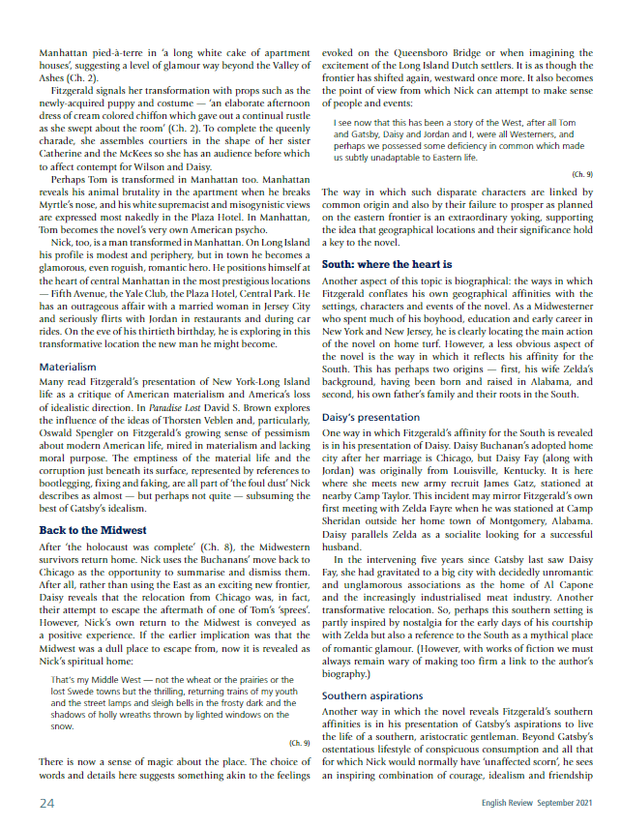

Slide 8
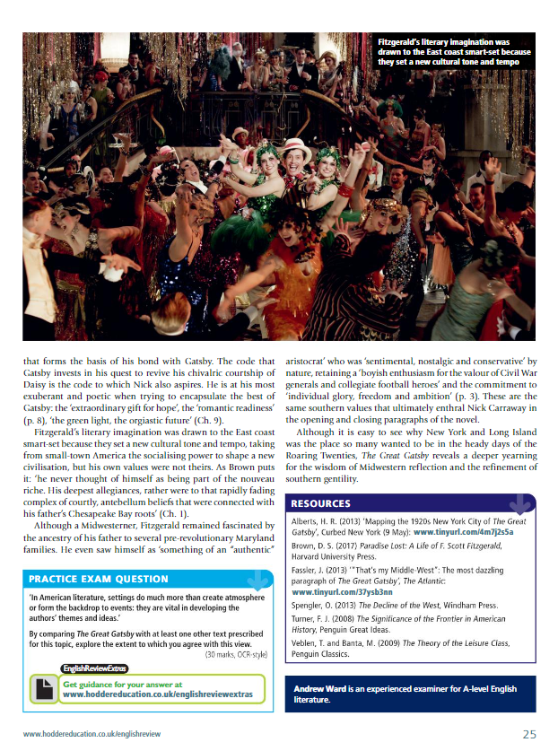

Slide 9
TASK THREE: the opening to Chapter One
Read the opening pages of Chapter One of The Great Gatsby (printed below or available online), then complete the tasks at the end.
In my younger and more vulnerable years my father gave me some advice that I’ve been turning over in my mind ever since.
“Whenever you feel like criticizing anyone,” he told me, “just remember that all the people in this world haven’t had the advantages that you’ve had.”
He didn’t say any more, but we’ve always been unusually communicative in a reserved way, and I understood that he meant a great deal more than that. In consequence, I’m inclined to reserve all judgements, a habit that has opened up many curious natures to me and also made me the victim of not a few veteran bores. The abnormal mind is quick to detect and attach itself to this quality when it appears in a normal person, and so it came about that in college I was unjustly accused of being a politician, because I was privy to the secret griefs of wild, unknown men. Most of the confidences were unsought—frequently I have feigned sleep, preoccupation, or a hostile levity when I realized by some unmistakable sign that an intimate revelation was quivering on the horizon; for the intimate revelations of young men, or at least the terms in which they express them, are usually plagiaristic and marred by obvious suppressions. Reserving judgements is a matter of infinite hope. I am still a little afraid of missing something if I forget that, as my father snobbishly suggested, and I snobbishly repeat, a sense of the fundamental decencies is parcelled out unequally at birth.
And, after boasting this way of my tolerance, I come to the admission that it has a limit. Conduct may be founded on the hard rock or the wet marshes, but after a certain point I don’t care what it’s founded on. When I came back from the East last autumn I felt that I wanted the world to be in uniform and at a sort of moral attention forever; I wanted no more riotous excursions with privileged glimpses into the human heart. Only Gatsby, the man who gives his name to this book, was exempt from my reaction—Gatsby, who represented everything for which I have an unaffected scorn. If personality is an unbroken series of successful gestures, then there was something gorgeous about him, some heightened sensitivity to the promises of life, as if he were related to one of those intricate machines that register earthquakes ten thousand miles away. This responsiveness had nothing to do with that flabby impressionability which is dignified under the name of the “creative temperament”—it was an extraordinary gift for hope, a romantic readiness such as I have never found in any other person and which it is not likely I shall ever find again. No—Gatsby turned out all right at the end; it is what preyed on Gatsby, what foul dust floated in the wake of his dreams that temporarily closed out my interest in the abortive sorrows and short-winded elations of men.
My family have been prominent, well-to-do people in this Middle Western city for three generations. The Carraways are something of a clan, and we have a tradition that we’re descended from the Dukes of Buccleuch, but the actual founder of my line was my grandfather’s brother, who came here in fifty-one, sent a substitute to the Civil War, and started the wholesale hardware business that my father carries on today.
I never saw this great-uncle, but I’m supposed to look like him—with special reference to the rather hard-boiled painting that hangs in father’s office. I graduated from New Haven in 1915, just a quarter of a century after my father, and a little later I participated in that delayed Teutonic migration known as the Great War. I enjoyed the counter-raid so thoroughly that I came back restless. Instead of being the warm centre of the world, the Middle West now seemed like the ragged edge of the universe—so I decided to go East and learn the bond business. Everybody I knew was in the bond business, so I supposed it could support one more single man. All my aunts and uncles talked it over as if they were choosing a prep school for me, and finally said, “Why—ye-es,” with very grave, hesitant faces. Father agreed to finance me for a year, and after various delays I came East, permanently, I thought, in the spring of twenty-two.

Slide 10
The practical thing was to find rooms in the city, but it was a warm season, and I had just left a country of wide lawns and friendly trees, so when a young man at the office suggested that we take a house together in a commuting town, it sounded like a great idea. He found the house, a weather-beaten cardboard bungalow at eighty a month, but at the last minute the firm ordered him to Washington, and I went out to the country alone. I had a dog—at least I had him for a few days until he ran away—and an old Dodge and a Finnish woman, who made my bed and cooked breakfast and muttered Finnish wisdom to herself over the electric stove.
It was lonely for a day or so until one morning some man, more recently arrived than I, stopped me on the road.
“How do you get to West Egg village?” he asked helplessly.
I told him. And as I walked on I was lonely no longer. I was a guide, a pathfinder, an original settler. He had casually conferred on me the freedom of the neighbourhood.
And so with the sunshine and the great bursts of leaves growing on the trees, just as things grow in fast movies, I had that familiar conviction that life was beginning over again with the summer.
There was so much to read, for one thing, and so much fine health to be pulled down out of the young breath-giving air. I bought a dozen volumes on banking and credit and investment securities, and they stood on my shelf in red and gold like new money from the mint, promising to unfold the shining secrets that only Midas and Morgan and Maecenas knew. And I had the high intention of reading many other books besides. I was rather literary in college—one year I wrote a series of very solemn and obvious editorials for the Yale News—and now I was going to bring back all such things into my life and become again that most limited of all specialists, the “well-rounded man.” This isn’t just an epigram—life is much more successfully looked at from a single window, after all.
It was a matter of chance that I should have rented a house in one of the strangest communities in North America. It was on that slender riotous island which extends itself due east of New York—and where there are, among other natural curiosities, two unusual formations of land. Twenty miles from the city a pair of enormous eggs, identical in contour and separated only by a courtesy bay, jut out into the most domesticated body of salt water in the Western hemisphere, the great wet barnyard of Long Island Sound. They are not perfect ovals—like the egg in the Columbus story, they are both crushed flat at the contact end—but their physical resemblance must be a source of perpetual wonder to the gulls that fly overhead. To the wingless a more interesting phenomenon is their dissimilarity in every particular except shape and size.
I lived at West Egg, the—well, the less fashionable of the two, though this is a most superficial tag to express the bizarre and not a little sinister contrast between them. My house was at the very tip of the egg, only fifty yards from the Sound, and squeezed between two huge places that rented for twelve or fifteen thousand a season. The one on my right was a colossal affair by any standard—it was a factual imitation of some Hôtel de Ville in Normandy, with a tower on one side, spanking new under a thin beard of raw ivy, and a marble swimming pool, and more than forty acres of lawn and garden. It was Gatsby’s mansion. Or, rather, as I didn’t know Mr. Gatsby, it was a mansion inhabited by a gentleman of that name. My own house was an eyesore, but it was a small eyesore, and it had been overlooked, so I had a view of the water, a partial view of my neighbour’s lawn, and the consoling proximity of millionaires—all for eighty dollars a month.

Slide 11
Across the courtesy bay the white palaces of fashionable East Egg glittered along the water, and the history of the summer really begins on the evening I drove over there to have dinner with the Tom Buchanans. Daisy was my second cousin once removed, and I’d known Tom in college. And just after the war I spent two days with them in Chicago.
Her husband, among various physical accomplishments, had been one of the most powerful ends that ever played football at New Haven—a national figure in a way, one of those men who reach such an acute limited excellence at twenty-one that everything afterward savours of anticlimax. His family were enormously wealthy—even in college his freedom with money was a matter for reproach—but now he’d left Chicago and come East in a fashion that rather took your breath away: for instance, he’d brought down a string of polo ponies from Lake Forest. It was hard to realize that a man in my own generation was wealthy enough to do that.
Why they came East I don’t know. They had spent a year in France for no particular reason, and then drifted here and there unrestfully wherever people played polo and were rich together. This was a permanent move, said Daisy over the telephone, but I didn’t believe it—I had no sight into Daisy’s heart, but I felt that Tom would drift on forever seeking, a little wistfully, for the dramatic turbulence of some irrecoverable football game.
And so it happened that on a warm windy evening I drove over to East Egg to see two old friends whom I scarcely knew at all. Their house was even more elaborate than I expected, a cheerful red-and-white Georgian Colonial mansion, overlooking the bay. The lawn started at the beach and ran towards the front door for a quarter of a mile, jumping over sundials and brick walks and burning gardens—finally when it reached the house drifting up the side in bright vines as though from the momentum of its run. The front was broken by a line of French windows, glowing now with reflected gold and wide open to the warm windy afternoon, and Tom Buchanan in riding clothes was standing with his legs apart on the front porch.
He had changed since his New Haven years. Now he was a sturdy straw-haired man of thirty, with a rather hard mouth and a supercilious manner. Two shining arrogant eyes had established dominance over his face and gave him the appearance of always leaning aggressively forward. Not even the effeminate swank of his riding clothes could hide the enormous power of that body—he seemed to fill those glistening boots until he strained the top lacing, and you could see a great pack of muscle shifting when his shoulder moved under his thin coat. It was a body capable of enormous leverage—a cruel body.
His speaking voice, a gruff husky tenor, added to the impression of fractiousness he conveyed. There was a touch of paternal contempt in it, even toward people he liked—and there were men at New Haven who had hated his guts.
“Now, don’t think my opinion on these matters is final,” he seemed to say, “just because I’m stronger and more of a man than you are.” We were in the same senior society, and while we were never intimate I always had the impression that he approved of me and wanted me to like him with some harsh, defiant wistfulness of his own.
We talked for a few minutes on the sunny porch.
“I’ve got a nice place here,” he said, his eyes flashing about restlessly.
Turning me around by one arm, he moved a broad flat hand along the front vista, including in its sweep a sunken Italian garden, a half acre of deep, pungent roses, and a snub-nosed motorboat that bumped the tide offshore.
“It belonged to Demaine, the oil man.” He turned me around again, politely and abruptly. “We’ll go inside.”

Slide 12
We walked through a high hallway into a bright rosy-coloured space, fragilely bound into the house by French windows at either end. The windows were ajar and gleaming white against the fresh grass outside that seemed to grow a little way into the house. A breeze blew through the room, blew curtains in at one end and out the other like pale flags, twisting them up toward the frosted wedding-cake of the ceiling, and then rippled over the wine-coloured rug, making a shadow on it as wind does on the sea.
The only completely stationary object in the room was an enormous couch on which two young women were buoyed up as though upon an anchored balloon. They were both in white, and their dresses were rippling and fluttering as if they had just been blown back in after a short flight around the house. I must have stood for a few moments listening to the whip and snap of the curtains and the groan of a picture on the wall. Then there was a boom as Tom Buchanan shut the rear windows and the caught wind died out about the room, and the curtains and the rugs and the two young women ballooned slowly to the floor.
The younger of the two was a stranger to me. She was extended full length at her end of the divan, completely motionless, and with her chin raised a little, as if she were balancing something on it which was quite likely to fall. If she saw me out of the corner of her eyes she gave no hint of it—indeed, I was almost surprised into murmuring an apology for having disturbed her by coming in.
The other girl, Daisy, made an attempt to rise—she leaned slightly forward with a conscientious expression—then she laughed, an absurd, charming little laugh, and I laughed too and came forward into the room.
“I’m p-paralysed with happiness.”
She laughed again, as if she said something very witty, and held my hand for a moment, looking up into my face, promising that there was no one in the world she so much wanted to see. That was a way she had. She hinted in a murmur that the surname of the balancing girl was Baker. (I’ve heard it said that Daisy’s murmur was only to make people lean toward her; an irrelevant criticism that made it no less charming.)
Complete the following tasks on what you have read by bullet pointing at least three things for each question.
What can be inferred about the narrator Nick?

Slide 13
Complete the following tasks on what you have read by bullet pointing at least three things for each question.
2. What do you learn about Gatsby and/or Gatsby’s house?
3. What do you learn about the differences between East Egg and West Egg?
4. What is implied about the home and lifestyle of Tom and Daisy Buchanen?
5. From your earlier research on context and setting in tasks one and two, what connections to this context can you see in the opening pages?

