Slide 1
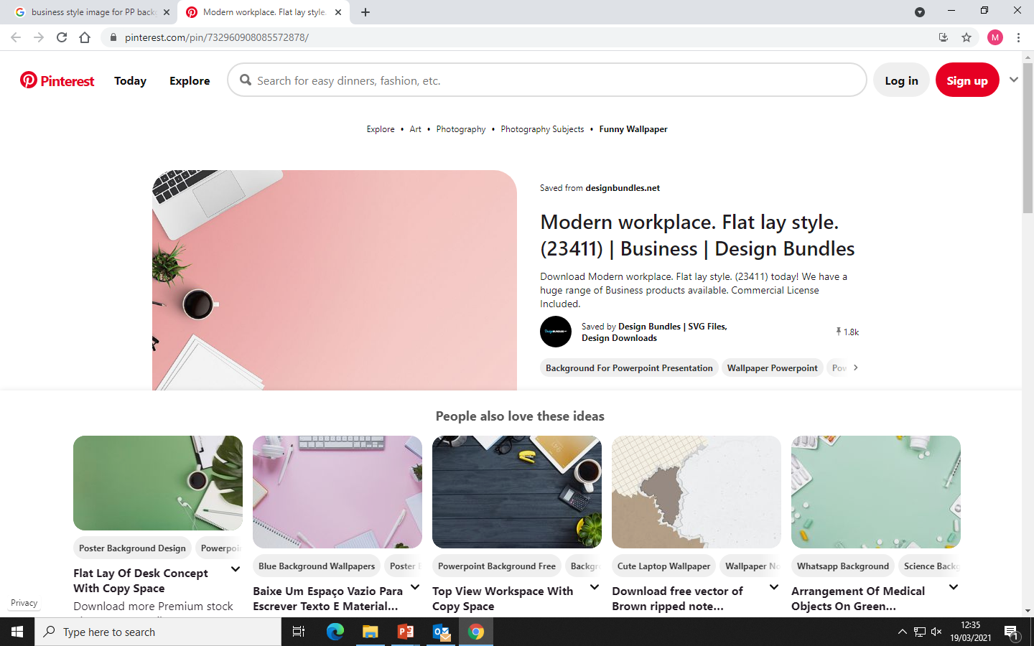

GCSE Business Studies
DD
Do you want to know what it takes to become an entrepreneur and set up and grow a successful business?

Slide 2
What is it All About?
DD
You will learn how small businesses are started and grow.
Discover how businesses plan their finances and adapt to changing environments.
Investigate how businesses promote themselves to increase sales and keep customers happy.
You will develop a sound business knowledge that you can take into the business world and will be able to spot business opportunities using examples from popular TV programmes such as Dragon’s Den and The Apprentice.
You will be given the opportunity to investigate real life business and look at how they have succeeded.
You will develop skills that will help you when you move into employment.

Slide 3
What is it All About?
“You don’t have to be a genius or a visionary or even a college graduate to be successful. You just need a framework and a dream.”
—Michael Dell do
Business and Enterprise is all about having ideas, taking an educated risk and turning your ideas into a successful business venture.

Slide 4
What is it All About?
“You don’t have to be a genius or a visionary or even a college graduate to be successful. You just need a framework and a dream.”
—do
During this course you will develop skills which are essential when setting up a business.

Slide 5
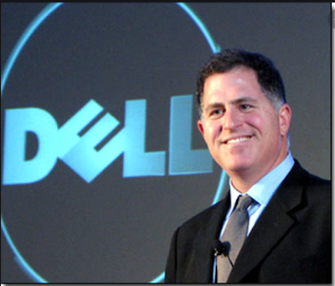
Quotes from Successful Entrepreneurs
“You don’t have to be a genius or a visionary or even a college graduate to be successful. You just need a framework and a dream.”
—Michael Del do
“You don’t have to be a genius or a visionary or even a college graduate to be successful. You just need a framework and a dream”
Michael Dell, American Billionaire, founder of Dell Technology

Slide 6
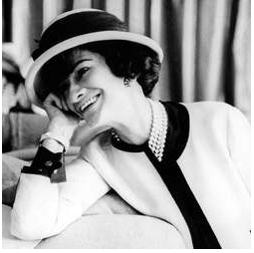
Quotes from Successful Entrepreneurs
“You don’t have to be a genius or a visionary or even a college graduate to be successful. You just need a framework and a dream.”
—Michael Del do
“ In order to be irreplaceable one must always be different”
“ Don’t be like the rest of them darling”
Coco Chanel, French fashion Designer and entrepreneur.

Slide 7
What Qualities Do I need?
“You don’t have to be a genius or a visionary or even a college graduate to be successful. You just need a framework and a dream.”
—Michael Del do
Be independent
Not be afraid to give things a try and make mistakes
Work well in teams.
Be hard working
Don't give up on your ideas

Slide 8
Course Content
“You don’t have to be a genius or a visionary or even a college graduate to be successful. You just need a framework and a dream.”
—Michael Del do
Theme 1: Investigating Small Businesses:
Theme 2: Building A Business:
Two written examination papers consisting of calculations, multiple-choice, short answer and extended-writing questions.
(Both contribute to 50% of the final grade).

Slide 9
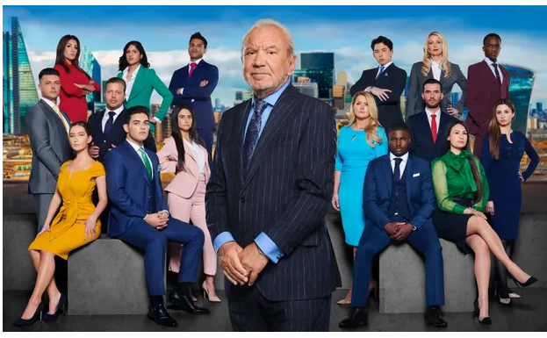
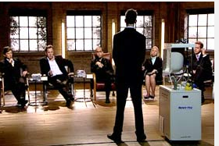
Could you be a successful entrepreneur?
“You don’t have to be a genius or a visionary or even a college graduate to be successful. You just need a framework and a dream.”
—Michael Del do
One day in the future you could be running your own successful business. You might be the star of the show on ‘The Apprentice’ or ‘Dragons Den’

Slide 10

What have we done in the past?
“You don’t have to be a genius or a visionary or even a college graduate to be successful. You just need a framework and a dream.”
—Michael Del do
Ran mini enterprises
Christmas, Easter and Summer Fairs
Enterprise competitions
Finance competitions
Guest speakers

Slide 11
What could you study in the future?
“You don’t have to be a genius or a visionary or even a college graduate to be successful. You just need a framework and a dream.”
—Michael Del do
BTEC Business Level 3
A level Business
Employment
Apprenticeships
University (UK or abroad)

Slide 12

Careers in Business Studies
“You don’t have to be a genius or a visionary or even a college graduate to be successful. You just need a framework and a dream.”
—Michael Del do
Let’s have a look at some of the career opportunities available to you in the world of Business.

Slide 13

Office administrator
“You don’t have to be a genius or a visionary or even a college graduate to be successful. You just need a framework and a dream.”
—Michael Del do
The role: Helping to ensure a business runs smoothly by meeting and greeting visitors, managing diaries and processing paperwork.
Salary: Earn £21k - £24k a year.

Slide 14

Financial adviser
“You don’t have to be a genius or a visionary or even a college graduate to be successful. You just need a framework and a dream.”
—Michael Del do
The Role: Helping people choose investments, savings, pensions, mortgages and insurances.
The Salary:
Earn £30k-£45k
a year.

Slide 15

Sales Managers.
“You don’t have to be a genius or a visionary or even a college graduate to be successful. You just need a framework and a dream.”
—Michael Del do
The Role: Coaching and leading a team of sale representatives to work towards a company target.
The Salary:
Earn £35,000 - £40,000
per year

Slide 16

Business Analyst
“You don’t have to be a genius or a visionary or even a college graduate to be successful. You just need a framework and a dream.”
—Michael Del do
The Role: They work with companies to help them change and identify ways of improving.
The Salary: £21k-£31k to start rising to £39k- £50 with experience.

Slide 17
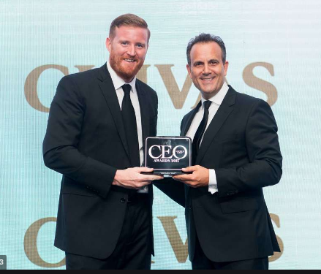
Chief Executive Officer
“You don’t have to be a genius or a visionary or even a college graduate to be successful. You just need a framework and a dream.”
£80k-£150k a year. Leading entire businesses ensuring that policies are planned and put into place to ensure the business is successful.
—Michael Del do
The Role: Leading entire businesses ensuring that policies are planned and put into place to ensure the business is successful.
The Salary:
£80k-£150k a year.

Slide 18

What Do Our Students think?
“You don’t have to be a genius or a visionary or even a college graduate to be successful. You just need a framework and a dream.”
—Michael Del do
I enjoyed the business course at GCSE, because it was very informative, it is helpful in school and in real life situations, the teachers help out a lot throughout the way. Jakub Brahma
I have developed the promotion and finance skills needed to run my own business in the future.

Slide 19
Next Steps……
“You don’t have to be a genius or a visionary or even a college graduate to be successful. You just need a framework and a dream.”
—Michael Del do
If you would like any more information about the course, or have any questions feel free to speak to
Mrs McKenzie ( room 188)

