Slide 1

BTEC L2 Heath and Social Care
Yr9 Options Assembly

Slide 2


Which Subjects Do These Topics Link to?
Exercise and BMI
Puberty
Religious beliefs
Nutrition
NHS
Housing needs
Relationships

Slide 3
Health and Social Has Links With Many Subjects
Physical Education
Science
Religious Education
Food Technology
History
Geography
PSHE

Slide 4

Need to Know
This is a level 1/2 qualification and is equivalent to one GCSE.
The qualification is graded Pass, Merit and Distinction (it is not graded 9-1).
What will I learn on the course?
Health and Social Care is the right subject for you if you are:
interesting in the topics that we will learn about,
have a passion for learning,
love to help people,
are organised,
and dedicated to working hard to meet deadlines set throughout the course.
You will be assessed through a mixture of assignments and an exam. You will be formally assessed throughout Yr10 and Yr11 of the course.

Slide 5

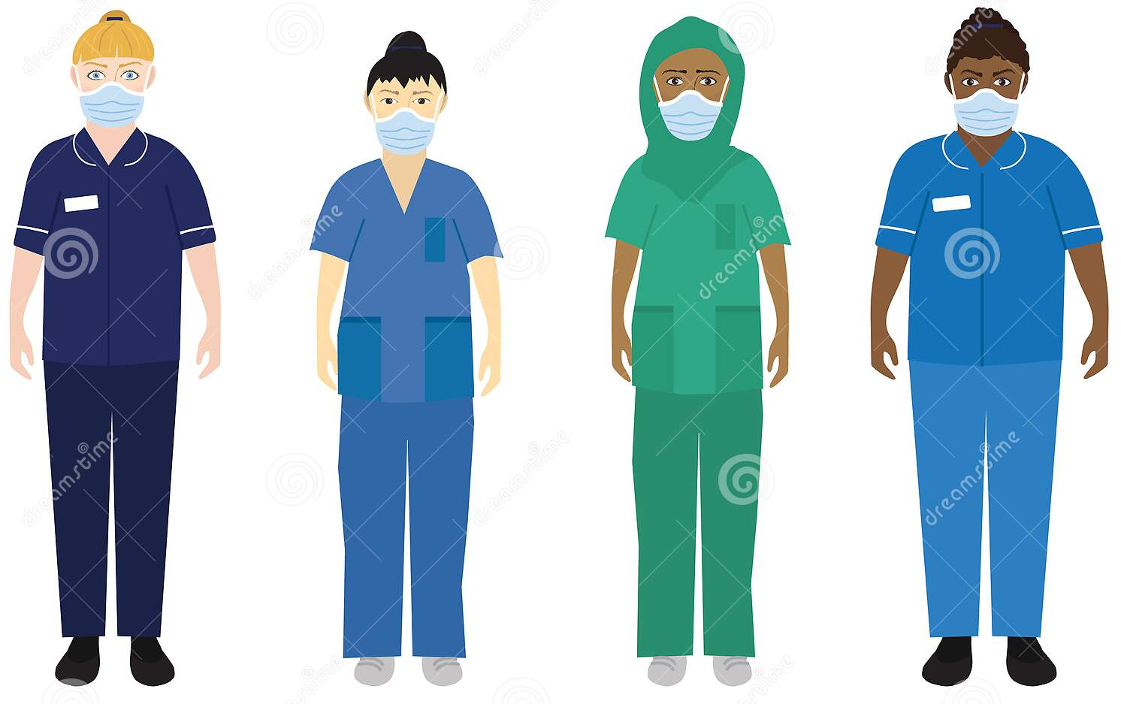
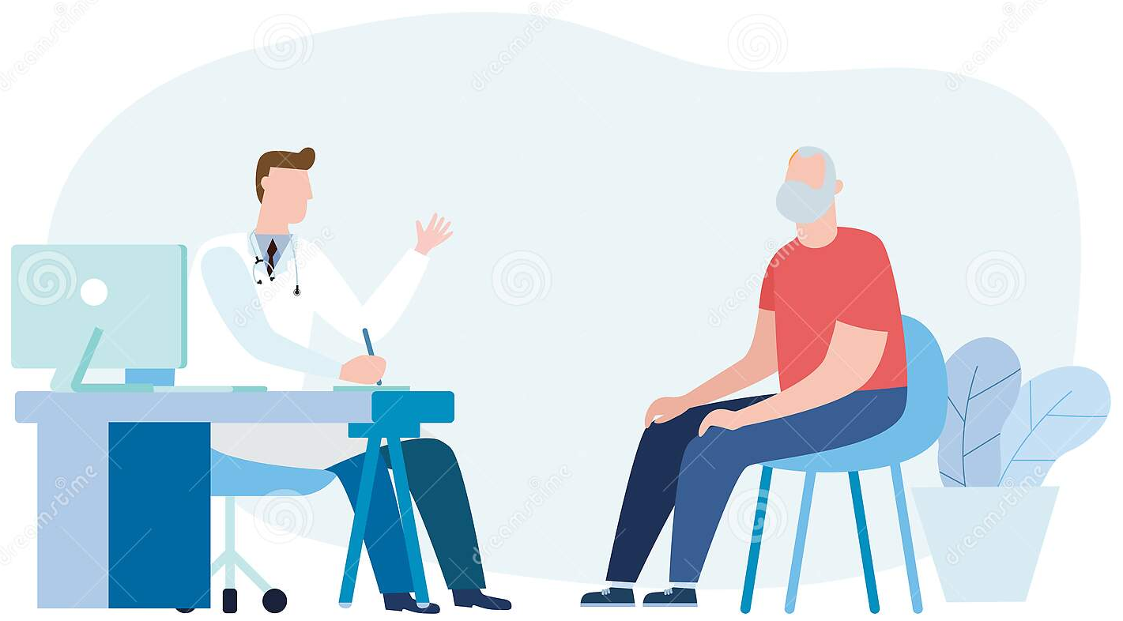
What You Will Learn
Component 1 (30%)
Human Lifespan Development This is assessed through assignments and cover the following topics: growth and development across life stages factors affecting growth and development different type of life events coping with change caused by life events
Component 2 (30%)
Health and Social Care Services and Values This is assessed through assignments and cover the following topics: health and social care services barriers to accessing services care values reviewing your own application of care values
Component 3 (40%)
Health and Wellbeing Human Lifespan Development This is assessed through an external exam factors affecting health and wellbeing physiological indicators lifestyle indicators health and wellbeing improvement plans obstacles to implementing plans

Slide 6


Careers in Health and Social Care
The National Health Service (nursing and midwifery)
Social Work
Sports science
Childcare
Community care
Allied Health Professional (physiotherapist, occupational therapist)
Management
Primary education
Health psychologist
There are so many careers that heath and social care can lead to. These careers not only allow you to work with a wide range of people in society but they allow you to share your caring nature for others and make a difference in people’s lives.
More information is available from Miss Macdonald (Teacher of Health and Social Care)

